Slide 1
Task 2
Laravel
Fullname:Lê Nguyễn Xuân Được

Slide 2
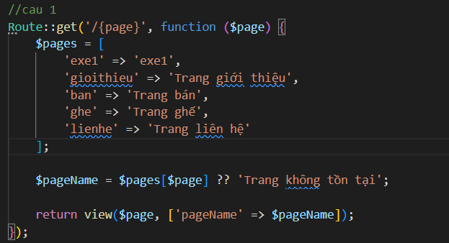
EXE 1
Screenshot of root file web.php, replace the image below

Slide 3





EXE 1
Screenshot of the view blade file, replace the image below

Slide 4
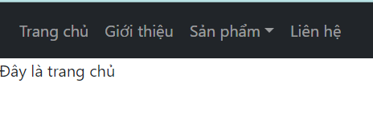
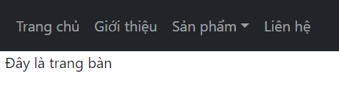
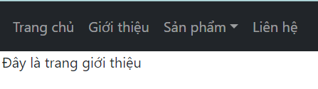
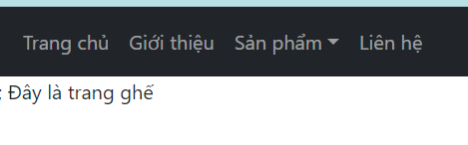
EXE 1
Screenshot of the result, replace the image below

Slide 5
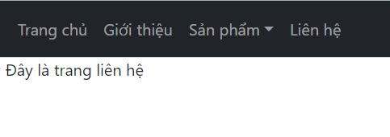

Slide 6
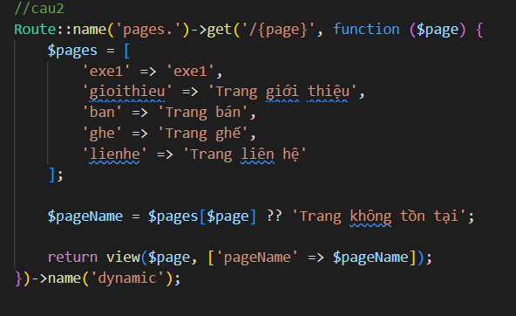
EXE 2
Screenshot of root file web.php, replace the image below

Slide 7
EXE 2
Screenshot of the view blade file, replace the image below

