Slide 1
Pizza Store
REPORT OF TECHNOLOGY AND WEB SERVICES (CT313H)
Students information
B1910712 – Nguyen Le Doan Thuy
B1910665 – Tran Phuc Loc
Semester I, 2022-2023

Slide 2
Description of application functions
This website is used to manage products including various kinds of pizza at a pizza store.
Frontend Functions:
Insert products into from database.
Alter products information.
Delete products from database.
Print list of products.

Slide 3
Jobs divide - Frontend
Nguyen Le Doan Thuy – B1910712
Design basic web interface (HTML, CSS).
Handle API connection.
Tran Phuc Loc – B1910665
Design add a new product, delete a product
Design showing a list of products.
Design edit a product.

Slide 4
Jobs divide - Backend
Nguyen Le Doan Thuy – B1910712
Design database.
Design backend route.
Tran Phuc Loc – B1910665
Design database.
Design product controller and product service.

Slide 5
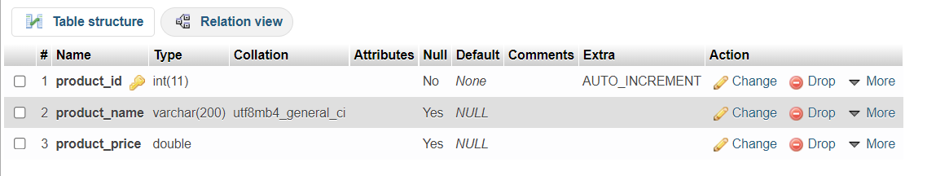
Database designing

Slide 6
HTTP API
Route | Definition | Data receive | Data return
Get: http://localhost:8080/products | Get all foods | None | List of foods
Post: http://localhost:8080/products | Add a new foods | Food information | Message, food
Get:http://localhost:8080/products/:id | Get specific food | Food id | Food
Put:http://localhost:8080/products/:id | Update specific food | Update food | Message, updated food
Delete:http://localhost:8080/products/:id | Delete specific food | Food id | Message

Slide 7
Used libraries-Frontend
"axios: use to send HTTP requests to backend API
"vue": used to build vue website
"vue-router": used to design route in website
“bulma”: provides ready-to-use frontend components that you can easily combine to build responsive web interfaces
“core-js”: create apps that have multiple working extensions that all interact with each other without ever actually knowing about one another

Slide 8
Used libraries-Backend
"cors": enable cors with various options
"express": define and config routes
"mysql2": use to connect to database
"vue": used to build vue website

Slide 9
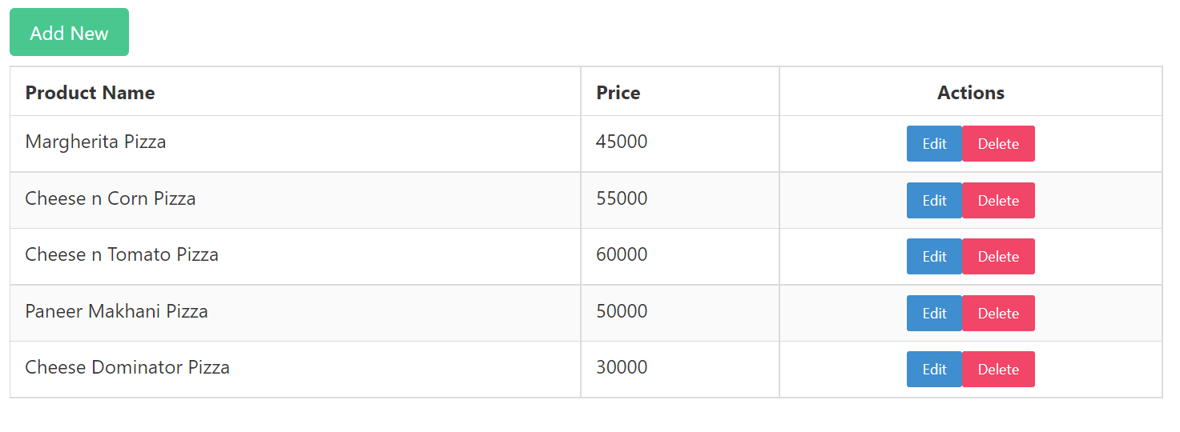
Result
The interface shows a list of all products in the pizza restaurant as following:

Slide 10
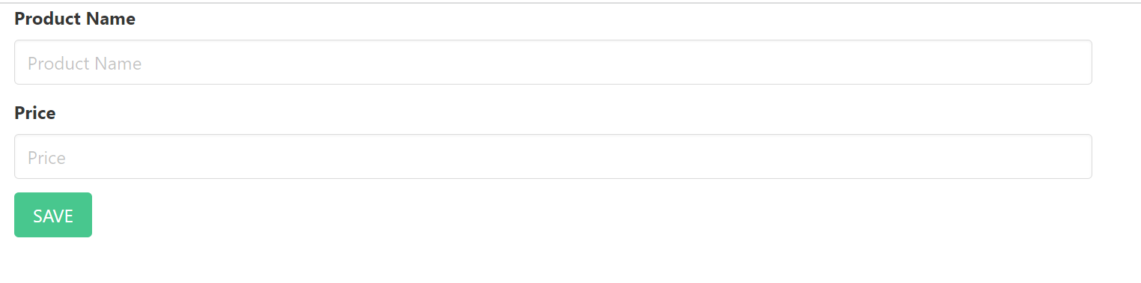
Result
The interface for adding a pizza product was described as following:

Slide 11
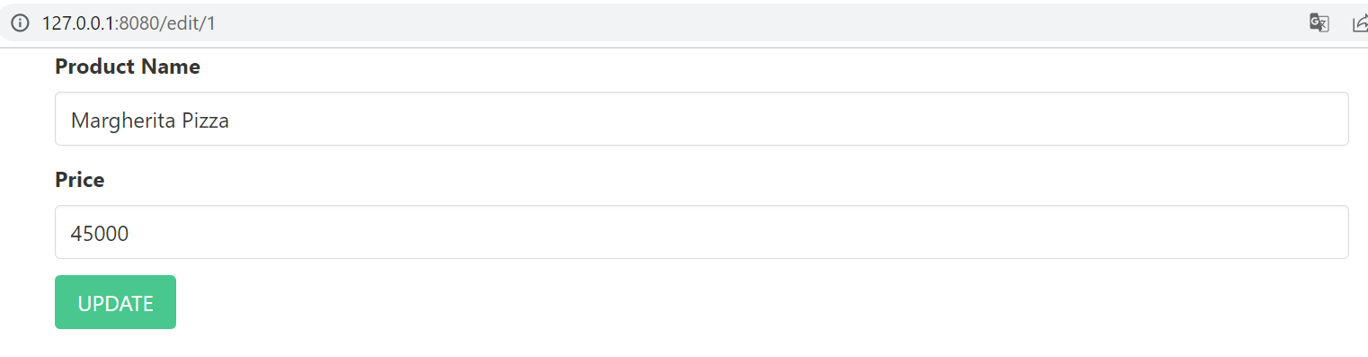
Result
The interface for editing a pizza product was described as following:

Slide 12
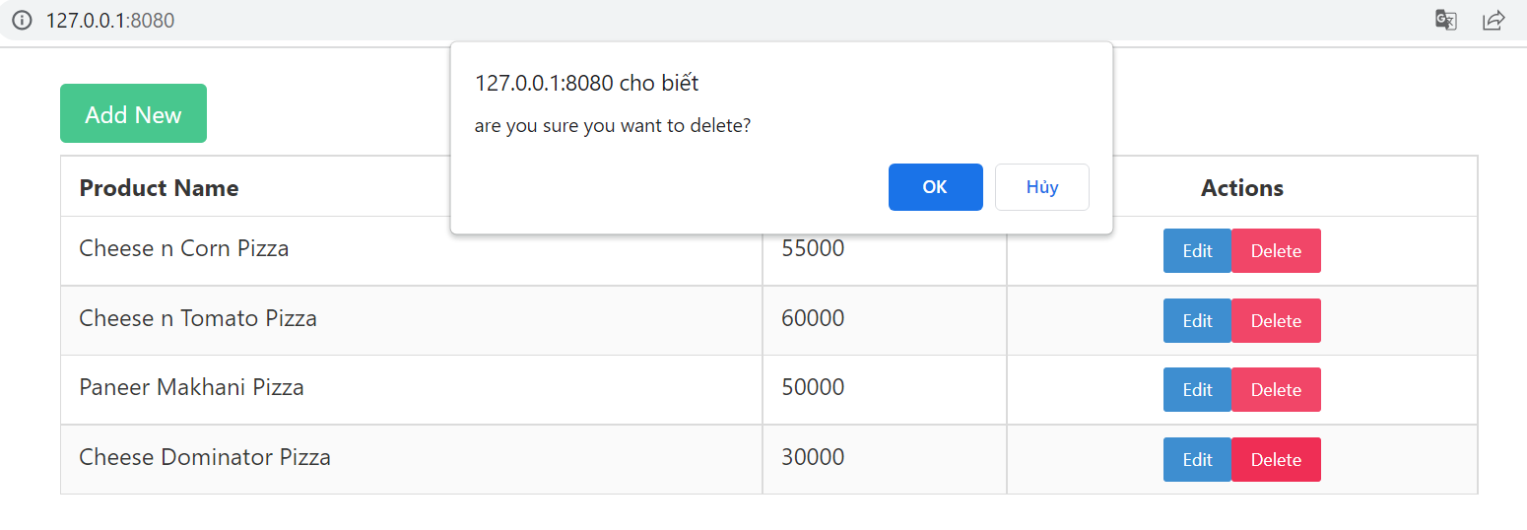
Result
The interface for deleting a pizza product was described as following:

Slide 13
Source code
https://github.com/TranPhucLoc/vueproject.git

Slide 14
Thank for your listening!

