Slide 1

MINISTRY OF EDUCATION AND TRAINING CAN THO UNIVERSITY COLLEGE OF INFORMATION AND COMMUNICATION TECHNOLOGY
GRADUATION THESIS
BACHELOR OF ENGINEERING IN
INFORMATION TECHNOLOGY (HIGH-QUALITY PROGRAM
AI-BASED NPC INTERACTION SYSTEM
FOR VIDEO GAME
Thesis Advisor:
Dr. Thai Minh Tuan
Student:
B2111946 – Tran Minh Quang

Slide 2
Graduation Thesis: AI-Based NPC INTERACTION SYSTEM FOR VIDEO GAME
AGENDA
Problem Statement
Related Work
Objectives
Research Scope
Main Function
Conclusion and Future Work

Slide 3
Graduation Thesis: AI-Based NPC INTERACTION SYSTEM FOR VIDEO GAME
PROBLEM STATMENT
Pre-scripted Dialogue Trees
Static NPC Behaviors
Disconnected Game Systems
No Voice Interaction Support
Limited Contextual Understanding
→ Reduced immersion & predictable gameplay

Slide 4
Graduation Thesis: AI-Based NPC INTERACTION SYSTEM FOR VIDEO GAME
RELATED WORK
Skyrim – NPC Daily Routine Behavior System
AI Dungeon – LLM-Based Dynamic Story Generation
Inworld AI / Convai – Cloud-Based Conversational NPC Platforms
Virtual Assistants – Voice Command System
Other traditional NPC Systems

Slide 5
Graduation Thesis: AI-Based NPC INTERACTION SYSTEM FOR VIDEO GAME
OBJECTIVES
Develop a Voice-Driven NPC Interaction System
Implement AI-Powered Dynamic Dialogue Generation
Design Autonomous NPC Daily Routine and Behaviors
Integrate a Quest Management System Connected to AI Dialogue
Build a Trading and Economy System Linked to NPC Behavior
Create a Unified Backend for STT, LLM, TTS and Game Logic

Slide 6

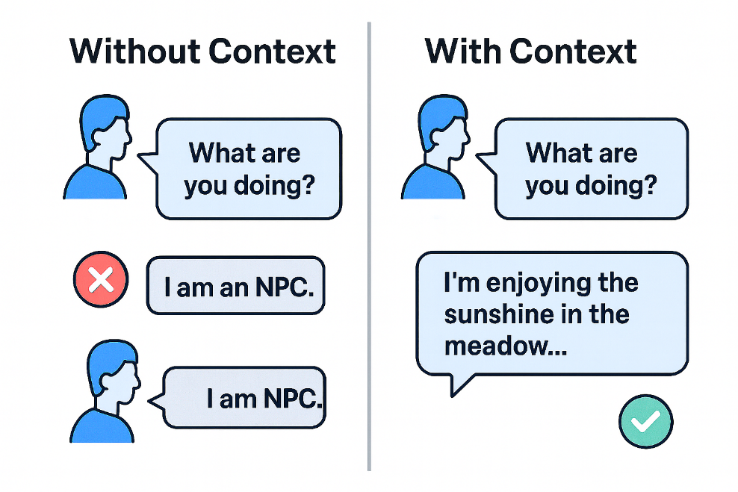
Graduation Thesis: AI-Based NPC INTERACTION SYSTEM FOR VIDEO GAME
Research Scope
STT Integration
Context-aware AI
STT Quest System
Database-driven Economy
NPC routine & schedules

Slide 7
SOLUTION IMPLEMENTATION

Slide 8
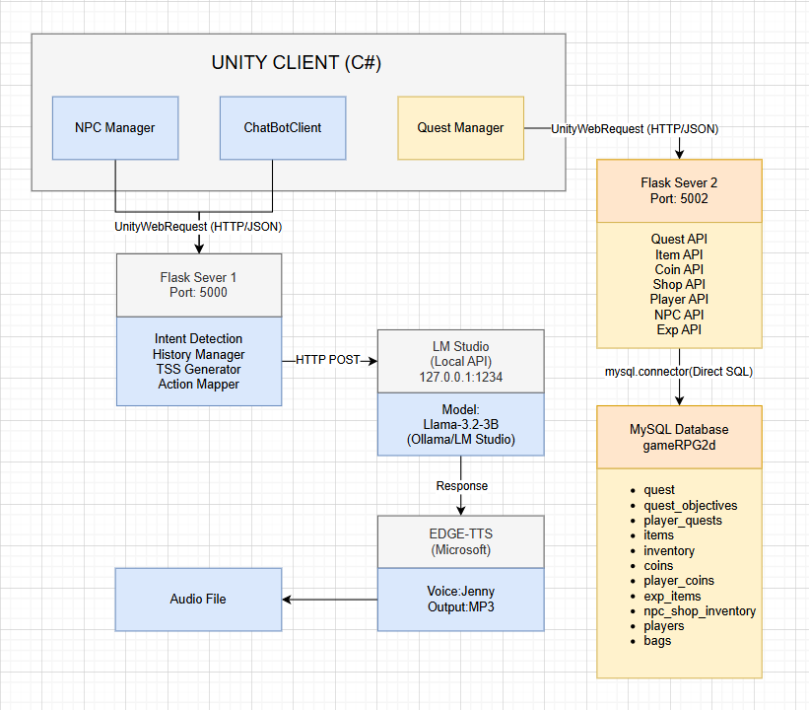
Graduation Thesis: AI-Based NPC INTERACTION SYSTEM FOR VIDEO GAME
SYSTEM INTERGRATION ARCHITECTURE

Slide 9
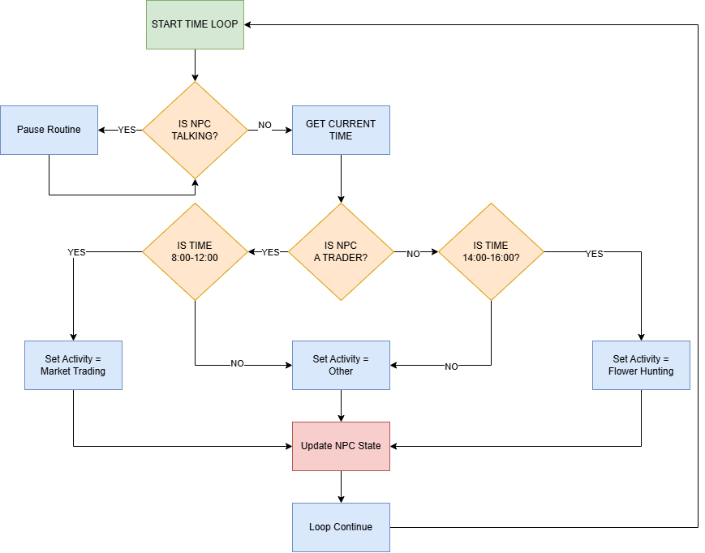
Graduation Thesis: AI-Based NPC INTERACTION SYSTEM FOR VIDEO GAME
MAIN NPC ROUTINE LOOP SYSTEM

Slide 10
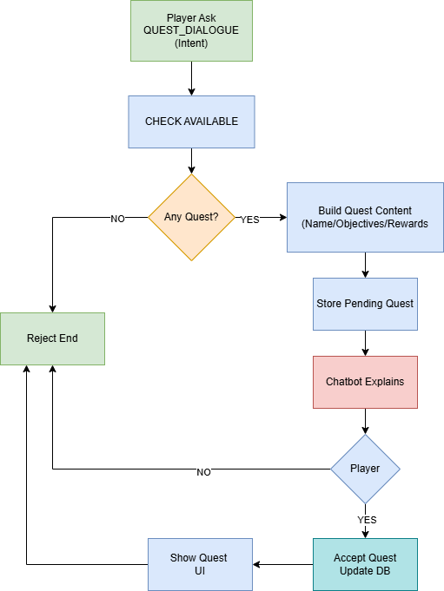
Graduation Thesis: AI-Based NPC INTERACTION SYSTEM FOR VIDEO GAME
NPC QUEST ASSIGNMENT

Slide 11
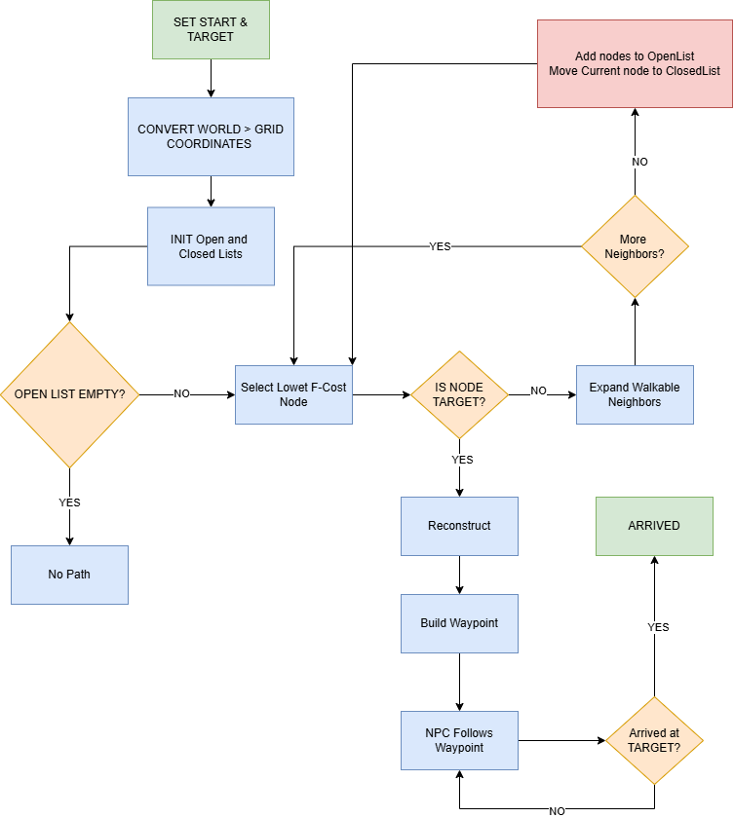
Graduation Thesis: AI-Based NPC INTERACTION SYSTEM FOR VIDEO GAME
NPC PATHFINDING (A* ALGORITHM)

Slide 12
Graduation Thesis: AI-Based NPC INTERACTION SYSTEM FOR VIDEO GAME
Conclusion
Voice-Driven Gameplay: Natural Speech Recognition & TTS
Intelligent NPC Routines
Dynamic Quest System
Full-Stack Integration

Slide 13
Graduation Thesis: AI-Based NPC INTERACTION SYSTEM FOR VIDEO GAME
FUTURE WORK
Enhanced Voice Recognition
Expanded NPC Behaviors
Improved AI Quality
Advanced Quest System
Combat Integration
Open World Expansion

Slide 14
Thank you for listening

