Slide 1

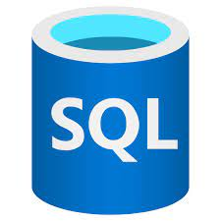






Data Source
ETL
Analysis
Visualization
Azure Blob Storage
Azure SQL Server
Azure Databricks
Power BI
Azure Data Factory
Orchestration
Infrastructure

