Slide 1
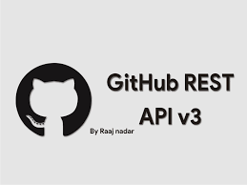









Visulization
Ingestion
Transformation
Orchestration
Infrastructure

