Slide 1
Web Services API Testing
Basic knowledge
Rieng Tran
Testing Coaching
Updated: May-2017

Slide 2
Basics
API: Application Programming Interface
Public interface of a function or routine that can be triggered to execute by other functions/applications.
Stateless / Stateful protocols
A stateless protocol is a communications protocol that treats each request as an independent transaction that is unrelated to any previous request so that the communication consists of independent pairs of request and response. A stateless protocol does not require the server to retain session information or status about each communications partner for the duration of multiple requests. In contrast, a protocol that requires keeping of the internal state on the server is known as a stateful protocol. (Wikipedia)

Slide 3
Basics (cont.)
A Web Service is a software system designed to support interoperable machine-to-machine interaction over a network (W3C)
Is a software function or method that communicates over network protocols
All Web Services are API but APIs are not Web Services
Working model: Provider 🡺 Consumers, or Server 🡺 Clients
2 common types of Web Services:
SOAP / XML (other type is XML-RPC)
RESTful / JSON (more generic type is Web API)
Generic Web API:
Web HTML form actions (HTTP GET/POST)
Any public API that supports HTTP GET / POST / PUT / DELETE /…

Slide 4
How a Web Application works?
Self-study:
https://www.youtube.com/watch?v=RsQ1tFLwldY

Slide 5
Common working model
Consumers
(clients)
Provider
(server)
SOAP / RESTful
XML / JSON
HTTP
HTTP
stateless
TCP
TCP
stateful
IP
IP
stateless
physical

Slide 6
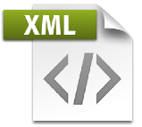

SOAP WS vs RESTful WS
SOAP is a messaging protocol
Run over HTTP/HTTPS and various protocols
Support GET/POST
Use WSDL as description language
Support services discovery
Request/response in SOAP / XML format
Complex and strict structured data
SOAP is designed as stateful protocol
Connect via port / operation (action)…
REST is an architectural style
Run over HTTP/HTTPS
Support GET/POST/PUT/DELETE
Use WADL (not standardized)
Hard to discover services
Request/response in JSON / XML format
Simple and flexible structure
REST is naturally stateless
Connect via URI
SOAP WS
RESTful WS

Slide 7
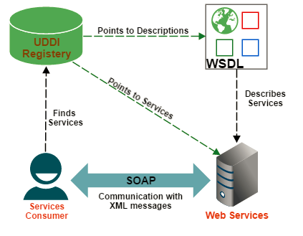
How SOAP WS Works
http://www.webservicex.com/globalweather.asmx?wsdl
Producer
Notes:
UDDI is an XML-based standard for describing, publishing, and finding web services. UDDI stands for Universal Description, Discovery, and Integration
http://www.webservicex.com/globalweather.asmx?wsdl

Slide 8
SOAP WS: Some characteristics
Usually supports POST because of the complexity of SOAP request:
Header (optional)
Content-Type: text/xml; charset=utf-8
Envelop
Body
Operation (action)
Parameters
GET is also supported, but cannot be used to send complex structured data.
Focus on request content (SOAP)

Slide 9
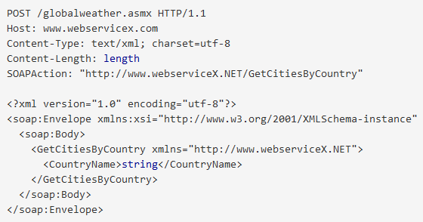
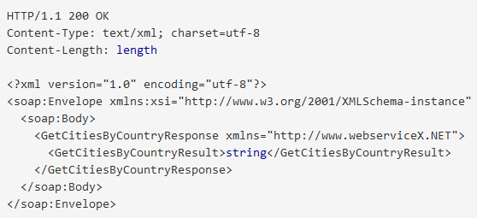
Sample of SOAP WS
WSDL: http://www.webservicex.com/globalweather.asmx?wsdl
Operation: http://www.webservicex.com/globalweather.asmx?op=GetCitiesByCountry
Sample POST using SOAP (demo with Firefox’s RESTClient)
Request
Response

Slide 10
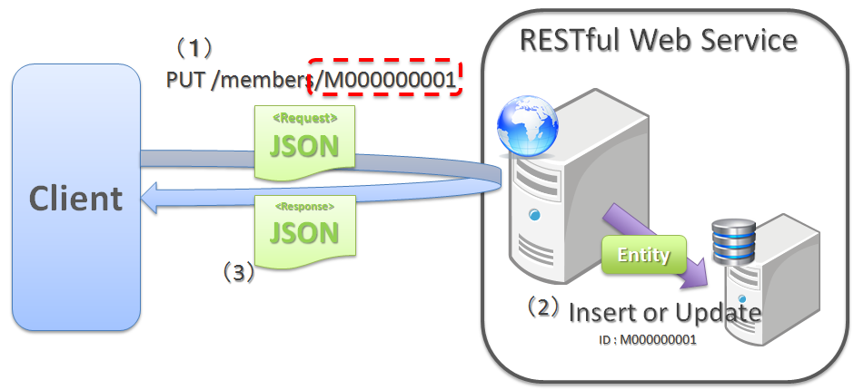
How RESTful WS Works
GET / POST / PUT / DELETE

Slide 11
RESTful WS: Some characteristics
URL | GET | POST | PUT | DELETE
Collection: http://api.domain.com/users/ | Get a list of users | Create a new user | Replace entire list with a new list of users | Delete entire list of users
Element: http://api.domain.com/users/1234 | Get detail info of an existing user | Not used (or same as PUT) | Update an existing user | Delete an existing user
 | No need request content, because param is already on URL | Need request content (JSON or XML) | Need request content (JSON or XML) | No need request content, because param is already on URL
HTTP header:
Content-Type: application/json or application/soap+xml; charset=utf-8

Slide 12
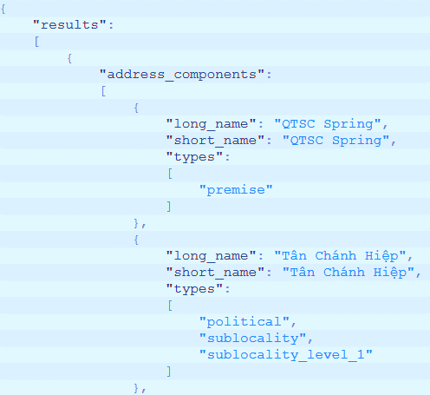
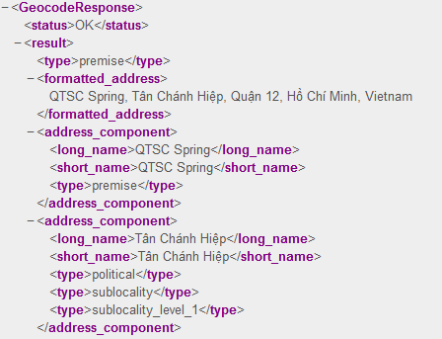
Sample of RESTful WS
URI: http://maps.googleapis.com/maps/api/geocode/json?address=qtsc
Sample GET request to API (json / xml, demo with Firefox’s RESTClient)

Slide 13
Authentication in Web Services
Common authentication types:
No authentication
Commonly used by public Web Services (weather, stock exchanges, etc.)
HTTP Basic authentication
Example: “Authorization: Basic YWRtaW46YWRtaW4=“
OAuth authentication (Open Authorization)
<Self research>
How to test WS that requires authentication? 🡺 Depends on WS specification.
Put credential directly into request payload
Set in HTTP Header or cookies

Slide 14
API WS Testing
Common App
Send structured request to server and analyze response
HTTP status code
Response content
Content length
…
Not require UI of target app.
Might require higher skill of testers (when scripting).
Can use tool or own script.
cURL, RESTClient, SOAPUI, eMonkey …
Presentation Layer
GUI
testing
Business Layer
API WS testing
Database Layer
DB
testing

Slide 15
What to Test in API WS Testing
Documentation
Make sure what is documented matches with what is published.
Discovery the visibility of services against public document (SOAP)
Usability of services (SOAP, RESTful)
Functionality of the APIs
Interoperability (SOAP1.1, SOAP1.2, schema…)
Performance / load / stress testing
WS must always ready to serve multiple requests
Automation test
Security
Availability
Input validation (combination, boundary, fuzzing of parameters)
Business logics
Data confidentiality & integrity

Slide 16
Basic steps to perform API WS testing (manual)
Understand API spec (environment, input, output)
If spec not available, try inspect / sniff the live traffic using browsers or sniffers
If APIs based on SOAP, get understanding of the WSDL document.
Prepare environment (OS, API’s preconditions)
Select appropriate tools (manual, automation)
Prepare request data (single special data, combinations of data)
Define check points (response data to determine passed or failed)
Write script to automate the tests (advance)
Execute the tests (manual, automation)
Verify response against check points (passed or failed)

Slide 17
Types of Bugs from API WS Testing
Invalid response data (format, structure)
Invalid response’s status code & information (wrong output)
Incorrect data handling (input validation & processing)
Incorrect fails handling (wrong error code, error message, wrong logics)
Undocumented information disclosure
Reliability and performance
Security related issues
…..

Slide 18
Challenges of API WS Testing
Testers need to understand clearly spec of APIs (input, output, environment)
Parameters combination, test data generation
Complex API calls sequencing is difficult to test (DevOps, CI integration)
Complex API requires higher skill of testers (APIs requires auth, etc)
Scripting to automate testing is difficult, requires higher skills of testers
Output validation is difficult (complex responses, server logs, database result…)
…

Slide 19
Tools for API WS Testing
Browser’s plugin (FF’s RESTClient, Chrome’s Advanced REST client, POSTMAN)
SOAPUI
DevTest
QTP-UFT
Parasoft dotTEST
cURL
Burp Suite
Acunetix WS
…

Slide 20
Demos on some basic tools
Browser’s built-in developer tool
To be presented
RESTClient
To be presented
POSTMAN
http://blog.getpostman.com/2014/03/07/writing-automated-tests-for-apis-using-postman/
SOAPGUI
https://www.soapui.org/rest-testing/getting-started.html

