Slide 1




Issue Report

Slide 2
Agenda
Greeting & identifying participants purposes
Scope of Issue report
Submit/ Open new issue/ ticket
Reopen existing issue
Clarification/ Comment
Verifying
Wording
Other operations
Experience/ Lesson learn question/ sharing
Page 2
Notes:
2

Slide 3
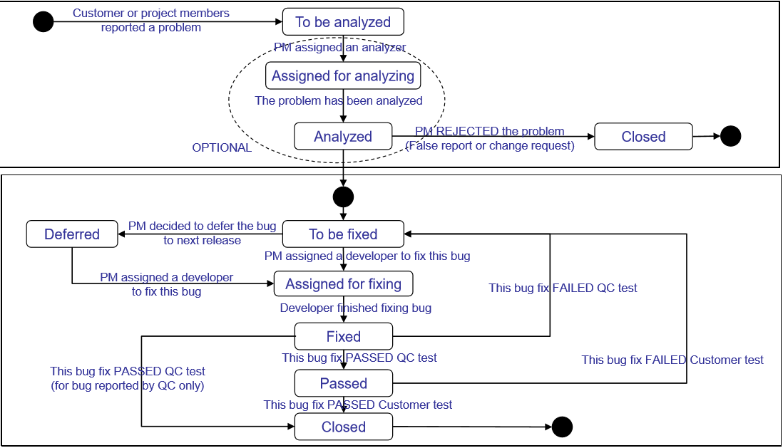
Activity flow (To be tailored to cover Issue’s Life Cycle)

Slide 4

Scope of issue report
Submit/ Open new issue/ ticket
Submit/ Open new issue/ ticket
Comment on existing issue
Clarification/ Comment
Verifying
===================
Go through JIRA fields
Basic requirement
Hints/ Best practices
Specific regulations in projects
Case study
Avoiding duplication
Page 4
Notes:
4

Slide 5
JIRA fields
Project
Issue type (*)
Summary (*)
Priority (*)
Due date
Components (*)
Affects version
Fix version
Assignee
Story point
Environment
Description (**)
Original estimate
Attachment (*)
Labels
Bug import ID
Bug import URL
Severity (*)
Qc Bug ID
Status
Resolution
Reporter
Created, Updated date
Watch
e.g. https://www.softwaretestinghelp.com/jira-bug-tracking/
Page 5
Notes:
5

Slide 6

JIRA fields – Issue types
Bug:
A problem which impairs or prevents the functions of the product.
Improvement/ Enhancement:
An improvement or enhancement to an existing feature.
Documentation:
Mistake in the document (UI, UX, Requirement, Design, etc.)
Page 6
Notes:
6

Slide 7

Open new issue – Summary
The title is the face of your report. A good title helps reduce duplicate issues and can quickly convey a summary of the bug. The descriptive title is very important and cannot be overstated.
Basic syntax: Bug + Action+ [Condition] OR Symptom + when + [where]
Hints
● Concise (should be one-line summary)
● Clear (avoid generic description)
● Grammar should be correct
● Words must be correct as used in documentation
● Should report one bug per report
● Report exactly the bug, not a symptom of the bug
● Should have Prefix/Suffix e.g: Specific environment, feature name etc
● Report the issue, not a symptom of the issue
Scenario: We are testing an Phone input field. We find that the Phone field allows “1234567890123456" and it also allows “!@#$%^&*()_+” ==> These are two different symptoms of the same bug. Closer analyst would detect that the real issue is the Phone field isn't being validated at all. The problem may be more serious than the first symptom you find. So focus and report the real bug instead.

Slide 8
JIRA fields – Priority
The level of (business) importance assigned to an issue
P1: Stopper (Must be fixed in order to continue testing)
System or feature failure. No further processing is possible.
P2: High (Must be fixed in order to launch)
A major, serious and high impact functionality of the application is not working
P3: Medium (Need to be fixed but product may launch with exception)
A small and low impact function of the application is not working, and user is able to continue using the product
P4: Low (May be fixed, but not critical for launch)
Very low priority, a rare or random defect that occurs at a very low re-productivity rate.
Page 8
Notes:
8

Slide 9

JIRA fields – Severity
The degree of impact that an defect has on the development or operation of a component or system
Critical: Loss of functionality or data, crashes, high impact performance issues
Major: Non-critical defects in the core functionality, but no workaround
Minor: Minor functional defects
Trivial: Minor cosmetic issues like misspelling or misalignment of texts
Page 9
Notes:
9

Slide 10

Open new issue – Description
● [Brief]
● [Preconditions]
● Steps to reproduce
● Actual result
● Expected result
● [Notes]
● Workaround: Workaround solution to come over the issue

Slide 11
Open new issue – Description (cont.)
[Brief]: Brief about the issue if you cannot express fully in the summary
[Preconditions]: pre-steps/environment settings to get ready to perform the first step.
Steps to reproduce: How to reproduce the bug
● Steps by number. Combine simple steps by “>"
● Keep steps short, easy to read and direct path to the issue
● Include input data in the step (especially for the complex case)
● Emphasize/highlight on the important part/words

Slide 12

Open new issue – Description (cont.)
Actual result: Describe what did happen, not what didn't happen.
● Always include the error message or error code if available.
● Question: Should symptom/ impact if doing further step be put here!
Expected result: Explain what should happen, not what shouldn't happen
● Use as many same words/sentence as possible on both Expected & Actual results
● State clearly why the actual result is not expected.
● Mention clearly if it is not the same as stated in a specific requirement or if the behavior is not consistent on all users/platform...
● Put directly related spec into the issue so as to provide more information for the expected result. Attachments are required if they help to clarify the result.
[Notes]: An optional section, but it is helpful for Developer to investigate an issue. It also represent maturity, seniority of the reporter
● Ability/ Frequency to reproduce an intermittent issue
● Specific situation that the actual result is different

Slide 13

JIRA fields – Attachment
Attachments could worth a thousand words. It's enabling the developer/reader to reproduce it. Help QC to protect themselves by evidence.
Allowed/ recommended format
Screen shots: Highlight issue area(s) in the bug image (with RED color circle / rectangle).
Video (if the issue is difficult to describe in words)
Data input:
For simple scenario: put in each step to reproduce
For complex scenario: attach an data input file, or screenshot with data inputted
Log file:
Highlight events that you want the reader to pay attention
Just focus log file (not a heavy file that have tracked log for several days with no meaning)
Page 13
Notes:
13

Slide 14

JIRA fields – Important notes
Must follow requirement, standards from client or committed with client
Pitfalls:
Reporter assumption, mind set => provide lack of info
Wrong foresee readers
Is not on end-user’s shoes => wrong definition of priority, severity
Case study/ best practice at WebQA team:
Too rely on attachment
Afraid of change
Changing Onshore QA lead
Avoid duplication
Search in bug tracking system
Follow common standards
Double check with teammates
Follow definition from client for same or different bug situations
Page 14
Notes:
14

Slide 15

Reopen an existing issue
When:
The issue was closed, but you encounter it again on being tested version
Question: What should we do if scenario/ enviroment is the same/ different?
How:
Comment
Reopen
Add effect version
…
Page 15
Notes:
15

Slide 16
Clarifying/ adding comment to an existing issue
When:
You are reassigned to give more info/ clarify some info
You encounter it on the being test version
You encounter in on another environment
….
How:
Comment
Reopen
Add effect version
…
Page 16
Notes:
16

Slide 17
When:
The issue has been fixed and released for testing on the being test version
New version has been launched, the opening issue was found in previous versions
How:
Recheck the main scenario on happening environments and not happening environment
Analyze the impact => do some regression test scenarios
Add comment what you have done, what result you get
Change status according to bug life cycle definition for that project
Verifying
Page 17
Notes:
17

Slide 18

Reference Examples
https://www.softwaretestinghelp.com/sample-bug-report/
Bug Name: Application crash on clicking the SAVE button while creating a new user.
Description: Application crash on clicking the SAVE button while creating a new the user, hence unable to create a new user in the application.
Steps To Reproduce: 1) Login into the Application 2) Navigate to the Users Menu > New User 3) Filled all the user information fields 4) Clicked on the ‘Save’ button 5) Seen an error page “ORA1090 Exception: Insert values Error…” 6) See the attached logs for more information (Attach more logs related to bug..IF any) 7) And also see the attached screenshot of the error page.
Expected Result: On clicking SAVE button, should be prompted to a success message “New User has been created successfully”.
(Attach ‘application crash’ screenshot. IF any)

Slide 19
Reference Examples (cont.)
http://testthewebforward.org/docs/bugs.html
Summary: the goal of summary is to make the report searchable and uniquely identifiable.
A bad example: drag crash
A good example: drag-selecting any page crashes mac builds in nsgetfactory
steps to reproduce
the goal of reproducible steps is to teach developer to recreate the bug on his own system. it may be as simple as load the attached testcase in browser xyz. a more complex case may involve multiple steps, such as:
step 1: load the attached testcase in browser xyz
step 2: scroll to the bottom of the page
step 3: click the link
step 4: press tab to navigate links
test results: The test results, including expected result and actual result, will show the developer what's wrong. expected result describes what should have happened, and actual result describes what happened.

