Slide 1


Vietnam - Korea University of Information and Communication Technology
Faculty of Computer Engineering and Electronics
SPECIALIZED PROJECTS 1
APPLICATION OF LORA TECHNOLOGY IN THE SYSTEM IOT ENVIRONMENTAL MONITORING IN THE GREENHOUSE
Instructor : Dr. NGUYEN VU ANH QUANG
Performer : TRAN VIET AN
DaNang, December 2022

Slide 2
THE UNIVERSITY OF DANANG
Vietnam - Korea University of Information and Communication Technology
01
02
Overview Introduction
System Model
Contents
03
04
Implementation
Result, Development

Slide 3

THE UNIVERSITY OF DANANG
Vietnam - Korea University of Information and Communication Technology
01
OVERVIEW INTRODUCTION

Slide 4
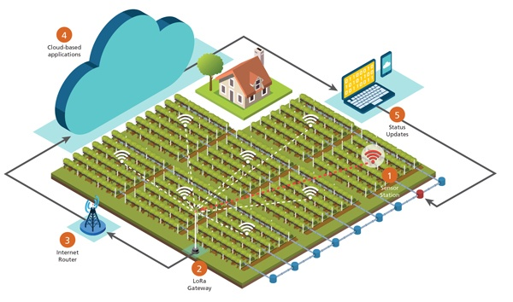
OVERVIEW
Reason:
Limitations of IoT technology
Energy consumption
LoRa technology is developed
Target:
Consolidate knowledge
Build an overview model
Apply into reality
Implementation content:
System model design
Design and build apps
PCB design
Embedded programming
Test, evaluate

Slide 5
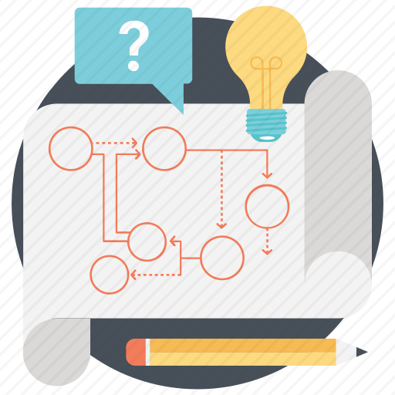
THE UNIVERSITY OF DANANG
Vietnam - Korea University of Information and Communication Technology
02
THEORY AND SYSTEM MODEL

Slide 6
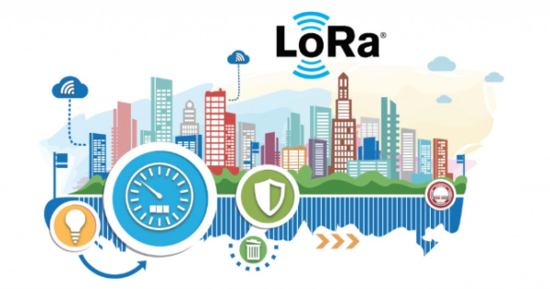
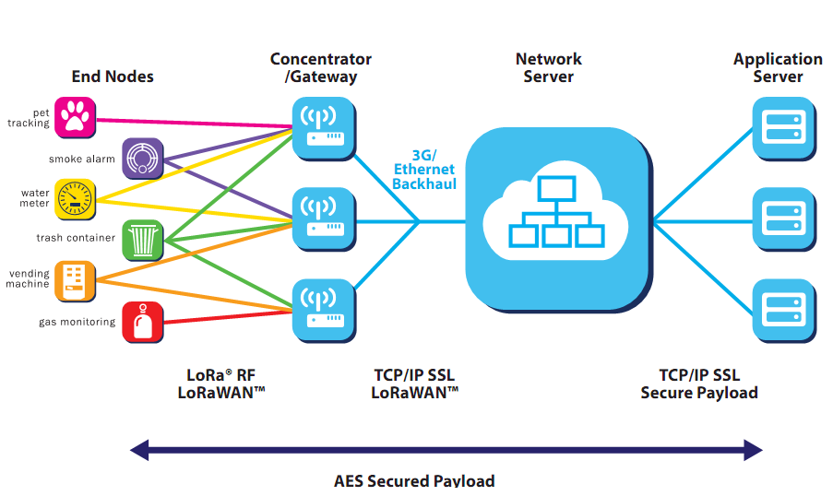
THEORY AND SYSTEM MODEL
LoRa – Long Range Radio
Long range data transmission
Energy saving
Widely used in sensor data collection
LoRaWAN - Long Range Wireless Area Network
A system architecture and communication protocol in a Lora-based network.
Main ingredient: End Nodes, Gateway, Network Server, Application Server

Slide 7
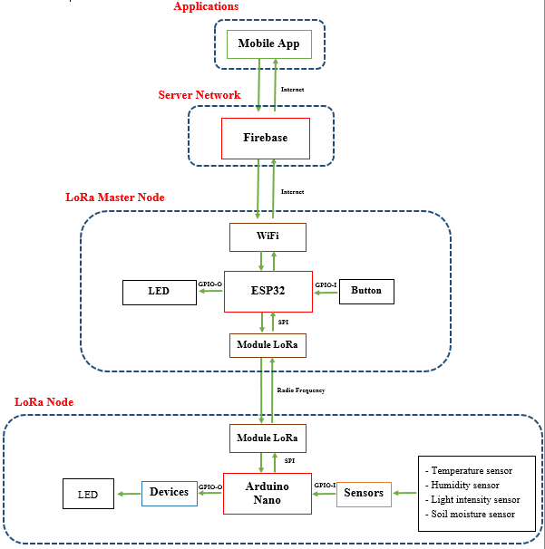
THEORY AND SYSTEM MODEL
Lora System Model Of The Topic
LoRa Node: Collect data from sensor, modulate, encapsulate and transmit to Master Node
LoRa Master Node: Receive data from the transmitted End Nodes, demodulate into separate data and transmit data to the Server for storage
Server Network: Use Firebase as database to authenticate users and store data in real time
Applications: Takes data of sensors stored on Firebase as input to the app for real-time rendering and graphing

Slide 8
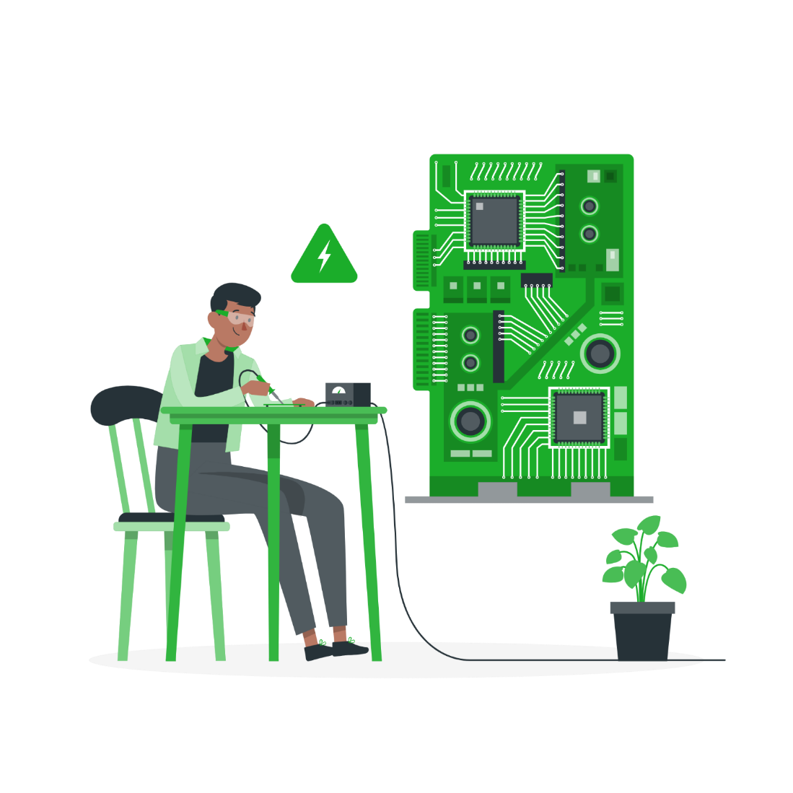
THE UNIVERSITY OF DANANG
Vietnam - Korea University of Information and Communication Technology
03
IMPLEMENTATION

Slide 9
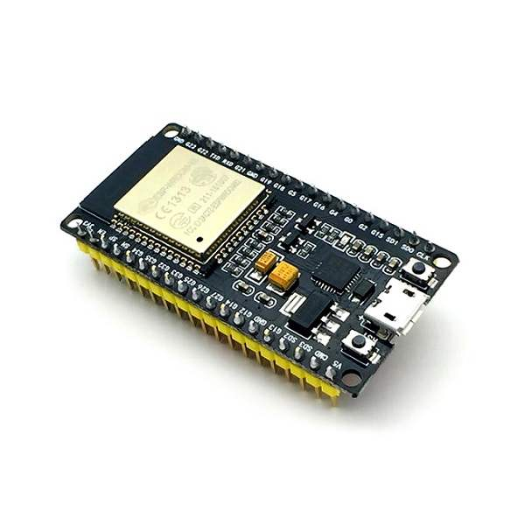
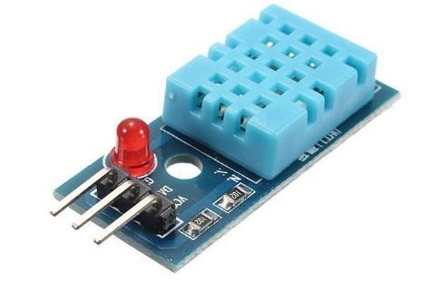
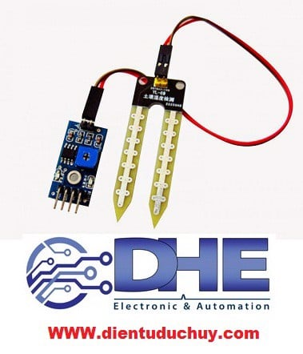
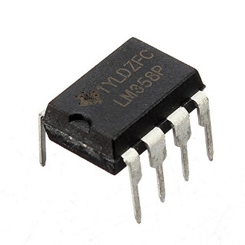
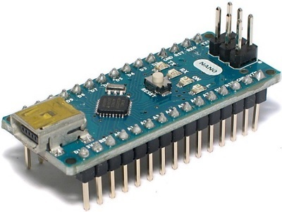
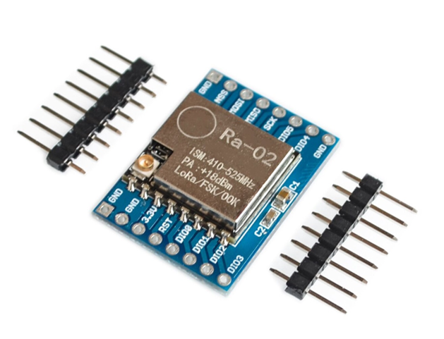
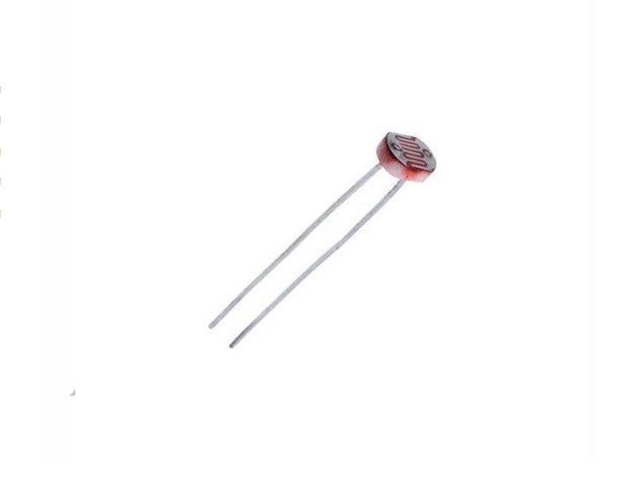
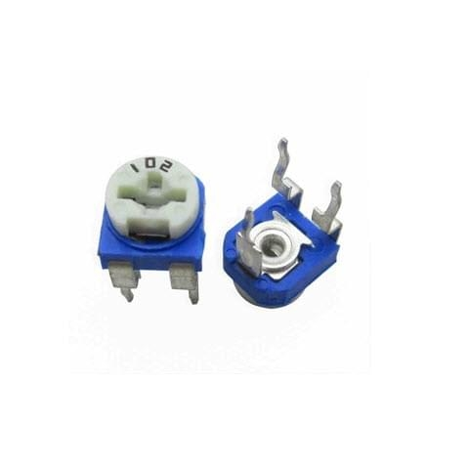
HARDWARE
ESP32
DHT11
Soid Sensor
IC LM358
Arduini Nano
LoRa Ra02
Photoresistor
Rheostat

Slide 10

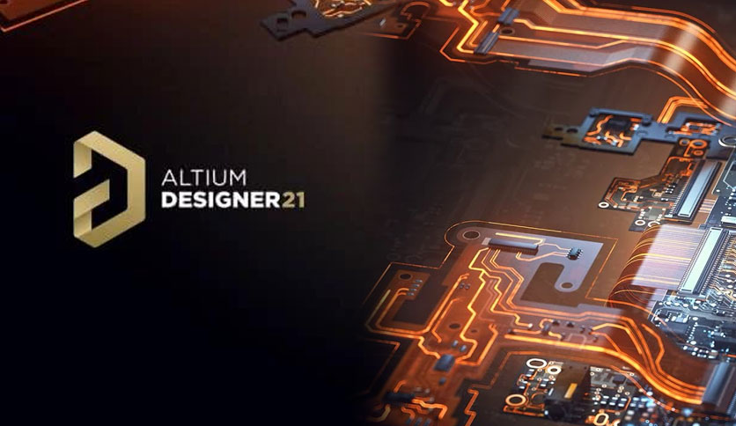
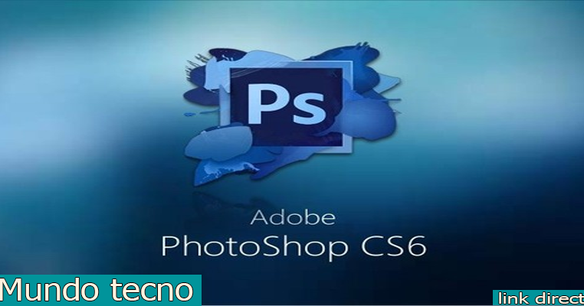
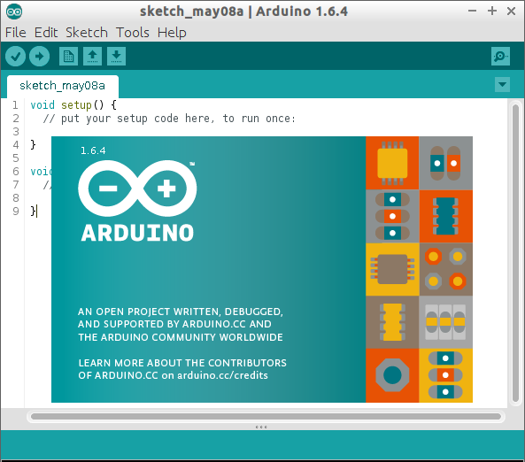
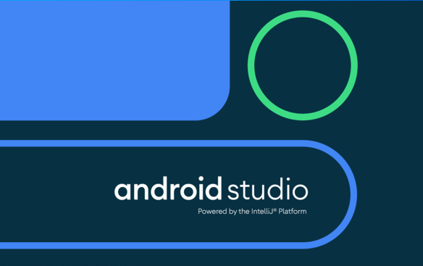
SOFTWARE
Firebase
Altium Designer
Photoshop CS6
Arduino IDE
Android Studio

Slide 11
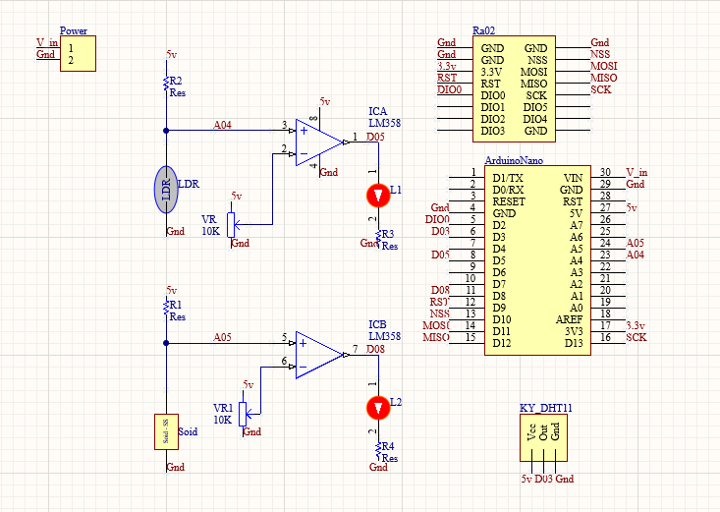
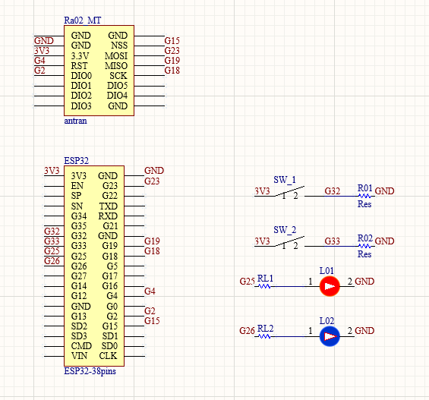
PRINCIPLE DIAGRAM
Schematic diagram of EndNodes
Schematic diagram of MasterNode

Slide 12
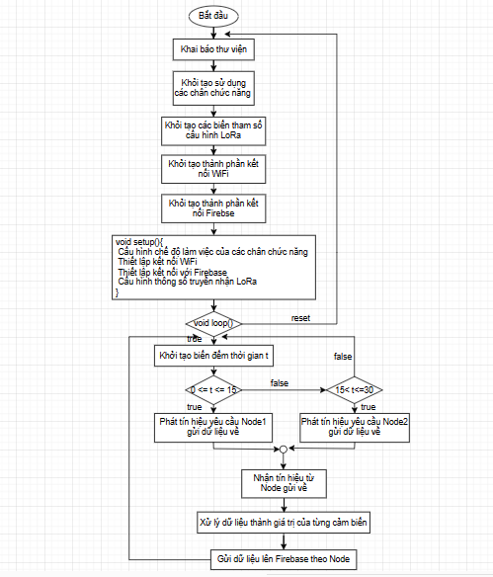
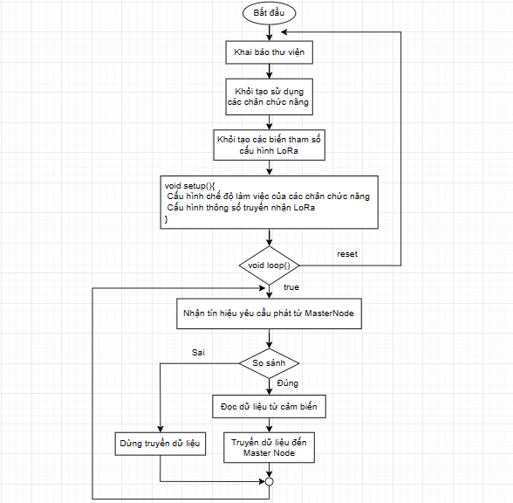
EndNodes
ALGORITHM FLOWCHART
MasterNode

Slide 13

THE UNIVERSITY OF DANANG
Vietnam - Korea University of Information and Communication Technology
04
RESULT, DEVELOPMENT

Slide 14
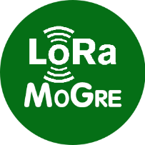
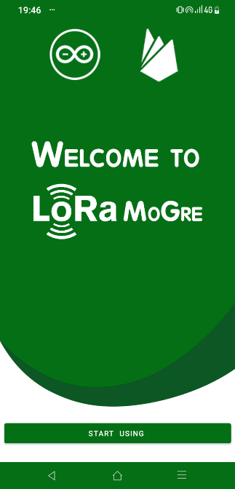
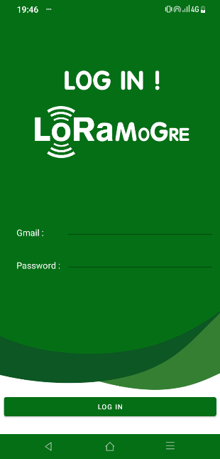
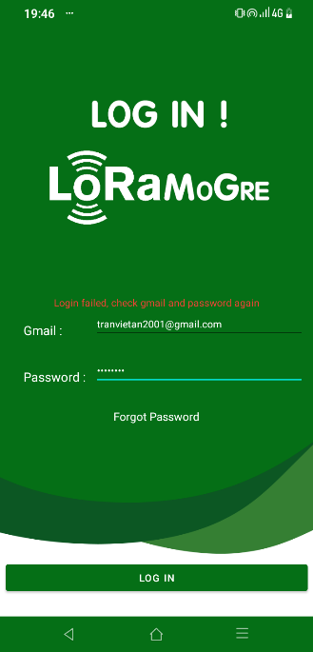
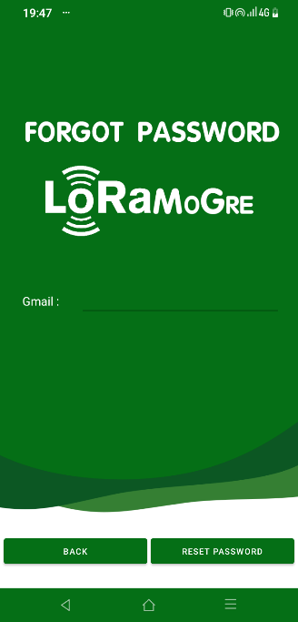
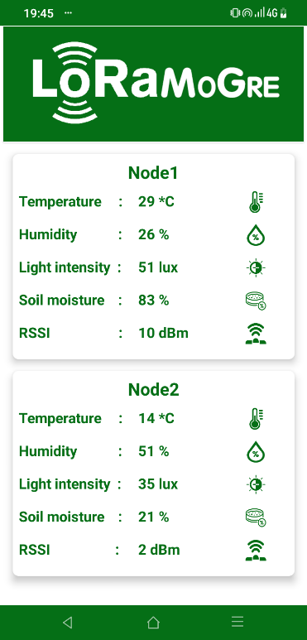
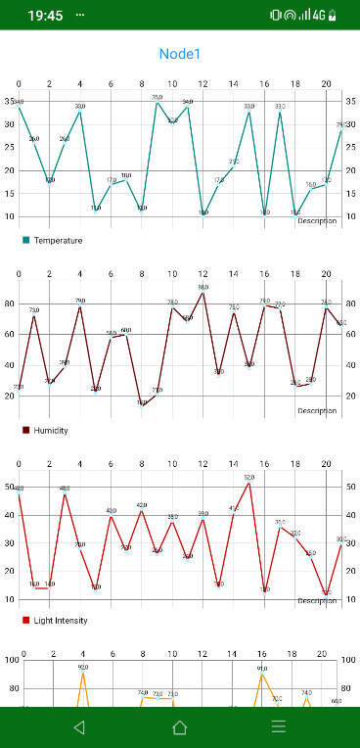
APPLICATION
“ LoRa MoGre ”

Slide 15
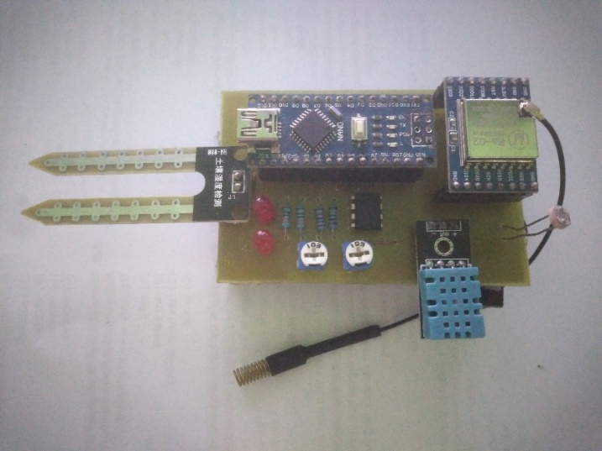
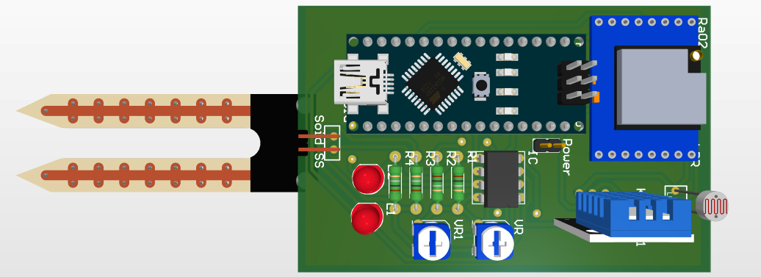
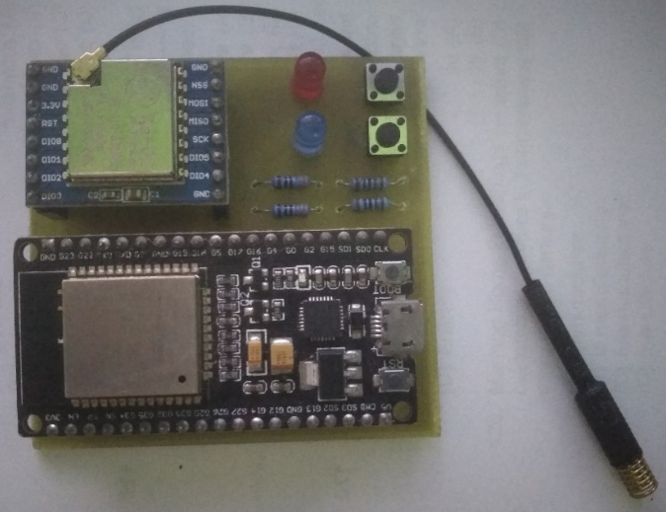
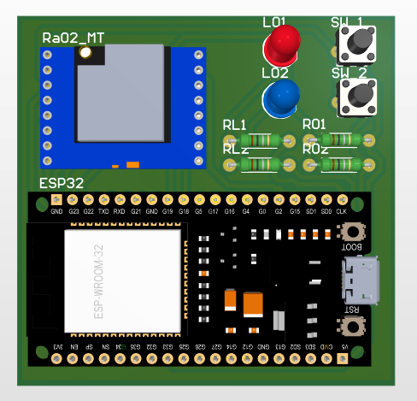
PCB CIRCUIT AND FINISHED PRODUCT

Slide 16
CONCLUSION
Result
Limit
Development
Complete ideas
Finish the product
Applying LoRa technology to the system
Build Android apps
Apply Firebase database to the system.
PCB circuit design and process
Just model
No practical application yet
Data transmission is limited
The ability to connect to Firebase is long
There are many shortcomings
Practical application
Applying new techniques
Create the right database
Increase security
Create cross-platform, multi-system applications.

Slide 17
Thank You For Your Listening

