Slide 1
Sensor
EV Board
Sensor
EV Board
Arduino
Shield
Jumper
DUE/UNO
Socket
3,3V I2C
Socket
5V I2C
Arduino
Multiplexer/
Level Shifter
Power Supply
Data
LEDs
Socket
3,3V SPI
Socket
5V SPI
Radio
Interface
Sensor
EV Board
Sensor
EV Board

Slide 2
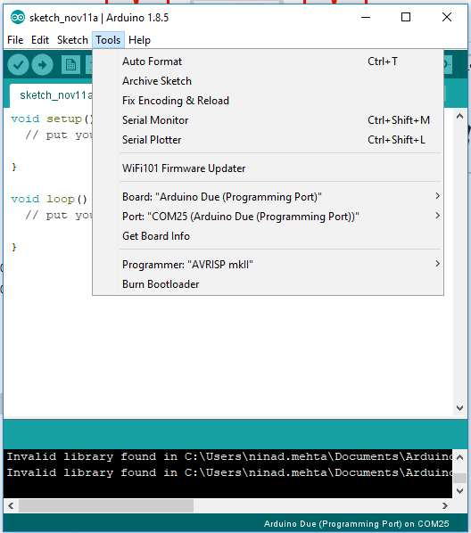

Slide 3
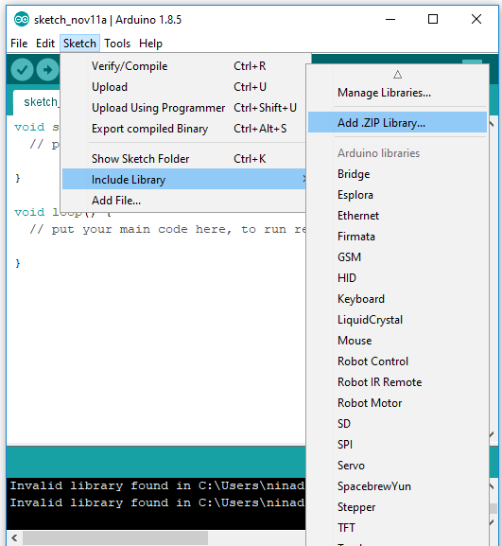

Slide 4
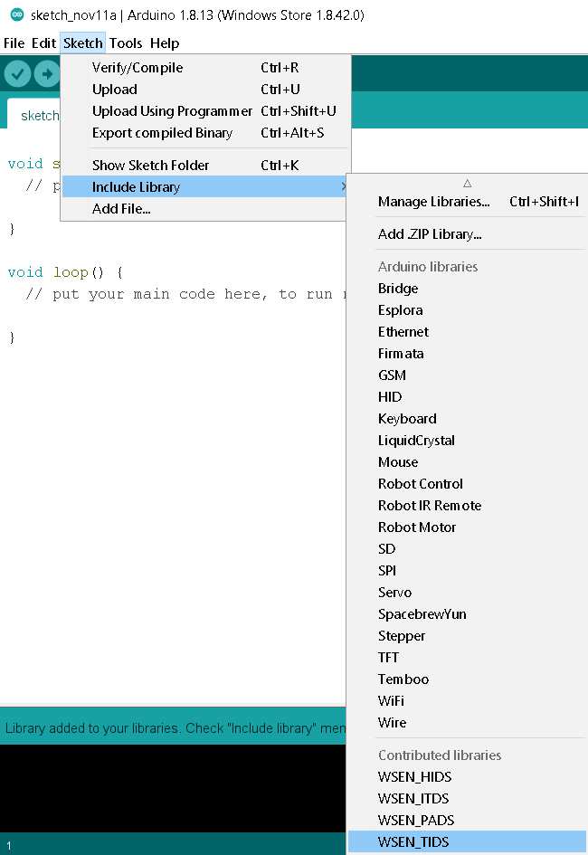

Slide 5
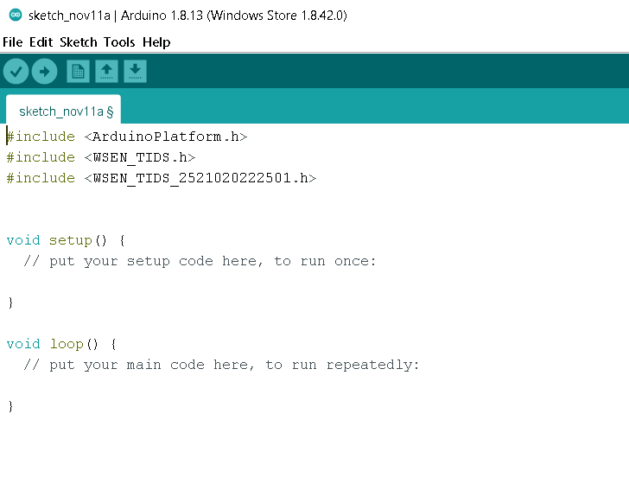

Slide 6
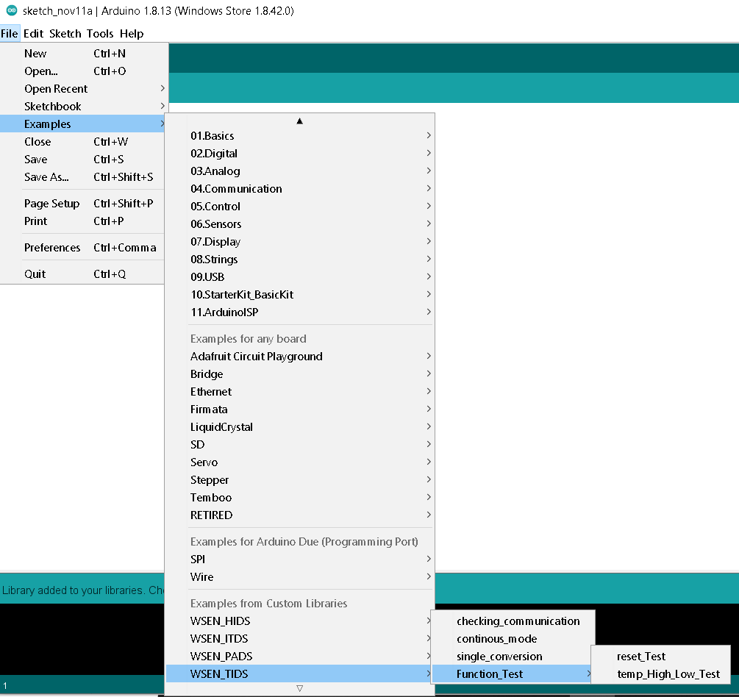

Slide 7
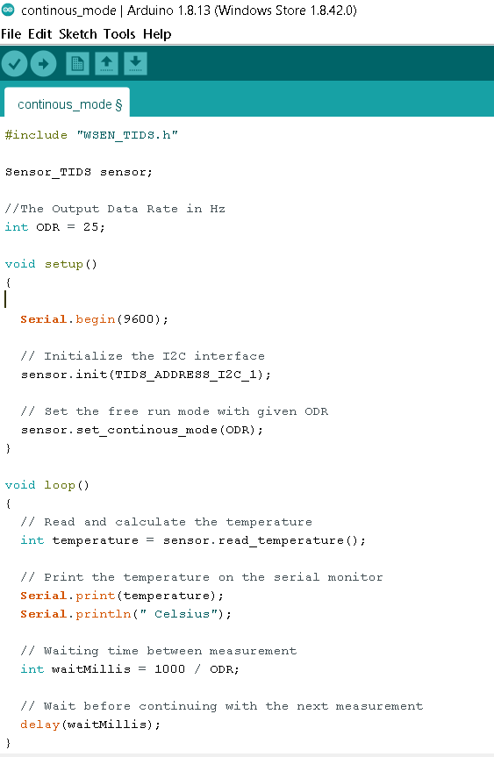

Slide 8
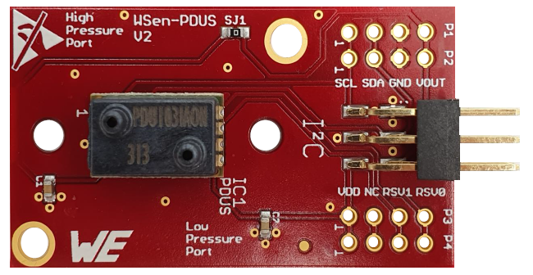
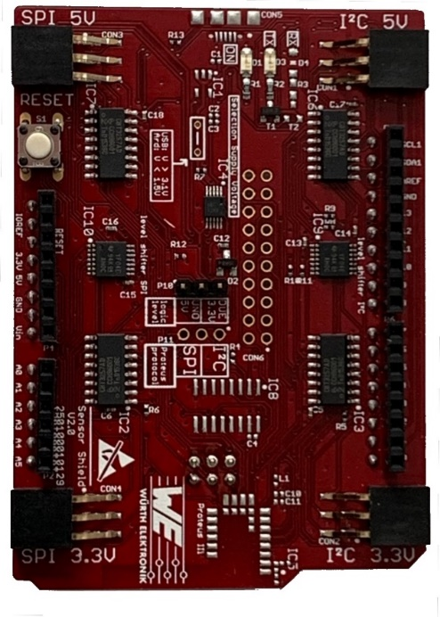
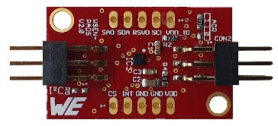
6-Pin connector
Arduino UNO/DUE jumper

Slide 9
