Slide 1
COMP 4901K Group 7 Named-entity recognition (NER)
Do Thuy Trang
Cheng Chi Ho
Wong Chi Ho

Slide 2
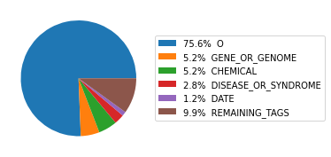
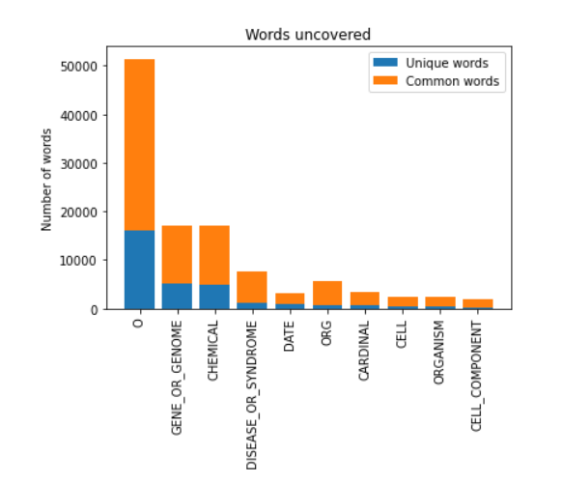
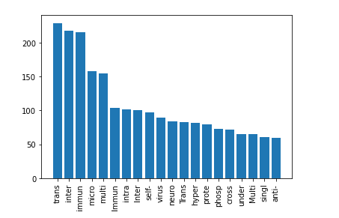
Exploratory Data Analysis
Distribution of tags
The distribution of entity tags is imbalanced, and most of them are labelled as no type ‘O’.
About 28% words that containing Greek letters, digits or short abbreviation such as: H5N1, Covid-19 are uncovered in general corpus
Many words share the same "prefix" that is good features for classifying name entity
Prefix distribution

Slide 3
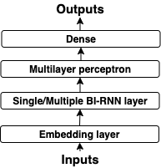
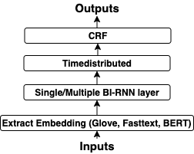
Methodology and Model Architecture
 | Structure
BERT | BERT ➤ Bi-LSTM ➤ Timedistributed ➤ CRF
RNN | Embedding ➤ 4 x Bi-LSTM ➤ 3 x MLP ➤ Dense
Fasttext | Fasttext ➤ 2 x Bi-LSTM ➤ Timedistributed ➤ CRF

Slide 4
Glove and Fasttext
Both are static embedding
Output same embedding for same word every time
Glove is an unsupervised learning algorithm for obtaining vector representations for words.
Common Crawl (840B tokens, 2.2M vocab, cased, 300d vectors)
Only 65% vocab coverage 😢
Can't get word embedding for many of our training data 😭
Fasttext builds character n-gram vectors as part of model training.
If there is out-of-vocabulary word, it can sum up the n-gram vector to produce a vector representing the whole word
Able to get word embedding for all our training data 👍👍👍

Slide 5
BERT
Pre-trained language model that uses bidirectional transformer
Able to an understand the context of each word in an input sequence
Generate contextualized word embeddings 👍
From BERT-mini to BERT-medium
Result Improved by ~0.5%
~5x training time with same settings 👎
https://github.com/jessevig/bertviz

Slide 6
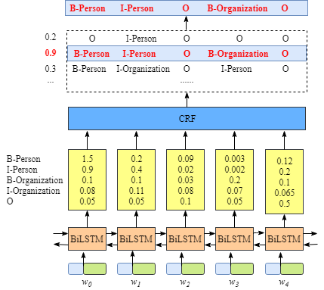
Bi-LSTM to CRF layer
DATE ORG O CORONAVIRUS O
CRF layer identify the tags of each word in the sentence
based on the surrounding context
Select the label sequence with the highest prediction score as the best answer
Learnable constraints to validate the final predicted label sequence
0.2
0.9
0.3
O ORG O O O
DATE ORG O CORONAVIRUS O
DATE CELL O ORG O
DATE
ORG
CORONAVIRUS
CELL
O
Notes:
Let me talk about why we used CRF layer as our final layer. CRF applies sequential dependencies that consider tags of “neighboring” words. So, we combined Bi-LSTM and CRF to predict the tag of each word based on the surrounding context. The prediction scores from Bi-LSTM are fed into the CRF layer, selecting the label sequence with the highest prediction score as the best answer. Also, CRF layer has one more benefit. It can add constraints to the final predicted labels to validate the correctness of the prediction and these constraints can be learnt from the training data.

Slide 7
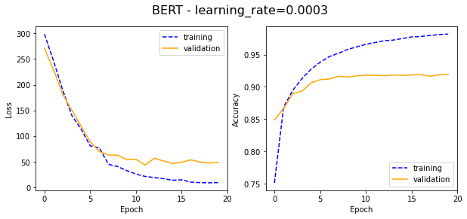
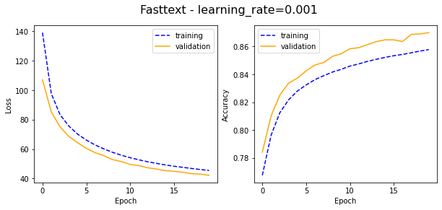
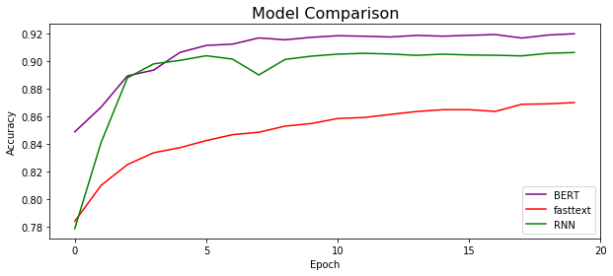
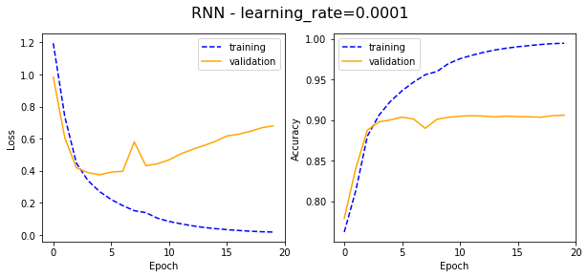
Training and Validation Results
BERT - highest validation accuracy (91%)
Fasttext does not overfit the training data
RNN - fastest rate of convergence
highest accuracy level with 3 epochs
BERT and Fasttext need 7 or more epochs
Notes:
Moving on to our results, BERT achieves the highest validation accuracy (91%). With the same dropout rate=0.5, Fasttext is the only model that does not overfit the training data probably due to less hidden layers in our fasttext model with a static embedding layer. Moreover, RNN has the fastest rate of convergence to its highest accuracy level with 3 epochs, while BERT and Fasttext need 7 or more epochs.

Slide 8
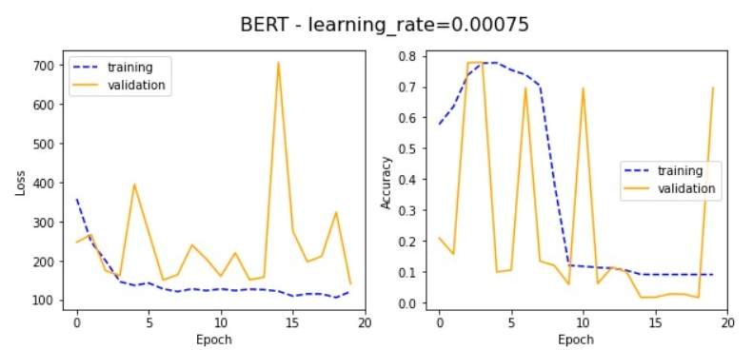
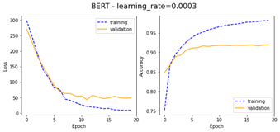
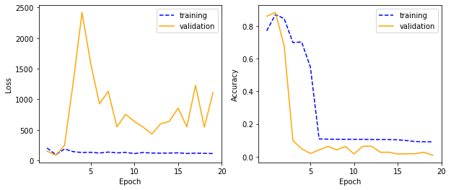
BERT Hyperparameter Tuning
Learning rate- [0.00075, 0.0003, 0.001]
Number of epochs- [20, 30, 40] & Dropout rate - [0.2, 0.5, 0.7]
similar accuracy
BERT – learning_rate=0.001
best learning rate
Notes:
To increase the BERT model accuracy, we tuned the hyperparameters for it. For the learning rate, we can see from the graph that the models with different learning rate has significantly different results and eventually learning rate 0.0003 is the only one that has converging results. For the number of epochs and dropout rate, we first start with 20 and tried 30 and 40 epochs and different dropout rate , but the accuracy is similar for different epochs and dropouts. So we chose 20 epoch and 0.5 dropout rate for our final model

Slide 9
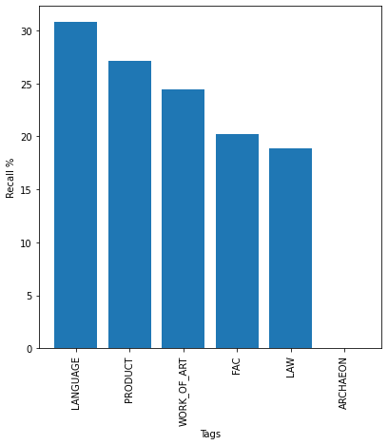
Result evaluation
 | Macro Precision | Macro Recall | Macro F1 | Weighted Precision | Weighted Recall | Weighted F1 | Validation Accuracy
BERT | 0.7421 | 0.6908 | 0.7155 | 0.9084 | 0.9108 | 0.9096 | 0.9108
RNN | 0.7110 | 0.6859 | 0.6982 | 0.8993 | 0.9011 | 0.9002 | 0.9011
Fasttext | 0.6063 | 0.4654 | 0.5266 | 0.8461 | 0.8546 | 0.8503 | 0.8546
6 worst tag's recall
The precision and recall of the tag ‘ARCHAEON’ is zero
Is the only tag that we can't predict correctly 😢
Frequency of the tag ‘ARCHAEON’ is extremely low
Only appears 12 times while there are in total 2791221 valid tags
Lowest frequency among all tags
Notes:
Even with our best model, the precision and recall of the tag ‘ARCHAEON’ is zero, which is the worst and the only tag that we can't predict correctly. This may be because the frequency of the tag ‘ARCHAEON’ is extremely low in our training dataset. It only appears 12 times while there are in total 2791221 valid tags.

Slide 10
Thank you
Q & A

