Slide 1
Text Classification
Emma DO
Source code: https://github.com/TrangDoThuy/Quora-Crawler/blob/master/fork-of-classification.ipynb

Slide 2
Pipeline
Data analysis
ML Model
Result Evaluation

Slide 3

Data Collection
Questions and stories with labels?

Slide 4
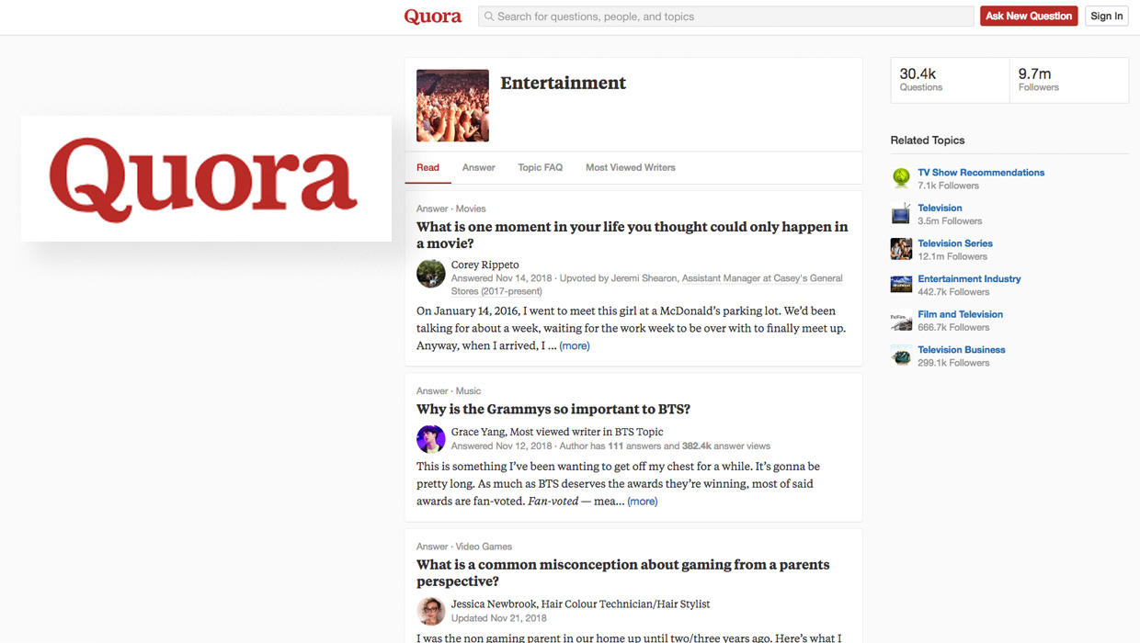

Slide 5
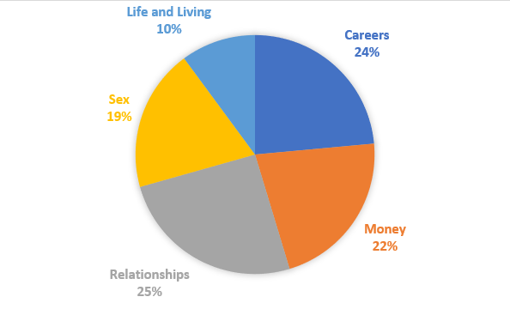
Exploratory Data Analysis
5 main topics
16.613 questions and answer
Length range: 10 – 1000 words

Slide 6
Pipeline
Data analysis
ML Model
Result Evaluation

Slide 7
Methodology and Model Architecture
Feature Extractor
Tokenize
Stem
RNN Model
Build vocabulary
RNN model
Filter stop-words

Slide 8
RNN Model
Input
Embedding layer
LSTM
Dropout layer
Fully connected layer
Activation function: softmax

Slide 9
Pipeline
Data analysis
ML Model
Result Evaluation

Slide 10
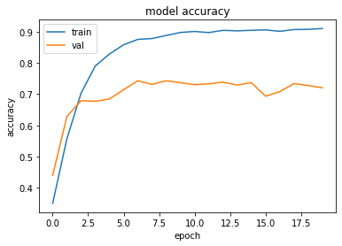
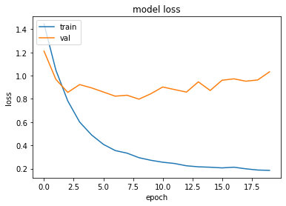
Result
- Training accuracy: 0.914
- Validation accuracy: 0.7206

Slide 11
Thank you

