Slide 1
English 10 · Global Success
UNIT 1: FAMILY LIFE
English 10 · Global Success · Periods 2–9
Trường THPT · Tổ Ngữ văn – Tiếng Anh · Biên soạn: TTT

Slide 2
OBJECTIVES · MỤC TIÊU
✔ Pronounce /br/, /kr/, /tr/ correctly
✔ Use words and phrases about family life
✔ Present simple vs. present continuous
✔ Read, speak, listen and write about family life
✔ Express opinions; British family values
✔ Project: Family Day
English 10 · Unit 1. Family life

Slide 3
WARM-UP · KHỞI ĐỘNG
Think, guess and share – Suy nghĩ, dự đoán
Who does the housework in your family?
Look at the list: cooking, doing the laundry, shopping for groceries, putting out the rubbish, doing the heavy lifting.
Who usually does each chore? What is he/she doing now?
English 10 · Unit 1. Family life

Slide 4
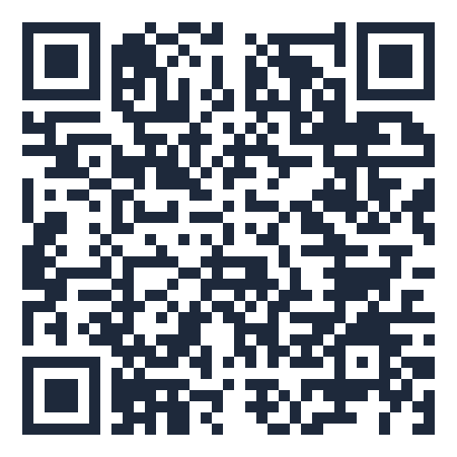
MIND MAP · SƠ ĐỒ TƯ DUY
Unit overview – scan the QR code for the online quiz
SCAN FOR THE QUIZ
breadwinner, homemaker
Present simple: habits
groceries, heavy lifting
Grammar &
Pronunciation
Present continuous: now
Vocabulary
do the laundry /
washing-up
No stative verbs in
-ing
put out the rubbish
/br/ /kr/ /tr/
UNIT 1 FAMILY
LIFE
Reading: benefits of
housework
Expressing opinions
British family values
6 MCQ + 1 True/False
Secure quiz room – answers sealed
trangtu66.github.io/Taode_thi_online/anh_cc_unit1_k10.html
Speaking: should/shouldn't
Skills
Culture & Project
Listening: family support
Family Day 28 June
Writing: family routines
email
Share chores = family
bonds
English 10 · Unit 1. Family life

Slide 5
VOCABULARY – FAMILY LIFE
breadwinner: someone who earns money to support the family
homemaker: a person who manages a home and raises children
groceries · heavy lifting · housework
put out the rubbish · do the laundry · do the washing-up · shop for groceries
English 10 · Unit 1. Family life

Slide 6
VOCABULARY 2 – TASK · ĐỀ BÀI
Work in pairs/groups – answers come next
Complete the sentences with: breadwinner, housework, groceries, homemaker, heavy lifting.
1. My mother is a ___. 2. I used to shop for ___ at this supermarket. 3. My eldest son is strong enough to do the ___.
4. Hanna hates doing ___ except cooking. 5. Mr Lewis is the ___ of the family.
💡 Hint: Read the definitions in Vocabulary 1 again.
English 10 · Unit 1. Family life

Slide 7
VOCABULARY 2 – ANSWER KEY · LỜI GIẢI
1. homemaker
2. groceries
3. heavy lifting
4. housework
5. breadwinner
Key: homemaker – groceries – heavy lifting – housework – breadwinner
English 10 · Unit 1. Family life

Slide 8
GRAMMAR – PRESENT SIMPLE vs. PRESENT CONTINUOUS
Present simple: habits / things we do regularly
My mother cooks every day.
Present continuous: actions happening now
My mother isn't cooking now. She's working in her office.
No continuous with stative verbs: like, love, need, want, know, agree
English 10 · Unit 1. Family life

Slide 9
GRAMMAR 2 – MRS LAM – TASK · ĐỀ BÀI
Work in pairs/groups – answers come next
Put the verbs in the present simple or present continuous:
Every day, she (1. do) ___ most of the housework. But today is Mother's Day, so Mrs Lam (2. not do) ___ any housework.
At the moment, she (3. watch) ___ TV. Her children (4. do) ___ the cooking and her husband (5. tidy up) ___ the house. Everybody (6. try) ___ hard.
💡 Hint: Find the time signals: every day / today / at the moment.
English 10 · Unit 1. Family life

Slide 10
GRAMMAR 2 – MRS LAM – ANSWER KEY · LỜI GIẢI
1. does
2. isn't doing
3. is watching
4. are doing
5. is tidying up
6. is trying
Key: Habits → present simple; now → present continuous
English 10 · Unit 1. Family life

Slide 11
READING – BENEFITS OF DOING HOUSEWORK – TASK · ĐỀ BÀI
Work in pairs/groups – answers come next
Read the text (SB p.11) and answer:
1. What do most people think about housework?
2. Why don't many parents make their children do housework?
3. What life skills can children learn?
💡 Hint: Scan for key words: most people, parents, life skills.
English 10 · Unit 1. Family life

Slide 12
READING – BENEFITS OF DOING HOUSEWORK – ANSWER KEY · LỜI GIẢI
1. Boring; the responsibility of wives and mothers
2. So that they have more time to play or study
3. Doing the laundry, cleaning the house, taking care of others
Key: Housework builds life skills, responsibility and family bonds
English 10 · Unit 1. Family life

Slide 13
SPEAKING – SHOULD OR SHOULDN'T? – TASK · ĐỀ BÀI
Work in pairs/groups – answers come next
Put the reasons in the correct column (SB p.12):
1. develop life skills 2. take responsibility 3. need plenty of playtime
4. may break things 5. strengthen family bonds 6. need time to study
💡 Hint: Positive effects → Should.
English 10 · Unit 1. Family life

Slide 14
SPEAKING – SHOULD OR SHOULDN'T? – ANSWER KEY · LỜI GIẢI
Should: 1, 2, 5
Shouldn't: 3, 4, 6
Key: Use: I think… / I'm afraid… / I strongly believe that…
English 10 · Unit 1. Family life

Slide 15
CULTURE – BRITISH FAMILY VALUES – TASK · ĐỀ BÀI
Work in pairs/groups – answers come next
Read the text (SB p.16) and list the five family values of British people in the 21st century.
💡 Hint: They are listed in order: on top, third, fourth and fifth.
English 10 · Unit 1. Family life

Slide 16
CULTURE – BRITISH FAMILY VALUES – ANSWER KEY · LỜI GIẢI
1. being truthful and honest
2. respecting older people
3. having good table manners
4. saying please and thank you
5. helping with family chores
Key: Five traditional values are still important
English 10 · Unit 1. Family life

Slide 17
LOOKING BACK – GRAMMAR – TASK · ĐỀ BÀI
Work in pairs/groups – answers come next
Find and correct the mistake:
1. I'm writing to tell you how much I'm wanting to see you.
2. Jack is away, so now I look after his dog.
3. Nam's often looking untidy.
4. She can't answer the phone now. She cooks dinner.
💡 Hint: Stative verbs? Time signals 'now', 'often'?
English 10 · Unit 1. Family life

Slide 18
LOOKING BACK – GRAMMAR – ANSWER KEY · LỜI GIẢI
1. wanting → want
2. look → am looking
3. is often looking → often looks
4. cooks → is cooking
Key: Check stative verbs and time signals
English 10 · Unit 1. Family life

Slide 19
BÀI TẬP CỦA BẠN · YOUR TASK
trangtu66.github.io/Taode_thi_online/anh_cc_unit1_k10.html
Scan with your phone · 6 multiple-choice + 1 True/False question · Results go to your teacher

