Slide 1
English 10 · Global Success
UNIT 2: HUMANS AND THE ENVIRONMENT
English 10 · Global Success · Periods 10–17
Trường THPT · Tổ Ngữ văn – Tiếng Anh · Biên soạn: TTT

Slide 2
OBJECTIVES · MỤC TIÊU
✔ Pronounce /kl/, /pl/, /gr/, /pr/
✔ Use words about humans and the environment
✔ Future: will / be going to; passive voice
✔ Read, talk, listen and write about green living
✔ Ask for and give advice; carbon footprint
✔ Project: Go Green Weekend
English 10 · Unit 2. Humans and the environment

Slide 3
WARM-UP · KHỞI ĐỘNG
Think, guess and share – Suy nghĩ, dự đoán
Look at the picture of the Go Green Club.
What are the students doing? Why?
What can you do this weekend to make your neighbourhood greener?
English 10 · Unit 2. Humans and the environment

Slide 4
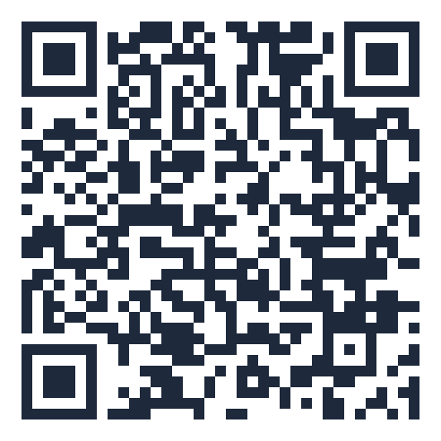
MIND MAP · SƠ ĐỒ TƯ DUY
Unit overview – scan the QR code for the online quiz
SCAN FOR THE QUIZ
household appliances,
energy
will: decide now, opinion
carbon footprint, litter
Grammar &
Pronunciation
be going to: plans,
evidence
Vocabulary
eco-friendly, green
lifestyle
Passive: be + V3
raise awareness, reduce
/kl/ /pl/ /gr/ /pr/
UNIT 2 HUMANS
AND THE ENVIRONMENT
Reading: green living
Asking for / giving
advice
Speaking: living green
Communication &
Project
6 MCQ + 1 True/False
Secure quiz room – answers sealed
trangtu66.github.io/Taode_thi_online/anh_cc_unit2_k10.html
Carbon footprint (CLIL)
Skills
Listening: a green event
Go Green Weekend
Writing: improve the
environment
Reduce – Reuse –
Recycle
English 10 · Unit 2. Humans and the environment

Slide 5
VOCABULARY – THE ENVIRONMENT
household appliances: fridges, TVs used at home
energy: power for machines, heat and light
carbon footprint: amount of CO₂ produced by a person
litter: rubbish in a public place
eco-friendly: causing no harm to the environment
English 10 · Unit 2. Humans and the environment

Slide 6
VOCABULARY 2 – TASK · ĐỀ BÀI
Work in pairs/groups – answers come next
Complete: eco-friendly, household appliances, carbon footprint, energy, litter.
1. ___ car models attract great attention at exhibitions.
2. Turn off your ___ when they are not used. 3. Small changes can reduce the ___ you produce.
4. One important source of ___ is the sun. 5. Pick up ___ on the ground.
💡 Hint: Use Vocabulary 1.
English 10 · Unit 2. Humans and the environment

Slide 7
VOCABULARY 2 – ANSWER KEY · LỜI GIẢI
1. Eco-friendly
2. household appliances
3. carbon footprint
4. energy
5. litter
Key: Eco-friendly – appliances – carbon footprint – energy – litter
English 10 · Unit 2. Humans and the environment

Slide 8
GRAMMAR – WILL vs. BE GOING TO
will: decisions at the moment of speaking; predictions based on opinion
This shirt looks beautiful. I will buy it.
be going to: plans made before; predictions based on evidence
Look at the dark clouds. It is going to rain soon.
English 10 · Unit 2. Humans and the environment

Slide 9
GRAMMAR – WILL / BE GOING TO – TASK · ĐỀ BÀI
Work in pairs/groups – answers come next
1. I don't think she ___ come tonight.
2. We have already made the decision. We ___ buy a new house.
3. I'm sure she ___ pass the final exam.
4. Look at the sun. It ___ be a beautiful day.
5. I forgot to phone Dad. I ___ do it right after lunch.
💡 Hint: Opinion or evidence? Plan or instant decision?
English 10 · Unit 2. Humans and the environment

Slide 10
GRAMMAR – WILL / BE GOING TO – ANSWER KEY · LỜI GIẢI
1. will
2. are going to
3. will
4. is going to
5. will
Key: will: opinion / instant decision; be going to: plan / evidence
English 10 · Unit 2. Humans and the environment

Slide 11
GRAMMAR – PASSIVE VOICE
S + be + past participle (+ by …)
Focus on the action, not the doer
The school playground is cleaned up every day (by students).
More trees will be planted. · Activities are going to be organised.
English 10 · Unit 2. Humans and the environment

Slide 12
PASSIVE VOICE – REWRITE – TASK · ĐỀ BÀI
Work in pairs/groups – answers come next
1. More and more people adopt a green lifestyle. → A green lifestyle …
2. The students didn't put the rubbish in the bins. → The rubbish …
3. We will plant more trees in the neighbourhood. → More trees …
💡 Hint: Keep the tense; object → subject.
English 10 · Unit 2. Humans and the environment

Slide 13
PASSIVE VOICE – REWRITE – ANSWER KEY · LỜI GIẢI
1. A green lifestyle is adopted by more and more people.
2. The rubbish wasn't put in the bins.
3. More trees will be planted in the neighbourhood.
Key: be (same tense) + V3
English 10 · Unit 2. Humans and the environment

Slide 14
SPEAKING – SHOULD OR SHOULDN'T? – TASK · ĐỀ BÀI
Work in pairs/groups – answers come next
Tick: 1. leaving appliances on 2. recycling used items 3. using plastic bags
4. buying organic food 5. dropping litter 6. planting trees
Match reasons a–f with the activities.
💡 Hint: Which actions harm the environment?
English 10 · Unit 2. Humans and the environment

Slide 15
SPEAKING – SHOULD OR SHOULDN'T? – ANSWER KEY · LỜI GIẢI
Should: 2, 4, 6 · Shouldn't: 1, 3, 5
a-5, b-1, c-3, d-4, e-2, f-6
Key: We should…, because… / We shouldn't…, because…
English 10 · Unit 2. Humans and the environment

Slide 16
CLIL – CARBON FOOTPRINT – TASK · ĐỀ BÀI
Work in pairs/groups – answers come next
Read the text (SB p.26) and complete the table:
Definition: the total amount of (1) ___ produced by human activities
Effects: increasing (2) ___ and air pollution
Ways to reduce it: taking shorter (3) ___, using (4) ___
💡 Hint: Scan the text for each gap.
English 10 · Unit 2. Humans and the environment

Slide 17
CLIL – CARBON FOOTPRINT – ANSWER KEY · LỜI GIẢI
(1) CO₂
(2) global temperatures
(3) showers
(4) public transport
Key: Make daily activities eco-friendly
English 10 · Unit 2. Humans and the environment

Slide 18
BÀI TẬP CỦA BẠN · YOUR TASK
trangtu66.github.io/Taode_thi_online/anh_cc_unit2_k10.html
Scan with your phone · 6 multiple-choice + 1 True/False question · Results go to your teacher

