Slide 1
English 10 · Global Success
UNIT 3: MUSIC
English 10 · Global Success · Periods 18–25
Trường THPT · Tổ Ngữ văn – Tiếng Anh · Biên soạn: TTT

Slide 2
OBJECTIVES · MỤC TIÊU
✔ Stress in two-syllable words
✔ Use words and phrases about music
✔ Compound sentences; to-infinitives & bare infinitives
✔ Read, talk, listen and write about music
✔ Make and respond to suggestions; chau van singing
✔ Project: traditional music
English 10 · Unit 3. Music

Slide 3
WARM-UP · KHỞI ĐỘNG
Think, guess and share – Suy nghĩ, dự đoán
Who is your favourite singer?
What musical instruments can he or she play?
How did he or she become famous?
English 10 · Unit 3. Music

Slide 4
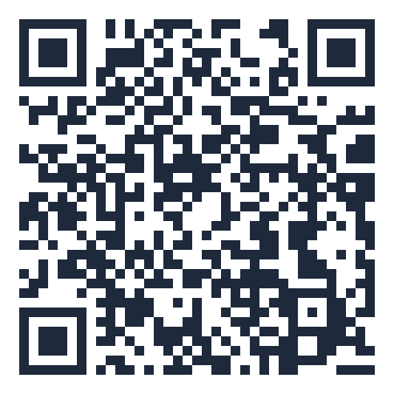
MIND MAP · SƠ ĐỒ TƯ DUY
Unit overview – scan the QR code for the online quiz
Compound: and, or, but,
so
SCAN FOR THE QUIZ
perform, judge, audience
talented, single
Grammar &
Pronunciation
V + to-inf: decide,
hope…
Vocabulary
musical instruments
make / let +
bare inf
upload, online star
Stress: 'singer / per'form
UNIT 3 MUSIC
Reading: American Idol
Making suggestions
Speaking: a TV music
show
6 MCQ + 1 True/False
Secure quiz room – answers sealed
trangtu66.github.io/Taode_thi_online/anh_cc_unit3_k10.html
Chau van singing
Skills
Culture & Project
Listening: music festival
Traditional music project
Writing: a blog
Love Vietnamese music
English 10 · Unit 3. Music

Slide 5
VOCABULARY – MUSIC
perform (v): sing, dance or play to entertain people
judge (n): a person who decides the results
audience (n): people who watch or listen
talented (adj): having a natural ability
single (n): a recording with one song
English 10 · Unit 3. Music

Slide 6
GRAMMAR – COMPOUND SENTENCES
Clause 1 + , and / or / but / so + Clause 2
It was raining, but they still went to the outdoor show.
and: adding · but: contrast · or: choice · so: result
English 10 · Unit 3. Music

Slide 7
COMPOUND SENTENCES – TASK · ĐỀ BÀI
Work in pairs/groups – answers come next
1. I am a jazz fan. My favourite style is from the late 1960s. (and/but)
2. Jackson wants to go to the festival. He has a maths exam on that day. (but/so)
3. You can book online. You can buy them at the stadium. (but/or)
4. The concert didn't happen. We stayed at home. (or/so)
💡 Hint: Relationship: adding, contrast, choice or result?
English 10 · Unit 3. Music

Slide 8
COMPOUND SENTENCES – ANSWER KEY · LỜI GIẢI
1. …, and my favourite style is…
2. …, but he has a maths exam…
3. …, or you can buy them…
4. …, so we stayed at home.
Key: and – but – or – so
English 10 · Unit 3. Music

Slide 9
GRAMMAR – INFINITIVES
decide, expect, plan, want, promise, agree, hope, ask + to-infinitive
make, let, hear, notice + object + bare infinitive
Her fans planned to send her a present.
Their performance made us fall asleep.
English 10 · Unit 3. Music

Slide 10
INFINITIVES – TASK · ĐỀ BÀI
Work in pairs/groups – answers come next
1. Her fans planned (send) ___ her a present.
2. Their performance was so boring that it made us (fall) ___ asleep.
3. The band decided (delay) ___ their concert.
4. Her parents won't let her (watch) ___ such TV shows.
💡 Hint: plan/decide + to-inf; make/let + bare inf
English 10 · Unit 3. Music

Slide 11
INFINITIVES – ANSWER KEY · LỜI GIẢI
1. to send
2. fall
3. to delay
4. watch
Key: to send – fall – to delay – watch
English 10 · Unit 3. Music

Slide 12
READING – AMERICAN IDOL – TASK · ĐỀ BÀI
Work in pairs/groups – answers come next
Match: 1. series 2. identify with 3. in search of 4. eliminated
a. feel similar to and understand b. a set of programmes on the same subject
c. removed from the competition d. looking for
💡 Hint: Read the sentences around each word.
English 10 · Unit 3. Music

Slide 13
READING – AMERICAN IDOL – ANSWER KEY · LỜI GIẢI
1-b
2-a
3-d
4-c
Key: series – identify with – in search of – eliminated
English 10 · Unit 3. Music

Slide 14
CULTURE – CHAU VAN SINGING – TASK · ĐỀ BÀI
Work in pairs/groups – answers come next
Read the passage (SB p.35) and complete the mind map:
Origin – Typical types – Main instruments – Costumes
💡 Hint: Find the information in each paragraph.
English 10 · Unit 3. Music

Slide 15
CULTURE – CHAU VAN SINGING – ANSWER KEY · LỜI GIẢI
Origin: 16th century, Northern Delta
Types: hat tho, hat hau
Instruments: moon-shaped lute, bamboo clappers, drum, gong
Costumes: clothes, hats, belts
Key: Part of Vietnamese national culture
English 10 · Unit 3. Music

Slide 16
BÀI TẬP CỦA BẠN · YOUR TASK
trangtu66.github.io/Taode_thi_online/anh_cc_unit3_k10.html
Scan with your phone · 6 multiple-choice + 1 True/False question · Results go to your teacher

