Slide 1
English 10 · Global Success
UNIT 4: FOR A BETTER COMMUNITY
English 10 · Global Success · Periods 32–39
Trường THPT · Tổ Ngữ văn – Tiếng Anh · Biên soạn: TTT

Slide 2
OBJECTIVES · MỤC TIÊU
✔ Stress in two-syllable words with the same spelling
✔ Words about community development; -ed/-ing, -ful/-less
✔ Past simple vs. past continuous with when/while
✔ Read, talk, listen and write about volunteering
✔ Express feelings; Save the Children
✔ Project: a volunteer project
English 10 · Unit 4. For a better community

Slide 3
WARM-UP · KHỞI ĐỘNG
Think, guess and share – Suy nghĩ, dự đoán
Have you ever done volunteer work?
What volunteer activities are there in your community?
How do they help people?
English 10 · Unit 4. For a better community

Slide 4
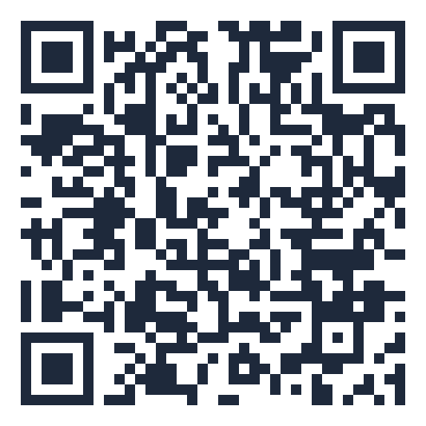
MIND MAP · SƠ ĐỒ TƯ DUY
Unit overview – scan the QR code for the online quiz
donate, volunteer,
generous
Past continuous: longer
action
SCAN FOR THE QUIZ
remote, benefit
Grammar &
Pronunciation
Past simple: interrupting
action
Vocabulary
-ed / -ing: excited,
exciting
when / while
-ful / -less: useful,
useless
'record (n) – re'cord
(v)
UNIT 4 FOR
A BETTER COMMUNITY
Reading: a volunteer club
Speaking: benefits of
volunteering
Expressing feelings
6 MCQ + 1 True/False
Secure quiz room – answers sealed
trangtu66.github.io/Taode_thi_online/anh_cc_unit4_k10.html
Save the Children
Skills
Culture & Project
Listening: volunteer
positions
A volunteer project
Writing: application
letter
Kindness & sharing
English 10 · Unit 4. For a better community

Slide 5
VOCABULARY – COMMUNITY DEVELOPMENT
donate (v): give money, food, clothes to a charity
volunteer (n): a person who works without being paid
generous (adj): giving freely
remote (adj): far away from other places
benefit (v): be useful to somebody
English 10 · Unit 4. For a better community

Slide 6
ADJECTIVE SUFFIXES
-ful: full of (useful, careful) · -less: without (useless, endless)
-ed: how people feel (excited, interested)
-ing: things causing the feeling (exciting, interesting)
I am interested in community development activities.
English 10 · Unit 4. For a better community

Slide 7
ADJECTIVE SUFFIXES – TASK · ĐỀ BÀI
Work in pairs/groups – answers come next
Choose: 1. We need to be careful / careless when we record the donations.
2. I am interested / interesting in community activities.
3. There are excited / exciting volunteering opportunities.
4. Last year, I was hopeful / hopeless at maths.
💡 Hint: Feeling (-ed) or cause (-ing)? Full of (-ful) or without (-less)?
English 10 · Unit 4. For a better community

Slide 8
ADJECTIVE SUFFIXES – ANSWER KEY · LỜI GIẢI
1. careful
2. interested
3. exciting
4. hopeless
Key: careful – interested – exciting – hopeless
English 10 · Unit 4. For a better community

Slide 9
GRAMMAR – PAST SIMPLE vs. PAST CONTINUOUS
Past continuous: a longer action in progress
Past simple: a shorter action that interrupted it
I was reading an article when she called.
While I was reading an article, she called.
English 10 · Unit 4. For a better community

Slide 10
COMBINE WITH WHEN / WHILE – TASK · ĐỀ BÀI
Work in pairs/groups – answers come next
1. They were cleaning the streets. It started to rain.
2. I was watching TV. I saw the floods and landslides in the area.
3. Tim was searching for employment opportunities. He found a job advert.
💡 Hint: Longer action → past continuous; interrupting action → past simple.
English 10 · Unit 4. For a better community

Slide 11
COMBINE WITH WHEN / WHILE – ANSWER KEY · LỜI GIẢI
1. They were cleaning the streets when it started to rain.
2. While I was watching TV, I saw the floods…
3. While Tim was searching…, he found a job advert…
Key: when + past simple; while + past continuous
English 10 · Unit 4. For a better community

Slide 12
READING – THE VOLUNTEER CLUB – TASK · ĐỀ BÀI
Work in pairs/groups – answers come next
Match: 1. various 2. participate 3. items 4. raised 5. delivering
a. objects or things b. taking things to someone c. several different
d. to take part in an activity e. collected money
💡 Hint: Read the sentence with each word.
English 10 · Unit 4. For a better community

Slide 13
READING – THE VOLUNTEER CLUB – ANSWER KEY · LỜI GIẢI
1-c
2-d
3-a
4-e
5-b
Key: various – participate – items – raised – delivering
English 10 · Unit 4. For a better community

Slide 14
CULTURE – SAVE THE CHILDREN – TASK · ĐỀ BÀI
Work in pairs/groups – answers come next
Complete the diagram (SB p.50):
now working in (1) ___ countries
helps teachers (2) ___ in their classrooms
creates opportunities for children in remote areas (3) ___
offers training on (4) ___
💡 Hint: Scan the text for numbers and key phrases.
English 10 · Unit 4. For a better community

Slide 15
CULTURE – SAVE THE CHILDREN – ANSWER KEY · LỜI GIẢI
(1) 120
(2) improve teaching skills and use digital technology
(3) to go to school
(4) life-saving skills
Key: Set up in the UK in 1919; in Viet Nam since 1990
English 10 · Unit 4. For a better community

Slide 16
BÀI TẬP CỦA BẠN · YOUR TASK
trangtu66.github.io/Taode_thi_online/anh_cc_unit4_k10.html
Scan with your phone · 6 multiple-choice + 1 True/False question · Results go to your teacher

