Slide 1
English 11 · Global Success
UNIT 2: THE GENERATION GAP
English 11 · Global Success · Periods 10–17
Trường THPT · Tổ Ngữ văn – Tiếng Anh · Biên soạn: TTT

Slide 2
OBJECTIVES · MỤC TIÊU
✔ Contracted forms
✔ Words about generational differences
✔ Modal verbs: must, have to, should
✔ Read, talk, listen and write about the generation gap
✔ Ask for and give permission; Asian American families
✔ Project: family survey
English 11 · Unit 2. The generation gap

Slide 3
WARM-UP · KHỞI ĐỘNG
Think, guess and share – Suy nghĩ, dự đoán
Do you live in a nuclear family or an extended family?
Do you and your grandparents have different views about clothes, jobs or housework?
English 11 · Unit 2. The generation gap

Slide 4
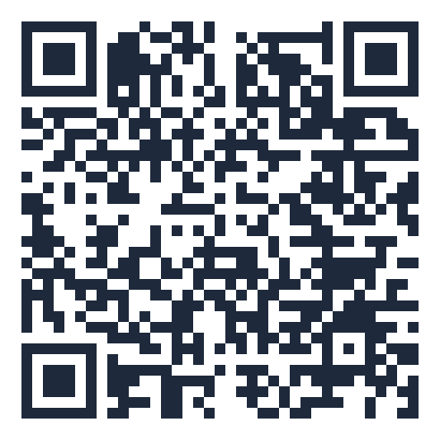
MIND MAP · SƠ ĐỒ TƯ DUY
Unit overview – scan the QR code for the online quiz
must / have to:
necessary
SCAN FOR THE QUIZ
nuclear / extended family
traditional view
Grammar &
Pronunciation
mustn't: not allowed
Vocabulary
cultural values
don't have to: not
necessary
generational conflict
Contracted forms: we'll,
don't
UNIT 2 THE
GENERATION GAP
Reading: Gen X, Y,
Z
Asking for permission
Speaking: start a
conversation
6 MCQ + 1 True/False
Secure quiz room – answers sealed
trangtu66.github.io/Taode_thi_online/anh_cc_unit2_k11.html
Asian American families
Skills
Culture & Project
Listening: family
conflicts
Family survey
Respect & understanding
Writing: opinion essay
English 11 · Unit 2. The generation gap

Slide 5
VOCABULARY – GENERATIONAL DIFFERENCES
nuclear family: parents and children
extended family: also grandparents, uncles, aunts…
traditional view · cultural values
common characteristics · generational conflict
digital natives: people born in the era of technology
English 11 · Unit 2. The generation gap

Slide 6
GRAMMAR – MUST, HAVE TO, SHOULD
must / have to: necessary (must – the speaker decides)
mustn't: not allowed · don't have to: not necessary
should / shouldn't: advice, opinion
My grandmother had to do all household chores.
English 11 · Unit 2. The generation gap

Slide 7
MODAL VERBS – TASK · ĐỀ BÀI
Work in pairs/groups – answers come next
1. You must / mustn't respect older people.
2. We don't have to / have to wear uniforms on weekdays. It's the rule.
3. You should / mustn't ask your parents for permission.
4. In the past, women had to / must do all the housework.
💡 Hint: Necessary? Not allowed? Advice? Past?
English 11 · Unit 2. The generation gap

Slide 8
MODAL VERBS – ANSWER KEY · LỜI GIẢI
1. must
2. have to
3. should
4. had to
Key: must – have to – should – had to
English 11 · Unit 2. The generation gap

Slide 9
READING – DIFFERENT GENERATIONS – TASK · ĐỀ BÀI
Work in pairs/groups – answers come next
Tick Gen X, Y or Z:
1. enjoy working in a team 2. use apps in creative ways 3. critical thinking
4. plan to have their own businesses 5. known for their curiosity
💡 Hint: Find key words in each paragraph.
English 11 · Unit 2. The generation gap

Slide 10
READING – DIFFERENT GENERATIONS – ANSWER KEY · LỜI GIẢI
1. Y
2. Z
3. X
4. Z
5. Y
Key: X: critical thinkers · Y: teamwork, curious · Z: digital natives
English 11 · Unit 2. The generation gap

Slide 11
SPEAKING – START A CONVERSATION – TASK · ĐỀ BÀI
Work in pairs/groups – answers come next
Put A–D in order:
Kevin: Ly, do you live with your extended family?
A. Yes. My grandparents are over 60… B. I see. What about your parents?
C. Yes, I do. I live with my grandparents… D. That's interesting. Have you noticed any differences…?
💡 Hint: Answer the first question first.
English 11 · Unit 2. The generation gap

Slide 12
SPEAKING – START A CONVERSATION – ANSWER KEY · LỜI GIẢI
(1) C
(2) D
(3) A
(4) B
Key: Present the topic – ask for information – ask for an opinion
English 11 · Unit 2. The generation gap

Slide 13
EVERYDAY ENGLISH – PERMISSION – TASK · ĐỀ BÀI
Work in pairs/groups – answers come next
Complete: A. Is it OK B. I'm afraid not C. Certainly D. can I
Lan: Mum, (1) ___ go to my friend's birthday party?
Mother: (2) ___. · Lan: (3) ___ if I stay the night? · Mother: Oh, (4) ___.
💡 Hint: Asking → giving → asking → refusing
English 11 · Unit 2. The generation gap

Slide 14
EVERYDAY ENGLISH – PERMISSION – ANSWER KEY · LỜI GIẢI
(1) D
(2) C
(3) A
(4) B
Key: Asking – giving – refusing permission
English 11 · Unit 2. The generation gap

Slide 15
BÀI TẬP CỦA BẠN · YOUR TASK
trangtu66.github.io/Taode_thi_online/anh_cc_unit2_k11.html
Scan with your phone · 6 multiple-choice + 1 True/False question · Results go to your teacher

