Slide 1
English 11 · Global Success
UNIT 3: CITIES OF THE FUTURE
English 11 · Global Success · Periods 18–25
Trường THPT · Tổ Ngữ văn – Tiếng Anh · Biên soạn: TTT

Slide 2
OBJECTIVES · MỤC TIÊU
✔ Linking final consonants to initial vowels
✔ Words about cities and smart living
✔ Stative verbs in the continuous form; linking verbs
✔ Read, talk, listen and write about future cities
✔ Express certainty / uncertainty; smart cities
✔ Project: the ideal city of the future
English 11 · Unit 3. Cities of the future

Slide 3
WARM-UP · KHỞI ĐỘNG
Think, guess and share – Suy nghĩ, dự đoán
Imagine our city in 2050.
How will people travel? Where will they live? What will the buildings look like?
English 11 · Unit 3. Cities of the future

Slide 4
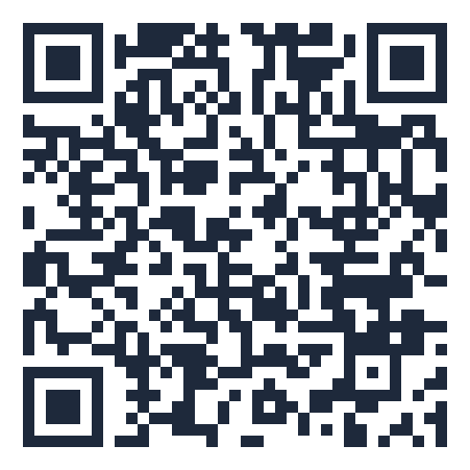
MIND MAP · SƠ ĐỒ TƯ DUY
Unit overview – scan the QR code for the online quiz
SCAN FOR THE QUIZ
city dweller, urban centre
Stative verbs: think,
have…
traffic jam, skyscraper
Grammar &
Pronunciation
He is having a
good time.
roof garden,
infrastructure
Vocabulary
Linking verbs + adj/noun
smart / green /
liveable city
UNIT 3 CITIES
OF THE FUTURE
Linking: lives_in
Reading: future cities
Certainty / uncertainty
Speaking: Wh-questions
Smart cities in the
world
6 MCQ + 1 True/False
Secure quiz room – answers sealed
trangtu66.github.io/Taode_thi_online/anh_cc_unit3_k11.html
Listening: smart city
problems
Skills
Culture & Project
Ideal city poster
Writing: pros & cons
article
Sustainable, liveable
cities
English 11 · Unit 3. Cities of the future

Slide 5
VOCABULARY – CITIES AND SMART LIVING
city dweller: a person who lives in the city
traffic jam · urban centre
roof garden: a garden on the top of a building
skyscraper: a very tall, modern building
infrastructure · high-rise buildings · smart sensors
English 11 · Unit 3. Cities of the future

Slide 6
GRAMMAR – STATIVE VERBS & LINKING VERBS
Stative verbs: think, believe, love, see, have… (state, not action)
My dad has a new car. → He is having a good time.
Linking verbs: be, seem, look, become, appear, sound, taste, smell + adj/noun
My mum looks very tired. · We became friends.
English 11 · Unit 3. Cities of the future

Slide 7
STATIVE OR CONTINUOUS? – TASK · ĐỀ BÀI
Work in pairs/groups – answers come next
1. I think / am thinking that living in the city is good for young people.
2. We are thinking / think of moving out of the city.
3. I don't see / am not seeing the building. It's too far away.
💡 Hint: Opinion / perception or action in progress?
English 11 · Unit 3. Cities of the future

Slide 8
STATIVE OR CONTINUOUS? – ANSWER KEY · LỜI GIẢI
1. think (opinion)
2. are thinking (considering)
3. don't see (perception)
Key: think = believe → simple; think of = consider → continuous
English 11 · Unit 3. Cities of the future

Slide 9
LINKING VERBS – CORRECT THE MISTAKES – TASK · ĐỀ BÀI
Work in pairs/groups – answers come next
1. The urban lifestyle seems more excitingly to young people.
2. The museum looks beauty from a distance.
3. Widening the road sounds a good solve to traffic problems.
💡 Hint: Linking verb + adjective / noun
English 11 · Unit 3. Cities of the future

Slide 10
LINKING VERBS – CORRECT THE MISTAKES – ANSWER KEY · LỜI GIẢI
1. excitingly → exciting
2. beauty → beautiful
3. solve → solution
Key: seem / look / sound + adjective or noun
English 11 · Unit 3. Cities of the future

Slide 11
READING – FUTURE CITIES – TASK · ĐỀ BÀI
Work in pairs/groups – answers come next
True or False?
1. About 70 million people will live in cities by 2050.
2. Smart cities use modern technologies to save time.
3. City dwellers will grow vegetables underground or in roof gardens.
💡 Hint: Scan for numbers and key words.
English 11 · Unit 3. Cities of the future

Slide 12
READING – FUTURE CITIES – ANSWER KEY · LỜI GIẢI
1. F – nearly 70 per cent of 10 billion people
2. T
3. T
Key: Future cities: smarter and more sustainable
English 11 · Unit 3. Cities of the future

Slide 13
CULTURE – SMART CITIES – TASK · ĐỀ BÀI
Work in pairs/groups – answers come next
Where can you…?
1. book a parking space via a mobile app
2. have a medical check-up online
3. pay for the bus with your bank card
4. unlock a bike from one station and return it to another
💡 Hint: Read about Singapore, Toronto, London, New York, Copenhagen.
English 11 · Unit 3. Cities of the future

Slide 14
CULTURE – SMART CITIES – ANSWER KEY · LỜI GIẢI
1. Singapore
2. Toronto
3. London
4. New York City
Key: Copenhagen: app for cyclists' best route
English 11 · Unit 3. Cities of the future

Slide 15
BÀI TẬP CỦA BẠN · YOUR TASK
trangtu66.github.io/Taode_thi_online/anh_cc_unit3_k11.html
Scan with your phone · 6 multiple-choice + 1 True/False question · Results go to your teacher

