Slide 1
English 11 · Global Success
UNIT 4: ASEAN AND VIET NAM
English 11 · Global Success · Periods 32–39
Trường THPT · Tổ Ngữ văn – Tiếng Anh · Biên soạn: TTT

Slide 2
OBJECTIVES · MỤC TIÊU
✔ Elision of vowels
✔ Words and phrases about ASEAN
✔ Gerunds as subjects and objects
✔ Read, talk, listen and write about ASEAN
✔ Give compliments; New Year festivals in ASEAN
✔ Project: an ASEAN member country
English 11 · Unit 4. ASEAN and Viet Nam

Slide 3
WARM-UP · KHỞI ĐỘNG
Think, guess and share – Suy nghĩ, dự đoán
How many countries are there in ASEAN?
Can you name their capitals? When did Viet Nam join ASEAN?
English 11 · Unit 4. ASEAN and Viet Nam

Slide 4
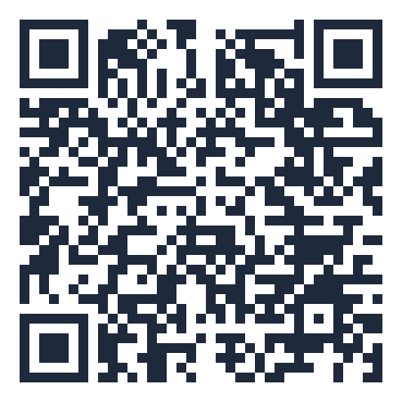
MIND MAP · SƠ ĐỒ TƯ DUY
Unit overview – scan the QR code for the online quiz
SCAN FOR THE QUIZ
cultural exchange
Gerund as subject
current issues
Grammar &
Pronunciation
Gerund as object: enjoy,
mind…
Vocabulary
contribution
After prepositions
leadership skills
Elision: diff(e)rent
UNIT 4 ASEAN
AND VIET NAM
Reading: ASEAN news
Giving compliments
Speaking: giving opinions
New Year festivals in
ASEAN
6 MCQ + 1 True/False
Secure quiz room – answers sealed
trangtu66.github.io/Taode_thi_online/anh_cc_unit4_k11.html
Skills
Culture & Project
Listening: ASEAN school
tour
Colours of ASEAN
Writing: a proposal
Unity in diversity
English 11 · Unit 4. ASEAN and Viet Nam

Slide 5
VOCABULARY – ASEAN
cultural exchange: sharing traditions and knowledge
current issues: important things happening now
contribution: something you give to help
leadership skills: abilities to lead people to a common goal
qualified · development · goals · volunteer
English 11 · Unit 4. ASEAN and Viet Nam

Slide 6
GRAMMAR – GERUNDS
Subject: Travelling might satisfy your desire for new experiences.
Complement after be: Her dream job is teaching English.
Object after like, enjoy, mind, involve, suggest
After prepositions: He apologised for not attending the meeting.
English 11 · Unit 4. ASEAN and Viet Nam

Slide 7
REWRITE USING GERUNDS – TASK · ĐỀ BÀI
Work in pairs/groups – answers come next
1. It is more convenient for students to apply online. → ___ is more convenient.
2. My sister usually listens to music. → My sister's hobby is ___.
3. Could you help me translate the documents? → Do you mind ___?
4. They managed to start a youth programme. → They succeeded in ___.
💡 Hint: Gerund as subject / complement / object / after preposition
English 11 · Unit 4. ASEAN and Viet Nam

Slide 8
REWRITE USING GERUNDS – ANSWER KEY · LỜI GIẢI
1. Applying online
2. listening to music
3. translating the documents
4. starting a youth programme
Key: V-ing works as a noun
English 11 · Unit 4. ASEAN and Viet Nam

Slide 9
READING – ASEAN NEWS – TASK · ĐỀ BÀI
Work in pairs/groups – answers come next
Match: 1. relations 2. eye-opening 3. represent 4. live-streamed
a. shown over the Internet b. to act officially for another person
c. the way people or groups behave towards each other d. surprising because you learn something new
💡 Hint: Read the sentences around each word.
English 11 · Unit 4. ASEAN and Viet Nam

Slide 10
READING – ASEAN NEWS – ANSWER KEY · LỜI GIẢI
1-c
2-d
3-b
4-a
Key: relations – eye-opening – represent – live-streamed
English 11 · Unit 4. ASEAN and Viet Nam

Slide 11
SPEAKING – GIVING OPINIONS – TASK · ĐỀ BÀI
Work in pairs/groups – answers come next
Complete: A. Don't you agree B. I'm afraid I have to disagree with you
C. I think they need to understand the current issues D. the most important thing is to speak English fluently E. Why do you think so
💡 Hint: Opinion → ask why → reason → ask agreement → disagree
English 11 · Unit 4. ASEAN and Viet Nam

Slide 12
SPEAKING – GIVING OPINIONS – ANSWER KEY · LỜI GIẢI
(1) C
(2) E
(3) A
(4) B
(5) D
Key: I think… / Why do you think so? / I'm afraid I have to disagree
English 11 · Unit 4. ASEAN and Viet Nam

Slide 13
CULTURE – NEW YEAR IN ASEAN – TASK · ĐỀ BÀI
Work in pairs/groups – answers come next
Lunar New Year: countries (1) ___; time: January or February
Buddhist calendar: Laos, Cambodia, Thailand, Myanmar; time (2) ___
💡 Hint: Read the text (SB p.50).
English 11 · Unit 4. ASEAN and Viet Nam

Slide 14
CULTURE – NEW YEAR IN ASEAN – ANSWER KEY · LỜI GIẢI
(1) Viet Nam, Singapore, Indonesia, parts of Malaysia
(2) April
Key: Different calendars, shared wishes for good luck
English 11 · Unit 4. ASEAN and Viet Nam

Slide 15
BÀI TẬP CỦA BẠN · YOUR TASK
trangtu66.github.io/Taode_thi_online/anh_cc_unit4_k11.html
Scan with your phone · 6 multiple-choice + 1 True/False question · Results go to your teacher

