Slide 1
English 12 · Global Success
UNIT 2: A MULTICULTURAL WORLD
English 12 · Global Success · Periods 10–17
Trường THPT · Tổ Ngữ văn – Tiếng Anh · Biên soạn: TTT

Slide 2
OBJECTIVES · MỤC TIÊU
✔ Diphthongs /ɔɪ/, /aɪ/, /aʊ/
✔ Words related to cultural diversity
✔ Articles (review and extension)
✔ Read, talk, listen and write about cultures
✔ Make introductions; culture shock
✔ Project: introduce a culture
English 12 · Unit 2. A multicultural world

Slide 3
WARM-UP · KHỞI ĐỘNG
Think, guess and share – Suy nghĩ, dự đoán
Kimchi, sushi, fish and chips, bun cha …
Which countries do these dishes come from?
Which one would you like to try at an International Cultural Festival?
English 12 · Unit 2. A multicultural world

Slide 4
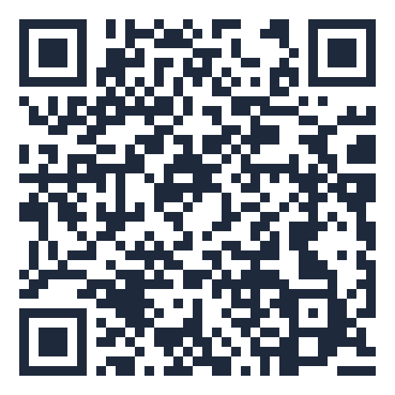
MIND MAP · SƠ ĐỒ TƯ DUY
Unit overview – scan the QR code for the online quiz
SCAN FOR THE QUIZ
a/an: not specific
origin, popularity
the: unique, mentioned,
the UK
identity, festivities
Grammar &
Pronunciation
Vocabulary
trend, cuisine
Ø: general
plural/uncountable
cultural diversity
UNIT 2 A
MULTICULTURAL WORLD
/ɔɪ/ /aɪ/ /aʊ/
Reading: globalisation
Making introductions
Speaking: Cultural
Diversity Day
6 MCQ + 1 True/False
Secure quiz room – answers sealed
trangtu66.github.io/Taode_thi_online/anh_cc_unit2_k12.html
Culture shock
Skills
Culture & Project
Listening: Halloween in
Viet Nam
Introduce a culture
Keep our identity
Writing: opinion essay
English 12 · Unit 2. A multicultural world

Slide 5
VOCABULARY – CULTURAL DIVERSITY
origin: where something starts to exist
popularity: being liked by many people
identity: what makes people different from others
festivities: activities to celebrate an event
trend: a general direction of change · cuisine: a style of cooking
English 12 · Unit 2. A multicultural world

Slide 6
GRAMMAR – ARTICLES
a/an: singular countable nouns, not specific
the: only one; already mentioned; instruments; the UK, the US; oceans, mountain ranges
Ø: plural/uncountable nouns used generally
Tigers are endangered animals. · The Pacific is the largest ocean.
English 12 · Unit 2. A multicultural world

Slide 7
ARTICLES – TASK · ĐỀ BÀI
Work in pairs/groups – answers come next
1. One tradition is admiring full moon / the full moon.
2. Charles Lindbergh flew solo across Atlantic / the Atlantic.
3. The Vietnamese women / Vietnamese women usually wear ao dai.
4. Many students go to study in US / the US.
5. My parents have never been to Rome / the Rome.
💡 Hint: Unique? Ocean? General? Country name? City?
English 12 · Unit 2. A multicultural world

Slide 8
ARTICLES – ANSWER KEY · LỜI GIẢI
1. the full moon
2. the Atlantic
3. Vietnamese women
4. the US
5. Rome
Key: the – the – Ø – the – Ø
English 12 · Unit 2. A multicultural world

Slide 9
READING – GLOBALISATION – TASK · ĐỀ BÀI
Work in pairs/groups – answers come next
Match sections A–C with headings:
1. Discovering K-pop music 2. Blending fashion styles 3. Fast food popularity
4. No borders for music 5. Variety of cuisines
💡 Hint: Read the first sentence of each section.
English 12 · Unit 2. A multicultural world

Slide 10
READING – GLOBALISATION – ANSWER KEY · LỜI GIẢI
A – 5. Variety of cuisines
B – 4. No borders for music
C – 2. Blending fashion styles
Key: Two headings are extra
English 12 · Unit 2. A multicultural world

Slide 11
CULTURE SHOCK – TASK · ĐỀ BÀI
Work in pairs/groups – answers come next
Tick (✓) or cross (✗):
1. The US – tipping 2. Japan – tipping
3. The UK – driving on the left 4. Singapore – chewing gum
💡 Hint: Read the text (SB p.29).
English 12 · Unit 2. A multicultural world

Slide 12
CULTURE SHOCK – ANSWER KEY · LỜI GIẢI
1. ✓
2. ✗ (can be rude)
3. ✓
4. ✗ (sale is illegal)
Key: Learn before you go – keep an open mind
English 12 · Unit 2. A multicultural world

Slide 13
EVERYDAY ENGLISH – INTRODUCTIONS – TASK · ĐỀ BÀI
Work in pairs/groups – answers come next
A. It's nice to meet you all B. I'd like you to meet C. this is D. Pleased to meet you
Ms Hoa: Good morning, class. (1) ___ Mr Paul Smith. Mr Smith: Hello, everyone. (2) ___.
Mai: Nam, (3) ___ Alan Samson. Nam: (4) ___, Alan.
💡 Hint: Formal → informal
English 12 · Unit 2. A multicultural world

Slide 14
EVERYDAY ENGLISH – INTRODUCTIONS – ANSWER KEY · LỜI GIẢI
(1) B
(2) A
(3) C
(4) D
Key: Introducing people – responding
English 12 · Unit 2. A multicultural world

Slide 15
BÀI TẬP CỦA BẠN · YOUR TASK
trangtu66.github.io/Taode_thi_online/anh_cc_unit2_k12.html
Scan with your phone · 6 multiple-choice + 1 True/False question · Results go to your teacher

