Slide 1
English 12 · Global Success
UNIT 3: GREEN LIVING
English 12 · Global Success · Periods 18–25
Trường THPT · Tổ Ngữ văn – Tiếng Anh · Biên soạn: TTT

Slide 2
OBJECTIVES · MỤC TIÊU
✔ Diphthongs /ɪə/, /eə/, /ʊə/
✔ Words and phrases about green living
✔ Verbs with prepositions; 'which' referring to a whole sentence
✔ Read, talk, listen and write about green living
✔ Make predictions; green festival traditions
✔ Project: eco-friendly leaflet
English 12 · Unit 3. Green living

Slide 3
WARM-UP · KHỞI ĐỘNG
Think, guess and share – Suy nghĩ, dự đoán
Our school is holding a Green Classroom Competition. The greenest classroom will win an ecotour!
What should our class do to win?
English 12 · Unit 3. Green living

Slide 4
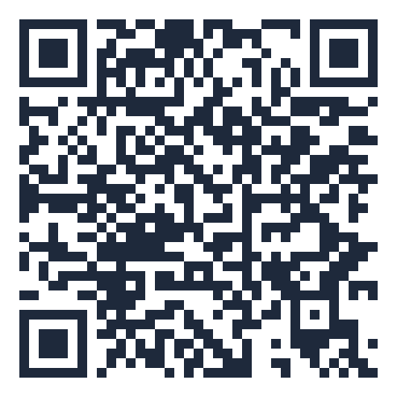
MIND MAP · SƠ ĐỒ TƯ DUY
Unit overview – scan the QR code for the online quiz
SCAN FOR THE QUIZ
waste, landfill
care about, depend on
reuse, packaging,
container
Grammar &
Pronunciation
Phrasal verbs: turn off
Vocabulary
…, which + whole
sentence
eco-friendly, decompose
carbon footprint
/ɪə/ /eə/ /ʊə/
UNIT 3 GREEN
LIVING
Reading: going green with
plastics
Making predictions
Speaking: reduce, reuse,
recycle
Communication &
Project
6 MCQ + 1 True/False
Secure quiz room – answers sealed
trangtu66.github.io/Taode_thi_online/anh_cc_unit3_k12.html
Green festival traditions
Skills
Listening: a compost pile
Eco-friendly leaflet
Writing: problem-solving
report
Zero waste
English 12 · Unit 3. Green living

Slide 5
VOCABULARY – GREEN LIVING
waste (n): careless use causing loss
landfill (n): land where waste is buried
reuse (v): use something again
packaging (n): materials to wrap things we buy
container (n): a box or bowl to keep things in
English 12 · Unit 3. Green living

Slide 6
GRAMMAR
Verbs + prepositions: ask about, apply for, agree on, refer to
Phrasal verbs: work out, turn on/off, look for, look after
…, which refers to the whole sentence
More people are recycling, which is good for the environment.
English 12 · Unit 3. Green living

Slide 7
COMBINE WITH WHICH – TASK · ĐỀ BÀI
Work in pairs/groups – answers come next
1. Plastic takes hundreds of years to decompose. This explains why it is harmful.
2. Public transport does not pollute the air as much as private vehicles. That's why more people should use it.
3. All students work hard to clean up the school. The teacher encourages this.
💡 Hint: Use ', which' to refer to the whole first sentence.
English 12 · Unit 3. Green living

Slide 8
COMBINE WITH WHICH – ANSWER KEY · LỜI GIẢI
1. …, which explains why it is harmful…
2. …, which is why more people should consider using it.
3. …, which the teacher encourages.
Key: Comma + which
English 12 · Unit 3. Green living

Slide 9
READING – GO GREEN WITH PLASTICS – TASK · ĐỀ BÀI
Work in pairs/groups – answers come next
Match information with names:
1. learnt from a past mistake 2. supported by a local business
3. learnt the recycling symbols 4. depends on drinking water facilities 5. reuses takeaway containers
💡 Hint: Read each email extract.
English 12 · Unit 3. Green living

Slide 10
READING – GO GREEN WITH PLASTICS – ANSWER KEY · LỜI GIẢI
1. Binh
2. Hai
3. Ha
4. Phuong
5. Hoang
Key: Small habits – big changes
English 12 · Unit 3. Green living

Slide 11
SPEAKING – REDUCE, REUSE, RECYCLE – TASK · ĐỀ BÀI
Work in pairs/groups – answers come next
Sort into Reduce / Reuse / Recycle:
a. recycled paper b. sorting paper waste c. printing on both sides d. old paper as compost
e. reusable containers f. smart devices for notes g. blank side of a sheet h. avoiding printing i. keeping paper waste clean
💡 Hint: Less use? Use again? Process into new things?
English 12 · Unit 3. Green living

Slide 12
SPEAKING – REDUCE, REUSE, RECYCLE – ANSWER KEY · LỜI GIẢI
Reduce: c, e, f, h
Reuse: g
Recycle: a, b, d, i
Key: Save trees, energy and water
English 12 · Unit 3. Green living

Slide 13
EVERYDAY ENGLISH – PREDICTIONS – TASK · ĐỀ BÀI
Work in pairs/groups – answers come next
A. will have a difficult decision B. is going to impress C. in the long run D. It's hard to predict
Nam: (1) ___ who'll win. Mark: Class 12C's programme (2) ___ the judges.
…lead to healthier lifestyles (3) ___. Nam: The judges (4) ___ to make.
💡 Hint: Certainty level
English 12 · Unit 3. Green living

Slide 14
EVERYDAY ENGLISH – PREDICTIONS – ANSWER KEY · LỜI GIẢI
(1) D
(2) B
(3) C
(4) A
Key: I guess… / It's likely that… / It's hard to predict…
English 12 · Unit 3. Green living

Slide 15
BÀI TẬP CỦA BẠN · YOUR TASK
trangtu66.github.io/Taode_thi_online/anh_cc_unit3_k12.html
Scan with your phone · 6 multiple-choice + 1 True/False question · Results go to your teacher

