Slide 1
English 12 · Global Success
UNIT 4: URBANISATION
English 12 · Global Success · Periods 32–39
Trường THPT · Tổ Ngữ văn – Tiếng Anh · Biên soạn: TTT

Slide 2
OBJECTIVES · MỤC TIÊU
✔ Unstressed words in connected speech
✔ Words related to urbanisation
✔ Present perfect; double comparatives
✔ Read, talk, listen and write about urbanisation
✔ Make complaints; Malaysia & Australia
✔ Project: an urban area in Viet Nam
English 12 · Unit 4. Urbanisation

Slide 3
WARM-UP · KHỞI ĐỘNG
Think, guess and share – Suy nghĩ, dự đoán
There used to be a rice field opposite Nam's house. Now there are several high-rise buildings.
How has your neighbourhood changed? Are the changes good or bad?
English 12 · Unit 4. Urbanisation

Slide 4
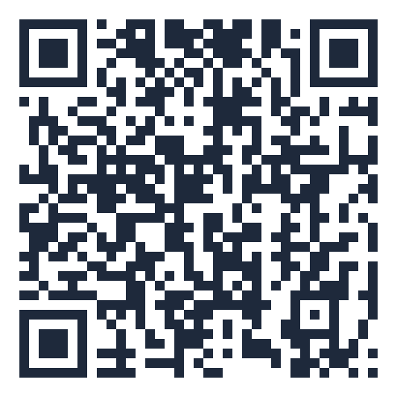
MIND MAP · SƠ ĐỒ TƯ DUY
Unit overview – scan the QR code for the online quiz
SCAN FOR THE QUIZ
It's the first time
I have…
afford, housing
expand, seek
Grammar &
Pronunciation
the best … I
have ever…
Vocabulary
unemployment
bigger and bigger
urban areas, rush hour
The more…, the more…
UNIT 4 URBANISATION
Reading: Ha Noi then
& now
Making complaints
Malaysia & Australia
6 MCQ + 1 True/False
Secure quiz room – answers sealed
trangtu66.github.io/Taode_thi_online/anh_cc_unit4_k12.html
Speaking: changes in an
area
Skills
Culture & Project
An urban area in
VN
Listening: radio talk
Writing: a line graph
Benefits vs. challenges
English 12 · Unit 4. Urbanisation

Slide 5
VOCABULARY – URBAN LIFE
afford (v): have enough money to buy or do something
housing (n): houses, flats where people live
expand (v): become larger
seek (v): look for something or somebody
unemployment (n): the number of people without a job
English 12 · Unit 4. Urbanisation

Slide 6
GRAMMAR – PRESENT PERFECT & DOUBLE COMPARATIVES
It/This is the first/second time + S + have/has + V3
It is the best/worst … + S + have/has ever + V3
Towns are getting bigger and bigger.
The bigger the city gets, the more crowded it becomes.
English 12 · Unit 4. Urbanisation

Slide 7
CLOSEST MEANING – TASK · ĐỀ BÀI
Work in pairs/groups – answers come next
1. Housing is getting more and more expensive, so many residents can't afford their own place.
2. The more people move into big cities, the higher the unemployment is.
3. The more houses are built, the less space we have for plants and trees.
💡 Hint: Keep the cause–effect meaning.
English 12 · Unit 4. Urbanisation

Slide 8
CLOSEST MEANING – ANSWER KEY · LỜI GIẢI
1. A
2. B (More people moving into big cities causes higher unemployment.)
3. C (We have less space for plants because more houses are built.)
Key: The more…, the more…
English 12 · Unit 4. Urbanisation

Slide 9
READING – HA NOI THEN AND NOW – TASK · ĐỀ BÀI
Work in pairs/groups – answers come next
Complete the table:
Area: about (1) ___ sq km (1954) → over 3,000 sq km
Population: about 530,000 → over (2) ___
Transport: (3) ___ and buses → modern buses and (4) ___
Architecture: mainly (5) ___ → more high-rise buildings
💡 Hint: Scan for numbers.
English 12 · Unit 4. Urbanisation

Slide 10
READING – HA NOI THEN AND NOW – ANSWER KEY · LỜI GIẢI
(1) 152
(2) 8 million
(3) trams
(4) metro
(5) low-rise buildings
Key: A small city → a modern city
English 12 · Unit 4. Urbanisation

Slide 11
WRITING – A LINE GRAPH – TASK · ĐỀ BÀI
Work in pairs/groups – answers come next
Order the paragraphs about Fantasia:
A. By contrast, the urban population rose…
B. The line graph shows population trends… Overall,…
C. In 1950, 94 per cent… lived in rural areas…
💡 Hint: Overview first, then details.
English 12 · Unit 4. Urbanisation

Slide 12
WRITING – A LINE GRAPH – ANSWER KEY · LỜI GIẢI
B – C – A
Key: Introduce – describe trends – compare
English 12 · Unit 4. Urbanisation

Slide 13
EVERYDAY ENGLISH – COMPLAINTS – TASK · ĐỀ BÀI
Work in pairs/groups – answers come next
A. I promise B. I want to complain about C. I'm sorry to have to say this D. there's nothing we can do about it
Ms Lan: (1) ___, but there is always loud music… Mai: (2) ___ this will never happen again.
Nam: Excuse me, (3) ___ the bus services. Conductor: I'm sorry, but (4) ___.
💡 Hint: Complaint → positive / negative response
English 12 · Unit 4. Urbanisation

Slide 14
EVERYDAY ENGLISH – COMPLAINTS – ANSWER KEY · LỜI GIẢI
(1) C
(2) A
(3) B
(4) D
Key: Making complaints – responding
English 12 · Unit 4. Urbanisation

Slide 15
BÀI TẬP CỦA BẠN · YOUR TASK
trangtu66.github.io/Taode_thi_online/anh_cc_unit4_k12.html
Scan with your phone · 6 multiple-choice + 1 True/False question · Results go to your teacher

