Slide 1
Playing Flappy Bird with Deep
Reinforcement Learning
Phase2
Jianan Yue
Yulin Shi

Slide 2
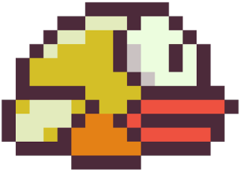
Current progress
Improved flappy bird game
Trained flappy bird agent for several times
Score for current round
Input：
bird.velocity
bird.y
current_gap.x
current_gap.y
Output:
flap
not flap
Best score for all rounds

Slide 3
Parameters
At the beginning of training, take random actions.
random_action_distribution=[0.9,0.1];
Probability: P(not flap) = 0.9 P(flap) = 0.1
epsilon:
Controls exploration exploitation tradeoff
Exploration: random act;
Exploitation: act depend on current experience
Decrease over time (form epsilon = 1 to epsilon = 0.05)

Slide 4
Parameters
Deep Neural Network (4 layers):
1 input layer
2 hidden layers: num_neurons = 50;
1 output layer
learning_rate: 0.001

Slide 5
Result
Best score: 63

Slide 6
Result
Average reward overtime
An emergent strategy (Watch the page)

Slide 7
Conclusion
It is validated that it is possible for an agent to generate control commands from perceptions, without any explicit model of the world.
Future work: optimize the net settings. Reduce training time.
Visualize the training processes, include loss curve and net parameters to the webpage

