Slide 1
Playing Flappy Bird with Deep Reinforcement Learning Phase2
Jianan Yue
Yulin Shi

Slide 2
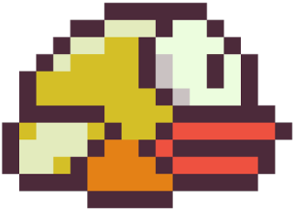
Current progress
Improved flappy bird game
Trained flappy bird agent for several times
Score for current round
Input：
bird.velocity
bird.y
current_gap.x
current_gap.y
Output:
flap
not flap
Best score for all rounds

Slide 3
Parameters
At the beginning of training, take random actions.
random_action_distribution=[0.9,0.1];
Probability: P(not flap) = 0.9 P(flap) = 0.1
epsilon:
Controls exploration exploitation tradeoff
Exploration: random act;
Exploitation: act depend on current experience
Decrease over time (form epsilon = 1 to epsilon = 0.05)

Slide 4
Parameters
Deep Neural Network (4 layers):
1 input layer
2 hidden layers: num_neurons = 50; (5 neuron is also proved to be effect)
1 output layer
learning_rate: 0.001

Slide 5
Result
Best score: 63

Slide 6
Result
Average reward overtime
An emergent strategy (Watch the page)

Slide 7
Conclusion
It is validated that it is possible for an agent to generate control commands from perceptions, without any explicit model of the world.

Slide 8
Next step
Vision perception.
It is more ambitious.
It avoids measuring the physical parameters e.g. distances
It demands on deep convolutional learning
There are convolutional learning tools in the “convnet” repository. It's doable if we use the pixels of snapshots as input of the agent. But it is empirical to choose number of network layers and neurons. Seeking for external assistant.

