Slide 1


Analysis of Gender Identity Freedom in the United States
Jade Selke
A Capstone Project Submitted to the Faculty of Utica University
April 2023
in Partial Fulfillment of the Requirements for the Degree of
Master of Science in Data Science

Slide 2

Introduction
The percentage of people identifying as other than cisgender is increasing
The number of people who identify as transgender or nonbinary across different regions can vary greatly
Throughout the world, the lack of protections based on gender means that any person identifying their gender outside the binary necessarily places them in marginalized positions
This project will use datasets in which people identify their gender, location, income, and regional religiosity in the US, as well as those that look at the relative penalty of laws governing the freedom to identify as a gender other than male or female
Notes:
The percentage of people identifying as other than cisgender, or the gender aligned with sex assigned at birth, is increasing globally, however, the number of people who identify as transgender or nonbinary across different regions varies greatly. Loh (2018) notes that one contributing factor for this is regulations which allow courts to morally and legally define which identities are acceptable in society.
In many areas, conservative and religious arguments contend that identifying as a gender outside the binary of male or female, places the individual outside the scope of human rights and removes basic human rights and protections, creating enormous groups of marginalized individuals.
This project utilizes datasets containing gender, location, income, and regional religiosity in the US to analyze the relative penalty of laws governing the freedom to identify as a gender other than male or female. The author has used machine modeling and A/B testing methodologies against the datasets to assess an individual's freedom to self-identify gender and detect factors which influence decreases in expected population reporting.

Slide 3
Literature Review
Collection and Time Analysis
Traditional survey methods do not come close to capturing the full diversity of identities and experiences
The self-reported transgender population increased from 0.15% to 0.35% over ten years (2006-2016)
Discrimination and Legal Consideration
Exclusion of trans rights may cause them to avoid self-identification
Correcting future discrimination relies on pushing against the court’s reliance on biological sex
Religiosity
Free exercise of religion must be a deliberate and delicate topic
Vocal conservative majorities can make people feel unsafe to self-identify
Notes:
Meerwijk & Sevelius (2017) found traditional survey methods fail to capture the full diversity of identities and experiences because there is no standard for measuring sexual orientation, gender identity, or related constructs. To correct this, researchers should consider additional measures and questions that reflect diversity of identity and experiences while protecting the safety and privacy of the participants.
2016 survey results show that the self-reported transgender population increased from 0.15% to 0.35% over ten years, or approximately 1 million US adults. And one year later, the transgender population was estimated to be between 560 per 100,000, or 0.6% of the population.
Discrimination against LGBTQ persons has forced many transgender people out of mainstream culture and into criminalized economies, such as drug trafficking and sex work, because of the ostracization and transphobia rampant in society. Flynn (2001) suggests pushing against the current court’s reliance on biological sex as a rigid definition of gender identity is the most straightforward path to correcting future discrimination and extending human rights to transgender people.
Human rights and civil liberties within countries is also affected by the freedom or restrictions placed by religion. As reported by Estelle (2022), recent anti-discrimination laws and health insurance mandates might go against the religious liberty a citizen or business may try to claim by denying service to others.

Slide 4
Methodology – Data Sets - Populations
Population Over Time Metadata
Variable Name | Description | Data Type | Role | Example
stateId | Unique identifier for each of the 50 US states | Nominal | IV | 6
stateName | Unique name of US state | Nominal |  | California
statePop2020 | Population of the corresponding state for 2020 | Interval, numeric | IV | 39338223
statePop2023 | Population of the corresponding state for 2023 | Interval, numeric | IV | 40223504
transPop2016 | Estimated transgender population of the corresponding state for 2016 | Interval, numeric | IV | 218400
transPercent2016 | Estimated transgender population as a percentage of the corresponding state population for 2016 | Ordinal, numeric | IV | 0.76
transPop2022 | Estimated transgender population of the corresponding state for 2022 | Interval, numeric | IV | 150100
transPercent2022 | Estimated transgender population as a percentage of the corresponding state population for 2022 | Ordinal, numeric | IV | 0.49
Notes:
United States Census survey data from 2003, 2009, 2011, and 2014 was examined and used to provide accurate state population data for the transgender population for 2014 in the first data set used (Flores, Herman, Gates, & Brown, 2016).
The second data set was compiled from the Center for Disease Control’s Behavior Risk Factor Surveillance System (BRFSS) and Youth Risk Behavior Survey’s (YRBS) information and used to estimate the transgender population per state for 2016 (Herman, Flores, O’Neill, 2022).
The third data set also used census data from 2020 as the total state population and data for the current state populations (World Population Review, 2023), and it represents the best clean data available

Slide 5
Methodology – Datasets - Religiosity
Variable Name | Description | Data Type | Role | Example
stateId | Unique identifier for each of the 50 US states | Nominal | IV | 6
religionImp2014 | Percentage of respondents by state who reported religion is important for Pew Study 2014 | Ordinal, numeric | IV | 0.50
worshipWeekly2014 | Percentage of respondents by state who reported weekly church attendance for Pew Study 2014 | Ordinal, numeric | IV | 0.34
prayDaily2014 | Percentage of respondents by state who reported praying once or more per day for Pew Study 2014 | Ordinal, numeric | IV | 0.51
certainAboutGod2014 | Percentage of respondents by state who reported certainty of God’s existence for Pew Study 2014 | Ordinal, numeric | IV | 0.61
overall2014 | Percentage representing overall religiosity of all respondents in a state for Pew Study 2014 | Ordinal, numeric | IV | 0.51
veryReligious2017 | Percentage of respondents by state who reported themselves as very religious for Gallup poll 2017 | Ordinal, numeric | IV | 0.35
modReligious2017 | Percentage of respondents by state who reported themselves as moderately religious for Gallup poll 2017 | Ordinal, numeric | IV | 0.29
nonreligious2017 | Percentage of respondents by state who reported themselves as nonreligious for Gallup poll 2017 | Ordinal, numeric | IV | 0.36
relLibVote2022 | Marked 1 if state prevents absentee voting, 0 otherwise for religious liberty 2022 | Ordinal, categorical | IV | 0 or 1
relLibVax2022 | Marked 1 is state does not require childhood immunization, 0 otherwise for religious liberty 2022 | Ordinal, categorical | IV | 0 or 1
relLibHealth2022 | Range of values from 0 to 20 based on how many laws are in place per state to allow individuals to opt out of issuing or providing contraception, sterilization, and abortion procedures to others for religious liberty 2022 | Ordinal, categorical | IV | 0,1, 2… 19, 20
relLibMandate2022 | Marked 1 if state has additional laws to prevent the purchase or issuance of contraceptives, 0 otherwise for religious liberty 2022 | Ordinal, categorical | IV | 0 or 1
relLibMarriage2022 | Range of values from 0 to 4 based on how many laws allow an entity to exempt itself from participating in a marriage celebration or ceremony for religious liberty 2022 | Ordinal, categorical | IV | 0,1,2,3,4
relLibRfra2022 | Marked 1 if state does not add any extra burden on the free practice of religion, 0 otherwise for religious liberty 2022 | Ordinal, categorical | IV | 0 or 1
relLibScore2022 | Overall weighted score with a range from 0 to 1, based on the other data for this set for religious liberty 2022, where values closer to 1 are considered to have more religious liberty | Ordinal, numeric | IV | 0.8052
Notes:
This project also evaluated religiosity for each state. From the Pew Research Center’s Religious Landscape Study in 2014, states were ranked states based on four measures of religious observance: respondents' confidence in religious importance, whether they worship weekly, pray daily, and how certain they are in God’s existence (Lipka & Wormald, 2016).
Next, a Gallup poll conducted in 2017 was conducted among US adults ranking respondents’ religiosity as either very religious, moderately religious, or nonreligious (Herman, Flores, & O’Neill, 2022).
Lastly, data from eleven safeguard laws to civil liberties in the US at a state-by-state level creates a composite score of the relative religious freedom individuals in the state experience (Estelle, 2022).
These combined data sets represent qualitative information to show the shifting attitudes of the public in the United States towards religion.

Slide 6
Methodology – Datasets – Anti-Trans Legislation Risk Index
Variable Name | Description | Data Type | Role | Example
stateId | Unique identifier for each of the 50 US states | Nominal | IV | 6
antiTrans112022 | Range of values from 0 to 4 based on the number of current and proposed anti-trans bills as well as the severity of the bills for a state for November, 2022 | Ordinal, categorical |  | 0,1,2,3,4
antiTrans122022 | Range of values from 0 to 4 based on the number of current and proposed anti-trans bills as well as the severity of the bills for a state for December, 2022 | Ordinal, categorical | IV | 0,1,2,3,4
antiTrans032023 | Range of values from 0 to 4 based on the number of current and proposed anti-trans bills as well as the severity of the bills for a state for March, 2023 | Ordinal, categorical | IV | 0,1,2,3,4
Notes:
The last compiled data set for state information combines three qualitative sets based on anti-trans bills passed over a five-month period. Reed (2022, November) created the first set of heatmaps to show the potential negative impact of these bills can potentially increase discrimination and harassment against transgender people while decreasing their physical and mental health state by state.
These heatmaps were updated in December 2022 and again in March 2023. The measure for safety under the protection of the law may serve as a crucial variable for determining whether people feel free to self-identify as transgender.

Slide 7
Methodology – Datasets – UCSB Pulse Surveys
Variable Name | Description | Data Type | Role | Example
SCRAM | Unique identifier for the survey respondent | Nominal |  | V340000001
WEEK | Range of values from 34 to 54 to identify the week the Pulse Survey was conducted on | Ordinal, categorical | IV | 34, 35, 36, … 53, 54
EST_ST | Unique identifier for each of the 50 US states | Nominal | IV | 6
TBIRTH_YEAR | Year of birth for the survey respondent, must be less than 2005 for adults | Discrete, numerical | IV | 1967
EEDUC | Numerical representation of survey respondent’s highest level of education:1 – less than high school 2 – some high school 3 – high school or equivalent 4 – some college 5 – Associate’s degree 6 – Bachelor’s degree 7 – Graduate degree | Ordinal, categorical | IV | 1, 2, 3, 4, 5, 6, 7
EGENID_BIRTH | Numerical representation of survey respondent’s sex assigned at birth, 1 for male and 2 for female | Ordinal, categorical | IV | 1, 2
GENID_DESCRIBE | Numerical representation of respondent’s gender identification at the time of the survey: 1 – man 2 – woman 3 – transgender 4 – none of these | Ordinal, categorical | DV | 1, 2, 3, 4
SEXUAL_ORIENT | Numerical representation of respondent’s sexual orientation at the time of the survey: 1 – gay or lesbian 2 – straight 3 – bisexual 4 – something else 5 – do not know | Ordinal, categorical | IV | 1, 2, 3, 4, 5
INCOME | Numerical representation of respondent’s income range at the time of the survey: 1 - $0 to $24,999 2 - $25,000 to $34,999 3 - $35,000 to $49,999 4 - $50,000 to $74,999 5 - $75,000 to $99,999 6 - $100,000 to $149,999 7 - $150,000 to $199,999 8 - $200,000 or more | Ordinal, categorical | IV | 1, 2, 3, 4, 5, 6, 7, 8
END_DATE | Date of the end of the week for the Pulse Survey | Date time | IV | 8/2/2021
Notes:
Pulse Surveys from the United States Census Bureau (USCB, 2023) to determine adult citizens’ general state since the beginning of Covid-19, weeks 34 through 54 contain assigned gender at birth data and current chosen gender data from participants. This census data was used to give the approximate population of transgender and gender non-conforming people in each state, as well as income, education level, and birth year.

Slide 8
Methodology – State Level Statistics
Variable Name | n | mean | mode | σ | min | median | max
statePop2020 | 50 | 6615242 | -- | 7436124 | 576851 | 4581796 | 39538223
statePop2023 | 50 | 8960485 | -- | 19076310 | 580817 | 4625424 | 40223504
transPop2016 | 50 | 27654 | -- | 36854 | 1400 | 19450 | 218400
transPercent2016 | 50 | 0.4202 | -- | 0.1217 | 0.3000 | 0.5350 | 0.7800
transPop2022 | 50 | 26638 | -- | 29081 | 2100 | 16950 | 150100
transPercent2022 | 50 | 0.2980 | -- | 0.1269 | 0.2000 | 0.5250 | 0.8700
religionImp2014 | 50 | -- | -- | -- | 32.0 | 51.0 | 77.0
worshipWeekly2014 | 50 | -- | -- | -- | 21.0 | 35.5 | 53.0
prayDaily2014 | 50 | -- | -- | -- | 33.0 | 53.0 | 75.0
certainAboutGod2014 | 50 | -- | -- | -- | 40.0 | 63.0 | 82.0
overall2014 | 50 | -- | -- | -- | 33.0 | 54.0 | 77.0
veryReligious2017 | 50 | -- | -- | -- | 16.0 | 36.5 | 59.0
modReligious2017 | 50 | -- | -- | -- | 16.0 | 29.5 | 33.0
nonreligious2017 | 50 | -- | -- | -- | 12.0 | 34.0 | 59.0
relLibVote2022 | 50 | 0.800 | 1 | 0.404 | 0 | 1 | 1
relLibVax2022 | 50 | 0.900 | 1 | 0.303 | 0 | 1 | 1
relLibHealth2022 | 50 | 6.760 | 5 | 4.023 | 0 | 5.5 | 20
relLibMandate2022 | 50 | 0.640 | 1 | 0.485 | 0 | 1 | 1
relLibMarriage2022 | 50 | 1.160 | 0 | 1.490 | 0 | 0 | 5
relLibRfra2022 | 50 | 0.480 | 0 | 0.505 | 0 | 0 | 1
relLibScore2022 | 50 | 0.3939 | 0.3377 | 0.1333 | 0.1558 | 0.3712 | 0.8182
antiTrans112022 | 50 | 1.82 | 1 | 1.34 | 0 | 2 | 4
antiTrans122022 | 50 | 1.86 | 3 | 1.34 | 0 | 2 | 4
antiTrans032023 | 50 | 2.00 | 4 | 1.60 | 0 | 2 | 4
Notes:
The data sets representing state information are clean. Some data sets included the District of Columbia and others did not, so it was removed. This table shows descriptive statistics for each variable from each compiled set. All this data together represents historical data that may limit an individual’s freedom to self-identify as their actual gender.

Slide 9
Methodology – Pulse Survey Statistics
Variable Name | mean | mode | σ | min | median | max
WEEK | -- | 43 | -- | 34 | -- | 54
EST_ST | -- | 6 | -- | 1 | -- | 56
TBIRT_YEAR | 1969 | 1955 | 1.640 | 1933 | 1968 | 2005
EEDUC | -- | 6 | -- | 1 | 6 | 7
EGENID_BIRTH | -- | 2 | -- | 1 | 2 | 2
GENID_DESCRIBE | -- | 2 | -- | -- | -- | --
SEXUAL_ORIENT | -- | 2 | -- | -- | -- | --
INCOME | -- | 5 | -- | 1 | 5 | 8
INCOMEMIN | 79359 | 100000 | 58849 | 0 | 75000 | 200000
Note. Based on an analysis of 1,048,575 responses from weeks 34 to 54.
Notes:
This table shows descriptive statistics for each variable from this data set. Looking at the statistics of the data presented, the information in the state datasets is straightforward allowing the determination for independent variables which limit the freedom of transgender people to self-identify.
The UCSB Household Pulse Surveys, however, require further breakdown and understanding of the data to extract statistically significant information. For example, when gender identity description is like the populations reported for individual states, a randomly selected subset must be generated to balance cisgender men, cisgender women, and transgender people.
Using a balanced sample will prevent any given model from simply guessing cisgender for every test case and showing an accuracy of more than 95% because more than 95% of the population identifies as cisgender.

Slide 10
Methodology – Pulse Gender Reporting by Week
Notes:
This figure shows the total respondents in a stacked bar chart with the total numbers of cisgender women, cisgender men, and transgender participants. The data indicates the weekly reported transgender population is under 2% of all participants. While 2% is much higher than the predicted national population of under 1%, using the complete set of participants would skew the resultant data.
Given that the lowest reported transgender population for a state from the Household Pulse Surveys is 113, aiming to have around 120 respondents from each population from each of the fifty states should yield a sample size of about 18,000.
Random seeding will help ensure that multiple testing will reduce bias in the sample set, and various tests will be run against different samples. The distribution of participants by state falls within a few percentage points that the state population represents of the US population overall.

Slide 11
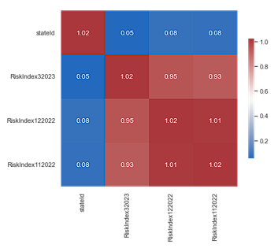
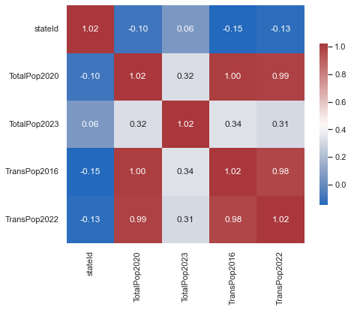
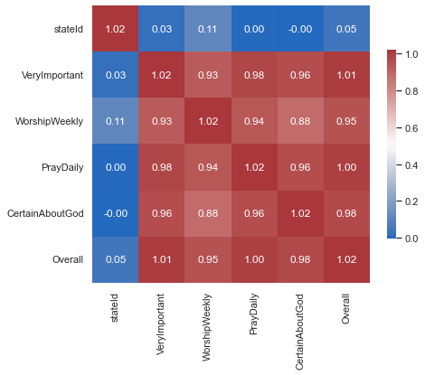
Data Analysis – Covariance Heatmapping
Notes:
In order to map specific data types, the sets of information were analyzed utilizing heatmapping to assess the covariance among the variables. Those with high positive or negative covariance may be dropped to facilitate efficient and cohesive data modeling.
This means data was limited to:
March 2023 for the Anti-trans Legislation Risk Index
Transgender population estimates were taken from 2022
Total population from 2020 and 2023
and only the overall score was used from the Pew 2014 survey on religiosity

Slide 12
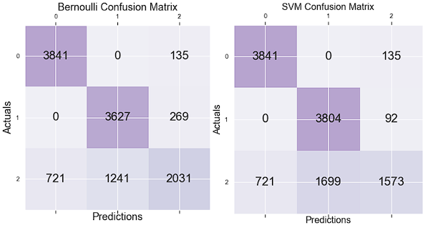
Modeling – Full Dataset
Notes:
Modeling was performed utilizing the Bernoulli Naïve Bayes classifier because it treats the variables as discrete values and predicts probability conditionally. Using this model for the sample set produced an overall accuracy of 81% which correctly predicts a person’s gender identity for 9,499 out of 11,865 test rows.
The second model chosen for testing was the Support Vector Machine (SVM) classifier. This model was selected for its ability to create hyperplanes between variable classified sets that maximize the margins to aid classification of data, while overlooking noise and outliers in the datasets.
The SVM classifier produced an overall accuracy of 80%, and correctly predicted a person’s gender identity for 9,218 out of 11,865 test rows

Slide 13
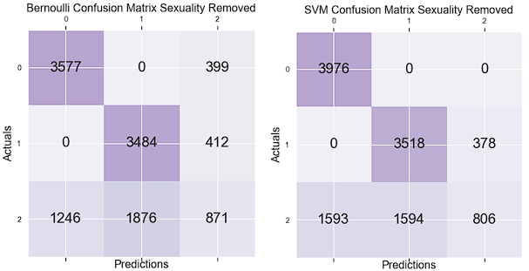
Modeling – Sexuality Removed
Notes:
A/B testing is generally used to optimize variable input usage in machine modeling. This project found that removing variables for education and income had no effect on either model. However, when sexuality was removed, both models' precision decreased by over 10%, primarily due to false positive cisgender men and women predicted to be transgender.

Slide 14
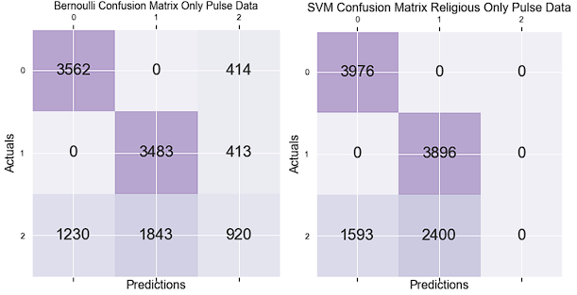
Modeling – Pulse Data Only
Notes:
Additional A/B testing showed removing all other state level variables had no significant impact on precision or accuracy of the models. However, reducing the dataset to just the Pulse Survey data with the sexuality column removed showed significant changes.
The Bernoulli Naïve Bayes classifier showed an overall accuracy of 64%, representing an overall drop of 16%, and a higher number of false positives than false negatives. However, the SVM classifier shows a significant drop in over 40% accuracy down to 44% overall and failing to guess any transgender people accurately.

Slide 15
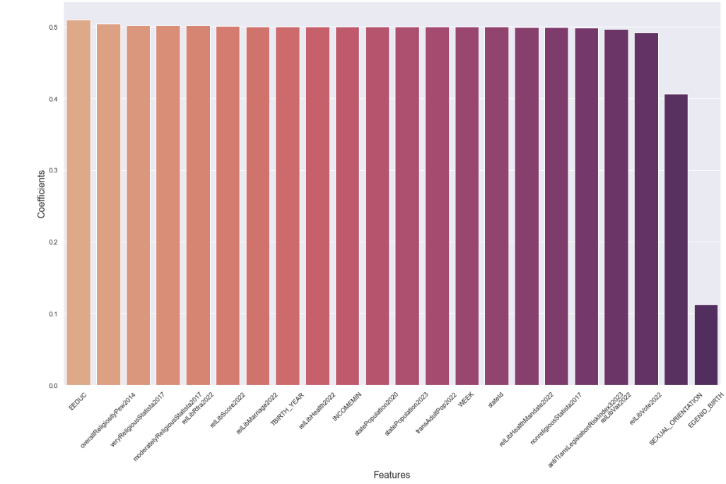
Modeling – LR Full Dataset
Notes:
Logistic Regression (LR) modeling was done for the same datasets to better understand the strength of the variables used in creating the predictions.
The LR had an overall accuracy of 79.1%. The coefficients are shown in the table for predicting those who identify as transgender. All variables used except for sexual orientation and sex assigned at birth are close to 0.5.
Therefore, for the entire dataset, sex assigned at birth has the most potent effect, with a coefficient of 0.113 for each gender prediction, and sexual orientation had a milder effect, with a coefficient of 0.406.

Slide 16
Modeling – LR Accuracy and Coefficient Valuations
Data Set Description | Accuracy | Sex Assigned at Birth Coefficient | Sexuality Coefficient
Only Sex Assigned at Birth Removed | 51.0% | -- | 0.402
Only Sexuality Column Removed | 70.9% | 0.112 | --
And Anti-Legislation Data Removed | 66.8% | 0.113 | 0.401
And Pew 2014 Data Removed | 66.9% | 0.112 | 0.403
And Statista 2017 Data Removed | 68.0% | 0.110 | 0.405
And Religious Liberty Data Removed | 71.0% | 0.112 | 0.403
Notes:
Following the same strategy employed previously, columns were removed individually from each model for the LR builds, and only removing the sex assigned at birth column dropped accuracy below 65%. For all the columns, the coefficient for sex assigned at birth and sexuality remain almost identical, and accuracy stays within 5% across the board.

Slide 17
Conclusion & Results
Results
Highly accurate models
A/B Testing show near identical correlation and predictability strength between:
Anti-trans legislation
State religiosity
Individual religious freedom
Highest indicator for prediction is Sexuality
Limitations
Can only predict the known transgender population
Lack of standards provides non-robust data sets
Conclusion
Legal and religious factors have a substantial effect on self-identification
Inability to quantify individual coefficients points to need for better data
Notes:
A high accuracy proves that the variables in use are adequate for building models that can predict if an individual will feel free enough in a social culture to come out as transgender if they were already going to come out as transgender. Using A/B testing, the data sets for anti-transgender legislation, religiosity by state, and religious freedom showed nearly identical correlations, while the variable for self-identified sexuality in the Pulse Surveys proved the strongest indicator for use in both models.
In the modeling process, lacking data on the transgender population also means that the model’s prediction can only point to the known transgender population. Since the actual population percentage of transgender people is unknown, the full demographic for the entire population is also unknown. Missing data means that the models built are necessarily biased to only select individuals with the freedom to self-identify.
This study has shown that legal and religious factors do have a substantial effect on an individual’s desire to self-identify, as shown by the drop in accuracy when variables related to each category is removed from the model, though the strength of correlation pertaining to each category could not be quantified. This inability to quantify the overall influence of coefficients is likely due to individual data from survey participants regarding these categories, including an individual’s self-reported sex, gender, and sexuality information.

Slide 18

References
Erni, J. (2013). Legitimating Transphobia. Cultural Studies, 27(1), 136–159. Retrieved from https://doi-org.ezproxy.utica.edu/10.1080/09502386.2012.722305
Estelle, S. M. (2022). Religious Liberty in the States 2022. First Liberty Initiative Center for Religion, Culture, and Democracy. Retrieved from https://religiouslibertyinthestates.s3.us-east-2.amazonaws.com/Religious_Liberty_in_the_States_Report-2022.pdf
Flynn, T. (2001). “Transforming” the Debate: Why We Need to Include Transgender Rights in the Struggles for Sex and Sexual Orientation Equality. Columbia Law Review, 101(2), 392–420. Retrieved from https://doi.org/10.2307/1123803
Lipka, M., Wormald, B. (2016, February 29). How religious is your state? Pew Research Center. Retrieved from https://www.pewresearch.org/fact-tank/2016/02/29/how-religious-is-your-state/?state=alabama
Loh, J. U. (2018). transgender identity, sexual versus gender ‘rights’ and the tools of the Indian state. Feminist Review, 119, 39–55. https://www.jstor.org/stable/26776500
Meerwijk, E. L., & Sevelius, J. M. (2017). Transgender Population Size in the United States: a Meta-Regression of Population-Based Probability Samples. American Journal of Public Health, 107(2), e1–e8. Retrieved from https://doi-org.ezproxy.utica.edu/10.2105/AJPH.2016.303578

Slide 19

References - Datasets
Estelle, S. M. (2022). Religious Liberty in the States 2022. First Liberty Initiative Center for Religion, Culture, and Democracy. Retrieved from https://religiouslibertyinthestates.s3.us-east-2.amazonaws.com/Religious_Liberty_in_the_States_Report-2022.pdf
Duffin, E. (2022, September 30). Religiosity in the United States in 2017, by state. Statista. Retrieved from https://www.statista.com/statistics/221454/share-of-religious-americans-by-state/
Flores, A. R., Herman, J. L., Gates, G. J., Brown, T. N. T. (2016 June). How Many Adults Identify as Transgender in the United States? UCLA School of Law, Williams Institute. Retrieved from https://williamsinstitute.law.ucla.edu/wp-content/uploads/Trans-Adults-US-Aug-2016.pdf
Herman, J. L., Flores, A. R., O’Neill, K. K. (2022, June). How Many Adults and Youth Identify as Transgender in the United States? UCLA School of Law, Williams Institute. Retrieved from https://williamsinstitute.law.ucla.edu/wp-content/uploads/Trans-Pop-Update-Jun-2022.pdf
Reed, E. (2022, November 15). The Post-Election Anti-Trans Legislative Landscape. Erin In The Morning. Retrieved from https://erininthemorn.substack.com/p/the-post-election-anti-trans-legislative?utm_source=profile&utm_medium=reader2
Reed, E. (2022, December 30). The Final Anti-Trans Legislative Risk Map Of 2022. Erin In The Morning. Retrieved from https://erininthemorn.substack.com/p/the-final-anti-trans-legislative
Reed, E. (2023, March 18). March Anti-Trans Legislative Risk Map. Erin In The Morning. Retrieved from https://erininthemorn.substack.com/p/march-anti-trans-legislative-risk
United States Census Bureau. (2023, March 20). Household Pulse Survey Public Use File (PUF). Retrieved from https://www.census.gov/programs-surveys/household-pulse-survey/datasets.html
World Population Review (2023). US States – Ranked by Population 2023. Retrieved from https://worldpopulationreview.com/states

