Slide 1

Multivariate Analysis of Salaries in Tech Over Time

Slide 2
Introduction
Major effects of salary over time
Role of gender in salary determination
Company loyalty vs. job-hopping
Notes:
For years, business have frowned upon employees discussing salaries, even though doing so is not illegal. Transparency in the industry is important to ensure that you are not only making enough money to thrive in the area you live, but to also ensure that employees are compensated fairly for like work.
What are the major effects of salary over time?
Is gender still a major role in salary determination in technology fields?
Is it better to stay with a company over a longer period, or find a job with a new company to ensure a raise commensurate with skill level?

Slide 3
Reasoning
Jack Kelly of Forbes reports (2019):
a 5-10% wage increase upon switching jobs
loyalty nets 2-4% raise yearly
companies fail to incentivize employee loyalty
US government predicts a shortage of at least 1 million STEM-based jobs over a 10-year period from 2016 to 2026 (Iammartino, et. al. 2016).
Women and minority genders in STEM fields are under-represented due to
persistent stereotyping, culture, competition, risk aversion, and other factors
(Kahn & Ginther, 2017).
Notes:
Jack Kelly of Forbes reports that new studies show that the average worker can expect a 5-10% wage increase upon switching jobs, where staying at a present job, while keeping job security, will only net an average 2-4% raise year over year (2019). Most companies don’t make initiatives to incentivize employees to stay, and so many feel the urge to job hop every few years in the current market.
Along with that, the US government predicted that there would be a shortage of at least 1 million STEM based jobs over a 10-year period from 2016 to 2026. This predicted shortage has led to a market in which employers must attract new employees with better and more diverse forms of benefits packages, along with new methods to generate more workers within these industries (Iammartino, R. et. al. 2016).
Finally, generating a larger workforce is more difficult due to under-representation of women and minority genders in STEM fields. According to Kahn and Ginther, persistent stereotyping, culture, competition, risk aversion, and other factors continue to contribute to the large gap in gender representation in STEM education, which leads to a continuing gap in diversity of representation in STEM fields (2017).

Slide 4

Hypothesis
Null Hypothesis (H0): Increases in salary over time in technology fields cannot be determined or attributed to any specific independent variables.
Given H0, none of the independent variables can be shown to covary with the dependent variable (total yearly compensation), can be rejected if:
One or more independent variables will show covariance with total yearly compensation and be statistically significant.
One or more independent variables may not show covariance or not be statistically significant when combined with other independent variables.
This outcome will show which independent variables can be shown to have a covariance with total yearly compensation, as well as which ones have the strongest covariance with it, thus helping to show what factors have the greatest impact, when trying to get the highest salary possible.
Notes:
Null Hypothesis (H0): Increases in salary over time in technology fields cannot be determined or attributed to any specific independent variables.
Given H0, none of the independent variables can be shown to covary with the dependent variable (total yearly compensation), can be rejected if:
One or more independent variables will show covariance with total yearly compensation and be statistically significant.
One or more independent variables may not show covariance or not be statistically significant when combined with other independent variables.
This outcome will show which independent variables can be shown to have a covariance with total yearly compensation, as well as which ones have the strongest covariance with it, thus helping to show what factors have the greatest impact when trying to get the highest salary possible.

Slide 5
Data Used
Data Source:
Anonymous Sample Set of Employee Salaries compiled from 2019 to 2021
Independent Variables:
company
title
gender
location
cityid
yearsofexperience
yearsatcompany
Dependent Variable:
totalyearlycompensation
Notes:
Data Source: Anonymous Sample Set of Employee Salaries compiled from 2019 to 2021
Independent Variables:
company – Nominal Discrete String
title - Nominal Discrete String
gender - Nominal Discrete String
location - Nominal Discrete String
cityid – Discrete Integer
yearsofexperience – Float (Decimal)
yearsatcompany – Float (Decimal)
Dependent Variable:
totalyearlycompensation – Discrete Integer, rounded down

Slide 6

Methodology
Multiple Linear Regression
independent variables have differing impacts
determination using significance value p <= 0.05
regression provides independent variable evaluation
Notes:
Build Multiple Linear Regression to understand the impact of company, title, gender, location, cityid, yearsofexperience, and yearsatcompany have on totalyearlycompensation.
Some of the independent variables may have more impact than others, and only those variables which are shown to be statistically significant will be kept, using a significance value p = 0.05.
Building this regression will show that salary is correlated with one of more of the independent variables and may show that there are much stronger correlations to some than others.

Slide 7
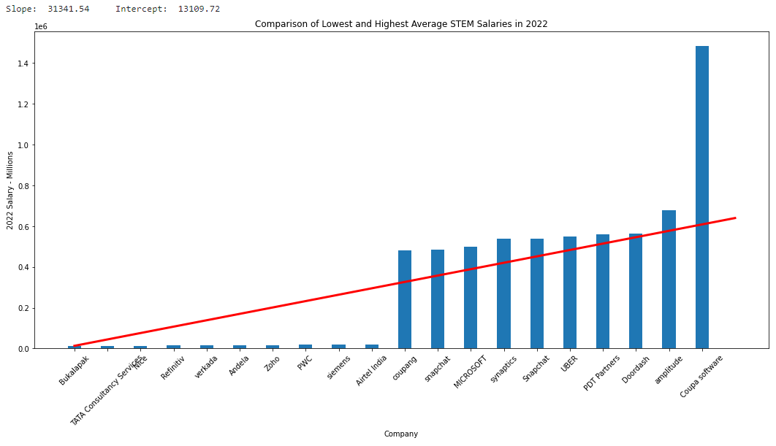
Simple Linear Regressions

Slide 8
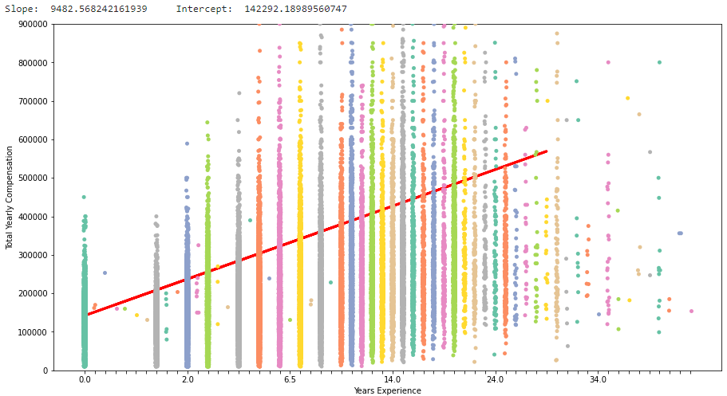
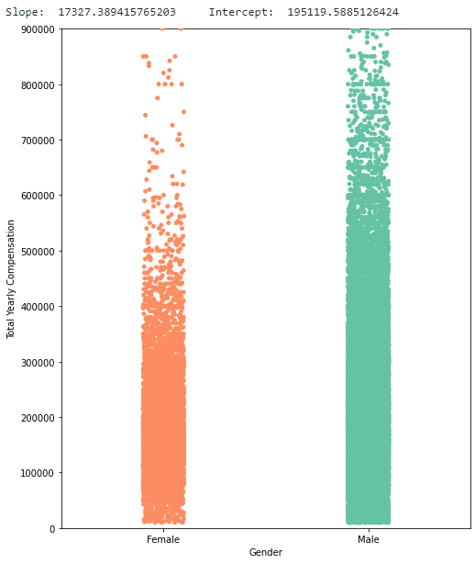
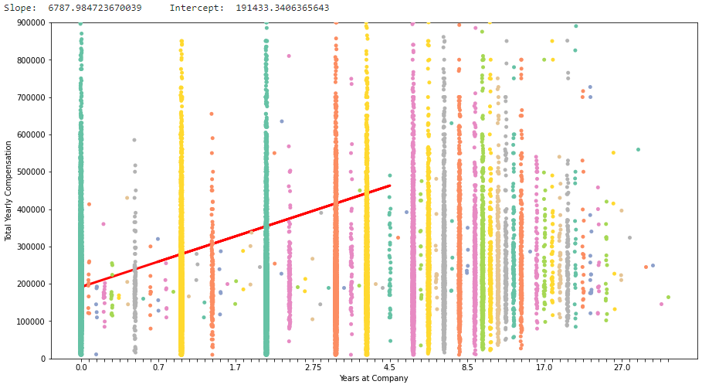
Simple Linear Regressions (CONTINUED)

Slide 9
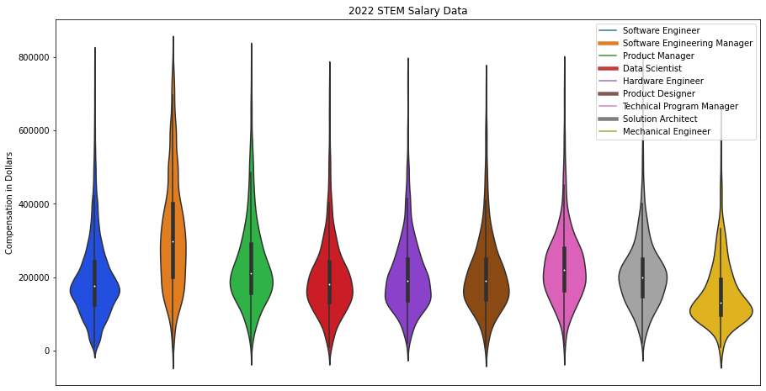
Violin Plot of Salary Data by Position

Slide 10
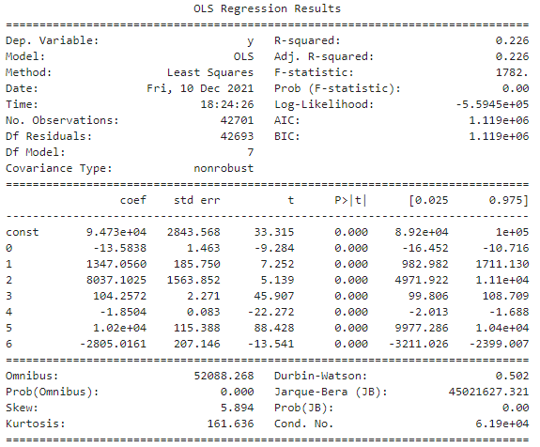
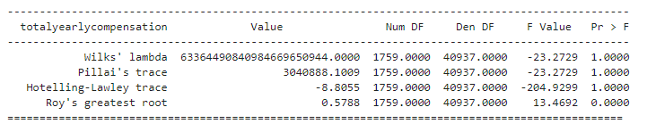
Multiple Linear Regression
Coefficient Equation:
totalyearlycompensation = $94,735 - $14*company + $1,347*title + $8,037*gender + $104*location
- $2*cityid + $10,203*yearsofexperience
- $2,805*yearsatcompany
Variable | Variable Inflation Factor
company | 1.001698
title | 1.018020
gender | 1.018877
location | 1.005509
cityid | 1.003424
yearsofexperience | 1.386071
yearsatcompany | 1.378561

Slide 11
Limitations
Not long term or longitudinal
Data scraped from one site
Small sample set (approx. 45,000 samples)
Potential geographic skew
Data cannot be verified
Population set skewed toward males

Slide 12
Next Steps
Future analysis benefited by:
determination of Covid and remote work impacts
gender populations effects in STEM fields on salary
impacts of diversity on “equal pay for equal work”

Slide 13
Conclusion
Independent Variables with Greatest Impact: gender, years of experience, and years at company
Independent Variables with Least Impact: location and cityid
Every independent variable is statistically significant (p<0.05).
ANOVA model showed a strong chance for collinearity
Variance inflation factor (VIF) test showed that all independent variables had a VIF near 1, almost no correlation
Expected slope in all situations != 0
The null hypothesis should be rejected. Increases in salary over time in technology fields can be determined or attributed to specific independent variables.

Slide 14
References
Iammartino, R., Bischoff, J., Willy, C., & Shapiro, P. (2016, April 19). Emergence in the U.S. science, Technology, engineering, and Mathematics (STEM) workforce: An agent-based model of worker attrition and group size in high-density stem organizations - complex & intelligent systems. SpringerLink. Retrieved December 11, 2021, from https://link.springer.com/article/10.1007/s40747-016-0015-7.
Kahn, S. & Ginther, D. (2017, June). WOMEN AND STEM. NBERG Working Paper Series. National Bureau of Economic Research. Retrieved December 10, 2021, from https://www.nber.org/system/files/working_papers/w23525/w23525.pdf.
Kelly, J. (2019, July 26). A New Study Concludes That It Literally Pays To Switch Jobs Right Now. Forbes. Retrieved December 10, 2021, from https://www.forbes.com/sites/jackkelly/2019/07/26/a-new-study-concludes-that-it-literally-pays-to-switch-jobs-right-now/?sh=7ecbbcd05959.
Ogozaly, J. (2021, October). Data Science and STEM Salaries. kaggle. Retrieved December 1, 2021, from https://www.kaggle.com/jackogozaly/data-science-and-stem-salaries.

