Slide 1

WHEN REVIEW STARS ALIGN AND PREVENTING MISALIGNMENTS
Sentiment and fraud analysis based on user reviews
Jade Selke

Slide 2
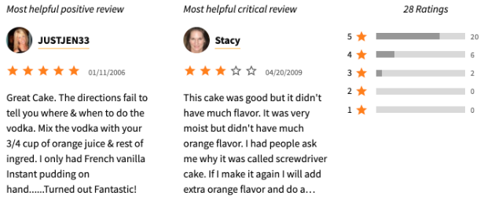
IMPORT
Reviews are difficult to process
Reviews have useful information
How to harness the information?
How to weed out bad information?
How to more forward with new tools?
(“Ratings and Review Guidelines,” 2020)
Notes:
Our databases are filled with data, some of it easy to maintain, clean and use, and some of it just the opposite. Specifically, our customer’s product reviews are hard to sift through. Sure, we have a star rating, but can we do more with that information? Can we turn our reviews into something useful, to earn more customer loyalty?
Beyond that, who is making the reviews, do we know if they are even real customers and if their purchases are legitimate? I spoke with the CDO, and we went through a little of our data, and it’s not easy to tell at all. Given that, I created a quick demo today to show what has been found so far, and where we can go from here. (Our data here is the YelpZip data set, Rayana, 2016).

Slide 3
ELSEWHERE
Amazon and eBay brushing scams generate real packing slips on fake sales across the world
This verified purchase becomes a fraudulent review to bolster a business
Identified with sentiment analysis and proximity markers
Goal is to employ these tactics here with an automated process
Dependent Variables: Customer ratings and reviews, flags for fake reviews, tokenized lemma
Independent Variables: Sentiment and Fraud predictions
Notes:
If you recall, right at the start of Covid, there were new agencies reporting seed packets arriving at people’s doorsteps. Tyko (2020) of USA Today announced this as a new scam called brushing, used to generate real packing slips on fake sales. These generated a verified purchase which could then be used to bolster specific sellers with a fraudulent review in order to increase their ratings, according to Rafter (2020).
Other researchers, such as Gloutnikov (2018) and Luca and Zervas (2016) have discussed the motivations behind fraudulent reviews and the use of markers to identify proximity of good and buyers versus similarity of goods. Given that, how can we use markers like these to build models and find this information for us based solely on the review of our customers?
We can use data we have on hand for this tasking, specifically utilizing our customers ratings, reviews, knowledge of those reviews that are already deemed fraudulent, and generated tokenized lemma from reviews as independent variables and generating sentiment and fraud predictions as dependent variables

Slide 4
BIG QUESTIONS
Logistic Regression of Reviews for Sentiment
Null Hypothesis: Sentiment of a review cannot be determined from sentiment analysis, natural language processing, and n-gram processing of the reviews using logistic regression.
Alternative Hypothesis: Sentiment of a review can be determined from sentiment analysis, natural language processing, and n-gram processing of the reviews using logistic regression.
Logistic Regression and K-Nearest Neighbors of Reviews for Fraud
Null Hypothesis: Fraudulent reviews and reviewers cannot be identified from sentiment analysis, natural language processing, and n-gram processing of the reviews using logistic regression or k-nearest neighbors algorithms.
Alternative Hypothesis: Fraudulent reviews and reviewers can be identified from sentiment analysis, natural language processing, and n-gram processing of the reviews using logistic regression or k-nearest neighbors algorithms.
Test the following:

Slide 5
EXPLORATORY DATA ANALYSIS
Concentrated on New York City customer restaurant reviews 2004-2015 (Rayana, 2015)
Analysis of MetaData
UserID
ProductID
StarRating
Date
FakeReview
Analysis of Reviews via Natural Language Processing
UserID
ProductID
Review
Notes:
This data was originally collected and released by Yelp, and cleaned and processed by Rayana (2015).

Slide 6
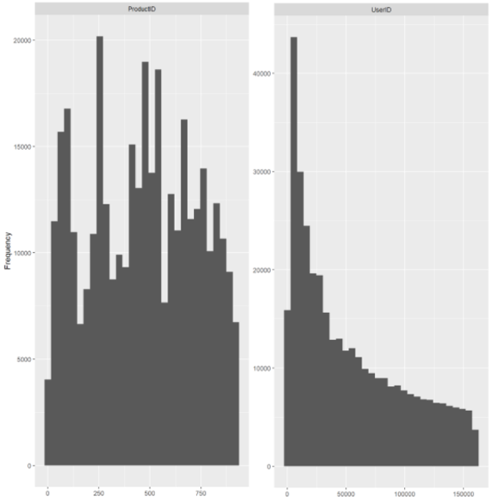
METADATA ANALYSIS
359,052 Total Reviews
ProductID
Nominal from 0 to 922
Generally, evenly distributed across restaurants
UserID
Nominal from 932 to 161,147
Early adopters have more reviews
Notes:
The metadata holds the reference information on each review, encompassing a total of 359,052 reviews in scope. It indicates which restaurant the customer visited, labeled as ProductID. The customer is labeled as CustomerID. Both values are nominal, and no values are missing.
The ProductIDs are generally evenly distributed across the reviews, and the UserIDs are more focused toward the lower end, as the longer a customer has been with us, the more reviews they have made.

Slide 7
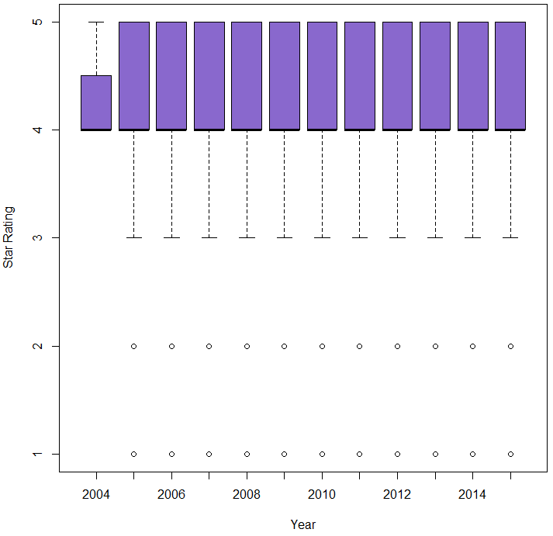
METADATA ANALYSIS (cntd)
Year | Number of Observations
2004 | 4
2005 | 301
2006 | 1,694
2007 | 5,068
2008 | 10,738
2009 | 20,175
2010 | 33,488
2011 | 47,934
2012 | 55,784
2013 | 75,845
2014 | 105,478
2015 | 2,543
StarRating
Integer representing interval data from 1-5
Heavily distributed from 4 to 5
Customers rate 4 or higher 75% of the time or the data set is heavily biased for positive reviews
Notes:
Turning toward the ratings themselves, the StarRating variable is an integer set on interval from 1 to 5, and is heavily distributed from 4 to 5 across the entire 10-year span, as see in the box and whisker plot on the left. In all cases, ratings of 1 or 2 are considered outliers.
The table on the right shows the number of reviews submitted over time and helps show our growth in trust with customers over time, as we get more reviews year over year. It should be noted in this dataset that customers rate restaurants a 4 or higher over 75% of the time, which may mean the dataset is biased for positive reviews.

Slide 8
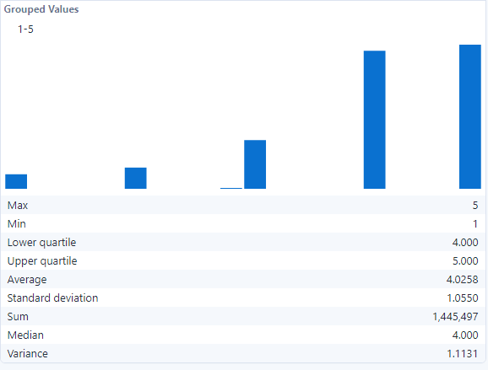
METADATA ANALYSIS (cntd)
Notes:
Diving just a bit further into StarRating data, using Alteryx to get a summary, we can see the tendency of users to rate a 4 or 5, with the Lower quartile, Average, and Median all pointing to 4. The standard deviation and variance are both about 1, but only because the total number of 5 reviews and 4 reviews are near equal in count.

Slide 9
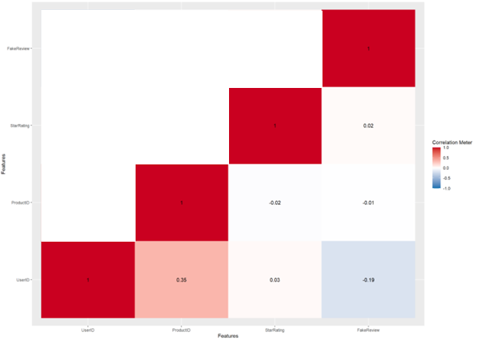
METADATA ANALYSIS (cntd)
 | Mean | Median | Mode | Standard Deviation | P0 | P25 | P50 | P75 | P100
FakeReview | 0.80 | 1 | 1 | 0.61 | -1 | 1 | 1 | 1 | 1
FakeReview
Integer to flag known fraudulent reviews
Binary as -1 and 1 in our system
Only 20% of Reviews know fraudulent
Correlation Analysis
Positive correlation b/w ProductID and UserID
Slight Inverse Correlation b/w UserID and FakeReview
Notes:
FakeReview is the last of MetaData to cover before looking at the Reviews themselves. The FakeReview variable is an integer, treated as binary but labeled as either -1 or 1, and no values are missing. As shown in the table above, 80% of our reviews are marked as real currently, and this reflects in the median and mode set at 1 as well in the quartile data on the righthand side of the table.
Looking to correlations between this data, you can see a heatmap of correlation analysis on the right. The pink square along the bottom shows a positive correlation between ProductID and UserID. This may suggest that reviewers that give very high reviews on a single restaurant tend to give good reviews to all restaurants. Alternately, it may suggest that restaurants that are particularly favorable receive reviews from customers that reflect their value.
The bottom left square tinted blue shows a slight inverse correlation between UserID and FakeReview. This suggests that if a user gives a fake review to one restaurant, they tend to give fake reviews to multiple restaurants, based on FakeReview reporting a negative value for a fake review.
This would be expected, as a user that gives a fake review would likely do so with specific intent: either to fraudulently improve, or to damage, the reputation of a restaurant. Also discussed in the Brushing report by Rafter (2020).

Slide 10
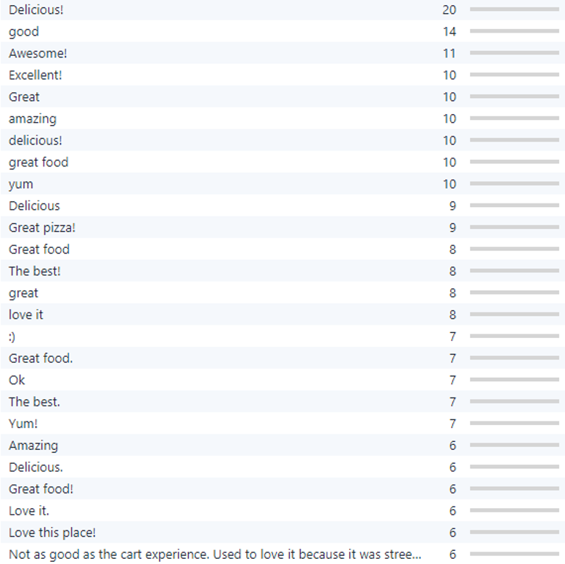
REVIEW AND NATURAL LANGUAGE PROCESSING ANALYSIS
Alteryx and RStudio used for analysis
Review is a string of customer review of restaurant
Freeform and qualitative
Mapped to other variables, UserID and ProductID
358,156 unique out of 359,052 reviews
Repeats are not statistically significant
Notes:
Alteryx and RStudio were first used to analyse the reviews before applying Natural Language Processing. The reviews are freeform string data, sometimes called slab data, and qualitative in nature. Reviews are mapped to UserID and ProductID and can be flattened for further analysis later.
896 reviews were found to be repeats, and the most common repeats are shown on the right with their counts, though the repeats themselves are not statistically significant, and not necessarily tied to specific customers.
Of note, if casing and punctuation were ignored, “delicious” would have 36 repeats. “Great food” and a few other values would also be quite high. Also, the last string here is interesting. To have such a long string for a review be repeated is something that should be analyzed further.

Slide 11
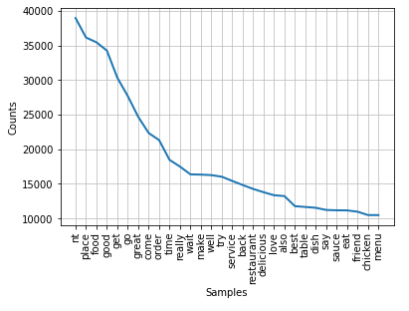
REVIEW AND NATURAL LANGUAGE PROCESSING ANALYSIS
Order | Word | Token | Stem | Part of Speech | Counts
1 | not | not | not | noun | 54697
2 | place | place | place | noun | 50843
3 | food | food | food | noun | 49892
4 | good | good | good | adjective | 48059
5 | get | get | get | verb | 42860
6 | go | going | go | verb | 39381
7 | great | great | great | adjective | 34853
8 | come | come | come | verb | 31299
9 | order | order | order | noun | 30485
10 | time | time | time | noun | 25805
Notes:
Using Natural Language Analysis, and breaking the reviews down word by word, we can look at the counts of individual words by their stems. Here stop words are removed. Stop words are the most common English words, and don’t impart any information by themselves. They include: I, an, the, and, to, and similar words. After that, we can see clearly that negation is the most used word, followed by place and food.
The counts of words drop drastically from there and level off. The top 10 are shown in the table on the right, and this shows how stems can be used as well, so the word go is counted as a repeat for “go,” “going,” “goes,” etc. Given that most of the reviews are positive, we should expect to see negation used in a positive sense as well, such as “not bad”, or to put a spin on negatives to say “not good” instead of “bad.”

Slide 12
MODEL BUILDING AND METHODOLOGY
Create a model set with equal numbers of Real Positive, Real Negative, Fake Positive, and Fake Negative Reviews
Smallest set is Fake Negative: 3,598
Total combined: 23,832
Divide into data frames to build LemmaSummaries and separate Sentiment and FakeReview flags as Independent Variables
N-gram of size 1-4
10,241 vectors generated
Logistic Regression and trained KNN modelling employed
Notes:
In order to create a balanced modelling set, equal numbers of the types of reviews are needed. Since the smallest set is Fake Negative reviews, with a total of 3,598 in the set, 3,598 of the other types were chosen at random to build a set of 23,832 total reviews.
This modelling set is later divided randomly into a Training set and a Test set at about an 80/20 ratio. Data frames are built in Python version 3 (Python Software Foundation, https://www.python.org/) using the pandas library version 1.3.3 (McKinney, 2010), and numpy library version 1.21.2 is used for division and training (Harris, et al., 2020).
Lemma Summaries are created using the stop words, punctuation, and casing all word stems. Then each string is parsed through a vectorizer to build a library of n-grams up to four in length, creating a total of 10,739 vectors to build regressions from.
The models themselves are built using logistic regression for the sentiment predictor, and logistic regression and k-nearest neighbors (KNN) for the fake review predictor. These models use the scikit modelling library version 0.23 and are pre-optimized for speed (Pedragosa et al., 2011).

Slide 13
LOGISTIC REGRESSION FOR SENTIMENT PREDICTOR
 | Precision | Recall | F1-Score | Support
Negative Sentiment | 0.91 | 0.94 | 0.92 | 2,533
Positive Sentiment | 0.94 | 0.91 | 0.93 | 2,662
Accuracy |  |  | 0.92 | 5,195
Macro Average | 0.92 | 0.93 | 0.92 | 5,195
Weighted Average | 0.93 | 0.91 | 0.91 | 5,195
Positive N-gram | Positive Coefficient | Negative N-gram | Negative Coefficient
delicious | 1.527 | overcook | -1.866
incredible | 1.529 | disappointment | -1.876
amaze | 1.556 | horrible | -2.029
fantastic | 1.603 | overprice | -2.092
excellent | 1.677 | meh | -2.095
perfect | 1.693 | terrible | -2.320
awesome | 1.693 | bland | -2.375
favorite | 1.740 | mediocre | -2.795
heaven | 1.849 | tasteless | -2.846
well worth | 1.934 | overrate | -2.850
Accuracy: 92.5% ± 1%
p-value: 0.0425
Intercept: 0.4225
Notes:
After building the logistic regression with the training set, we can see the results of the model predicting against the test set. Its overall accuracy was calculated at 92.5% plus or minus 1% with a p-value of roughly 0.0425, as shown in the table on the left.
An equation can’t really be shown for the 10,739 coefficients of the vectorized lemma summary for this set, but the intercept for this set is 0.4225 and the highest ten and lowest ten can be seen on the table on the right.
It is worth noting that no trigrams or tetragrams appear in the highest and lowest coefficients, and that the negative coefficients have a 68% higher magnitude than the strongest positive coefficients.

Slide 14
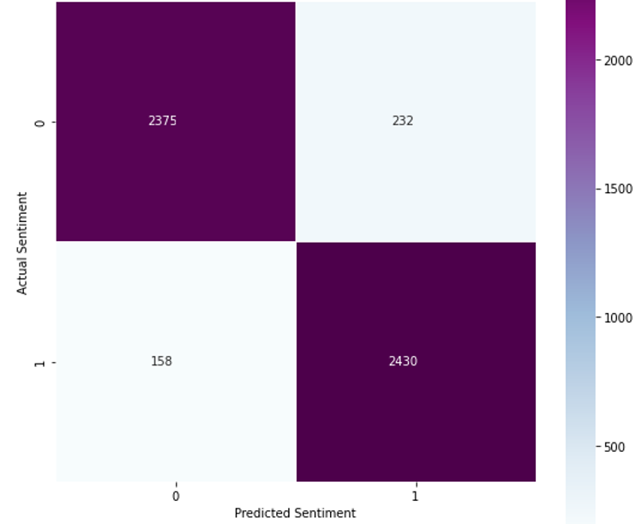
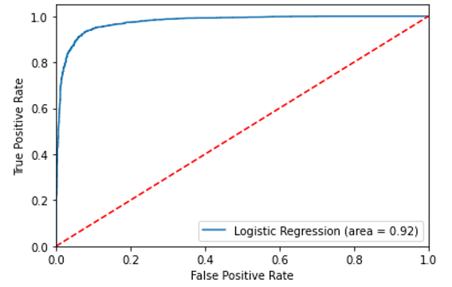
LOGISTIC REGRESSION FOR SENTIMENT PREDICTOR (cntd)
Notes:
A confusion matrix was also generated based on test results, shown on the left. This shows that logistic regression can accurately predict the sentiment of a review as negative when the review is negative 2,375 times out of 2,607 cases; and predict a positive sentiment when a review is positive 2,430 times out of 2,588 events.
In the case of a Type I error, in which a review is predicted to have positive sentiment when it has a negative sentiment instead of being predicted correctly, happens 232 out of 4,963 events in the test set, or 4.67% of the time. A Type II error, in which a negative sentiment is predicted when a review is positive instead of being correctly predicted happens 158 out of 4,963 events in the test set, or 3.18% of the time.
On the right, a precision-recall curve for the test set is shown. This displays the tradeoff between true positive rates and false positive rates for the sentiment predictor (Brownlee, 2021). The further the model bows away from the diagonal dotted line, the more accurate or precise the model. Therefore, this model has a high degree of accuracy in predicting true false positive or predicting a sentiment is positive.

Slide 15
LOGISTIC REGRESSION FOR FRAUD REVIEW PREDICTOR
 | Precision | Recall | F1-Score | Support
Fraudulent Review | 0.63 | 0.58 | 0.60 | 2,783
Real Review | 0.57 | 0.59 | 0.58 | 2,412
Accuracy |  |  | 0.59 | 5,195
Macro Average | 0.59 | 0.60 | 0.59 | 5,195
Weighted Average | 0.60 | 0.59 | 0.59 | 5,195
Real Review N-gram | Real Review Coefficient | Fraud Review N-gram | Fraud Review Coefficient
restaurant time | 1.536 | amateur | -1.524
friend place | 1.542 | kind service | -1.536
ready wait | 1.543 | anything not | -1.538
cheat | 1.565 | 3rd time | -1.545
thicker | 1.580 | minute make | -1.577
always delicious | 1.593 | exquisite | -1.628
last visit | 1.594 | route | -1.633
bread really | 1.713 | price service | -1.655
find good | 1.759 | really sweet | -1.746
aunt | 1.764 | fold | -1.918
Accuracy: 59%
p-value: 0.59
Intercept: -0.648
Notes:
For the logistic regression model built for predicting fraudulent reviews, testing it against the test set yielded an accuracy of only 59%, and a p-value of about 0.59, as seen in the table on the left. The table on the right shows the highest and lowest n-gram coefficients, as before.
Notably, these use more references to food than previously seen, such as really sweet and thicker. The scale of coefficients are also much closer to each other than seen in the sentiment predictor.

Slide 16
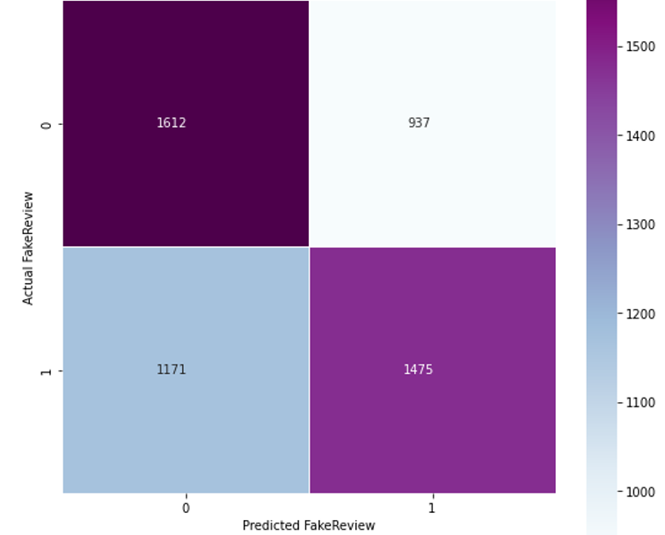
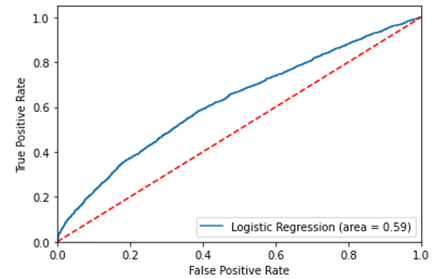
LOGISTIC REGRESSION FOR FRAUD REVIEW PREDICTOR (cntd)
Notes:
For the confusion matrix, shown on the left, we can see the logistic regression predictor predicts a review as fraudulent when the review is fraudulent at 1,612 times out of 2,549 cases and predicts a real review when a review is real 1,475 times out of 2,646 events.
Type I errors occurred 937 out of 3,087 events in the test set, or 30.4% of the time. A Type II error happened 1171 out of 3,087 events in the test set, or 37.9% of the time. This shows that the predictor is better than a coin flip, but not by much.
The precision recall curve on the right shows much the same, with a bowing towards true positives, implying that the predictor is better that a no-skill predictor, such as a coin flip.

Slide 17
K-NEAREST NEIGHBORS FRAUD REVIEW PREDICTOR
K must be selected for
Evaluation using accuracy and receiver operating characteristic
Range of 2 to 2,500 attempted
Best values: 7 and 2003
scikit provides a supervised model
No equation or coefficients
Notes:
In order to build the KNN model, the number of neighbors, or k, must be selected. This model was run for all possible values of k from 2 to 2,500 to isolate the best value. After a 3 hour run, the best values of 7 and 2,003 were isolated, and 7 was chosen for this model.
The scikit package offers a supervised variant of the model, and it was also utilized in building the predictor. Since this does not build an equation, there are no coefficients to analyze. Each input must be analyzed individually against the neighbors selected.

Slide 18
K-NEAREST NEIGHBORS FRAUD REVIEW PREDICTOR (cntd)
 | Precision | Recall | F1-Score | Support
Fraudulent Review | 0.70 | 0.51 | 0.59 | 3,488
Real Review | 0.36 | 0.56 | 0.44 | 1,707
Accuracy |  |  | 0.53 | 5,195
Macro Average | 0.53 | 0.54 | 0.52 | 5,195
Weighted Average | 0.59 | 0.53 | 0.54 | 5,195
Accuracy: 53%
Mean: -0.427
Standard Deviation: 0.388
Mean Squared Error: 1.68
P-value: 1
Notes:
The accuracy for the KNN model was found to be only about 53%, as seen in the table on the left. The mean found was -0.427, and std dev of 0.388. The p-value was calculated to be roughly 1, and so not statistically significant, and the mean squared error was calculated at 1.68. While these results look worse than the logistic regression, the confusion matrix tells a different story.

Slide 19
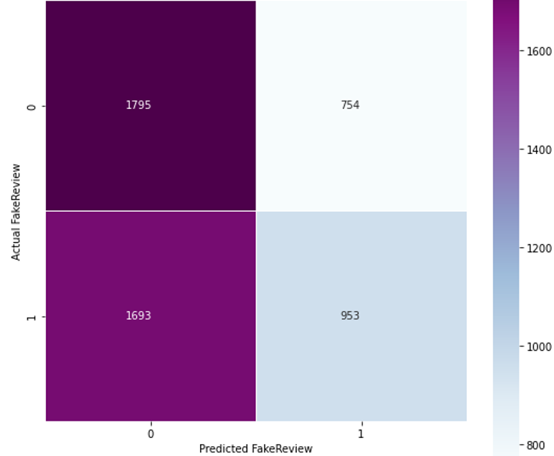
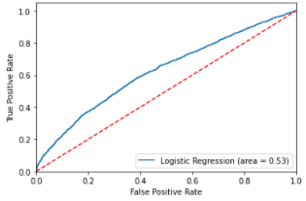
K-NEAREST NEIGHBORS FRAUD REVIEW PREDICTOR (cntd)
Notes:
From the confusion matrix shown on the left, we can see that the knn model is actually much more accurate than a coin flip – if it is used to predict that a review is fraudulent when it is actually fraudulent, but it also gives a high percentage of false negatives.
So, in the case of a Type I error, it predicted incorrectly 1,693 out of 2,748 events in the test set, or 61.6% of the time. However, a Type II error, in which a fraudulent review is predicted to be real instead of being correctly predicted happens 754 out of 2,748 events in the test set, or 27.4% of the time.
As before, the precision recall curve is shown on the right, and helps to show that this model used against the full set is not much better than a no-skill predictor, with a slight bow towards the true positive side.

Slide 20
MOVING FORWARD
Reject the null hypothesis in both cases!
Sentiment Analysis is solid as is
KNN would make more sense to isolate
Build models which are accurate first
Iterate multiple times after accuracy is met
Notes:
Based on the analysis of the results, it is safe to reject the first null hypothesis. It is possible to use sentiment analysis, natural language processing, and n-gram processing to build a logistic regression to accurately predict the sentiment of a user to a particular restaurant in New York City based on the review that they provide of the restaurant.
The use of two different models for the second hypothesis shows that rejecting the second null hypothesis is a safe conclusion as well. Though neither was especially accurate, the logistic regression fraud detector was more accurate than a no-skill predictor, such as a coin flip.
Given that the number of negative reviews that are fraudulent are such a small sample in the entire population, it may be worth building a new model that first separates reviews into positive and negative, and then builds out separate models for fraud on each of those new data sets.
This may provide better predictions and new methodologies moving forward. This also builds on the idea of the central limit theorem, in that when an event is predicted that has an outcome that is far less likely to be observed by chance, there should be more confidence that other factors are at play (Wheelan, 2014).
To get the highest degree of accuracy and precision in fraud detection, it would be important to build models which are first accurate, and then test them against samples that more closely resemble the population to ensure that they maintain the same level of precision and accuracy moving forward.

Slide 21
References
Brownlee, J. (2021, Jan 13). How to Use ROC Curves and Precision-Recall Curves for Classification in Python. Machine Learning Mastery. https://machinelearningmastery.com/roc-curves-and-precision-recall-curves-for-classification-in-python/
Gloutnikov, S.S. (2018). Using Sentiment Analysis and Pattern Matching to Signal User Review Abnormalities. Master's Projects (629), https://doi.org/10.31979/etd.8hau-p2f5, https://scholarworks.sjsu.edu/etd_projects/629
Harris, C.R. et al. (2020). Array programming with NumPy. Nature 585, 357–362. https://doi.org/10.1038/s41586-020-2649-2
Luca, M., Zervas, M. (2016). Fake It Till You Make It: Reputation, Competition, and Yelp Review Fraud. Management Science (62), 3412-3427. https://doi.org/10.1287/mnsc.2015.2304
McKinney, W. (2010) Data structures for statistical computing in python. Proceedings of the 9th Python in Science Conference, 445. https://conference.scipy.org/proceedings/scipy2010/pdfs/mckinney.pdf
Pedregosa et al. (2011). Scikit-learn: Machine Learning in Python. JMLR 12, pp. 2825-2830. http://jmlr.csail.mit.edu/papers/v12/pedregosa11a.html
Rafter, D. (2020). Brushing Scams: What Are Those Mysterious Amazon Packages at Your Door? Internet Security. LifeLock by Norton. https://www.lifelock.com/learn-internet-security-scams-brushing-scams.html
Ratings and Review Guidelines. (2020). Meredith Help Center. Retrieved from https://websupport.meredith.com/hc/en-us/articles/360046384174-Ratings-and-Reviews
Rayana, S. (2016). YelpZip dataset. Outlier Detection Sets. Stony Brook University. http://odds.cs.stonybrook.edu/yelpzip-dataset/
Tyko, K. (2020, Aug 4). Amazon Packages. What you need to know about ‘brushing’ scams. USA Today. https://www.usatoday.com/story/money/2020/08/04/free-amazon-orders-scam-mysterious-seeds-packages-brushing/5580858002/
Waskom, M. (2021). seaborn: statistical data visualization. Journal of Open Source Software, 6 (60), 3021. https://doi.org/10.21105/joss.03021
Wheelan, C. J. (2014). In Naked Statistics: Stripping the Dread from the Data (pp. 145-148). W.W. Norton & Company.

