Slide 1
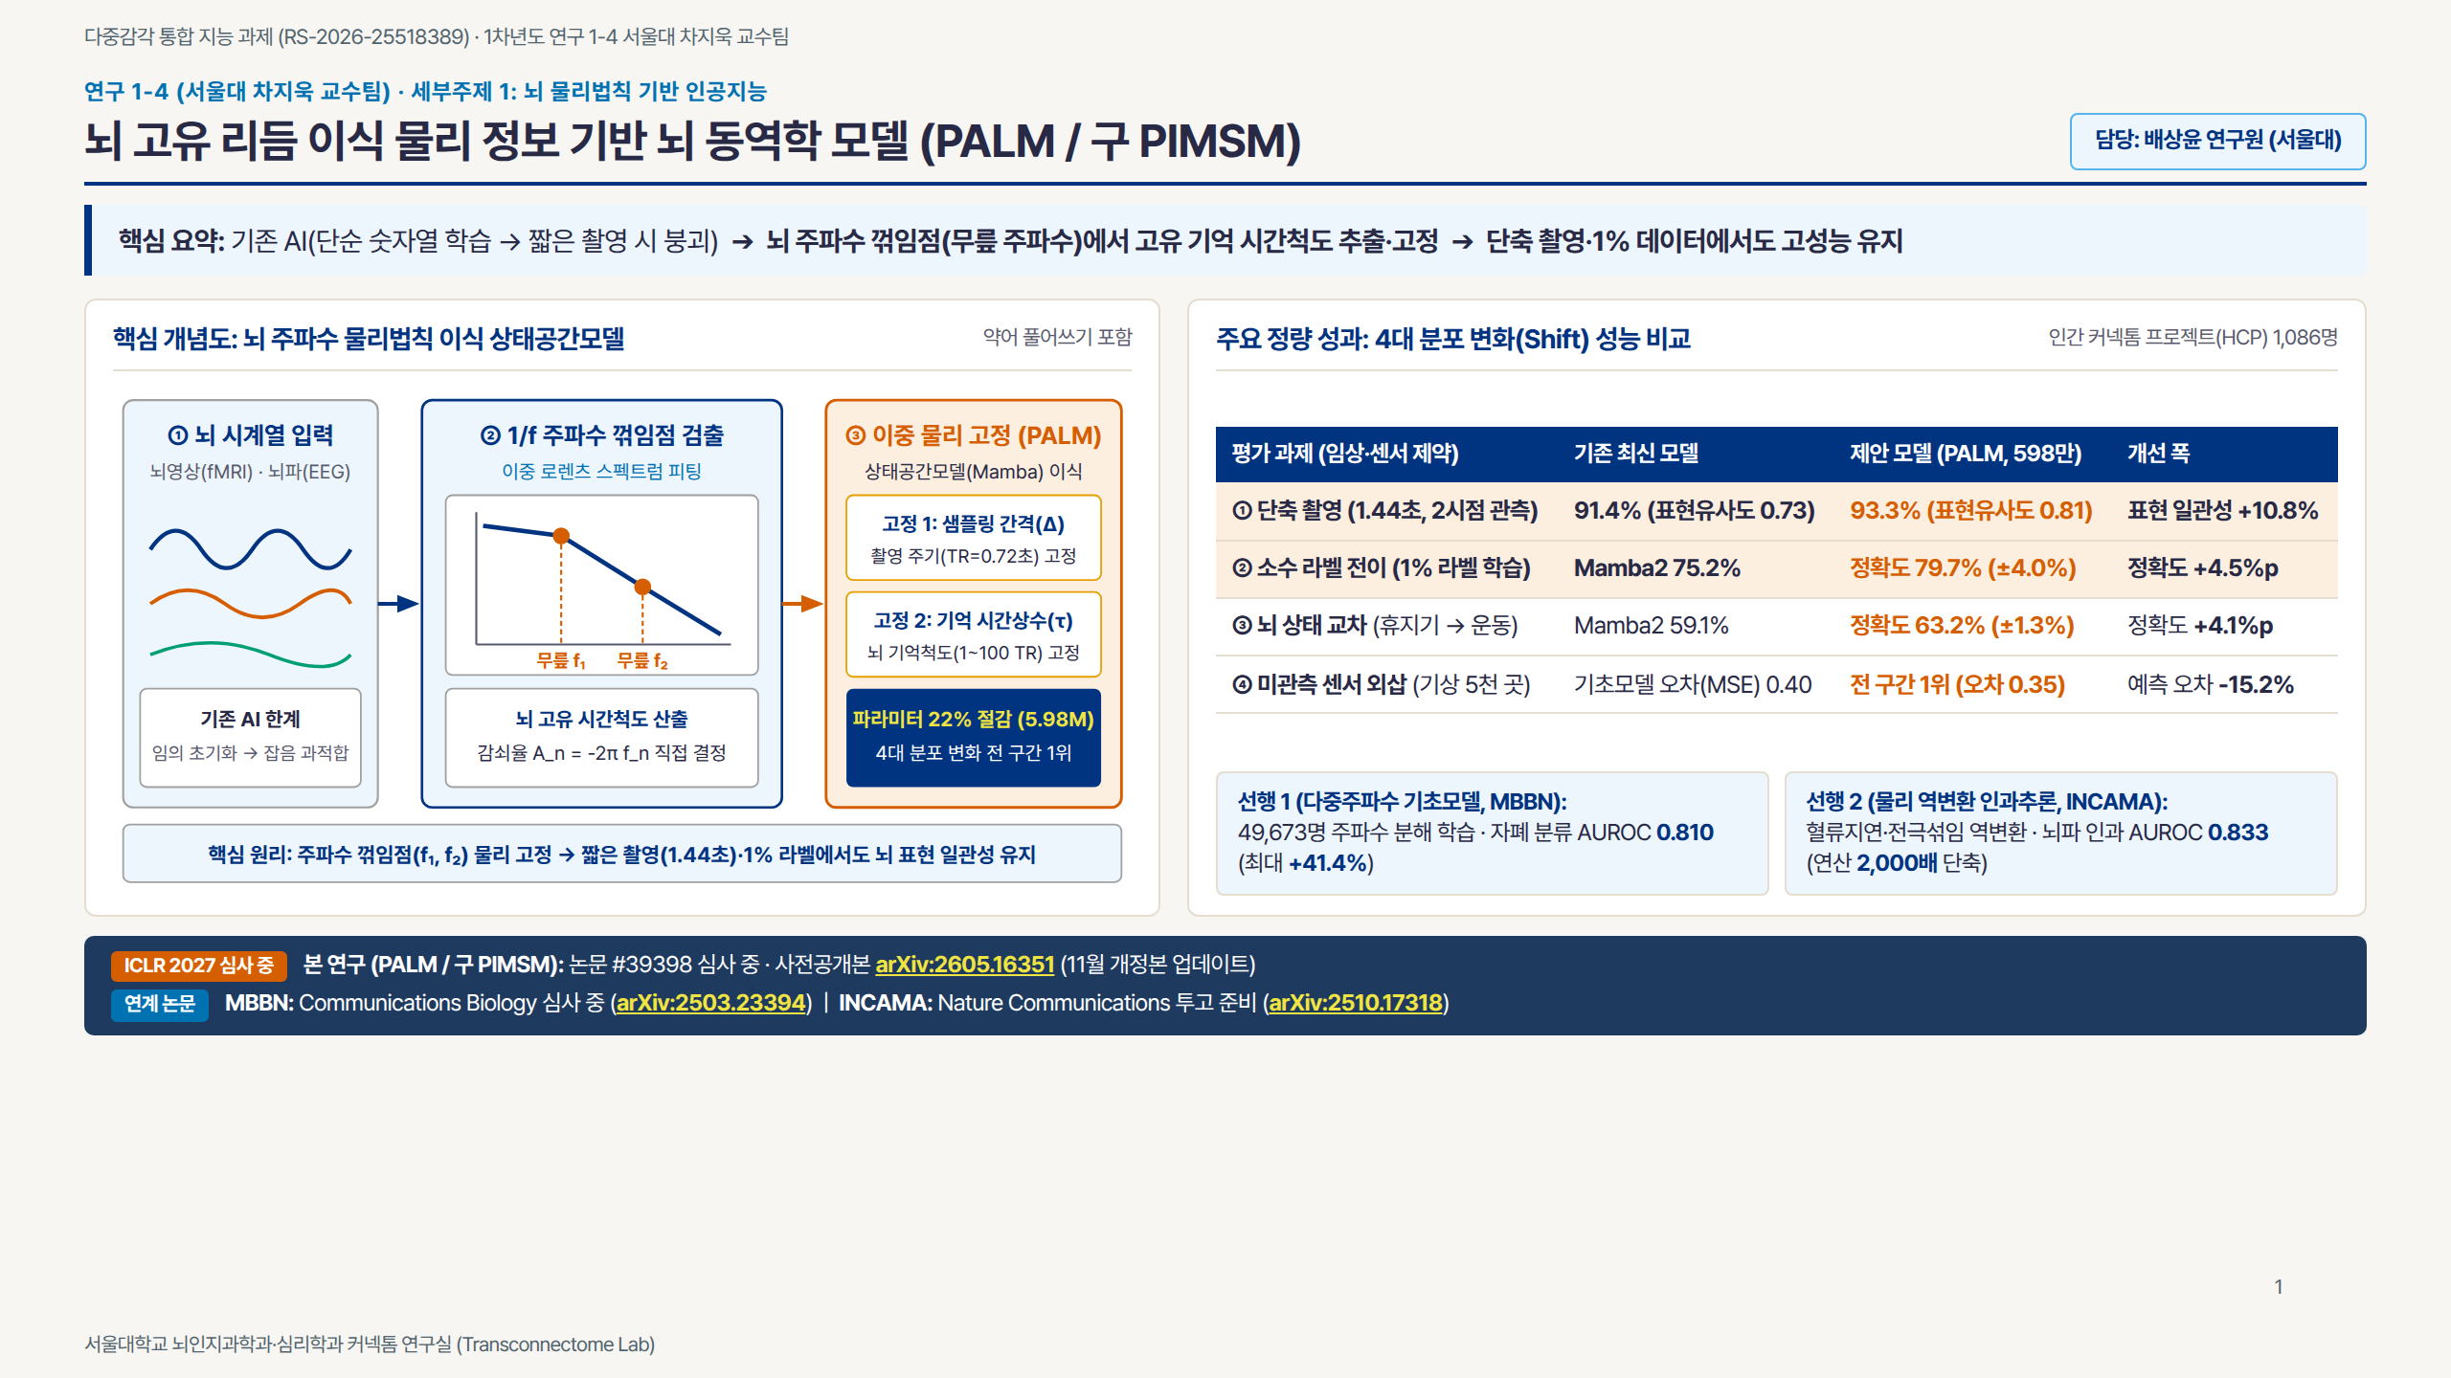
Notes:
Slide 1: PIMSM / PALM

Slide 2
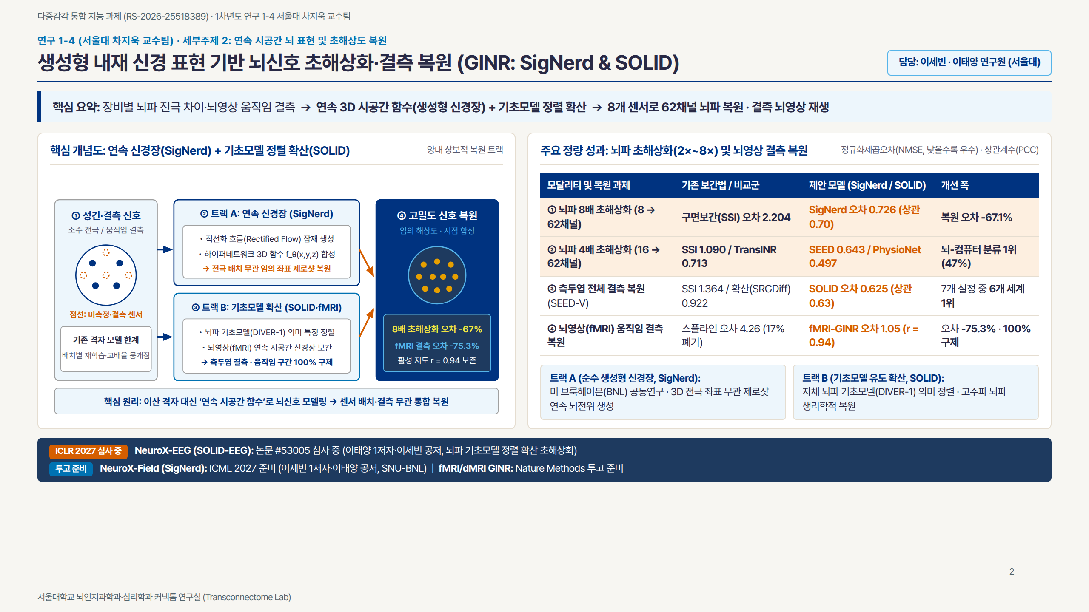
Notes:
Slide 2: GINR

Slide 3
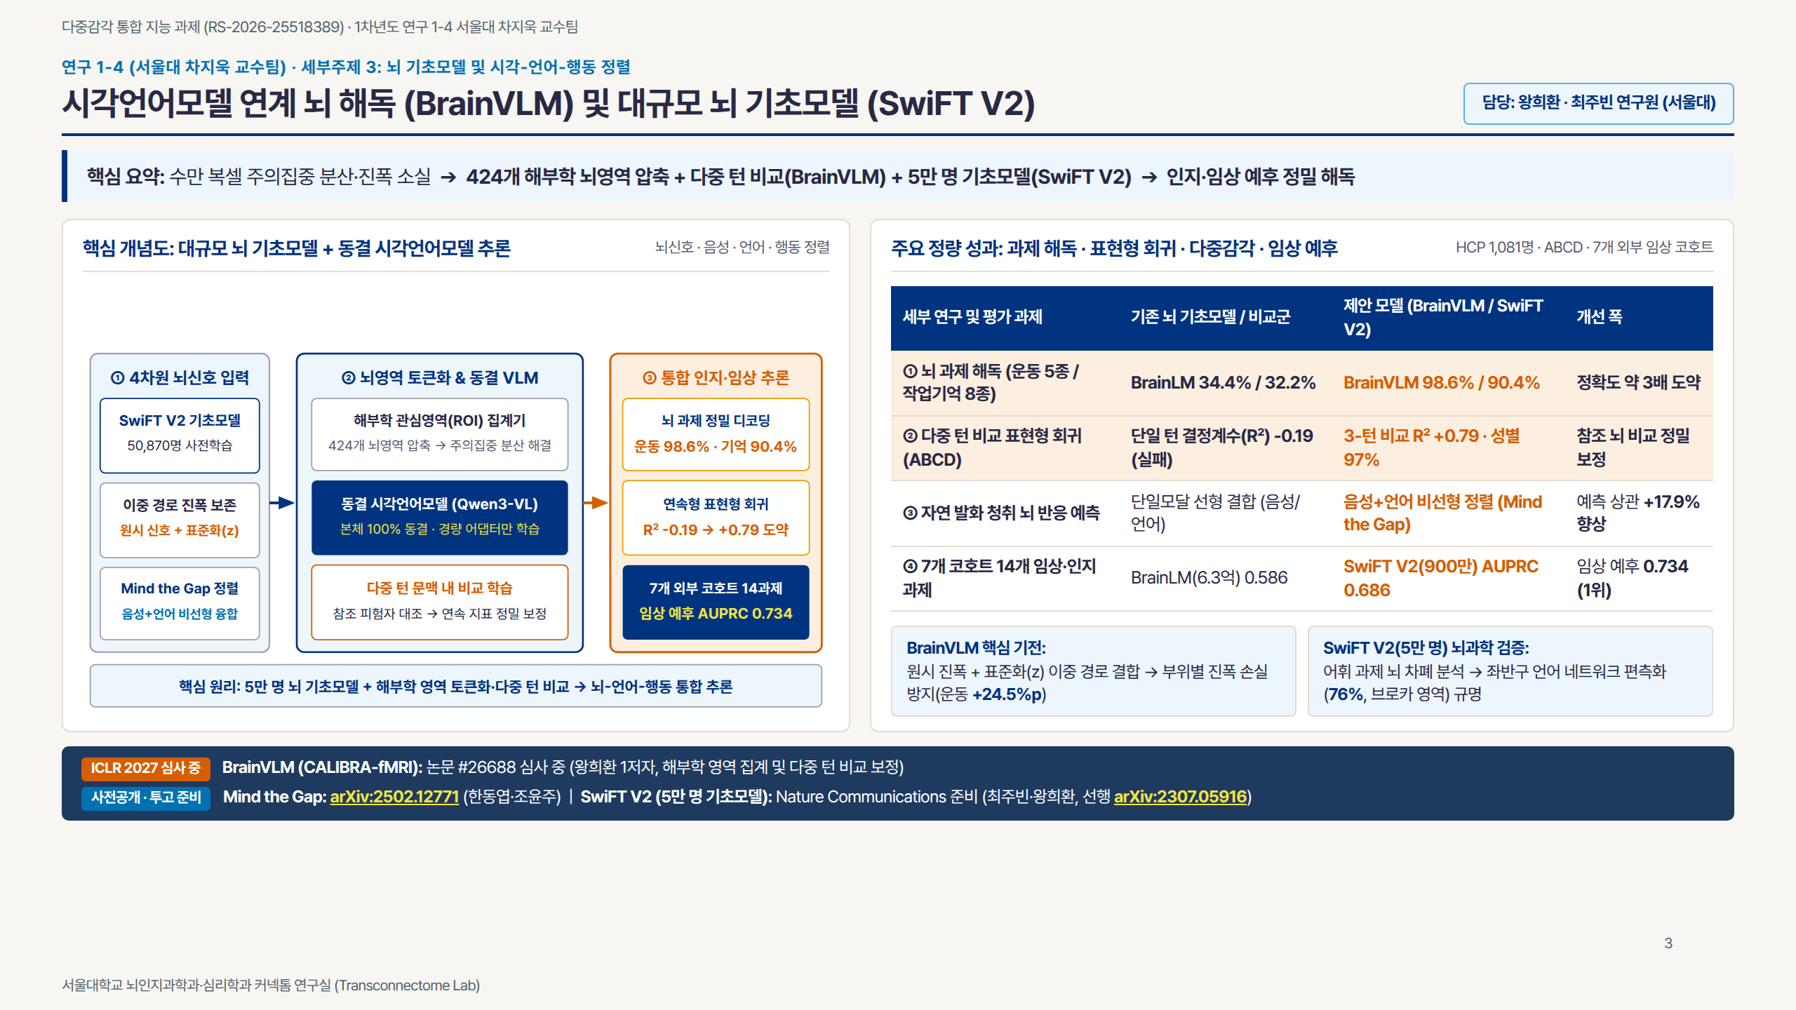
Notes:
Slide 3: VLM & SwiFT V2

