Slide 1


Welcome

Slide 2

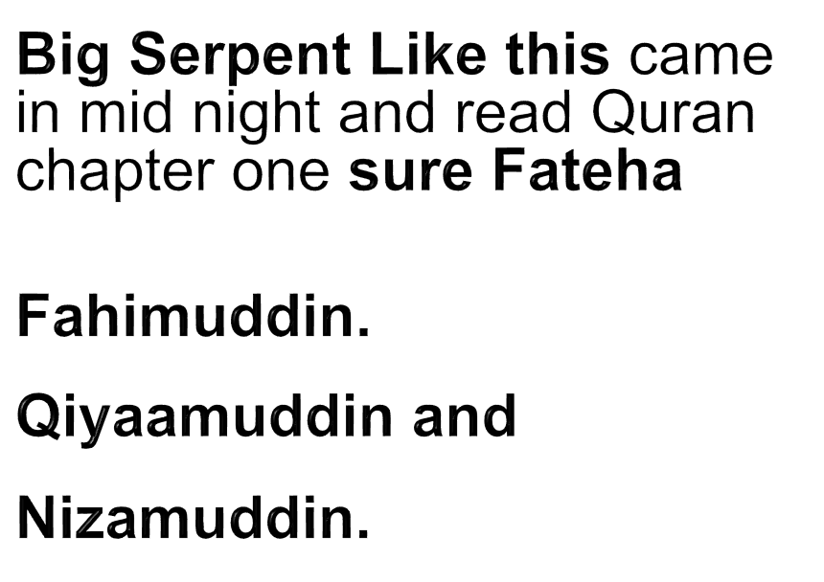
My past encounter-with Jinn (Quran 72)

Slide 3
Testimony: How Jesus is working with me
1-Desire to know Jesus: the truth: C.Th. Lucknow GTh, Hardoi
2. Miracle in my life in Lucknow MARK 16:15-20 (Meaning-Inspiration)
3. Desire to Study Bible Deeply: English as gift Ranchi DTh– BTh, ABS kerla
4. Desire for godly educated life-Partner –Rebekah M Com
5. Desire for University degree (Izhar) (M.A.) Master of Art in theology
6. Desire to share gospel-Muslims (1) Radio program1999 (2) Haqeeqat-TV 2008. (3) Zindegi-TV 2015.(Rebekah got diagnosed Kindly Pray for her.)
7. Desire to train people: to reach Muslims 1-26 place
8-Vision: Muslims Test Jesus of the Quran & Jesus Christ of the Bible

Slide 4
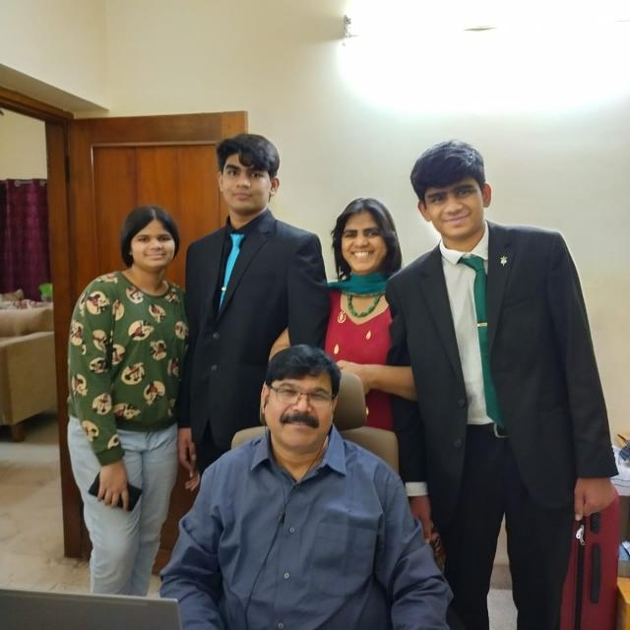
STRUGGLE IN MISSION: Dear praying friends
Your prayers and fasting strengthen us in many ways.
Rebekah was Diagnosed
Now Chemo-Radiation is done
Our Research has slowdown
Sometimes she feels very Exhausted.....we need your PRAYERS-and Support

Slide 5
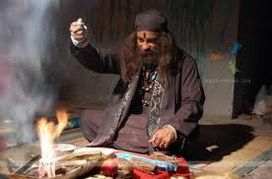
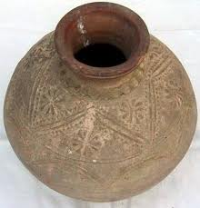

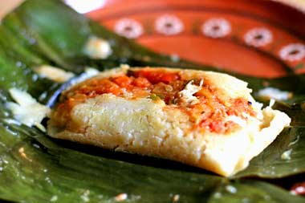
Vision: of Tantric Hindu & Sufi in 2002
  I was focusing on Muslims Ministry but I found many obstacle questians to share gospel to Muslims. After Vision:
  I found these all arguments are coming from this book.
  I began to think, until we respond to this book, gospel cannot be shared in meaning full (This is not the only way)

Slide 6
How Muslims are coming to Jesus
1. By dream seeing Jesus (When you Pray Jesus will visit them)
2. By Miracle experience in lives ( when you Pray miracle will ?)
3. By uniqueness of Jesus in the Quran (compared to Muhammad)
4. By Loving behaviour of Christian (When you Pray love will ?)
5. By Spiritual distinction between Q & B (72 Hurries in Heaven)
6.By Encounter with the Truth : Intellectual discussion When Muslims see Christian faith is better than Islam.

Slide 7
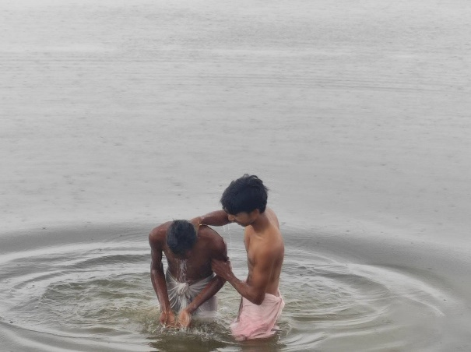


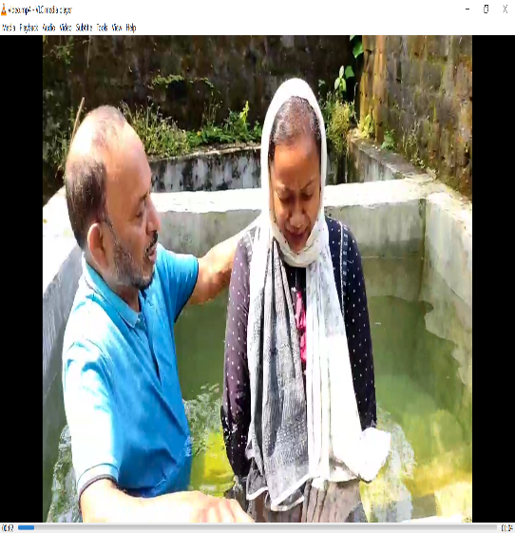
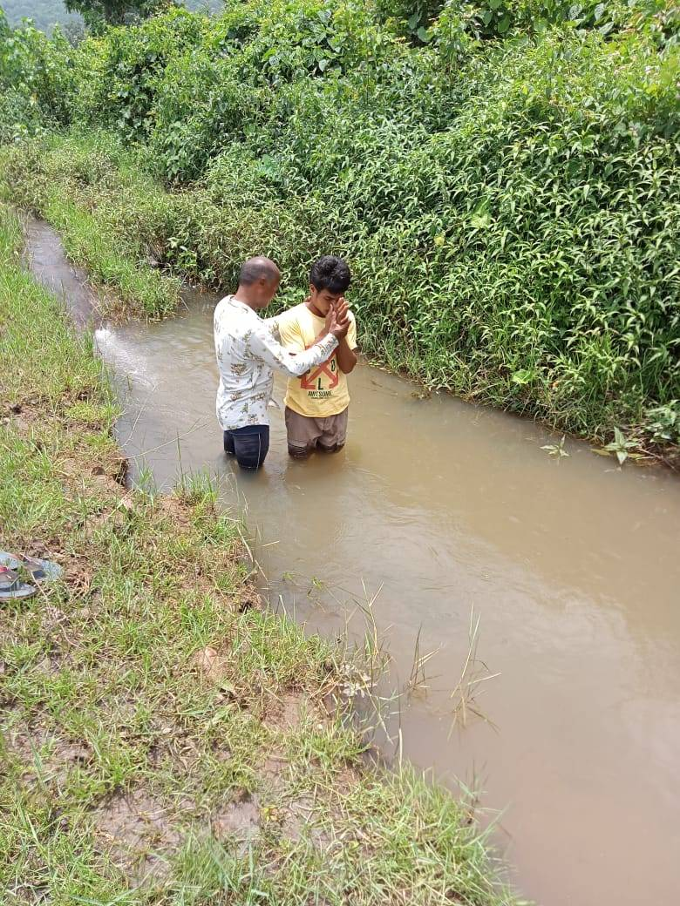


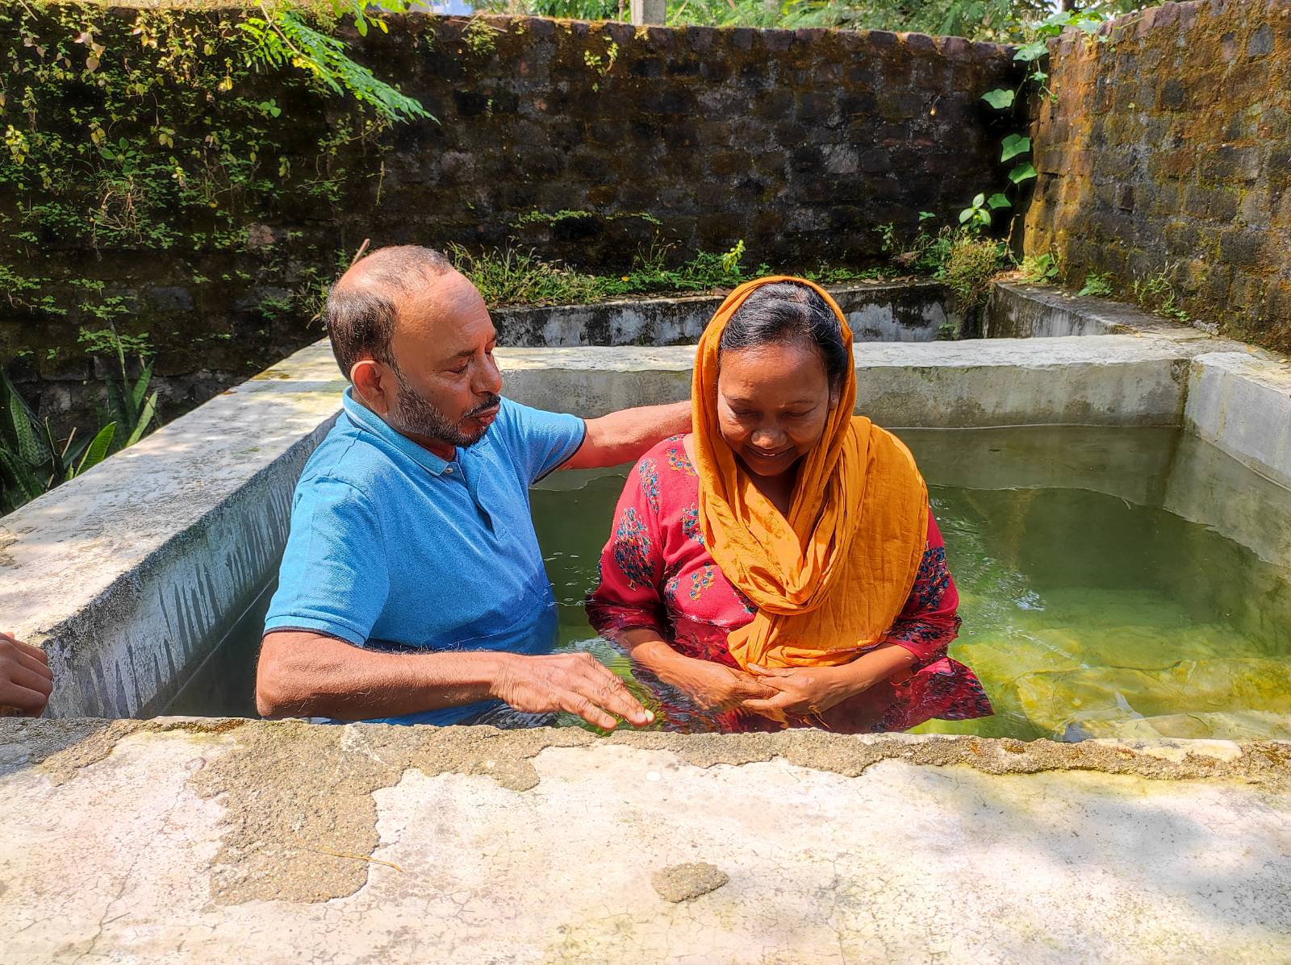
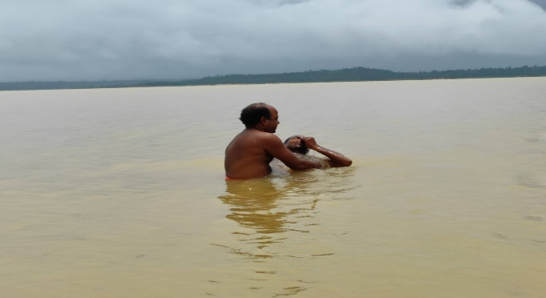





1-Yakub Bro Baptism by Love to Muslims

Slide 8

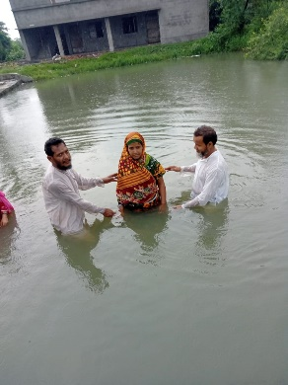
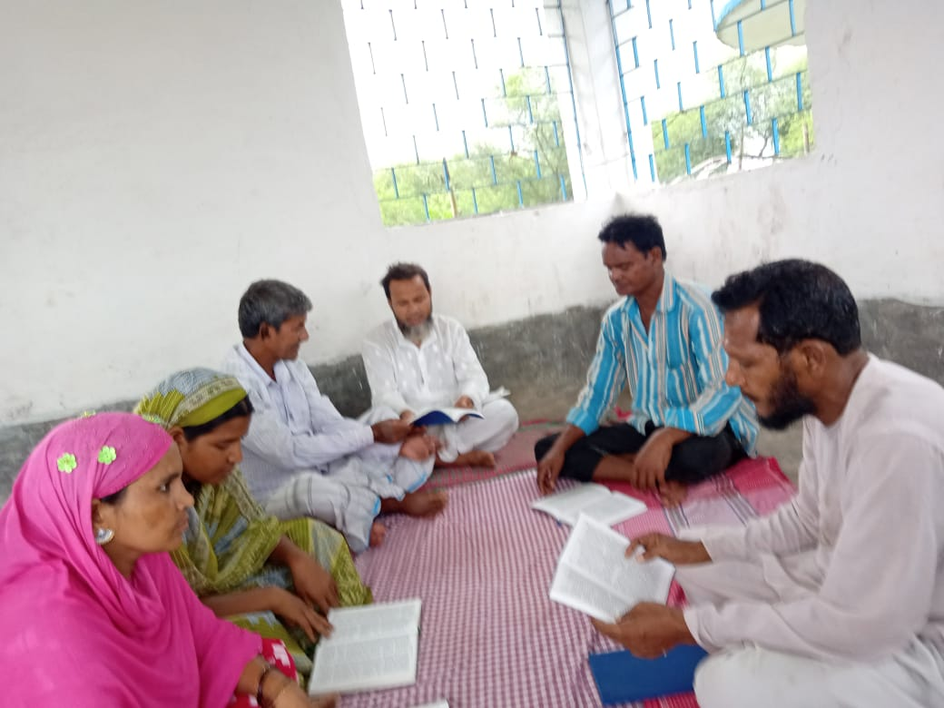

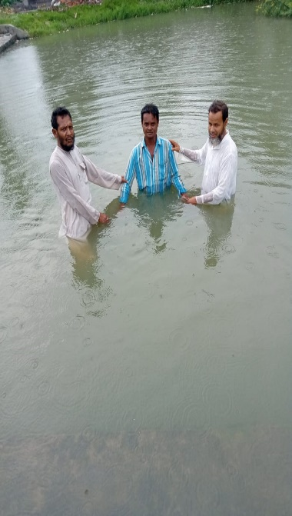
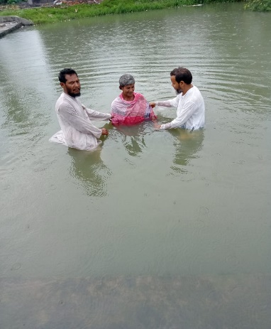
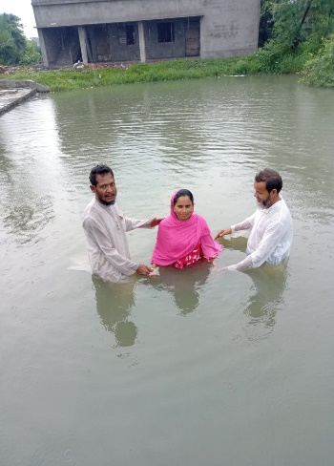




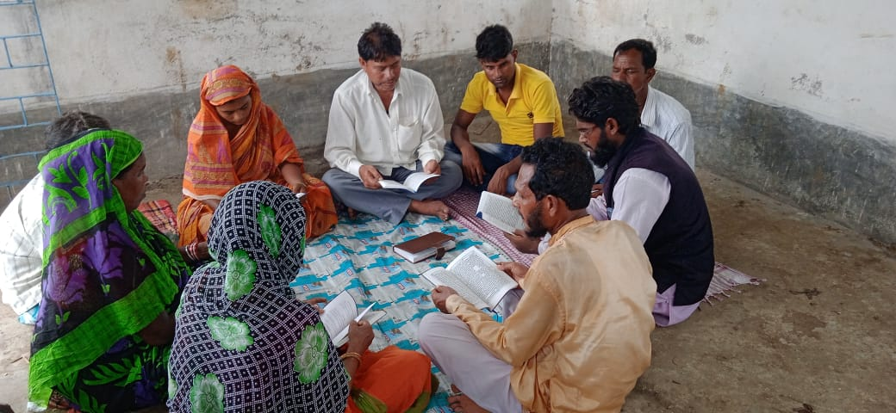

2-Abdul Salam
Scholarly discussion

Slide 9
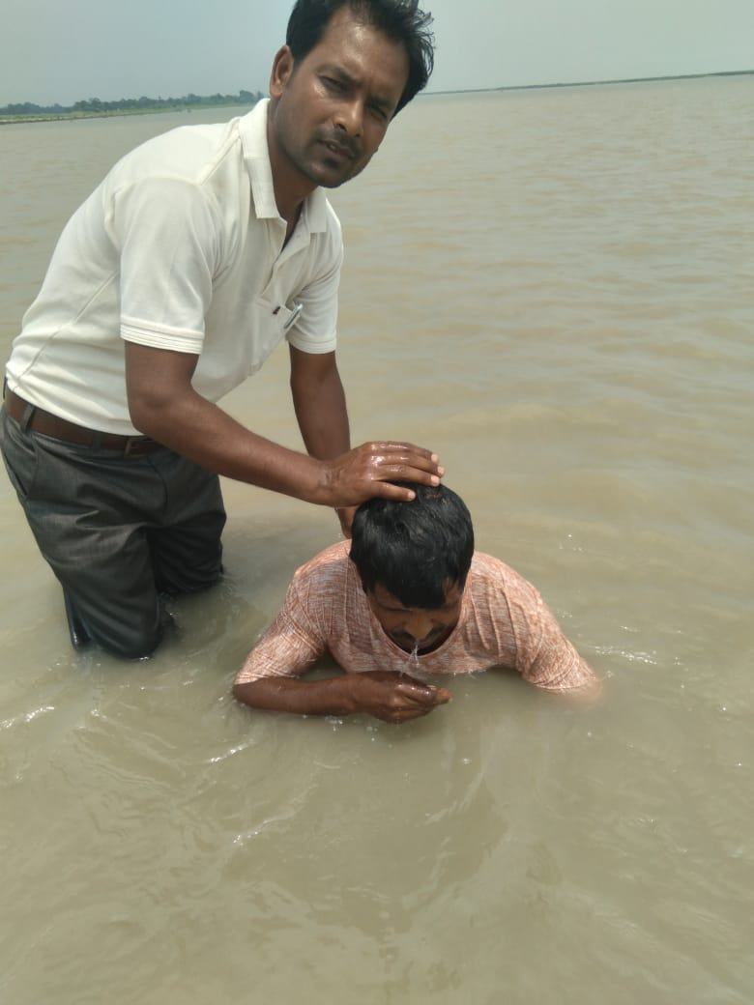
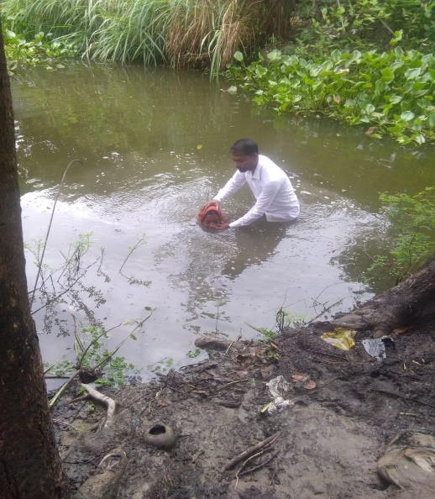


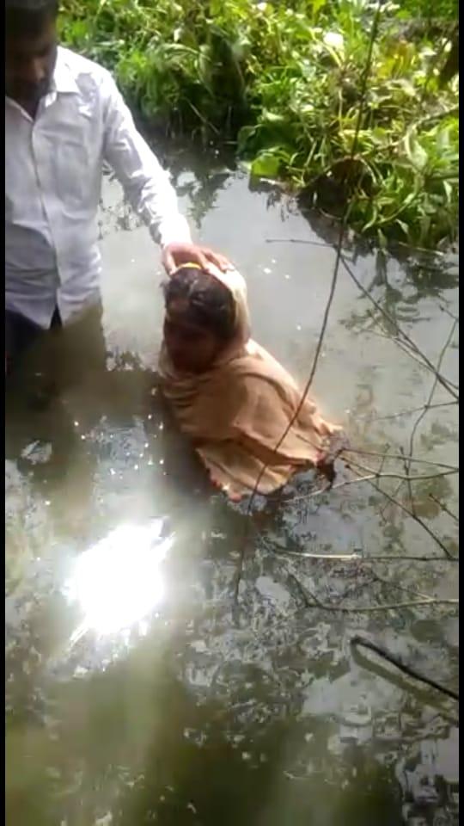
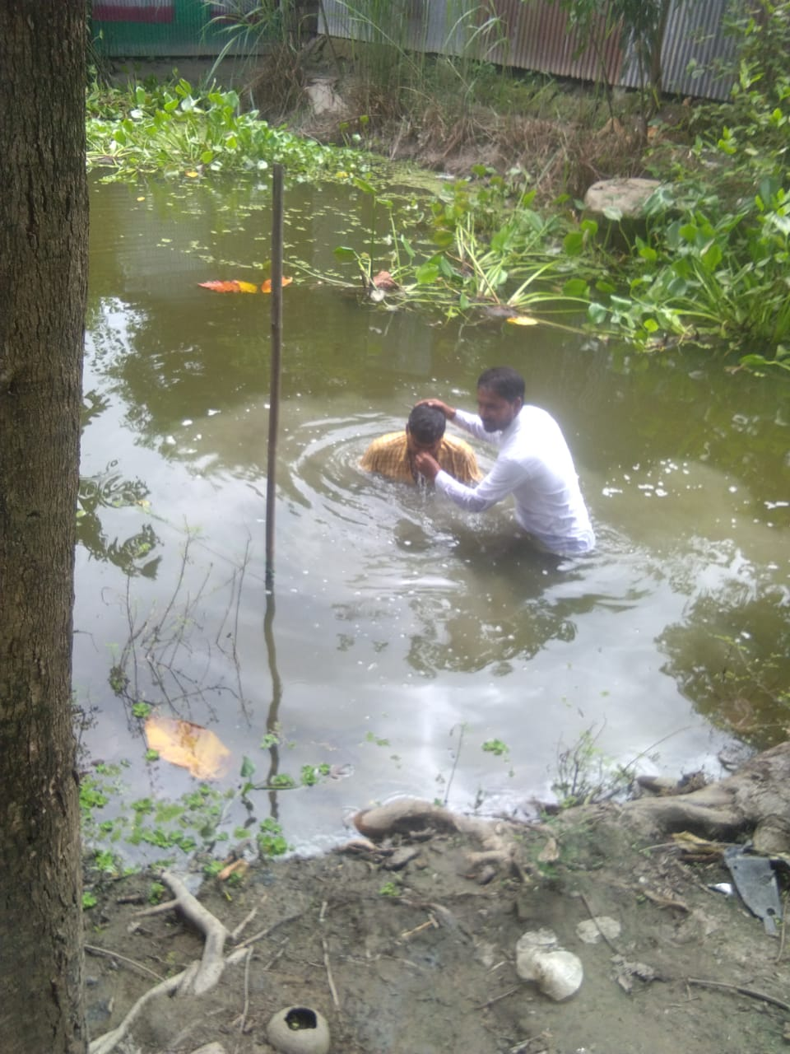
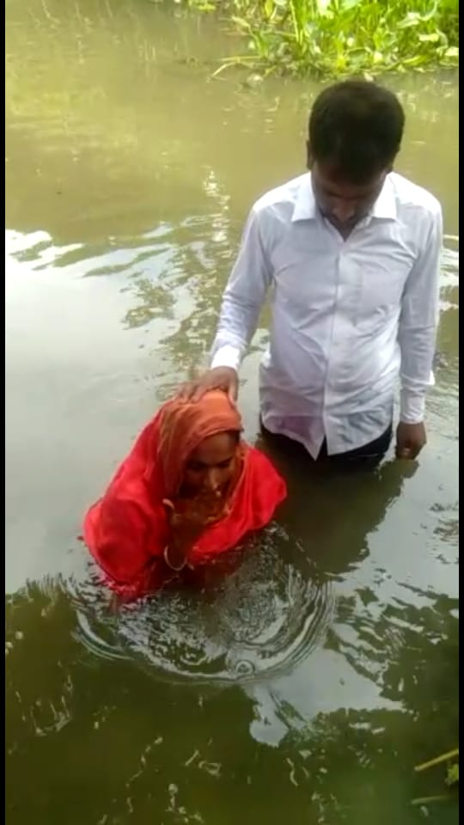
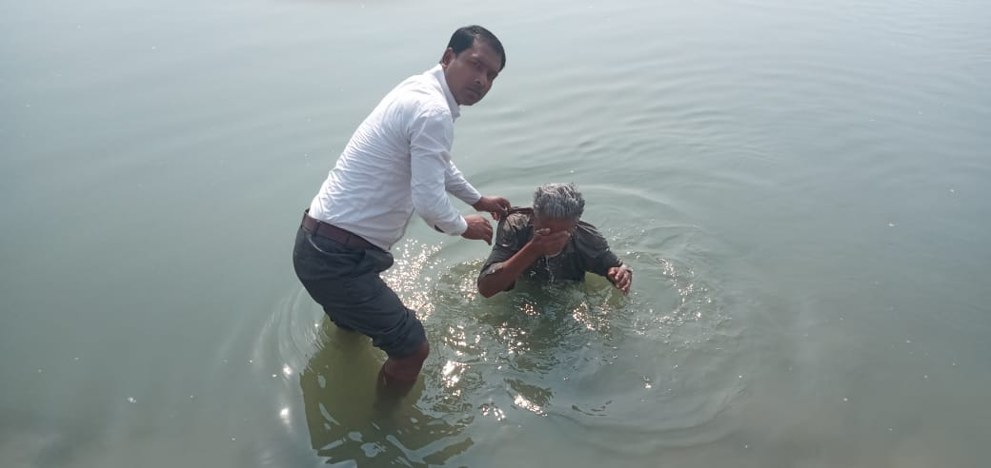
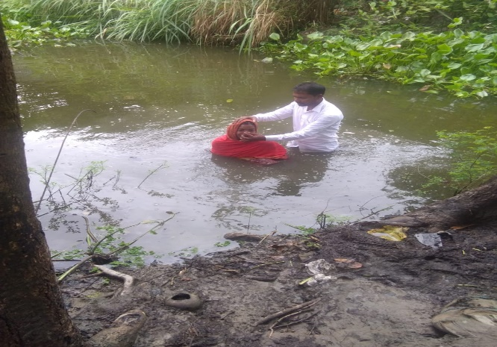
3-Training Result

Slide 10
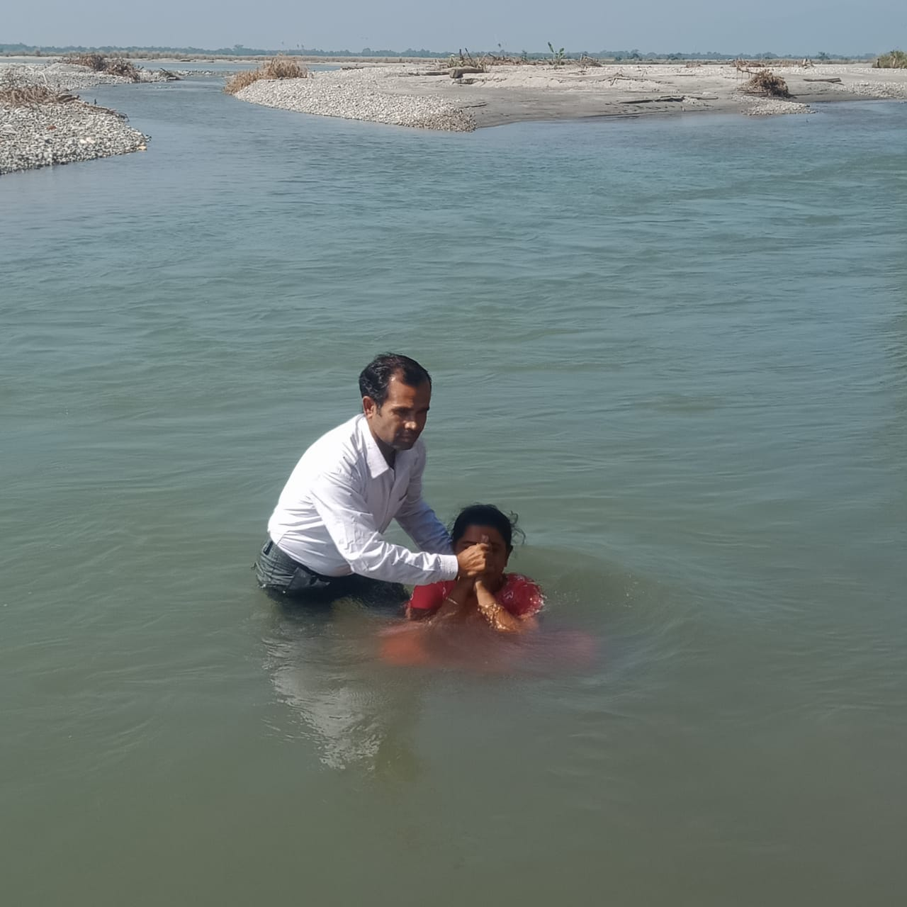
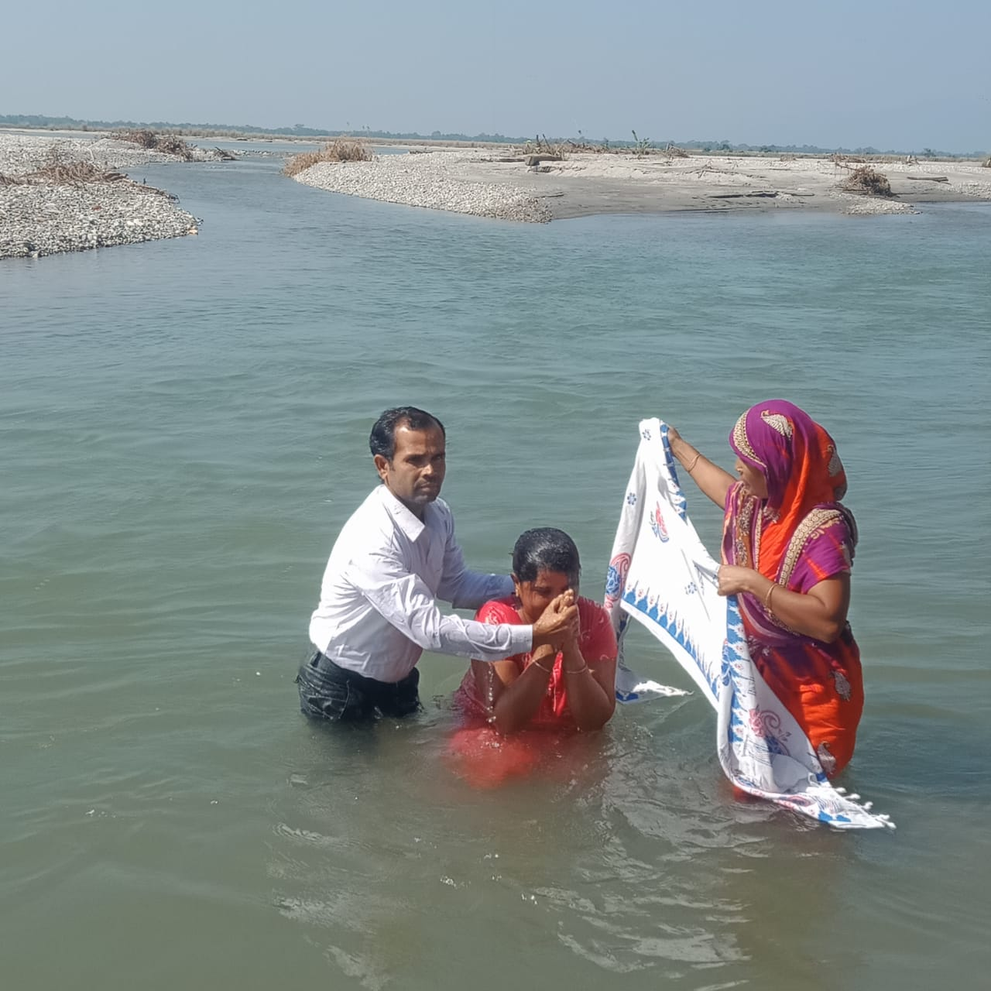
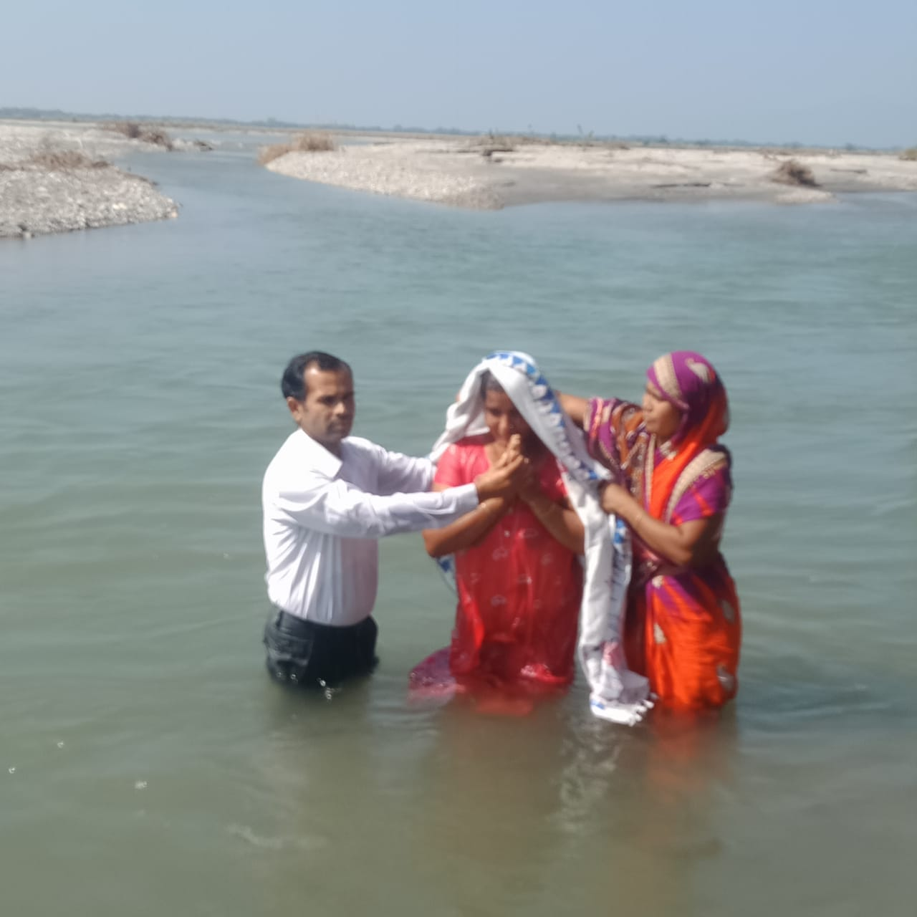
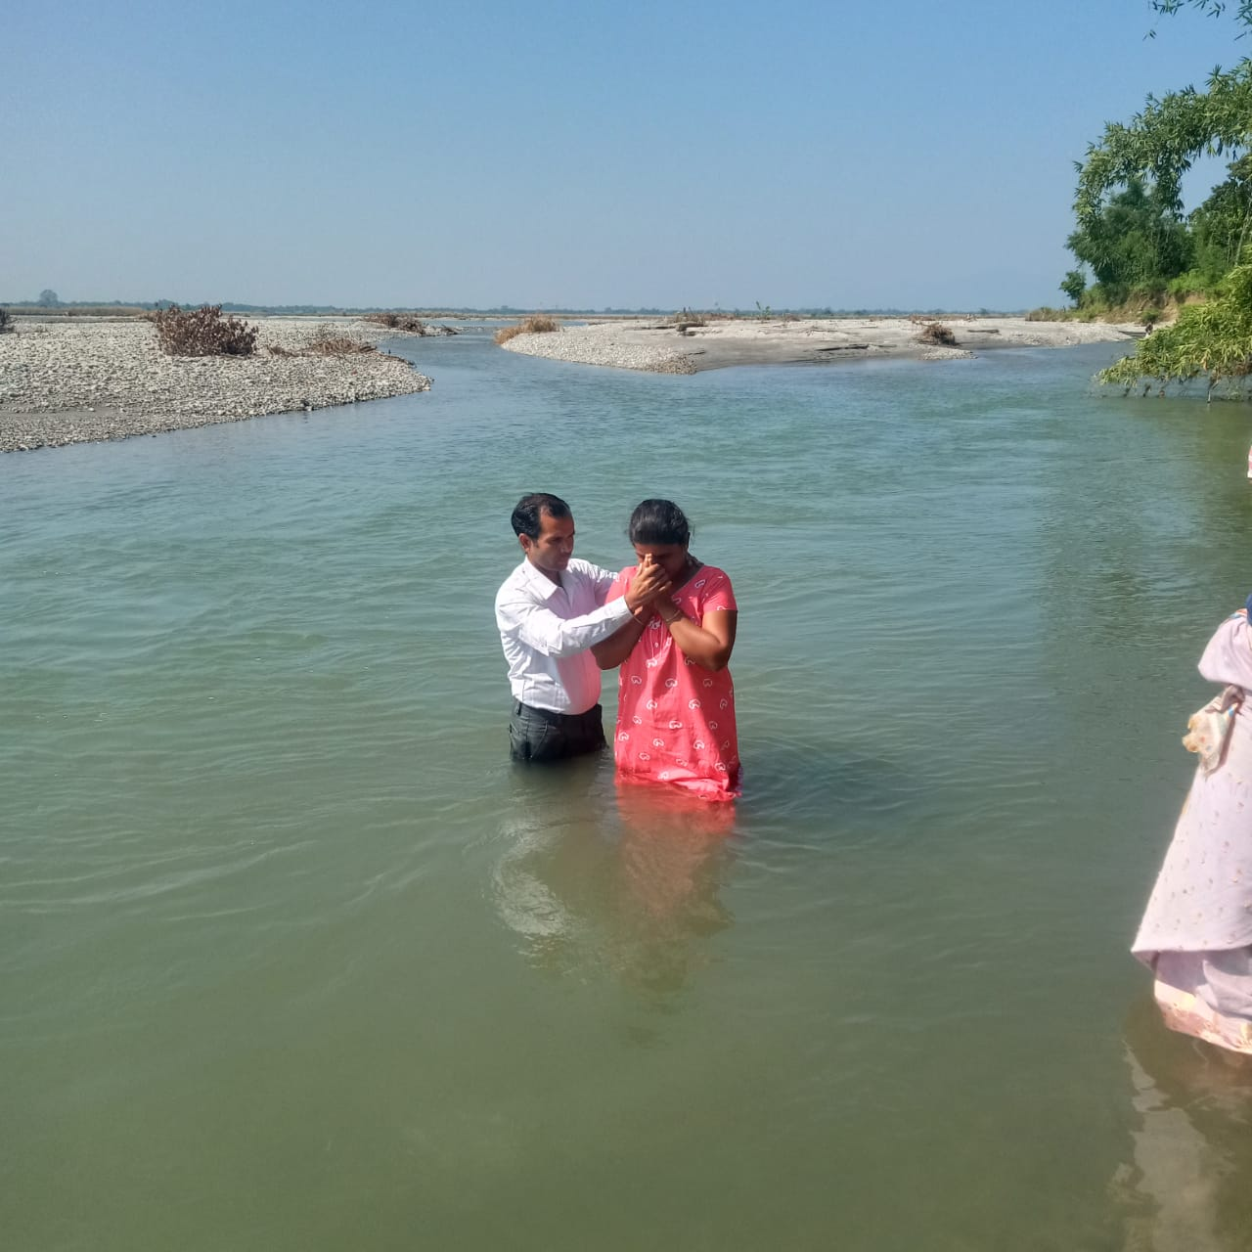
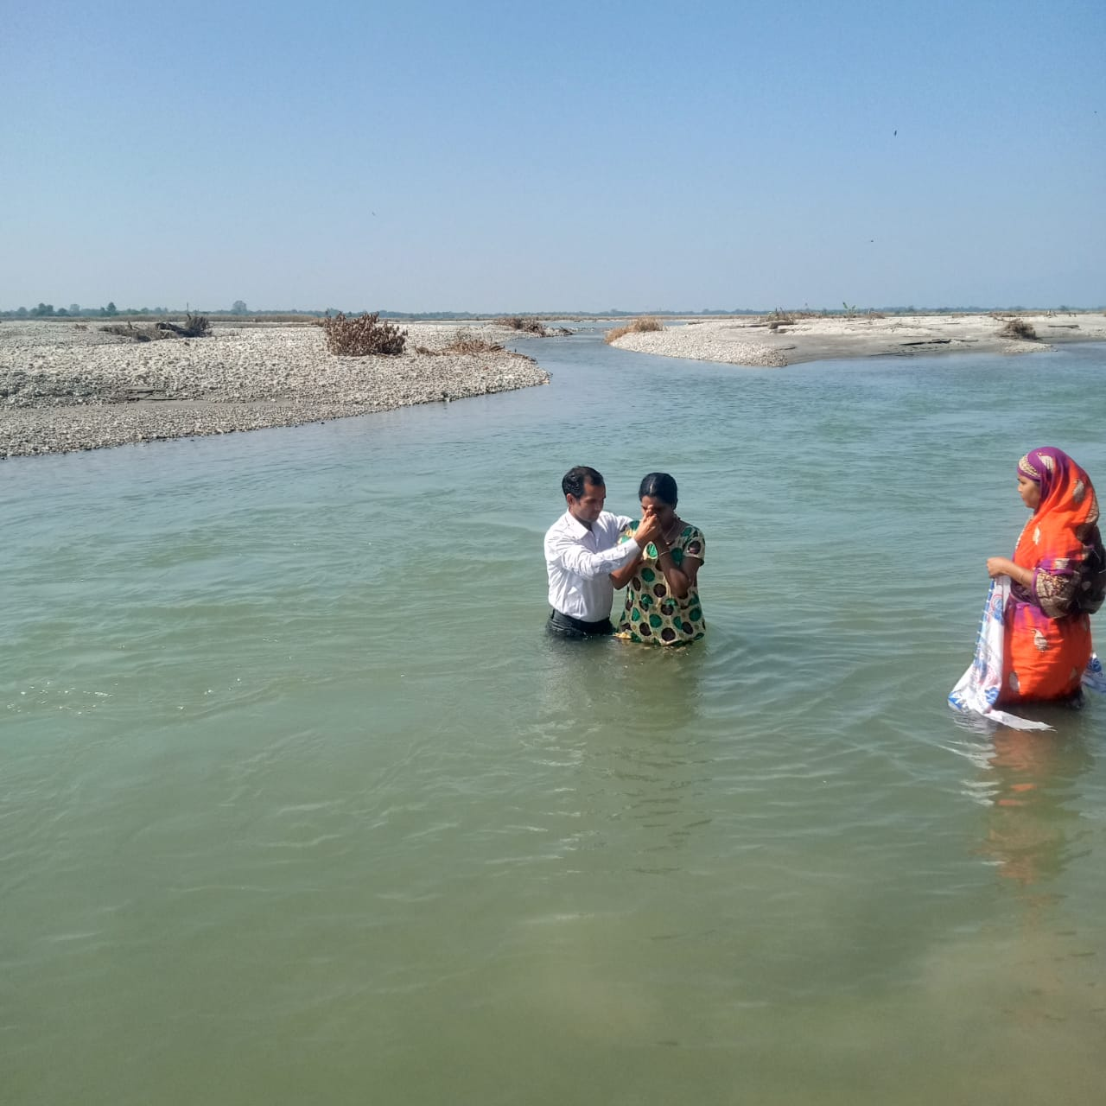
4-Fakruddin Baptism

Slide 11


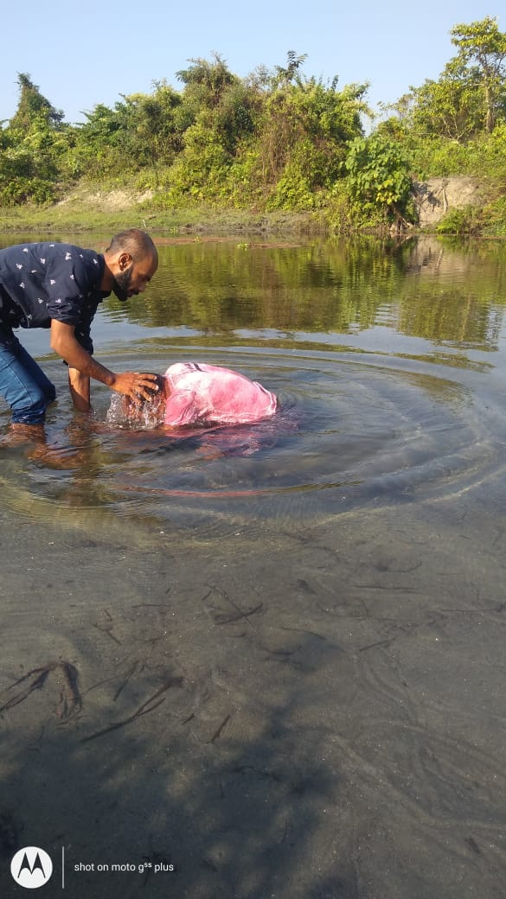
5-Hamza Baptism

Slide 12
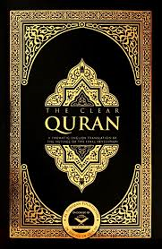
Islamic Teaching Can be divided into three part because there was: Three shift in the life of Muhammad
1. What Quran says neutral (A.D. 610-622)
2. What Quran says in favour of us. ( A.D. 622-624)
3. What Quran says against us. (A.D 624-632)
Why: Meccans depend on medina Jewish?
Sources: Ibn Ishaq p 136 why Muhammad moved from Mecca to Medina

Slide 13
I- Theme in Quran: Neutral to gospel A.D. 610-622
1. Laws command to obey the messenger Muhammad (Quran 3:31)
2. Obey Allah and the messenger– (sūras) 47:33
3. Stories of prophets from the past, the Children of Israel)
4. Communication with the (messenger second person singular)
5. The (Qur’an) is revealed- 6. (Jihad)- 47.4-6 – “in the way of Allah”
7. Personal situation of the “prophet” Muhammad (as in Sūra 33)
8. Human beings are sinners in the Qur’an, but Muslims denied why
9. Allah loves conditional- someone, as well as Allah doesn’t love someone.
10. Salvation Form physical trouble- 11. “Signs” of the Creator’s power and goodness
11 End Times (last things, including judgment, punishments, and heaven and hell)

Slide 14
Why world view is impotent
For a Hindu & for Muslims I becoming Hindu & Muslims to win them for Christ yet strongly living in Christ Jesus I Corinth 9:19-23 These requires 4 things
1- Bible’s sound theology
Jesus’ story & gospel
2-Be relevant to Audience’s needs
Physical, Intellectual & spiritual
4-Vision/ passion, what is your
Goal-Testimoney - Audience to believe?
3-Engage with Audience’s Religious
And philosophical world view

Slide 15
II-WHAT IS IN FAVOUR OF THE GOSPEL
1. MARY IS MOST HOLY IN QURAN 3:36,37,42 Why
2. JESUS WAS BORN BY VIRGIN QURAN 3:45-47 why Gen 3:14-15 Is 7:14. mt 1:21-23
3. JESUS IS A WORD FROM ALLAH Q 3:39,45; 4:171) What does it mean John 1:1-3;20:28
4. JESUS IS A SPIRIT FROM ALLAH (Q 4:171) What does ? II Cor 3:7-18 I Cor 10:2-5)
5. JESUS IS HONORED in this life & hereafter (Q 3:45 Q 49:13 (cont of Sin TGA p.137-41)
6. JESUS IS A PURE CHILD (QURAN 19:19) What does it mean John 8:1-46,
7. JESUS WAS SUPPORTED WITH THE HOLY SPIRIT (Q 2:87,253, 5:110) but MD no Q 17:59
8. JESUS PERFORMED MIRACLES (Q 3:49, 5:110-118). JESUS create bird What does Jn 1:3-4
9. JESUS is mercy for mankind Quran 19:21 JOHN 1:16-17 ROM 3:23,6:23
10 .Jesus is coming to judge people Q 43:61

Slide 16
III- :Why Muhammad become against JESUS? Islamic designed
Polemic: Arguments against Jewish, Christians Gentiles
1- Jesus is not God Quran 5:72-73,116-117
2-Jesus is not Son of God Quran 19:35
3. Trinity is rejected Quran 4:171 5:119-120
4. JESUS IS not CRUCIFIED Quran 4:157
5. JESUS is not savior - Quran 6:164; 17:15; 23:62
6. JESUS is only for ISRAELITES Quran 3:49, 5:75
7. The Bible is corrupt Quran 3:78. Is connected with 8. Moses & Jesus prophesied about Muhammad Q 61:6, 7:157 Full discussion is in The Gentle Answer chapters 3-6
Sources:
Ibn Ishaq p.136
The History of Al-Tabari: translated by M. V. McDonald, 1987], Vol. VII, p. 25; (16 month in synagogue)

Slide 17
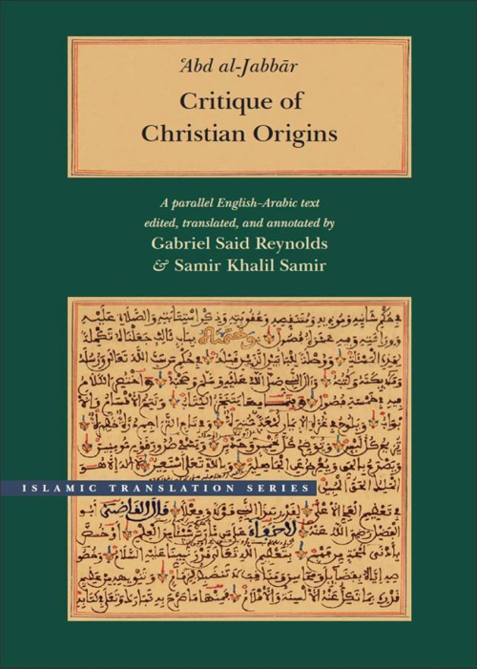

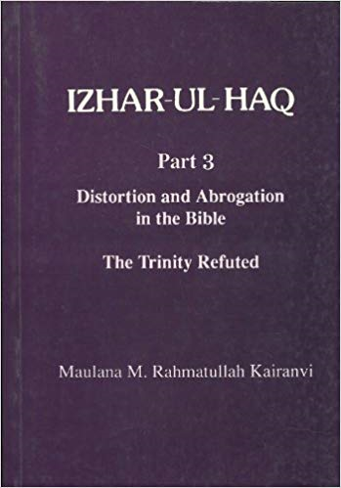
Ibn Hazm Kitab al-Fasal. A.D. 994-1068
Four Authors of Islam made the many Muslim mind against gospel Muhammad, Ibn Hazm and Kairanwi
Muhammad AD 570-63.
The Quran 644 AD.( 632-900)
Kitab Tathbit dala'il al-nubuwwa by qadi al-qudat & 'Abd al-Jabbar (d. 415/1025)
Rahmatullah Kairanwi 1818, 1891,
Izharul haq 1864 3 vol.

Slide 18
I. What is in favour of us
PRAISE FOR MARY Q 3:36,37,42
Why holy
2. VIRGIN BIRTH Q 3:45-47,19:16-21, What does it mean
Gen 3:14-15.Isa 7:14.Mt 1:21-23,28:20
3. JESUS IS A WORD FROM ALLAH
Q 3:39,45; 4:171) - What does it mean -John 1:1-3.5:22
Quran 10:94 Ask to Jewish-Christians BUT Quran-5:46-47 Judge with Injil

Slide 19
In favour of us: Jesus is Holy
4. JESUS IS A PURE CHILD (QURAN 19:19) John 8:1-46,
A sinner need to punished
B. You all are sinner
C. Who can prove my sin John 8:46
Mt 26:57-64 Caiaphas –scribes
Lk 23:4 Pilot no blame
Lk 23:14-15 Herod-pilot- yet Jesus was innocent Heb 4:15
Mt 27:4-5 Judah declared
Quran 10:94 Quran-5:46-47

Slide 20
Bible Quran
CONCEPT OF SIN
Description | In the Bible | In the Quran
Adam | Gen 3:1-24 | Quran 7:19-22; 2:30-35
Noah | Gen 9:20-27 | Q 71:28
Abraham | Gen 12:10-20; | Q 26:82: 6:76-78
Moses | Exo 2:11-15 | Q 28:16
David | II Sam 11:2-27 | Q 38:24-25
Solomon | I King 11:1-13 | Q 38:34-35

Slide 21
Description | In the Bible | In the Quran
Jonah All Beings All Prophets Mohammad Jesus is Holy | Jonah 1:3,4:1-11 Rom 3:23,5:12-19 Rom 3:23, Matt 24:24 Jn 8:46, 1 John 3:5 | Quran 37:139-147 Q 16:61,k.m.m v-3,p-360 Quran 22:52,Bs.V6,236 Q 47:19,Bs,V8,319 407,408,335 Q19:19, S.B,V.6,71,236,V-4,641 The Gentle Answer.-p.137-143.

Slide 22
Mohammad was worst sinner
Quran 47:19; So know (O Muhammad) that there is no God save Allah, and ask forgiveness for thy sin and for believing men and believing women. Allah knoweth (both) your place of turmoil and your place of rest.
Quran 48:1, 2; Lo! We have given thee (O Muhammad) a signal victory, That Allah may forgive thee of thy sin that which is past and that which is to come, and may perfect His favour unto thee, and may guide thee on a right path,
Jesus is Holy why QURAN 19:19 John 8:1-46,
Quran 10:94 Quran-5:46-47

Slide 23
Mohammad’s sins
Allah commanded Muhammad to confess his sins (Q 47:19; 48:2; 40:55).
The Arabic word used here for ‘sin’ is ‘dhanb’ (zanb); the 37 times it occurs in the Qur’an tells us about the magnitude of the word:
  Q 5:18:- It is equal to shirk
  Q 6:6:- God destroyed all people because of this.
  Q 8:52:- Punishment as for as crimes.
  Q 8:54:- It is for evil doers.
  Q 12:29:- It is for adulterers. Quran 33:37-38,40,50,52,66:,65
  Q 12:97:- It is equal to kidnapping.
  Q 14:10:- Equal to idolatry. Sahih al-Bukhari Book 67. Vol. 7: Hadith 407
  Q 67:11:- It will take to hell.
  But Jesus is Holy Quran 19:19 Why
Quran 10:94 Ask to Jewish Quran-5:46-47

Slide 24
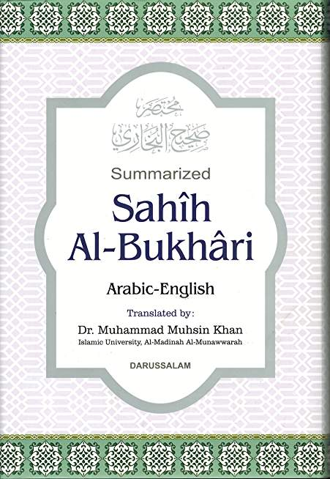
Muhammad and Idolatry
Allah's Apostle presented a dish of meat to Zaid bin 'Amr, but Zaid refused to eat of it and then said "I do not eat of what you slaughter on your stone altars (Ansabs) nor do I eat except that on which Allah's Name has been mentioned on slaughtering." (Sahih al-Bukhari Book 67. Vol. 7: Hadith 407)

Slide 25

Muhammad and Idolatry
Ibn Ishaq, who wrote:
I was told that the apostle of Allah said, as he was talking about Zayd son of 'Amr son of Nufayl, 'He was the first to upbraid me for idolatry and forbade me to worship idols….. Ibn Ishaq (Guillaume, pp. 102-103)

Slide 26
5.Satan touched all BUT not to Jesus Why?
Narrated bin Al-Musaiyab:
Abu Huraira said, "I heard Allah's Apostle saying, 'There is none born among the off-spring of Adam, but Satan touches it. A child therefore, cries loudly at the time of birth because of the touch of Satan, except Mary and her child Jesus ." Then Abu Huraira recited: "And I seek refuge with You for her and for her offspring from the outcast Satan" (3.36)
Bukhari: Book 55: Vol 4 Hadith 641

Slide 27
What is in favour of us
6. JESUS IS A SPIRIT FROM ALLAH
(Q 4:171,58:22) II Cor 3:17-18 I Cor 10:2-5) Mt 17:2-5 Ex 33:18
… Surah 58.22 …..Whenever anyone offers his heart in faith and purity to God, God accepts it, engraves that Faith on the seeker's heart, and further fortifies him with the divine spirit which we can no more define adequately than we can define in human language the nature and attributes of God. (Yusuf Ali, The Holy Qur'an, p. 1518)

Slide 28
What is in favour of us
7. JESUS IS HONORED in this life and in the hereafter and among those nearest to Allah (QURAN 3:45) Quran 49:13 righteous
“Honor the Son, even as they honor the Father” John 5:18-23
8. JESUS WAS STRENGTHENED WITH THE HOLY SPIRIT (QURAN 2:87,253, 5:110)
Mt 3:16-17.John 1:33 Acts 2:38.Joyel 2:28-30
9.JESUS PERFORMED MIRACLES (QURAN 3:49, 5:110,115-118) .create bird

Slide 29
10 .Jesus is coming to judge people Q 43:61
Quran 43:61 says Jesus will come again
To top Muhammad told his followers that Jesus would return from heaven to reign on earth as a just ruler and fair judge:
Quran 43:61. And lo! verily (Jesus is the sign) of the knowledge of Hour. So doubt ye not concerning it, but follow Me.(Jesus) This is the right path.
(And he shall be a sign for (the coming of) the Hour.) means, sign and “One of the signs of the Hour will be the appearance of `Isa son of Maryam before the Day of Resurrection.” Something similar was also narrated from Abu Hurayrah, Ibn `Abbas, `Abu Al-`Aliyah, Abu Malik, `Ikrimah, Al-Hasan, Qatadah, Ad-Dahhak and others. Many Mutawatir Hadiths report that the Messenger of Allah said that `Isa will descend before the Day of Resurrection as a just ruler and fair judge. (Tafsir Ibn Kathir, Q. 43:61)

Slide 30
Sahih al-Bukhari.Vol. 4, Book 55, Number 657:
Narrated Abu Huraira: Allah's Apostle said, "By Him in Whose Hands my soul is, surely (Jesus,) the son of Mary will soon descend amongst you and will judge mankind justly (as a Just Ruler); he will break the Cross and kill the pigs and there will be no Jizya (i.e. taxation taken from non Muslims). Money will be in abundance so that nobody will accept it, and a single prostration to Allah (in prayer) will be better than the whole world and whatever is in it."
Ahmad bin Hambal, al-Musnad, vol 2, p. 240
Sahih Muslim, Book 001, Number 0289
(Sahih Muslim, Book 001, Number 0287, 0288 )
Sahih Bukhari Vol. 4, Book 55, Num. 658:
Sahih Bukhari Volume 3, Book 34, Number 425:

Slide 31
But Why did Muhammad become against the gospel?
1-Mecca MD started preach
A-Life not Appealing
B-No Miracle to prove
C-Marriage compromise?
2- Why consulting Jewish?
Jewish gave three questions
A-who is Holy Spirit Quran 17:85
B-Who ruled sun rise to down 18:83-98
C-Who were & how many God Protected in cave(Q 18:9-26ff (Insaa Allah)
3-Jewish and Christians could not believe that Muhammad was prophesized by Moses Quran 7:157-158 and Jesus Quran 61:6
Sources: Ibn Ishaq P.136.
The History of Al-Tabari: translated by M. V. McDonald, 1987], Vol. VII, p. 25; (16 month in synagogue)

Slide 32
II- :Why did Muhammad become against JESUS?
1. JESUS is only for ISRAELITES Quran 3:49, 5:75, Mat 10:5,15:24
2- Jesus is not God Quran 5:72-73,116-117
3-Jesus is not Son of God Quran 19:35
4. Trinity is rejected Quran 4:171 5:119-120
5. JESUS IS not CRUCIFIED Quran 4:157
6. JESUS is not savior - Quran 6:164; 17:15; 23:62
7.The Bible is corrupt Quran 3:78. Is connected with 8. Moses & Jesus prophesied about Muhammad Q 61:6, 7:157 Full discussion is in The Gentle Answer chapters 3-6
9-So Jewish –Christians Accept Islam or ready to die Q. 9:28-29
Sources:
Ibn Ishaq p.136
The History of Al-Tabari: translated by M. V. McDonald, 1987], Vol. VII, p. 25; (16 month in synagogue)

Slide 33
Why did Muhammad become against gospel
1- Muhammad was 25- Khadija 40 When Muhammad was 53 married 6-9 years girl Aiyesh Sahih al Bukhari vol. 7:65, vol. 5:234 How Muhammad is an Example as mentioned in the Q 33:21
Sahih al Bukhari vol. 7:88:- When she was 9, he had intercourse with her.
Sahih Muslim vol.2: 3309; Saunan Abu Dawood vol. 2116;
Tabari vol.7 pg 7; vol. 9 pg 131:- Muhammad died when Aisha was 18 years old.
According to Quran 24:59; 65:4; Sahih al Bukhari vol. 3:18, only after physical maturity, a girl is capable of sex. QUESTIONS TO ASK
? Does the society or civil courts agree with this kind of thing that Muhammad committed to Aisha?
? If Muhammad is the model for all Muslims, what is the moral results?
? Is it not the encouragement of child marriages? Are these kinds of marriages good examples in society?
? Is a woman’s life partner or a thing in the market? Is it called freedom for the woman?

Slide 34
Some question about Muhammad
2- Muhammad Married his daughter In-law Q 33:37-38 then how he is an example for all of Humanity Q 33:21
3- If Md was a greater prophet than Jesus why he could not save his children? The History of Al-Tabari, volume IX, p. 136- 1Ki 17:17-22- 2 King 4:18 -37- John 11:35-44 What is proof you are from God? Name: Tanvi
4- According to the Bible Magic power has no authority over true believers then how on Muhammad? Num 23:23 –Ex 5-12 Quran 17:65,15:40. Name: Caleb

Slide 35
Can Muhammad be Holy Spirit Spirit
5-To reconcile people to God which prophet become an Idol worshiper as Muhammad did (Tarikh –al-Tabari vol.1. Urdu .pp. 101-105).
6- Muhammad gave permission to tell lies how an example Ibn Ishaq pp. 519-520. Name: Karen
7- Muhammad’s special revelation for sexual benefits Q 33:50.
8- Muhammad died by poison Sahih Bukhari 7:669 poison.
9-Muhammad doubter for himself Bukhari 1:3 Q 10:94,95; 16:43; 21:7.
10-Mohammad is a sinner in Quran 47:19 and Jesus is holy in the Quran 19:19 then how can he replace Jesus?

Slide 36
Why did Muhammad become against JESUS?
1. JESUS is only for ISRAELITES Quran 3:49, 5:75, Mat 10:5,15:24
2- Jesus is not God Quran 5:72-73,116-117
3-Jesus is not Son of God Quran 19:35
4. Trinity is rejected Quran 4:171 5:119-120
5. JESUS IS not CRUCIFIED Quran 4:157
6. JESUS is not savior - Quran 6:164; 17:15; 23:62
7.The Bible is corrupt Quran 3:78. Is connected with 8. Moses & Jesus prophesied about Muhammad Q 61:6, 7:157 Full discussion is in The Gentle Answer chapters 3-6
9-So Jewish –Christians Accept Islam or ready to die Q. 9:28-29
Sources:
Ibn Ishaq p.136
The History of Al-Tabari: translated by M. V. McDonald, 1987], Vol. VII, p. 25; (16 month in synagogue)

Slide 37
Why gentle answer
The Lord’s servant must not be (1) quarrelsome but must be kind to all, (2) able to teach and (3) answer opponents gently, (4) in the hope that God will grant them repentance (5) leading them to a knowledge of the truth, (6) that they will come to their senses and (7) escape from the trap of the devil, who has taken them captive to do his will. 2Tim 2:24-26, 1Pet 3:15 “Learn of me; for I am meek and humble in heart” Mat 11:29

Slide 38
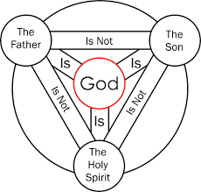
1-Yahweh God has revealed in Triune persons Isaiah 6: & 48:11-17
Isaiah 6:1-9 Father is Yahweh
ISAIAH HAS REVEALED SIX PICTURE OF JESUS
Isaiah 6: 5-8 Son is Yahweh
in John 12:37-41
1-Isa_40:3; Yahweh- came as Jesus Mk 1:3; Luke 3:3-6 Jn1:21
2-Yahweh -the Son saviour came with H. S. Isa 48:11-17 John17:3-5
3) Isiah 9:6 Child is born, Son Mighty God (Isa 9 quoted by Mt 4:14-16)
4) Isiah 42:1-4 Jesus become as Yahweh’ servant in Mt 12:17-21
5) Isiah 53:1-12 died (v1 Joh12:38) Rom10:16-17( v 4 Mat 8:17 )
V 9 In Acts 28:25-28 Holy Spirit is Yahweh
6) Isaiah 45:1,23 Dan 3:16-29 John 12:37-41 JESUS IS YAHWEH God the SON 13:13-17 SET AN EXAMPLE quoted in Phil 2:5-11
SO JESUS BEING YAHWEH GOD, HE SAID DESTROY THIS TEMPLE, I WILL RAISE ON THIRD DAY JOHN 2:19-21
Isa 40:6-8 The grass withereth, the flower fadeth: but the word of our God shall stand for ever.

Slide 39
I-Jesus means Yahweh | II-JESUS IS YAHWEH (Son) | III WHY YAHWEH-Son become human | IV- Jesus is fully God and man | V-WHO IS JESUS IN ISLAM?
Num 13:8 Oshea Num 13:16 Moses called Jehoshua = Yahweh- saves | Name of Yahweh Ex.3:6,13-14,23:20-21 JESUS John 8:53-58, John 13:13,10:33 | 1-Priest Aron Death Num 20:22-29 Aaron’s Sons died Leviticus 10:1-3 | Isaiah 9:6 a child is born Mighty God | Islam confirms JESUS’ humanity & deny his Divinity
BDB, 221; Friedrich Heinrich Wilhelm Gesenius, 386 Is 6:1-9 Jn 12:37 | Yahweh creator Ps 102:25-27 quoted in Heb. 1:8-12 for JESUS | All pries fall in sin 1 Sam 2:12-35 So Yahweh- priest) Ps 110:1,4. Heb 5:6 mt22:41-46 | John 1:1, 14 The Word was God The word became flesh/human | So ??? on divinity. If Jesus was God why he was praying?
Editor, Samuel Prideaux Tregelles LXX Bible-Ἰησοῦν. Greek -NT-Ιησούν | Holiness of Yahweh Lev 19:1-2 quoted in 1 Pet 1:10-16 for JESUS | 2-Yahweh- Prophet Duet 18:15-22, Ex 20:18-21, Act 3:22-23, 7:37 | kill me, a man Before - I am! John 8:40,-53-58 | Where did Jesus said I am God?
English JESUS Mt 1:21 JESUS will save | Description of Yahweh Ezek. 43:2, Mat17:2-5 refer -JESUS | 3-People couldn’t trust Yahweh as king so Duet 17:14-20, Soul | Son of David Lord of David Mt 21:9-16, 22:41-46 | If Jesus was God? how God can die?
ARABIC ESHA who saves sinner? | Worship of Yahweh Ps 8:1-2 quoted Mathew 21:9,16-17 JESUS | David II Sam 7:1-17, Finally Jesus is King Jer 23:5-6,Lk 1:32-35 | The Son God The Son David Luke 1:32 | If Jesus was God? why he said Father is greater than me

Slide 40
I-Jesus name Yahwe
Yah -HOSHEA
(SALVATION)
5-JESUS
Jesus
(English; KJV)
1-JOSHUA
JOSHUA
YEH+OSHUA
(LORD is salvation; Numbers 13:8,16)
4-Iesus / IESVS
(Latin Vulgate )
2-JESHUA
YESHUA (Nehemiah 8:17)
3-Iesous
(LXX-Greek; Matthew 1:21)

Slide 41
Numbers 13:8,16 -MATTHEW 1:21
JESHUA
YESHUA
יֵשׁ֙וּעַ
Iesous
(Ὶησους)
Ye (יֵ) Yod
Ie (Iη)
sh (שׁ֙) Shin
s (σ)
u (וּ) vav
ou (ου)
a (עַ) Ayin
s (ς)

Slide 42
Meaning of Jesus, Hebrew to Greek- English to Arabic
Hebrew | GREEK | Latin Vulgate IESVS | ENGLISH JESUS (KJV) | ARABIC Quran 3:45 (عِيسَى) ISA ARABIC –BIBLE Yasūʿ (يَسُوع)
Ye (יֵ) Yod | Ie (Iη) | Ie | JE | ʿayn -ع
sh (שׁ֙) Shin | s (σ) | S | S | Sin -س
u (וּ) vav | ou (ου) | U (O Disappear) | U
a (עַ) Ayin | s (ς) | s | S | yāʾ ى
JESHUA
YESHUA
יֵשׁ֙וּעַ
Iesous
(Ὶησους)
Arabic

Slide 43
2-Does the Bible explicitly says Jesus is Yahweh God?
Explicit Christology
1. Name and Character of Yahweh
Exod. 3:14.23:20-23, and Isa 43:11 alluded to in John 8:53-58
Exodus 15:3-8 The LORD is a man of war; The LORD is His name there stood a man over against ( NKJV)
(Ex 3:5 Joshua 5:13-15 Loose thy shoe from off thy foot; place …. is holy)
2. Work of Yahweh in creation
Ps 102:25-27 quoted in Heb. 1:10-12
Isa 44:6 alluded to in Rev. 1:17, I am the first, and I am the last

Slide 44
3. Holiness of Yahweh
Lev 19:1-2 quoted in 1 Pet 1:10-16
Lev 19:1-2 Ye shall be holy: for I the LORD your God am holy
1Pe 1:13-15 …….Jesus Christ…1Pe 1:15 But as he which hath called you is holy
1Pe 1:16 Because it is written, Be ye holy; for I am holy.
Paul Mean Jesus is Yahweh
Ex 17:6 quoted in I Corinth 10:4 And did all drink the same spiritual drink: for they drank of that spiritual Rock that followed them: and that Rock was Christ.
Deu 32:6 O foolish- thy father that hath bought thee?

Slide 45
4. Descriptions of Yahweh
Ezek. 43:2 and Dan. 10:6 alluded to in Rev. 1:7, 13-17)
Mat 17:1 Jesus …..Mat 17:2 And was transfigured before them: and his face did shine as the sun, and his raiment was white as the light.
5. Worship of Yahweh
Isa 45:23 alluded to in Phil. 2:5-11; Dan 3:16-29
Dan 3:25 He answered and said, Lo, I see four men loose, walking in the midst of the fire, and they have no hurt; and the form of the fourth is like the Son of God.
Ps 8:1-2 quoted in Mathew 21:16-17

Slide 46
6. Salvation of Yahweh Joel 2:32 quoted in Rom. 10:13
Joe 2:32 And it shall come to pass, that whosoever shall call on the name of the LORD shall be delivered:
Act 2:16 But this is that which was spoken by the prophet Joel;
Act 2:21 … whosoever shall call on the name of the Lord shall be saved.
Rom 10:11-13 For the scripture saith, For whosoever shall call upon the name of the Lord shall be saved.
BUT Paul Asks some questions
Rom 10:14 How then shall they call on him in whom they have not believed?
and how shall they believe in him of whom they have not heard?
and how shall they hear without a preacher?
Rom 10:15 And how shall they preach, except they be sent?
as it is written, How beautiful are the feet of them that preach the gospel of peace, and bring glad tidings of good things!
Rom 10:17 So then faith cometh by hearing and hearing by the word of God.

Slide 47
7.The glory of Yahweh God the Son Jesus
Isa 6:1-10 alluded to in John 12:37-41
Isa 6:5 Then said I, Woe is me! ---for mine eyes have seen the King, the LORD of hosts.
John 12:41 Isaiah said this because he saw Jesus' glory and spoke about him.
8. Jesus is Yahweh God the Son, confirmed by John the Baptist and Jesus
Isa 40:3 quoted in John 1:19-23,
Isa 40:3 The voice of him that crieth in the wilderness, Prepare ye the way of the LORD
John 1:22 Then said they unto him, Who art thou?
John 1:23 He said, I am the voice of one crying in the wilderness, Make straight the way of the Lord, as said the prophet Esaias.

Slide 48
III WHY YAHWEH God become human
1-Priest Aron Death, Num 20:22-29
Aaron’s Sons died, Leviticus 10:1-3
All pries fall in sin, 1 Sam 2:12-35
So Yahweh- Priest) Ps 110:1,4. Heb 5:6 mt 22:41-46
2-Yahweh- Prophet, Duet 18:15-22, Ex 20:18-21, Act 3:22-23, 7:37
3-People could trust Yahweh as king so Duet 17:14-20, Soul
David II Sam 7:1-17, Finally Jesus is King Jer 23:5-6,Luke 1:32-35

Slide 49
Can God become man?-Logical possibilities?
Islamic objection: Quran 112:4 there is non like Allah,
Gen 1:26, Col 1:15 Jesus is image of God Invisible God, “When man is created in the image of God then why God cannot be Incarnate in His own Image as man?”
Ex 3:1-15 God in the Fire yet bush is not consumed why?
Dan 3:16-28 Shadrach, Meshach, and Abednego are in the fire yet not
consume? Why God in Fire Isiah 45:1,23, Phil 2:5-10

Slide 50
IV. Does the Bible says Jesus is fully God and man
1) Exo 15:3 The LORD is a man of war: the LORD is his name I Cor 10:4-5
2) Isaiah 9:6 For unto us a child is born, unto us a son is given: and the government shall be upon his shoulder: and his name shall be called Wonderful, Counsellor, The mighty God, 10:20-21

Slide 51
How Jesus is God and man at the same time?
3) "In the beginning was the Word, and the Word was with God, and the Word was God... The Word became flesh and made his dwelling among us.." John 1:1, 14
So God His divinity Flesh his Humanity

Slide 52
Jesus is fully God and man
4) "As it is, you are determined to kill me, a man John 8:40 But 'I tell you the truth,' Jesus answered, "before Abraham was born, I am!'" John 8:53- 58
Jesus Him self said I am man & God
5) John 20:17-28-29 Ps 35:23 My Lord my God Mathew 17:2-10 resurrection prove

Slide 53
Jesus is fully God and man
6) Luke 1:32-35 Son of David & Son of God
Luk 1:32 He shall be great, and shall be called the Son of the Highest: and the Lord God shall give unto him the throne of his father David:
The Son God shows his Divinity
The Son David his Humanity

Slide 54
Jesus is fully God and man
7) Rev 22:16 I Jesus have sent mine angel to testify unto you these things in the churches. I am the root and the offspring of David, and the bright and morning star.
The only way for the Messiah to be both David's Lord and son is if he were both God and Man at the same time.

Slide 55
Jesus is fully God and man
The only way for the Messiah to be both David's Lord and son is if he were both God and Man at the same time.
This is precisely the answer Jesus himself gives in Revelation:

Slide 56
Where did Jesus said I am God worship me?
1- Ex 3:1,2,6 When Angel of God said I am the God of Abraham Isaq Jacob, ( In Heb the word God is Elohim,
2- In BC 150 Trans Gk Theos- In AD. 1611 (Eng) God (but Elohim was used for Egyptian gods also Ex 12:12 Num 33:4,)
3- So Moses asked what is your name? Ex 3:13 Why?
4-God answered my name is I am who I am, Ex 3:14-15, 6:2-3
5- I am the LORD/ Yahweh Ex 3:14-15, 6:2-3,
6- In BC 150 OT translated in Greek Yahweh- Kurios (Eng) LORD
So the questions should be, Did Jesus claimed to be I am and LORD

Slide 57
Did Jesus ever claim to be “I am” & “Lord” (The Lord God appear to Moses)? Being man You make yourself God John 10:33, 20:29
1. Jesus Said I am the Bread of Life ((John 6:35)
Exodus 16:35 they eat Manna and died
2. Jesus Said I am the Light of the World
(John 1:4, 9, 8:12, 9:5, John 12:46, Rev 21:22-24 Mt 17:2-5)
3. Jesus Said I am the Door John 10:9-enter-in close door Joh 20:19
4. Jesus said I am the Good Shepherd John 10:11
Psalm 23: Mat 22:41-46 I am the Lord of David
5. Jesus I am the Resurrection and the Life
John 11:25-26. I kill and I make alive Duet 32:39 Isa 25:6-9
6. Jesus said I am the Way, the Truth, and the Life
John 14:6 “..the LORD be a true and faithful." Jer. 42:5
7. Jesus said I am the true Vine John 15:5

Slide 58
Biblical Trinity
DISCRIPTION | FATHER | SON | HOLYSPIRIT
Called God | Gen 1:1-31 Phil. 1:2 | John 1:1-4 Col 2:9 | Acts 5:3-4
Creator | Isa 64:8; 44:24 | Jh 1:3 Col 1:15-17 | Job 33:4,26:13
Resurrects | 1Thess. 1:10 | Jh 2:19-21, 5:21,10:17 | Rom. 8:11
Indwells | 2 Cor. 6:16 | Col. 1:27 | John 14:17
Everywhere | 1 Kings 8:27 | Mat 28:20;18:20 | Ps 139:7-10
All knowing | 1 John 3:20 | John 16:30 | 1 Cor. 2:10-11
Sanctifies | 1Thess.5:23 | Heb. 2:11 | 1 Pet. 1:2
Life giver | Gen. 2:7 | Jh1:3;5:21 | 2 Cor. 3:6,8

Slide 59
Question Bible says you all are gods
. Bible says all Judges are God Ps 82:1,6
Bible says Moses is God Ex 4:16,7:1
Satan is God II Cor 4:4,
So if Jesus also called God he is Not God because Bible says there is only one God beside him there is no God

Slide 60
True God | False gods | Figurative gods
True God II Chr 15:3 | That are not gods Jer 5:7, 16:20 | Moses, F god (Elohim) Exo 4:16; 7:1; 4:24,25; Num 20:8-10
True God Jer 10:10 | No god beside Me Deut 32:39 | Judges F gods Exo 21:5-6; 22:8; Deut 1:17
Only true God John 17:3 | No god was formed before Me Isa 43:10 | You are all gods (judges) Psalms 82:1-2;6-7

Slide 61
True God I Thes 1:9 | There is no god beside Me Isa 44:6,8 | You are all gods (prophets) John 10:34-36 being of god
True God Rev 6:10 | There is no god beside Me Isa 45:5,6,21,22 | you are man, not god Ezek 28:1-10, Isa 14:3-4,12-22
True God Jer 42:5 | No god like Yehowah Psalms 86:8,10 | Satan tried to be god, promoted Adam and Eve failed, but still Satan claims to be god, claiming among people that he is god but not by nature II Cor 4:34; Jn 8:44; Gal 4:8

Slide 62
True God John 3:33 | demons behind idols which are not gods I Cor 10:19,20 | Stomach is god Phil 3:19
True God I John 5:20 | gods are demons, so God will punish them Exo 12:12, Num 33:4, Deut 32:16,17, I Sam 5:3-8, Psalms 106:36,37, God will punish all false gods at the day of judgment Zeph 2:11 | all the gods worship Jesus Psalm 97:7; Phil 2:10,11

Slide 63
Now let us see, into which category Jesus comes, false gods?,
Figurative gods? Or True God by nature?
Yes. I John 5:20 says “Jesus Christ is the true God…”
So now let us compare and see how Jesus is the only one true God in His Name, Titles, Nature, Essence and attributes, just as YEHOVAH. In the light of Islam etc;

Slide 64
The Names, Titles and Attributes Demonstrating That Jesus and Yahweh Are One in essence and nature
"There is one God" - I Corinthians 8:6

Slide 65
YHWH (I AM) | Description of the Father Exodus 3:14 Duet 32:39 Isaiah 43:10 | Description of the Son Jesus John 8:24 John 8:58 John 18:4-6
2. God | Genesis 1:1 Deut 6:4 Psalm 45:6,7 | Isaiah 7:14, 9:6; John1:1,14;20:28; Rom 9:5; Titus2:13; Heb1:8; 2 Peter 1:1,II Jesus is God
3. Alpha & Omega | Isaiah 41:4; 44:6; 48:12 Revelation 1:8 | Rev 1:17,18; 2:8 Rev 22:12-16

Slide 66
4. Lord | Isaiah 45:23 | Matt 12:8; Acts 7:59,60; 10:36 Rom 10:12; I Cori 2:8; 12:3 Philip 2:10,11
5. Savior | Isaiah 43:3,11 Isaiah 63:8 Luke 1:47 I Timothy 4:10 | Matt 1:21; Luke 2:11 John 1:29; John 4:42; Titus 2:13 Hebrews 5:9
6. King | Psalm 95:3 Isaiah 43:15 I Timothy 6:14-16 | Rev 17:14 Rev 19:16

Slide 67
7. Forgiver of Sin | Exodus 34:6-7 Nehemiah 9:17 Daniel 9:9 Jonah 4:2 | Mark 2:1-12 Acts 26:18 Colo 2:13; 3:13
8. Lord our Healer | Exodus 15:26 | Acts 9:34
9. Omnipresent | Psalm 139:7-12 Proverbs 15:3 | Matthew 18:20 Matthew 28:20 Ephesians 3:17; 4:10

Slide 68
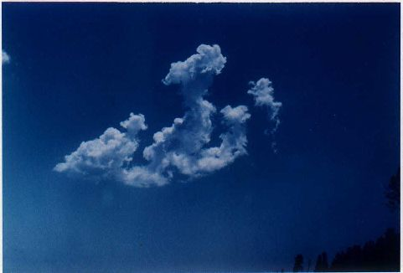
The Goal of discussion
Answering Islamic objection to bring Muslims to Jesus Christ
Paul Asgar Ali
9845-219-832
Email asgaali@gmail.com

Slide 69
Thanks
Q/A

