Slide 1
Detecting and Preventing Power Outages in a Smart Grid using eMoflon
Sven Peldszus, Jens Bürger, Daniel Strüber University of Koblenz and Landau
Transformation Tool Contest Marburg, July 21, 2017

Slide 2

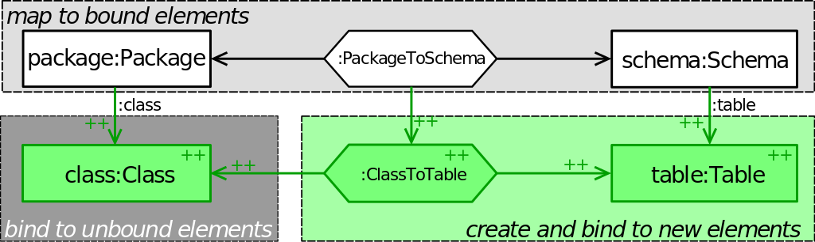
eMoflon: A tool for building tools
Based on the Triple Graph Grammar paradigm
How it works:
User specifies correspondence rules between source and target meta-model
Forward and backward transformation code is generated
Model software systems using a visual or a textual syntax
Generate EMF-compliant Java code from your model
Incremental execution mode

Slide 3
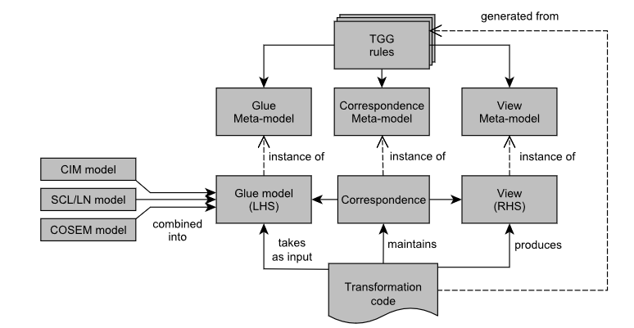
Overview of solution
Interpret the set of input models as the LHS, and the output view as the RHS.
Glue meta-model integrates involved meta-models; glue model integration in a preprocessing step
No support for incremental yet

Slide 4
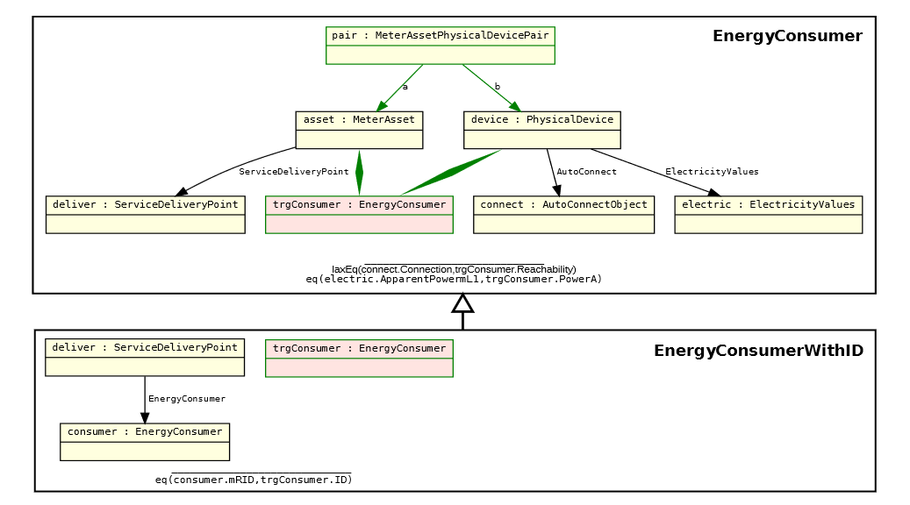
Task 1: An example TGG rule and its refinement

Slide 5
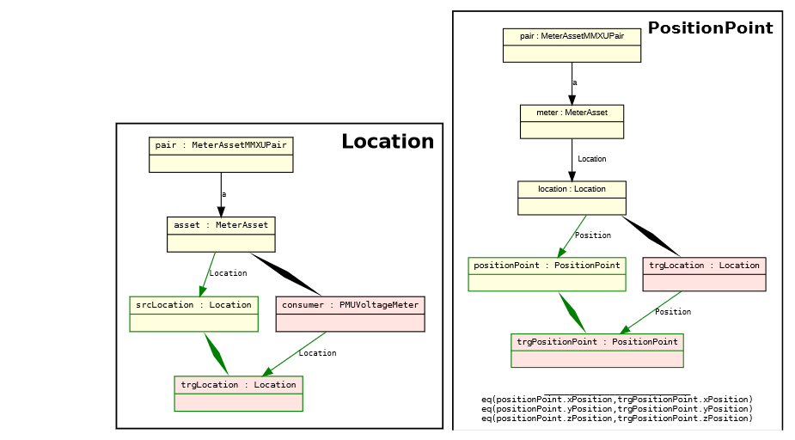
Task 2: Two related TGG rules for producing the view

Slide 6
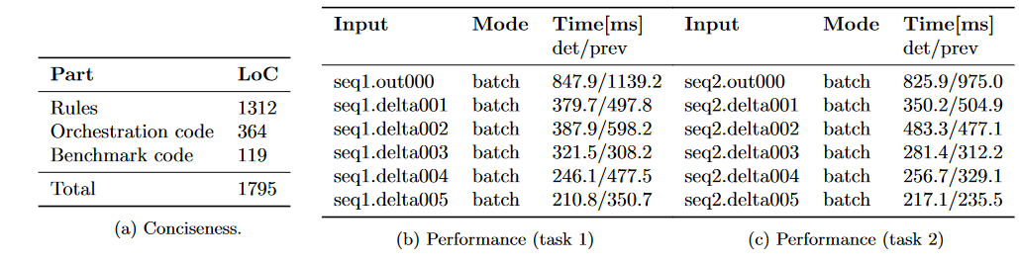
Evaluation

Slide 7
Thank you

Slide 8
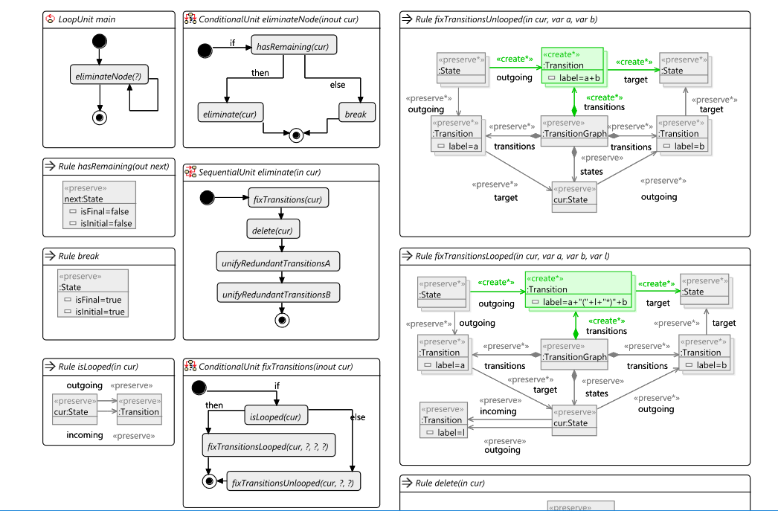
Backup

Slide 9
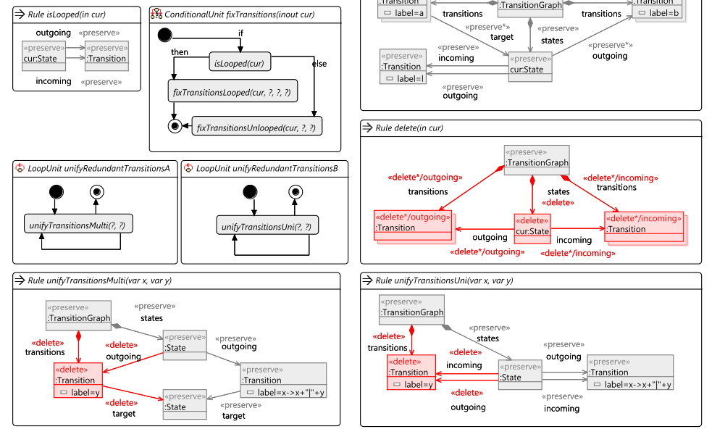
Bacup

