Slide 1
The SDMLib Solution to the TTC 2017 Families 2 Persons Case
Albert Zündorf and Alexander Weidt
Kassel University
zuendorf | alexander.weidt @uni-kassel.de

Slide 2
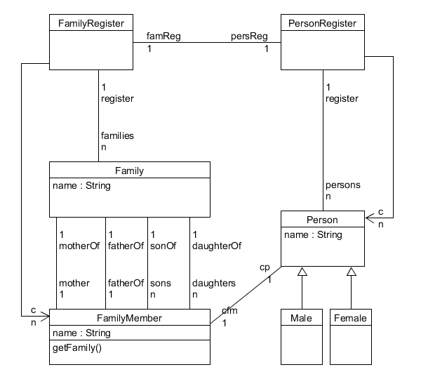
NOT EMF: SDMLib Class Model and Code Generation

Slide 3
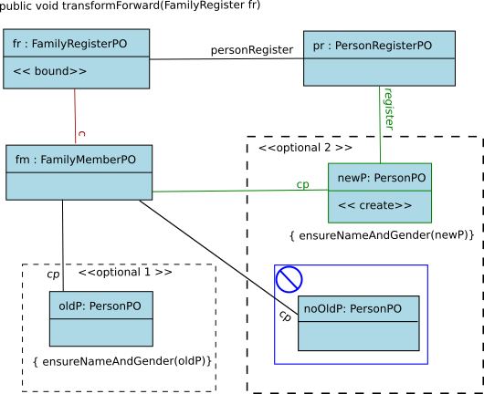

Slide 4
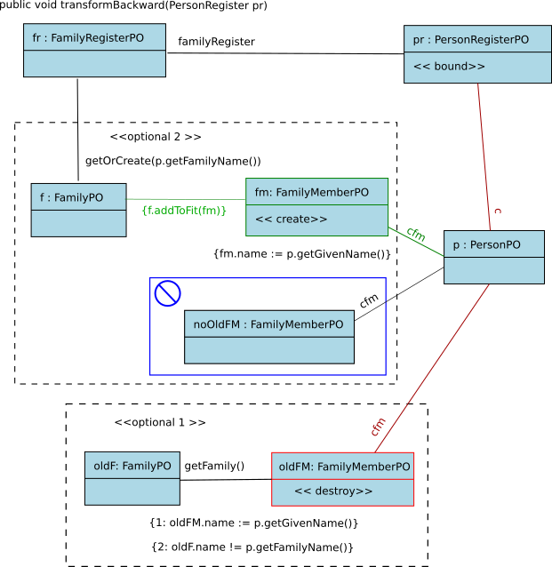

Slide 5
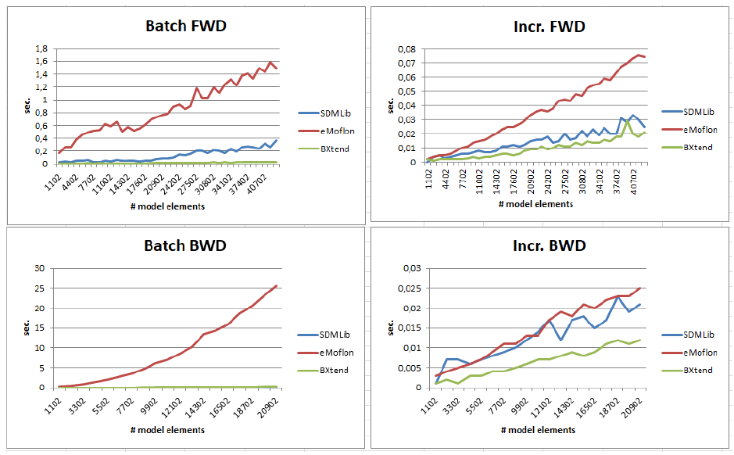
Correctness: all Junit tests are passed (in principle)

