Slide 1
Transformation of Finite State Automata to Regular Expressions using Henshin
Daniel Strüber University of Koblenz and Landau
Transformation Tool Contest Marburg, July 21, 2017

Slide 2

Henshin: A graph-based model transformation language and framework
Expressive transformation language with a graphical syntax
Support for in-place endogenous and exogenous transformations
Efficient interpreter engine based on constraint solving
Verification using state space tools
Conflict and dependency detection based on critical pair analysis

Slide 3
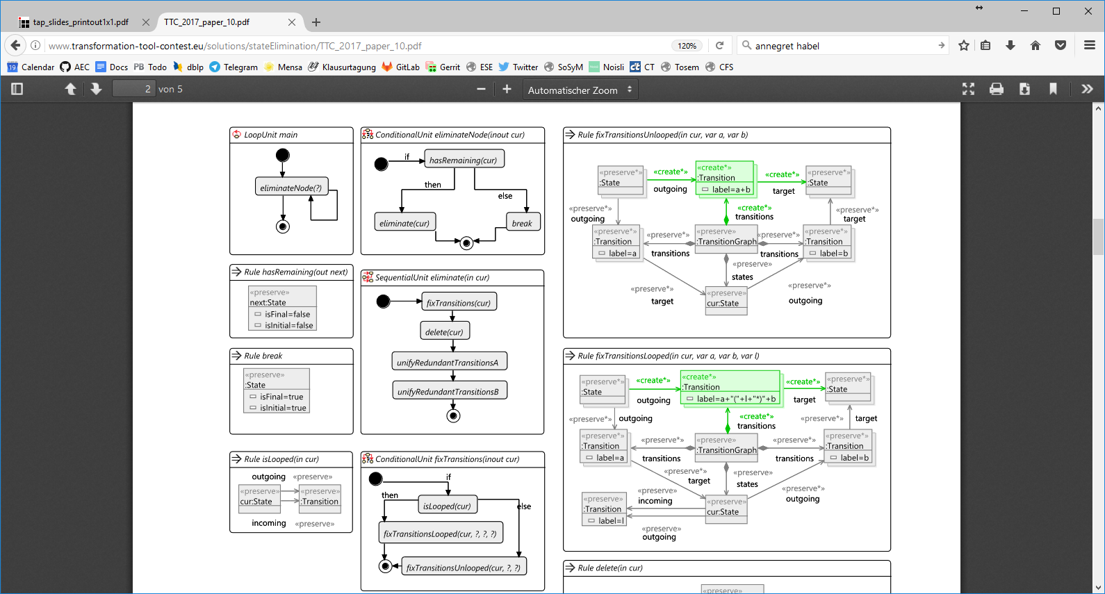
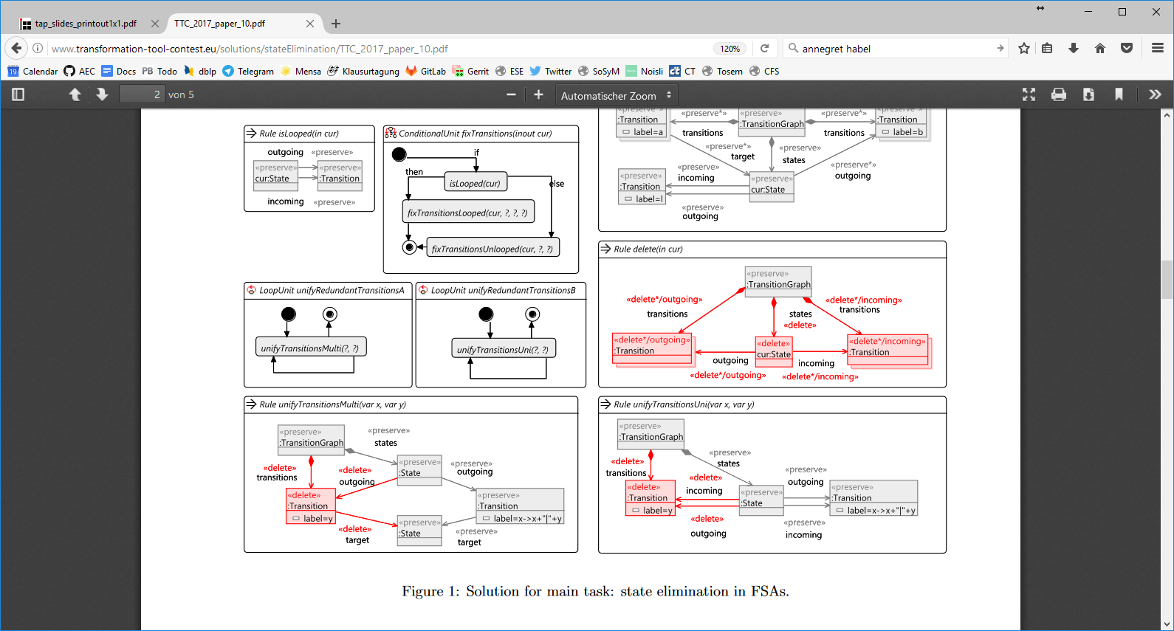
Solution: Main task
Implemented the state elimination algo using 8 rules and 6 units

Slide 4
Solution: Rules for main task

Slide 5
Solution: Control flow units for main task

Slide 6
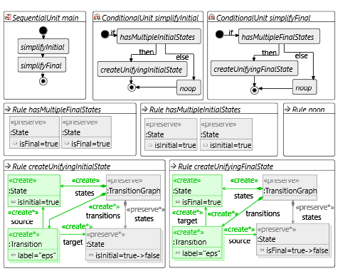
Solution: Extension 1
Implemented the simplification algo using 5 rules and 3 units

Slide 7
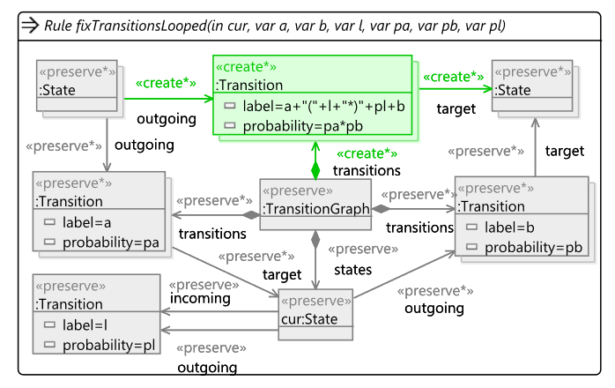
Solution: Extension 2
Added extensions to main task solution to mimic reference impl

Slide 8
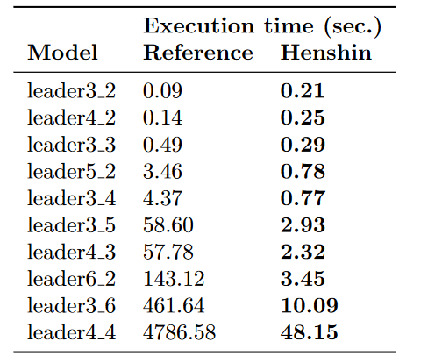
Evaluation
Full correctness for all three tasks
Mostly declarative solution
Execution times as per table
Scalability: leader4_5 was last model to take less than 1 hour

Slide 9
Thank you

Slide 10
Backup

Slide 11
Bacup

