Slide 1
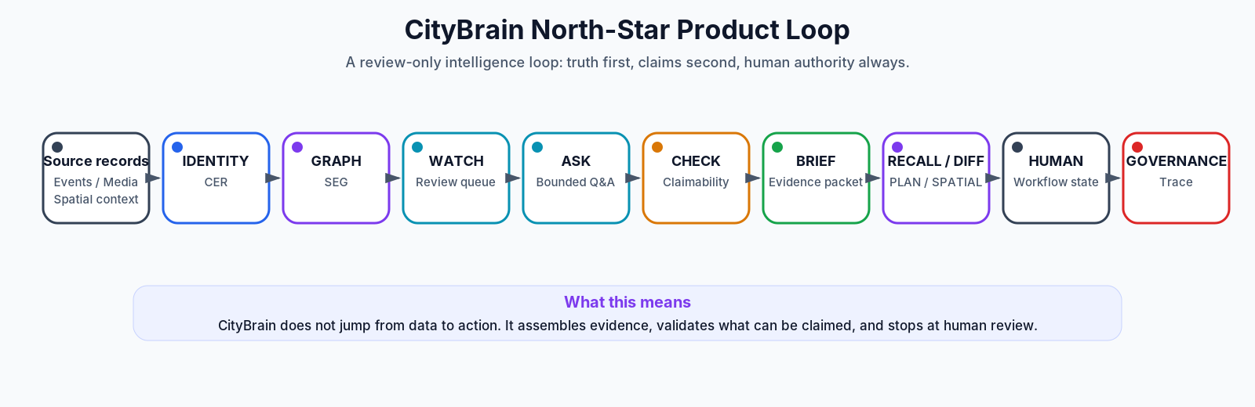
CityBrain Product Consolidation
Product, architecture, gaps, parked work, and component plug-in map
CityBrain - governed review intelligence, not production command/control

Slide 2
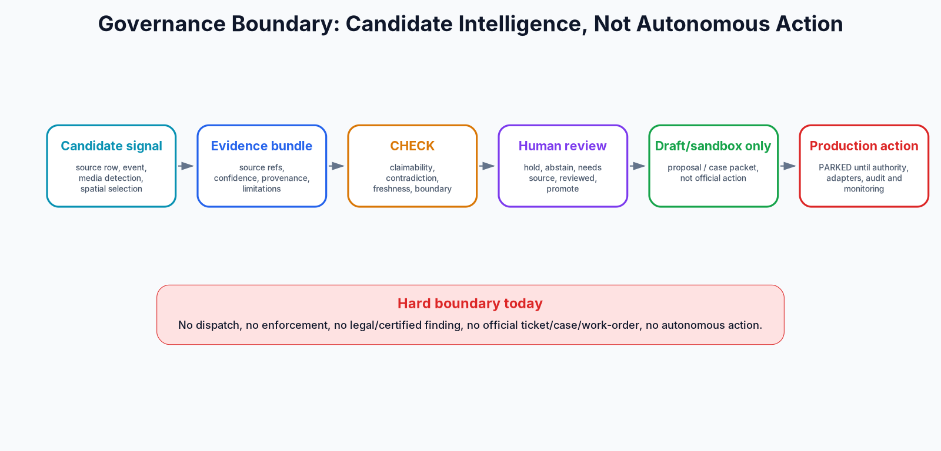
The product truth
CityBrain is a governed review-only intelligence cockpit.
CityBrain is a governed review-only city intelligence cockpit that turns fragmented city records, events, media candidates and spatial context into evidence-backed human-review packets.
Current strength: trusted local/replay review packets, not autonomous operations.
The product unit is a packet: entity + graph + evidence + CHECK + authority + workflow state.
CityBrain - governed review intelligence, not production command/control

Slide 3
North-star loop
Truth flows through identity, graph, evidence, CHECK, human review and governance.
CityBrain - governed review intelligence, not production command/control

Slide 4
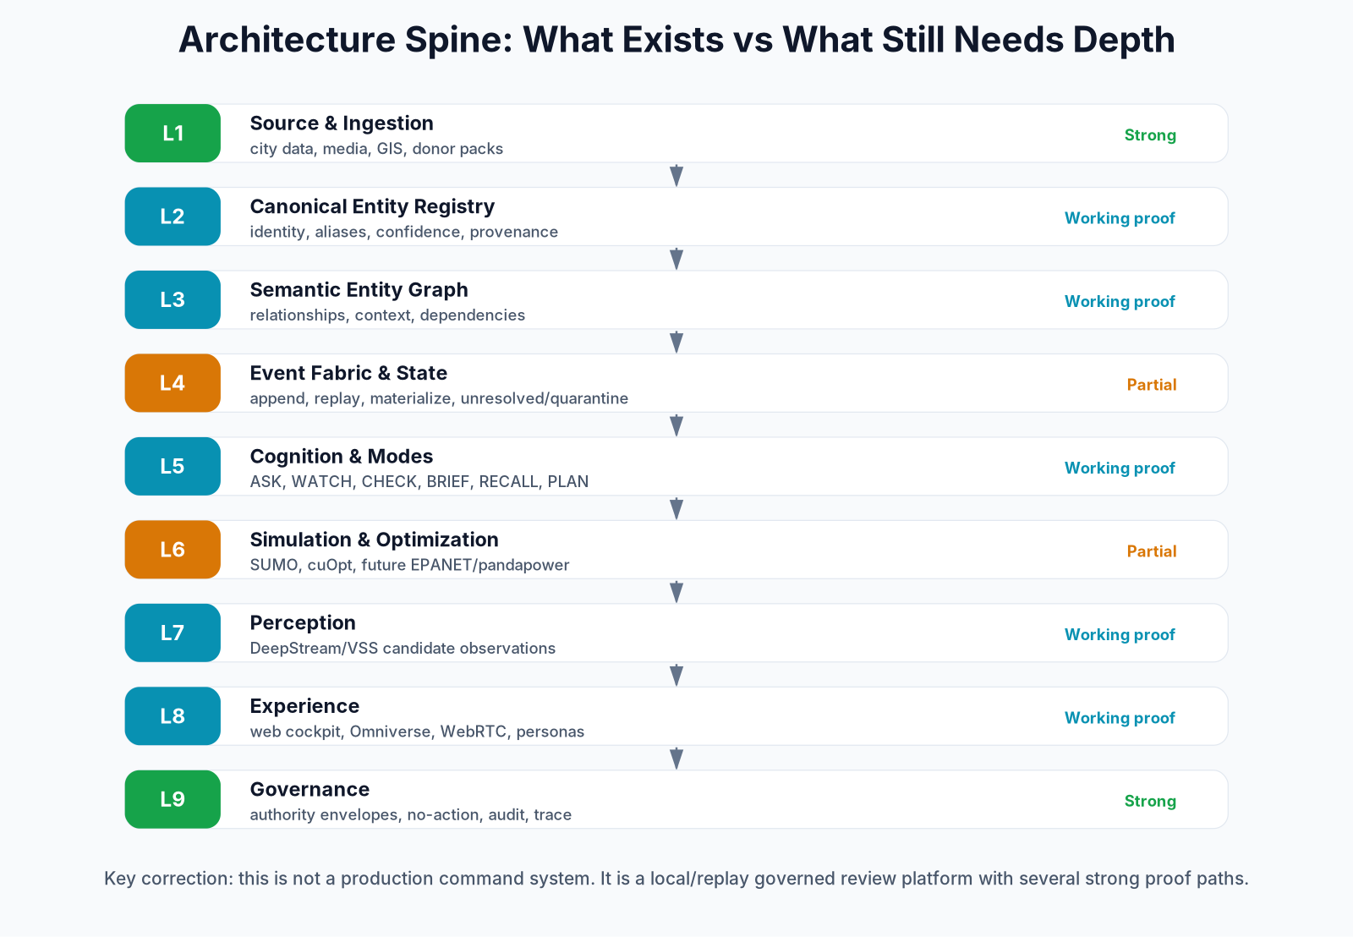
Architecture spine
CER first, graph second, evidence and governance always.
CityBrain - governed review intelligence, not production command/control

Slide 5
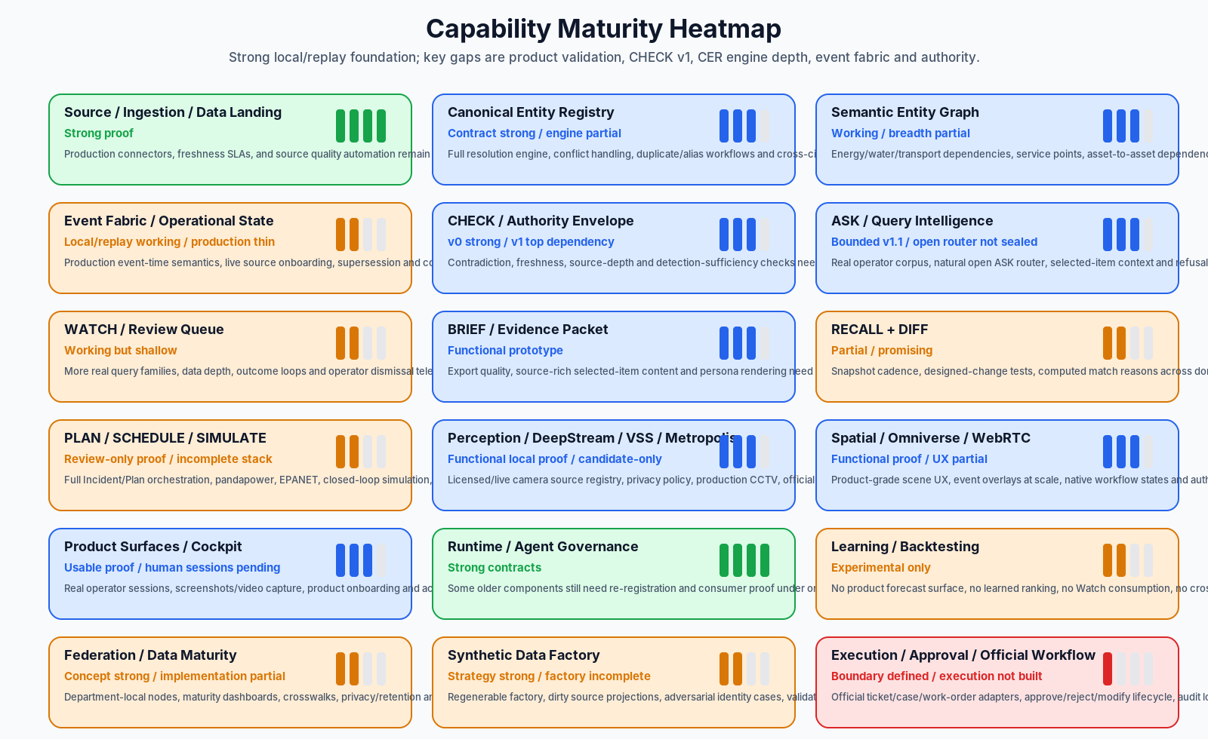
What exists today
Strong proof paths, but conservative claims.
Source records and data landing across several cities.
Canonical graph and evidence packet proofs.
Web cockpit, Omniverse/WebRTC and DeepStream/VSS local proof lanes.
CHECK/Authority/trace/no-action governance patterns.
One offline experimental forecast, frozen-replay only.
CityBrain - governed review intelligence, not production command/control

Slide 6
What cannot be claimed yet
This honesty is a credibility feature.
Production live operations.
Public API / SLA.
Certified citywide digital twin.
Autonomous monitoring or dispatch.
Enforcement/legal/certified finding.
Official ticket/case/work-order creation.
Product forecast surface.
Live Watch consumption of a forecast model.
Cross-city learned transfer.
Trained ranking in operator surfaces.
Production-grade execution adapters.
Official execution remains parked until authority exists.
CityBrain - governed review intelligence, not production command/control

Slide 7
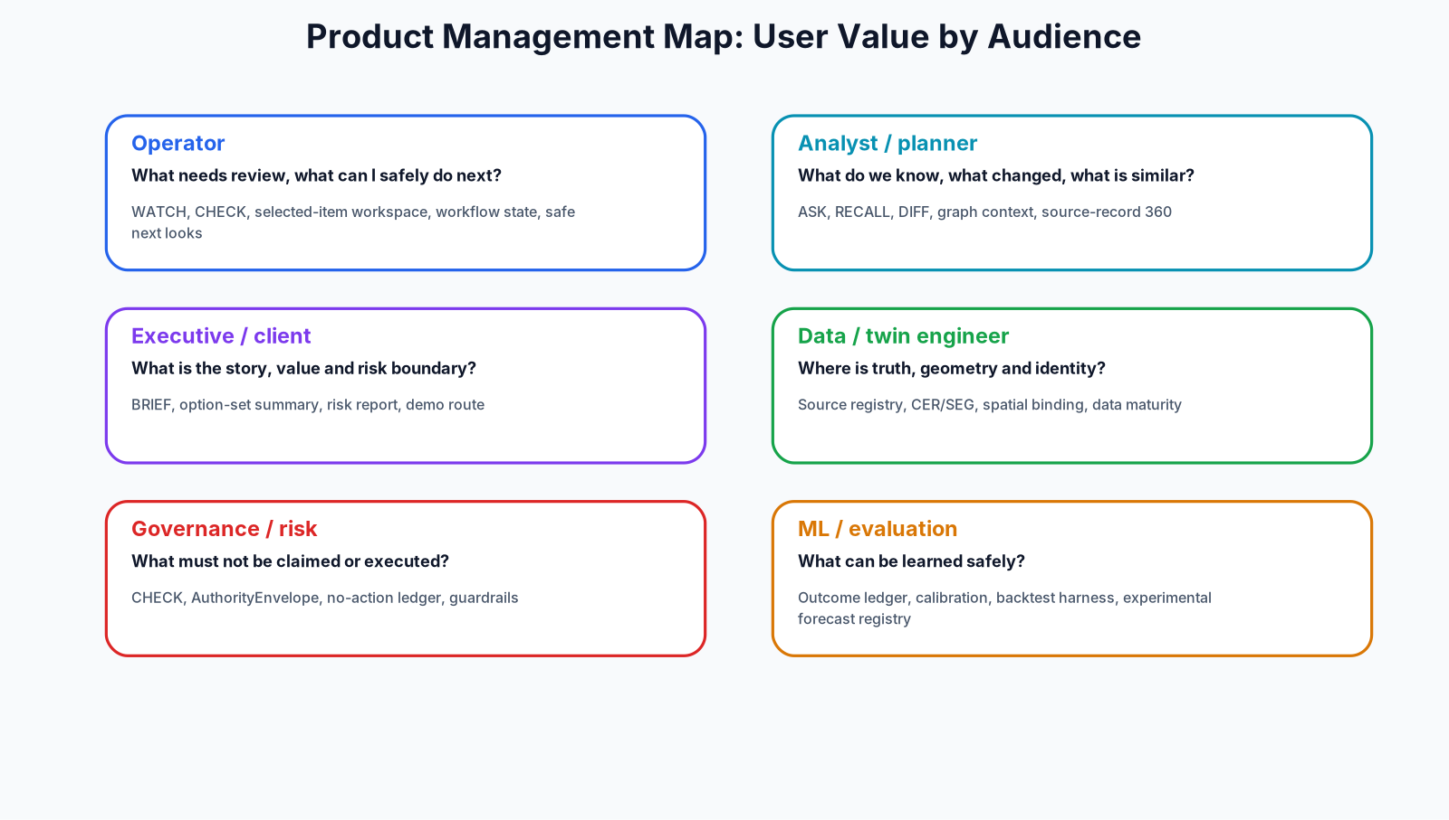
Product management map
Different users see the same evidence chain through different lenses.
CityBrain - governed review intelligence, not production command/control

Slide 8
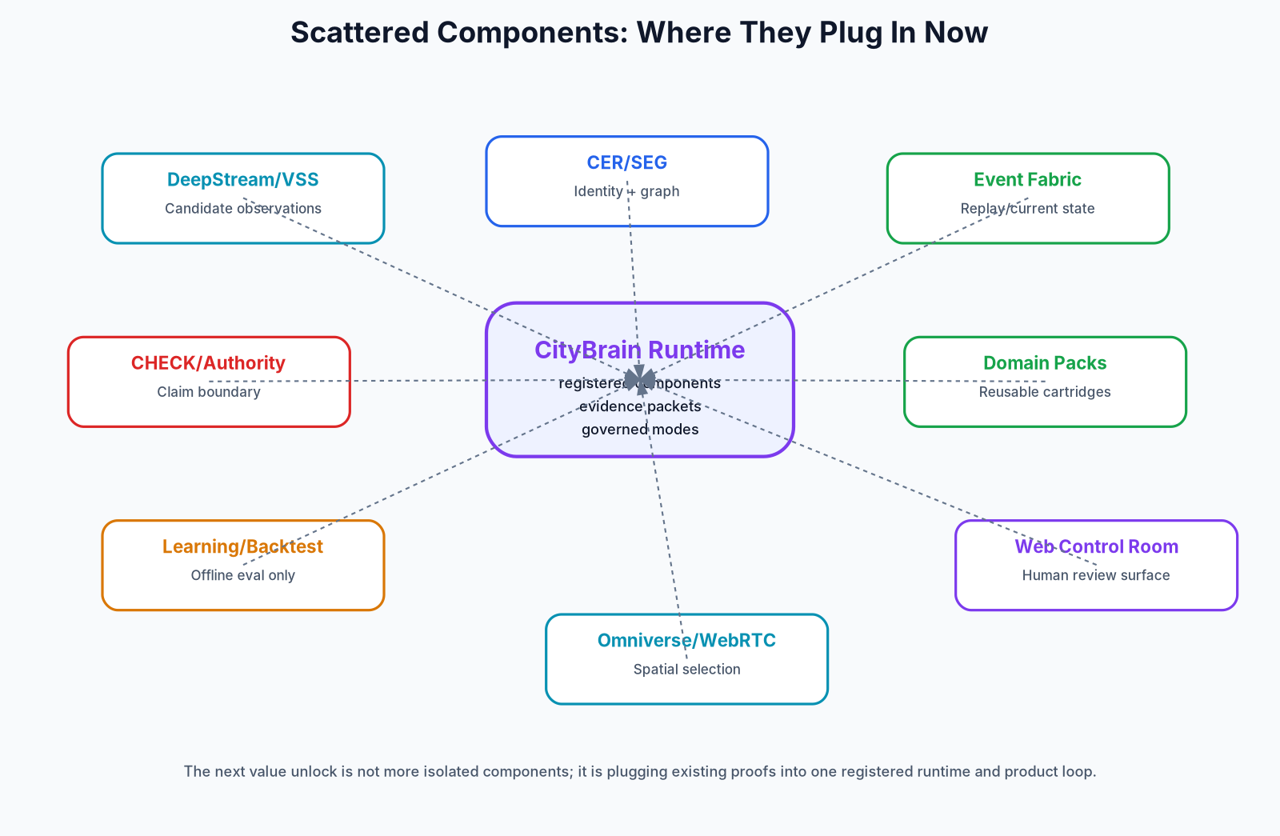
Component plug-in map
The next value unlock is connecting existing proofs into one runtime.
CityBrain - governed review intelligence, not production command/control

Slide 9
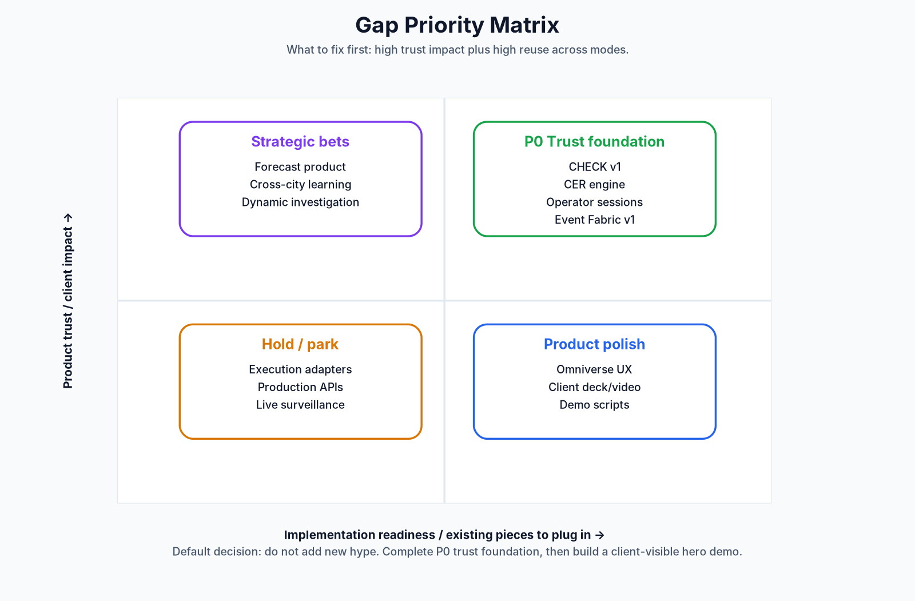
Gap priority matrix
P0 gaps are trust foundation, not feature polish.
CityBrain - governed review intelligence, not production command/control

Slide 10
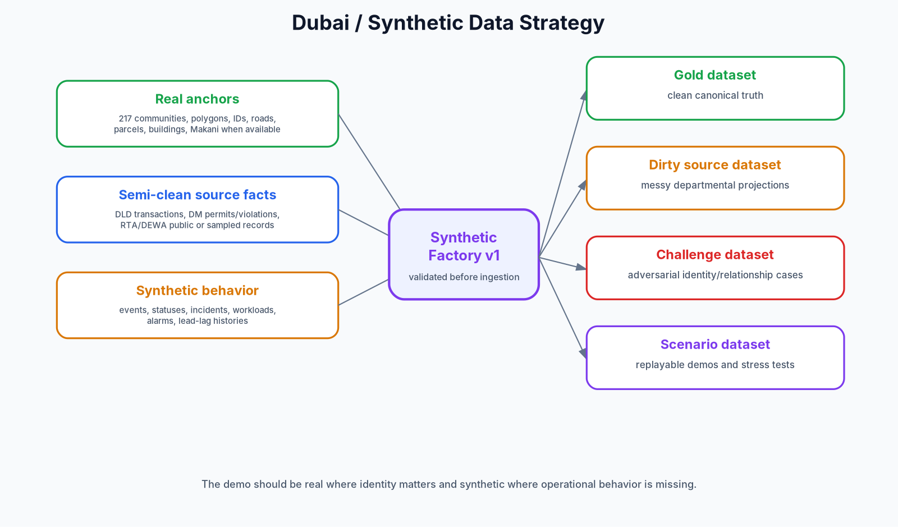
Synthetic and Dubai strategy
Real where identity matters; synthetic where operational behavior is missing.
CityBrain - governed review intelligence, not production command/control

Slide 11
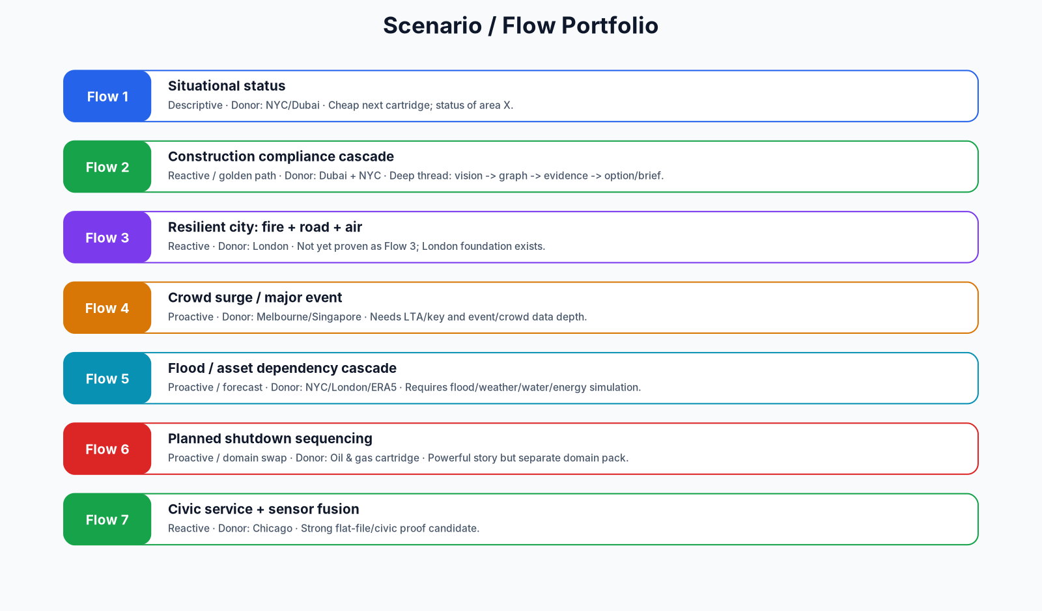
Scenario portfolio
One spine, many cartridges.
CityBrain - governed review intelligence, not production command/control

Slide 12
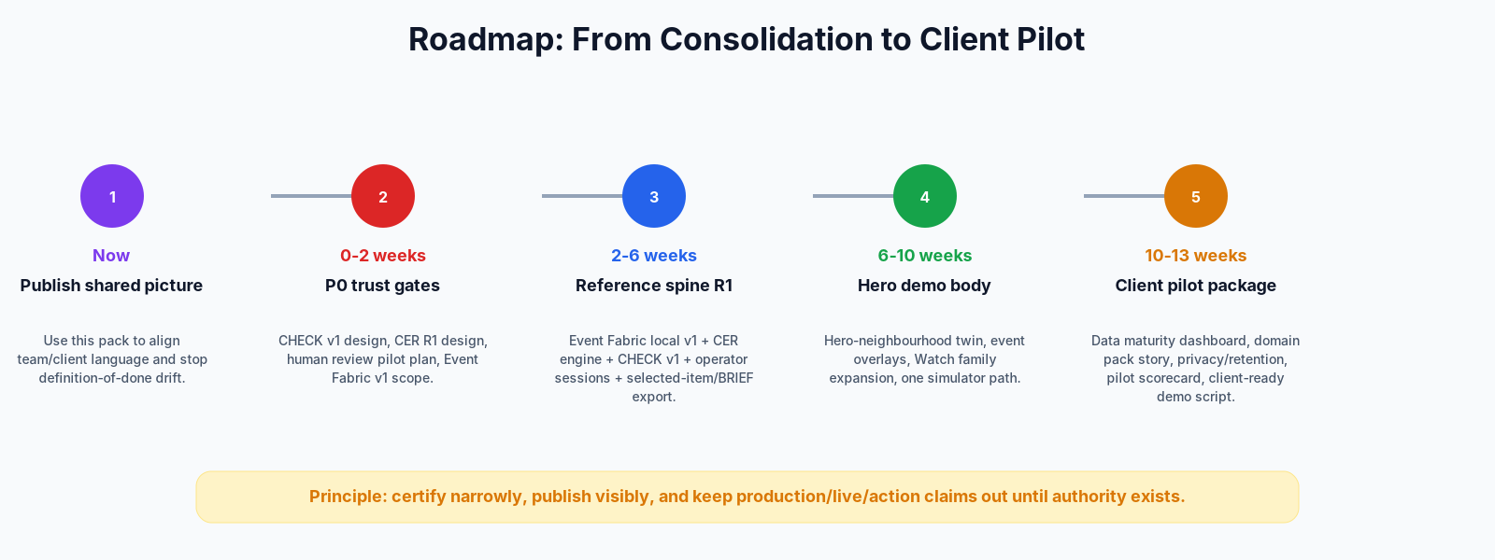
Roadmap
Consolidate trust foundation, then demo/pilot.
CityBrain - governed review intelligence, not production command/control

Slide 13
Immediate action plan
Make the picture real, testable and explainable.
Publish this pack as the single product room.
Build CHECK v1 and CER Engine R1.
Run first real operator sessions.
Finish local Event Fabric v1.
Build hero-neighbourhood twin with event overlays.
Package a client demo route with strict claims.
CityBrain - governed review intelligence, not production command/control

Slide 14
Client close
The safest, strongest message.
CityBrain is a review-and-governance layer between messy city reality and eventual approved operations.
It helps humans know what happened, what matters, what can be claimed, what should be checked next and what is still forbidden.
The current product is trusted review, not autonomous command.
CityBrain - governed review intelligence, not production command/control

