Slide 1
Battleship
by Joseph DiPalma, Annan Miao, and Ben Xu
<number>
Notes:
Joseph

Slide 2

Background and Problem Domain
We created a computerized version of the classic board game Battleship.
The game allows 2 players to play over LAN.
The problem domain consisted of:
creating a functional GUI,
implementing a working networking client/server, and
making sure that the game was responsive for both players.
<number>
Notes:
Joseph
Picture Source:
- https://i.ytimg.com/vi/1w6wt2uS8To/hqdefault.jpg

Slide 3
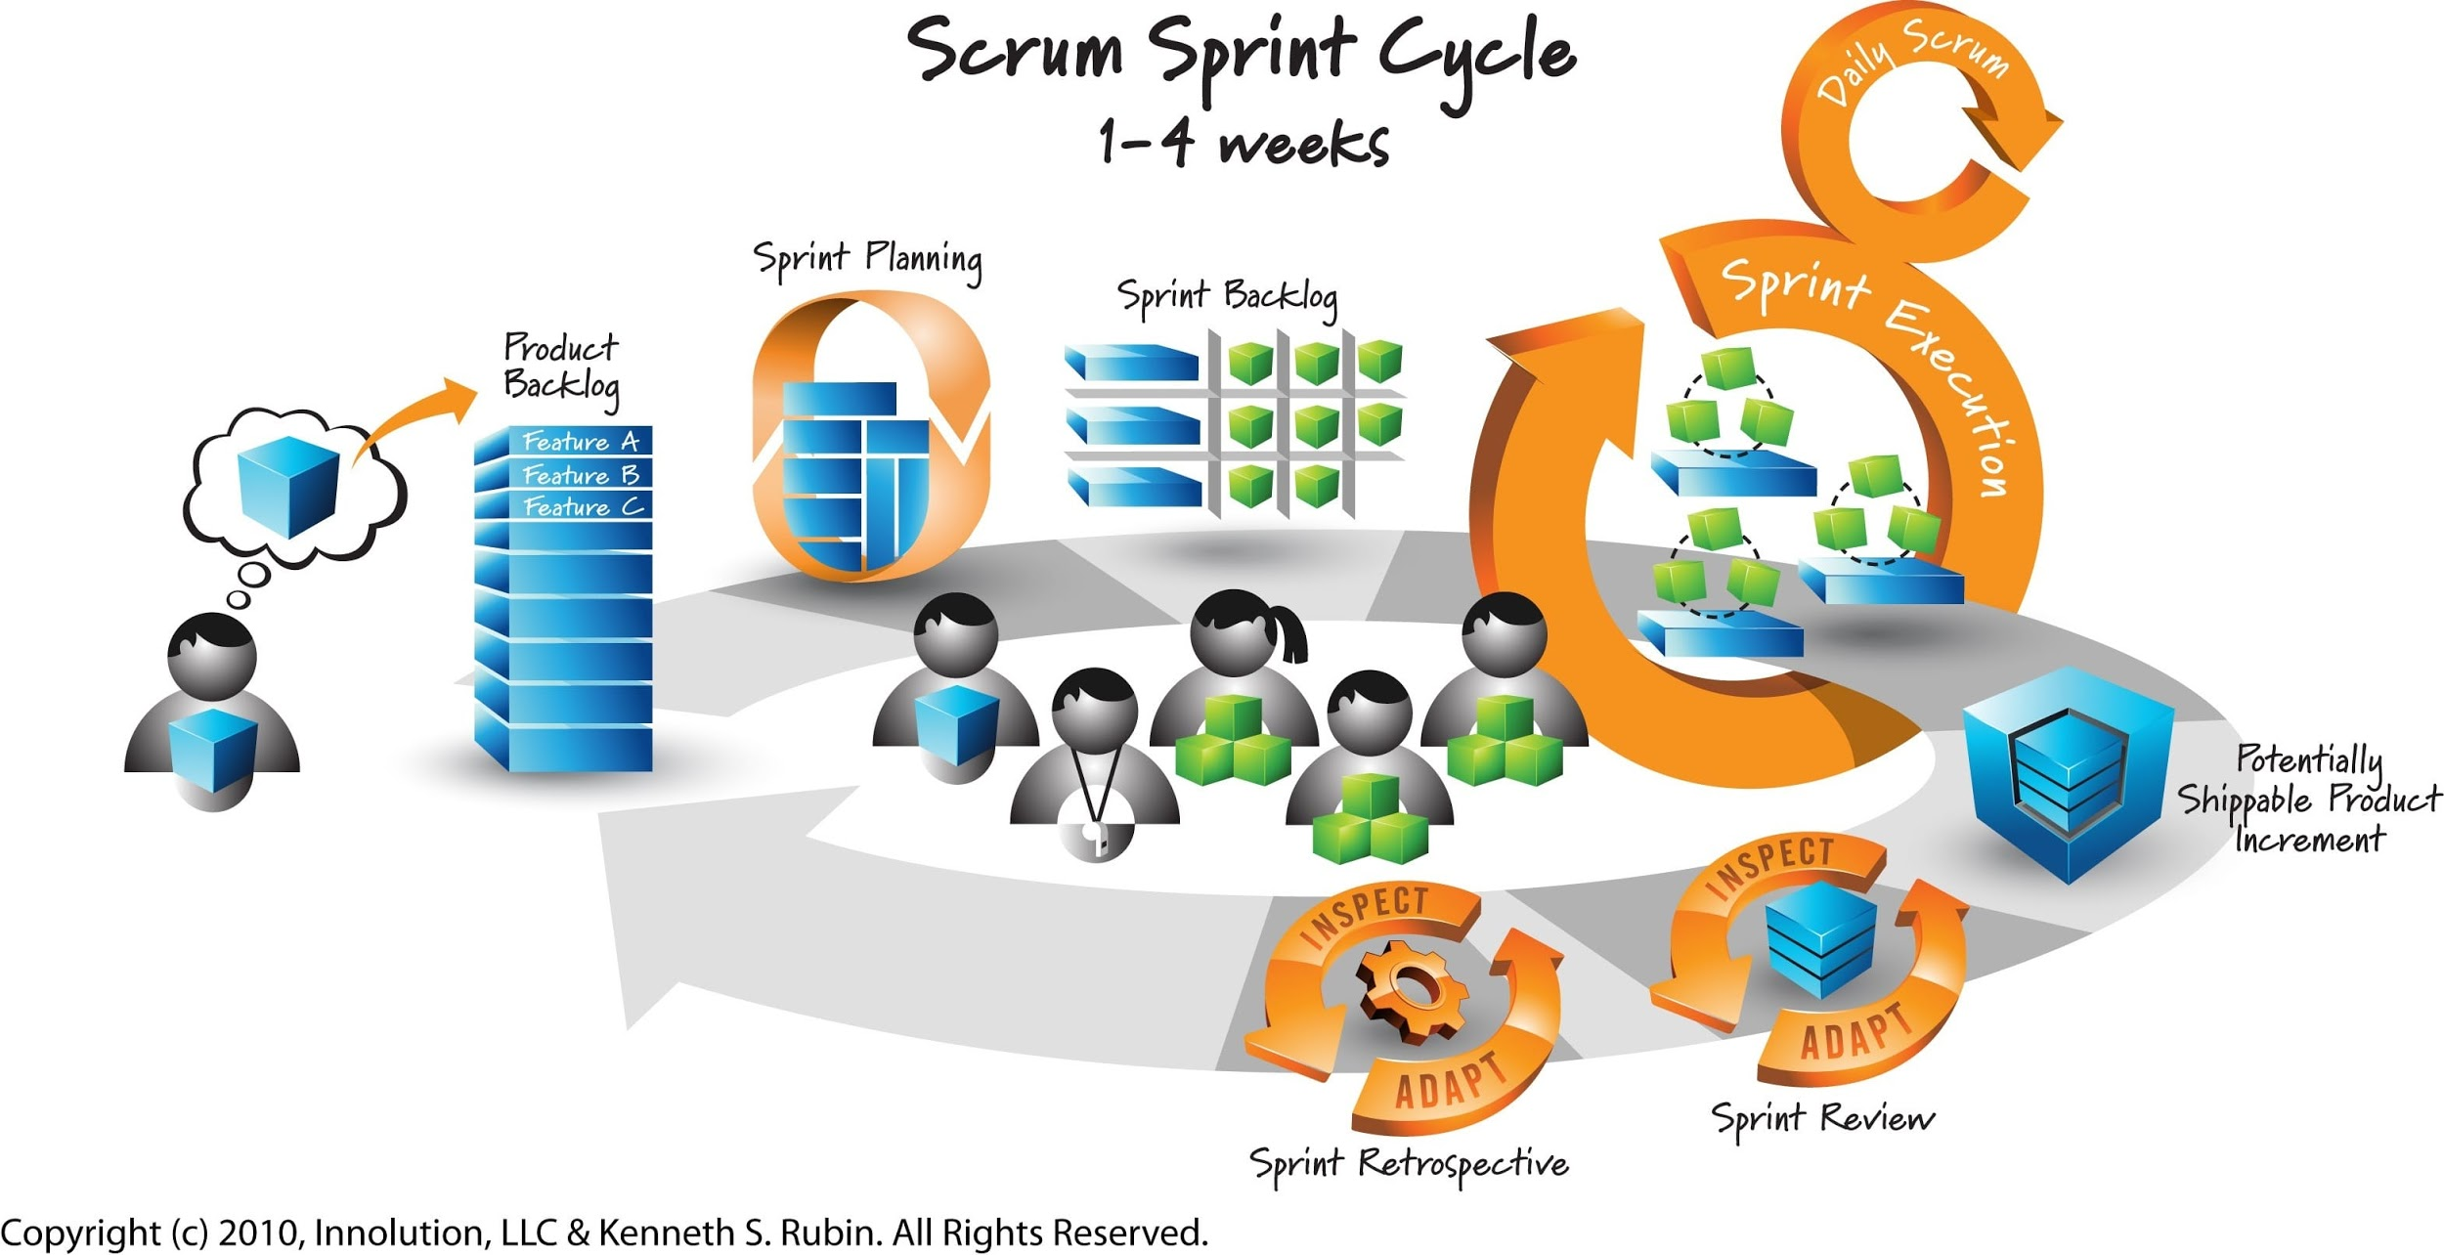
Scrum
<number>
Notes:
Joseph
Picture Source:
- https://springtimesoft.co.nz/images/pages/agile-software-development-scrum/agile_scrum_wellington_auckland.jpg

Slide 4
Key User Stories
As a user I want to be able to connect to the network so I can play with another person on a different computer.
As a user I want to be able to view where my opponent has attacked my ships so that I can make my next move.
As a user I want a view of the hits and misses I have made on my opponent's board so that I can plan where to make my next move.
As a user I want to be able to place my ships on my board so that I can start the game.
<number>
Notes:
Joseph

Slide 5
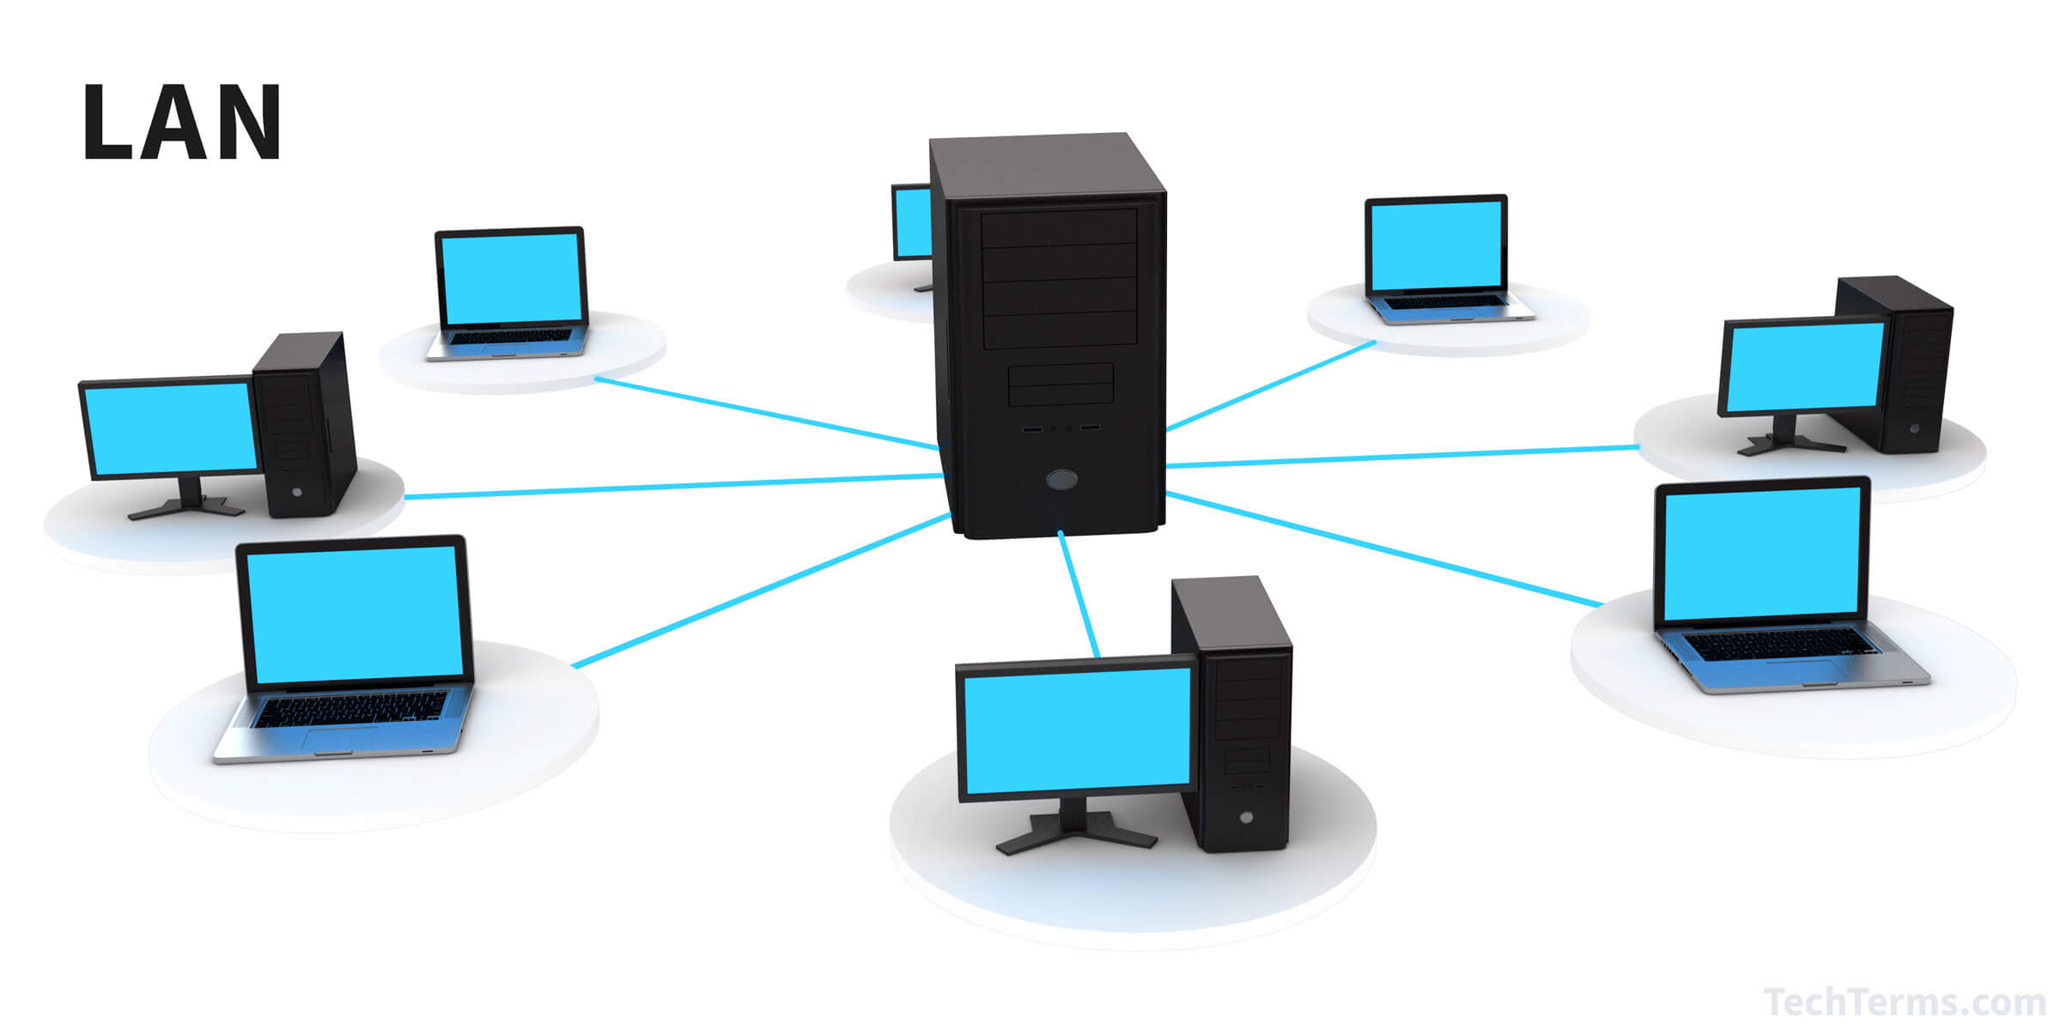
User Story: As a user I want to be able to connect to the network so I can play with another person on a different computer.
<number>
Notes:
Ben
Picture Source:
- https://techterms.com/img/lg/lan_79.jpg

Slide 6
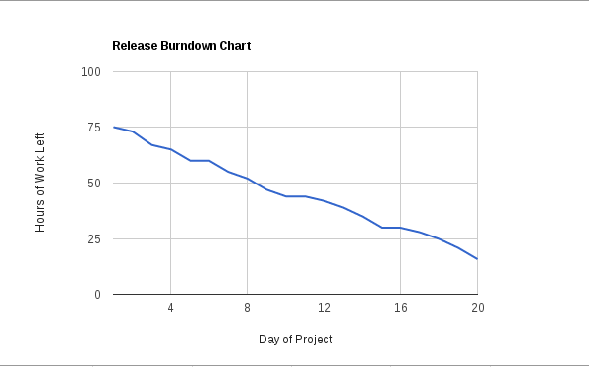
Burndown Chart
<number>
Notes:
Joseph

Slide 7
Strengths and Weaknesses
Strengths:
Good at object-oriented design.
Weaknesses:
Communication.
Scrum.
What to do differently?
More closely follow the Scrum model.
Establish better communication between team members.
<number>
Notes:
Joseph

Slide 8
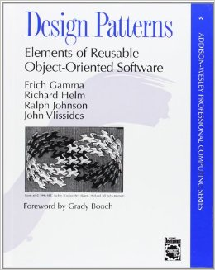
Design and Implementation
<number>
Notes:
Ben
Picture Source:
- https://images-na.ssl-images-amazon.com/images/I/51szD9HC9pL._SX258_BO1,204,203,200_.jpg

Slide 9
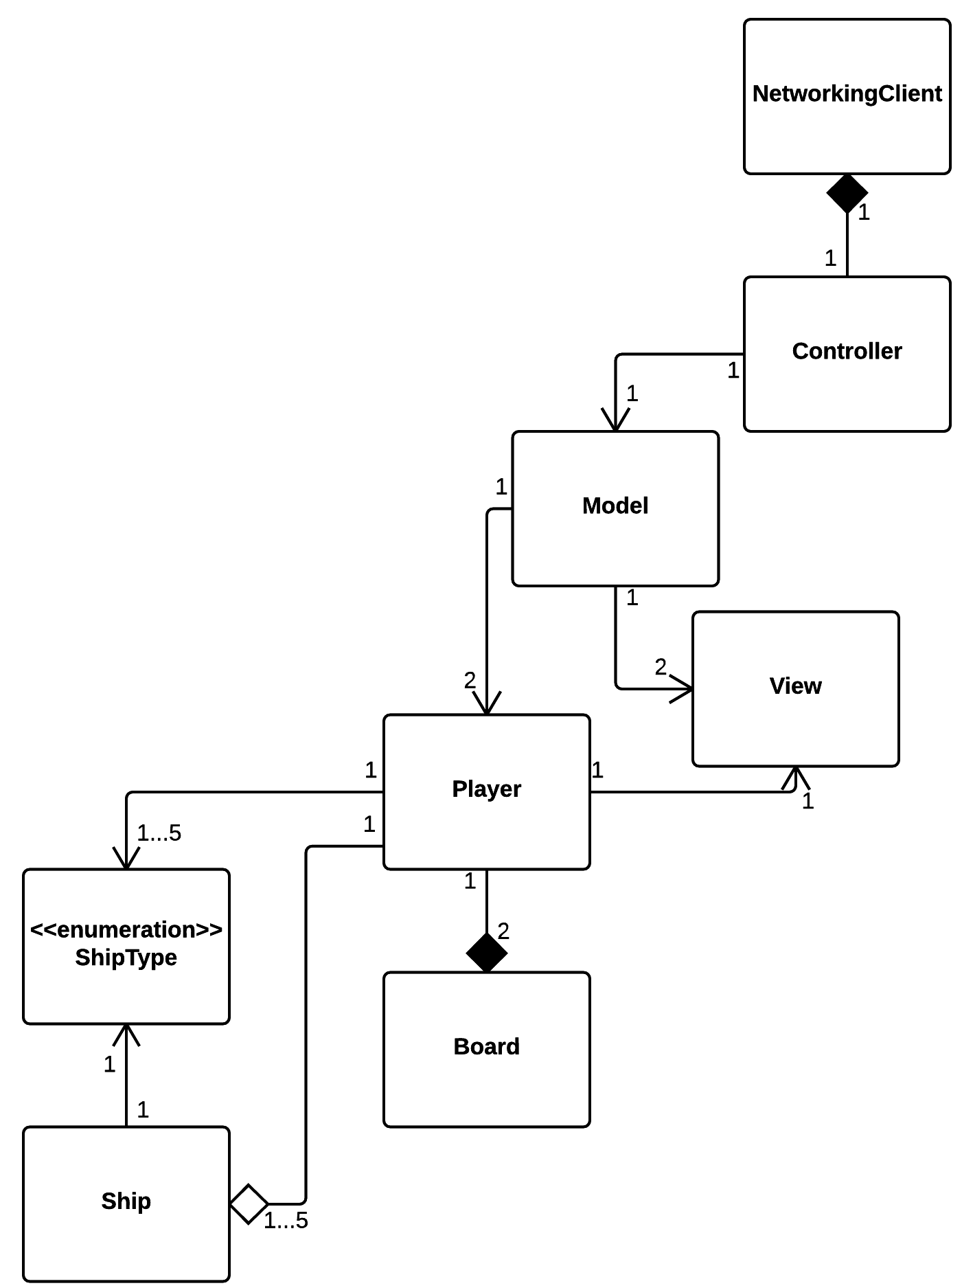
UML Class Diagram
We had to implement the networking client so that both players would see only their board. We did this using the Java Socket API.
We used JavaFX for the GUI.
We choose to represent each type of ship as an enumerated type.
<number>
Notes:
Ben

Slide 10
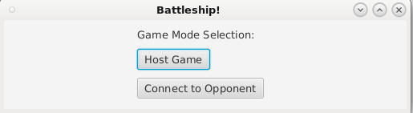
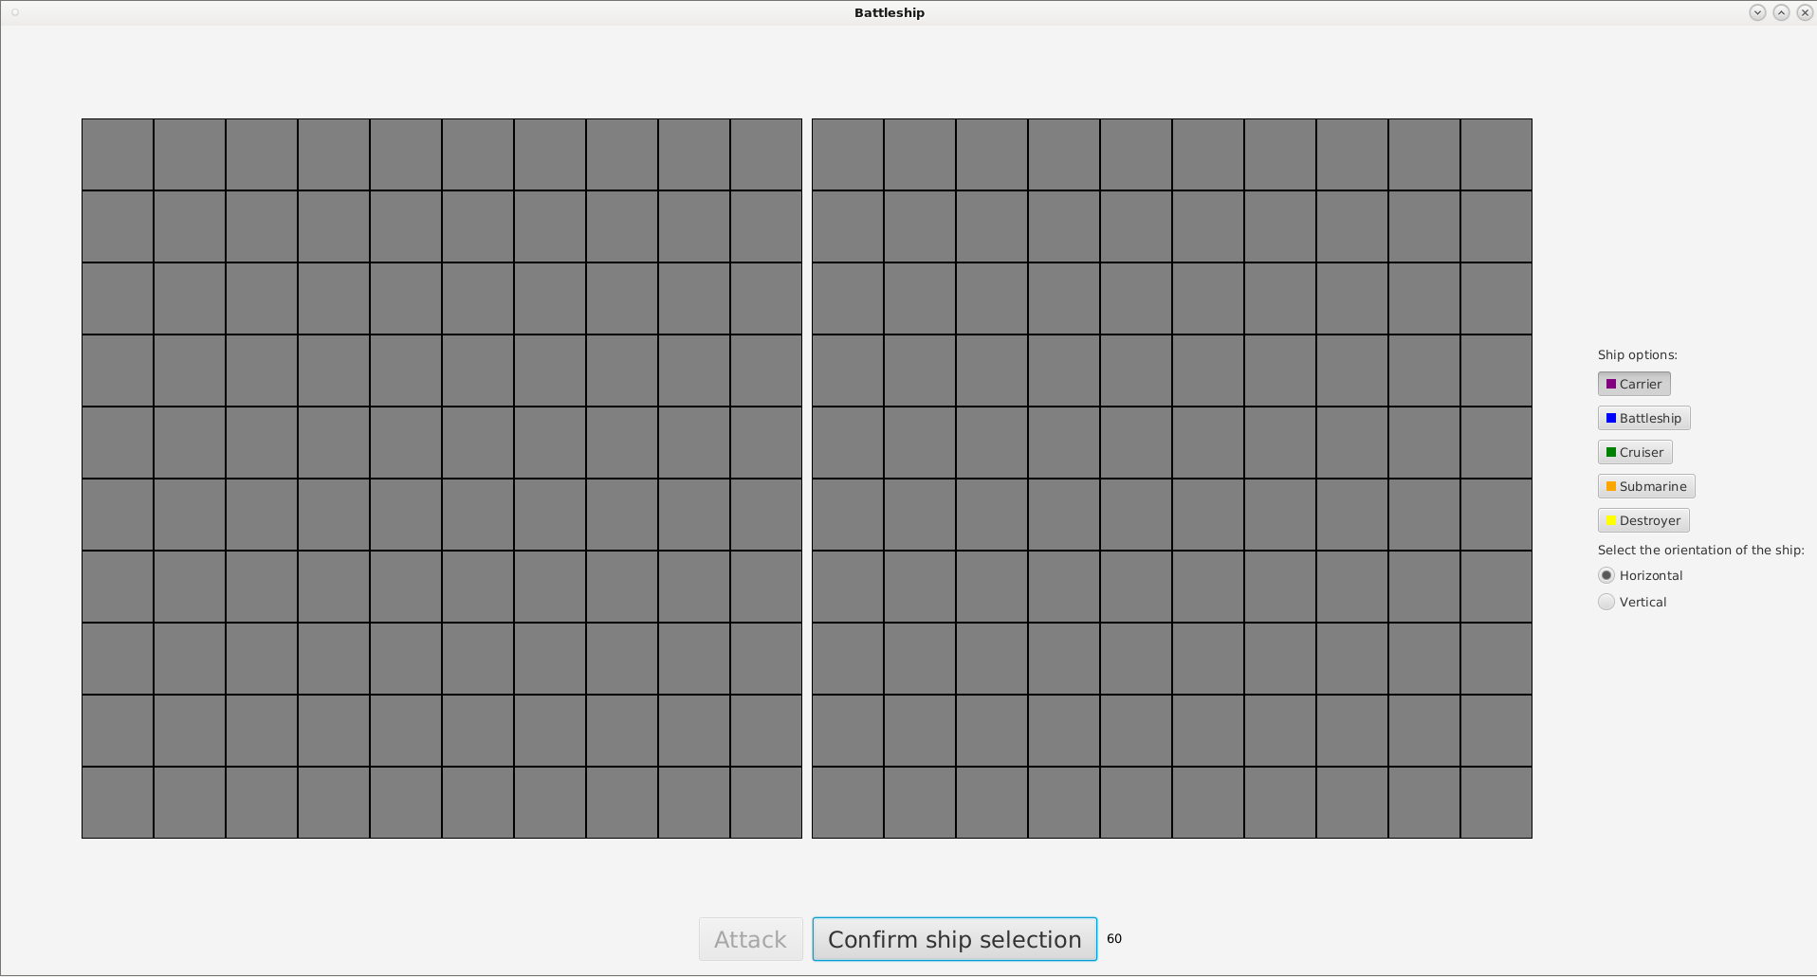
User Interface
<number>
Notes:
Joseph

Slide 11
Demonstration
<number>
Notes:
Annan

Slide 12
Conclusion
<number>
Notes:
All

Slide 13
Project Challenges
Merging the networking with the GUI and command line game code.
Making a functional GUI that was relatively easy to use.
Connecting everything with networking.
Understand how to implement networking with no background knowledge.
<number>

Slide 14
What we learned
We should have used Scene Builder to create the GUI instead of coding everything ourselves.
It's important to have a Daily Scrum.
Communication is crucial when working on a software development team.
<number>

Slide 15

Changes for Version 2.0
Improve the GUI aesthetics.
Make the networking autonomous.
Add background music and sound effects.
Add the ability to play online.
Allow the user to "drag and drop" ships.
Ability to customize board size and type and number of ships.
<number>
Notes:
Picture Source:
- http://www.bradburyfields.org.uk/userfiles/cache/EventDetail_v2.0.png.jpg

Slide 16
Picture Sources
https://i.ytimg.com/vi/1w6wt2uS8To/hqdefault.jpg
https://springtimesoft.co.nz/images/pages/agile-software-development-scrum/agile_scrum_wellington_auckland.jpg
https://images-na.ssl-images-amazon.com/images/I/51szD9HC9pL._SX258_BO1,204,203,200_.jpg
http://www.bradburyfields.org.uk/userfiles/cache/EventDetail_v2.0.png.jpg
https://techterms.com/img/lg/lan_79.jpg
<number>

