Slide 1
Sentiment Analysis to Trade Cryptocurrency
Annan Miao and Jon Li

Slide 2

Introduction
Sentiment Analysis is application of ML model to determine ‘sentiment’ behind a piece of text
These reactions are first marked as positive or negative and then introduced to other ‘emotions’
Python has a host of libraries to use with Natural language Processing along with a host of libraries
Twitter has a high number of influencers who have a real effect on the perception and thus price of X-Coin

Slide 3
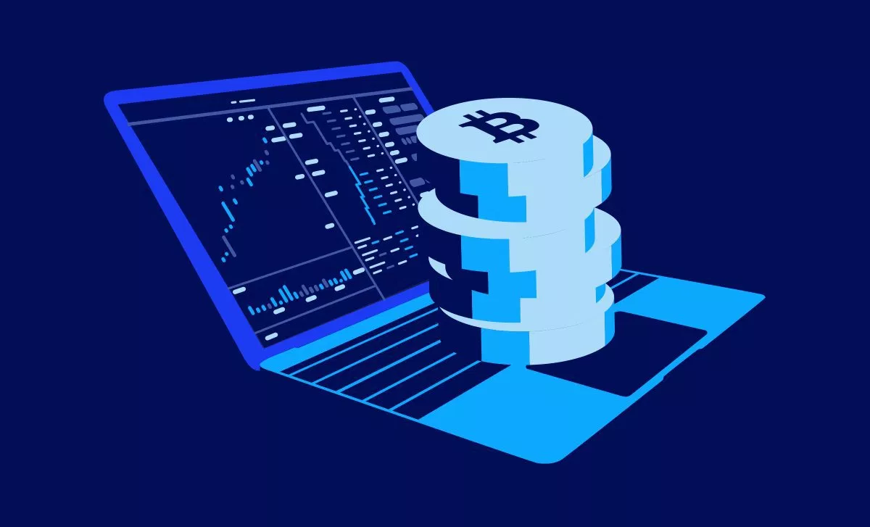
Project Idea
Measure sentiment of X-Coin based on tweets by top influencers and compare that vs price movement in the coin and compared with historical averages.
Supplementary trading tool that examines correlation between prices and sentiment
“The public is often right during the trends, and wrong at both ends.
Make buy/sell recommendations based on sentiment signals
Could be implemented to trade small-cap coins
Tweets what recommendations can be based on analysis

Slide 4
Theory
Keyword Spotting
classify text by the presence of unambiguous affect key words such as happy, sad, afraid, and bored.
Lexical Affinity
assign arbitrary words a probable affinity to particular emotions.
i.e. assign the word “accident” a 75-percent probability of indicating a negative affect, as in “car accident” or “hurt by accident.”

Slide 5
Theory
Statistic Method
Feed a machine-learning algorithm with a large training corpus of affectively annotated texts. The system would take into account arbitrary keywords, punctuation, and word co-occurrence frequencies.
Semantically weak. Only work well when they receive sufficiently large text input.

Slide 6
Implementation
Regular expression for input text data mining
Vectorization
Create one very large matrix with one column for every unique word in the corpus. Then transform each tweet into one row containing 0s and 1s, where 1 means that the word in the column appears in that tweet.
Modeling and Training
Model the dataset of the vectorization.
Train the model using the entire training set.

Slide 7
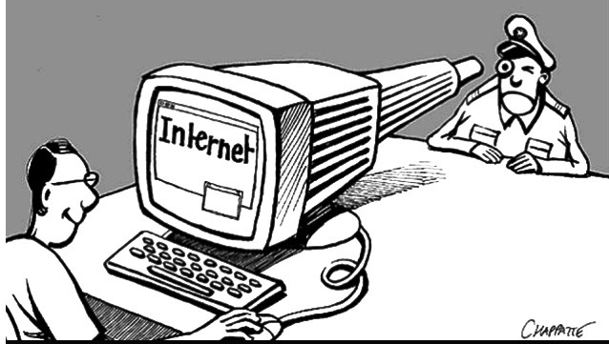
Ethics
Disclosure vs. Privacy of tweets
Data Mining of tweets...is this ethical when analyzing market functions?
Market Manipulation

Slide 8
Sources:
https://medium.com/@Melt_Dem/transparency-and-ethics-in-cryptocurrency-investing-4201cf776c64
https://www.geeksforgeeks.org/twitter-sentiment-analysis-using-python/
https://medium.com/@BlockchainEng/crypto-trading-bot-sentiment-analysis-bot-bfbd8dd1df5a
https://github.com/aaronkub/machine-learning-examples/blob/master/imdb-sentiment-analysis/Sentiment%20Analysis%20Walkthrough%20Part%201.ipynb
https://ieeexplore.ieee.org/document/6468032
https://towardsdatascience.com/sentiment-analysis-with-python-part-1-5ce197074184

