Slide 1
Sentiment Analysis to Analyze Tron ($TRX)
Annan Miao and Jon Li

Slide 2
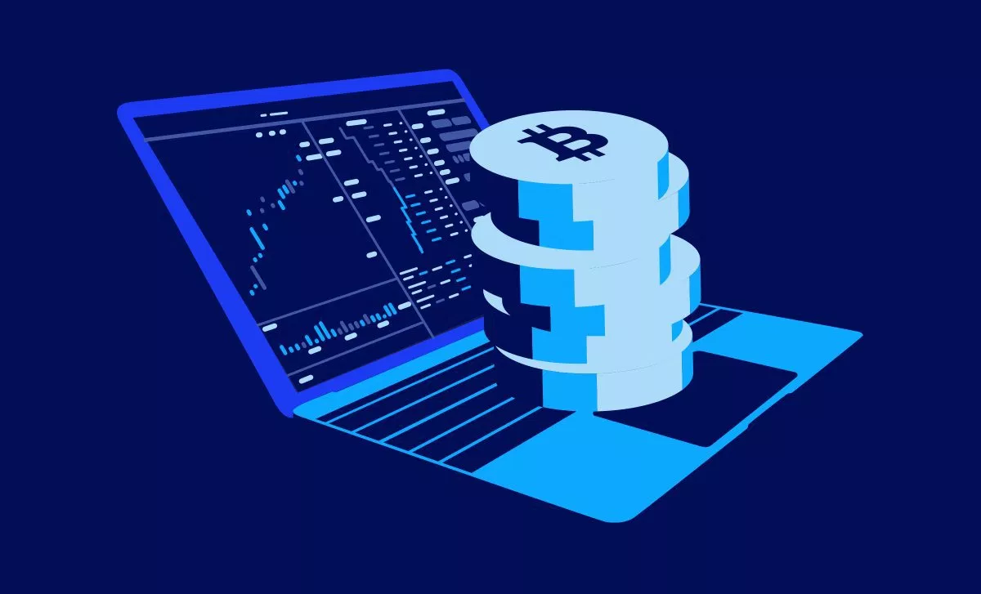
Project Idea
Measure sentiment of TRX based on tweets by top influencers and compare that vs price movement in the coin and compared with historical averages.
Supplementary trading tool that examines correlation between prices and sentiment
“The public is often right during the trends, and wrong at both ends.
Make initial buy/sell recommendations based on sentiment signals
Correlation to price movement
Could be implemented to trade small-cap coins
Tweets what recommendations can be based on analysis

Slide 3
Data from Twitter
Mark the current state of market as “buyer’s market or seller’s market
Classification
Initial Predictions

Slide 4
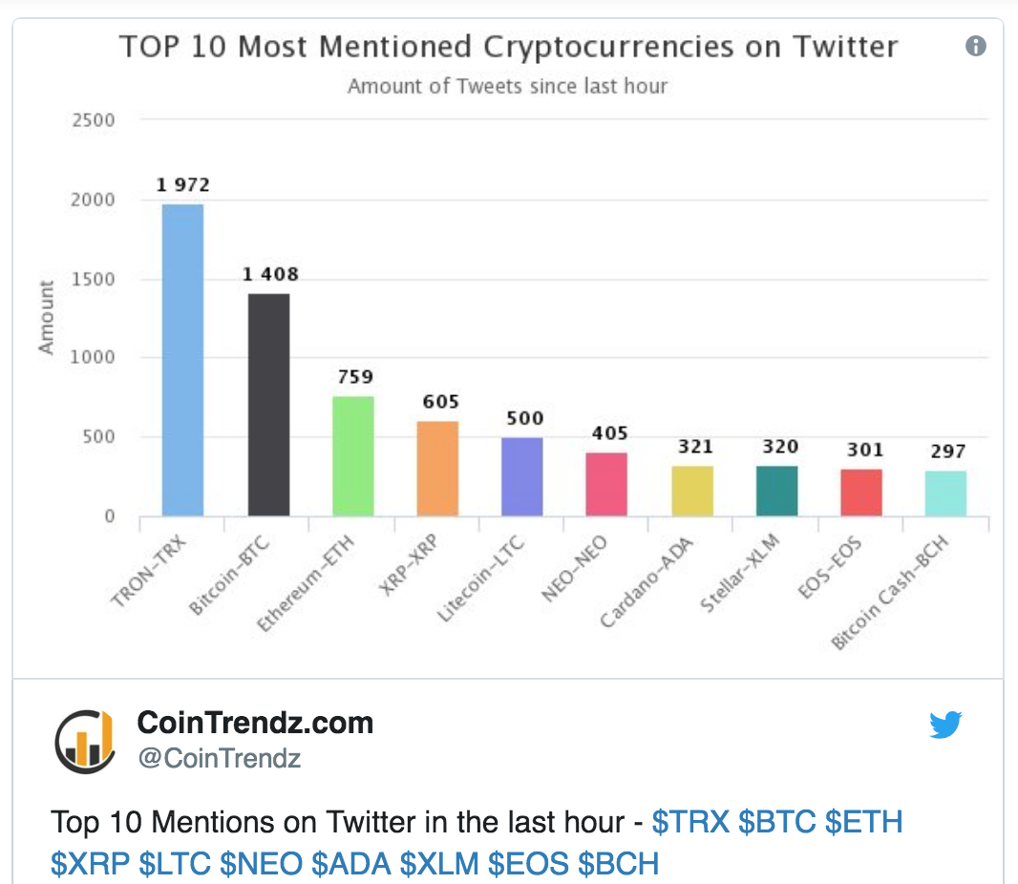

Slide 5
Why this coin?
“A plagiarized project, theatrical announcements and twisted sense of belonging are what the TRON community deals with. I was expecting a big pump in June, especially with their Mainnet launch. EOS pumped and TRX should have pumped the same. I’m sure a lot of investors like me didn’t get what they were looking for. The question I ask myself, is it worth Hodling?” - Prabjhot Singh

Slide 6
History
Ambcrypto has implemented sentiment analysis on a weekly basis
However, our theory is that technical financial analysis is overrated
Market correlation with public perception

Slide 7
Data Collection
Price movement in the coin and compared with historical averages.
csv files provided in Kaggle (a public data platform)
Sentiment related to TRX (the case we will use sentiment analysis)
tweets by latest 100 tweets

Slide 8
Data Collection (cont)
$TRX and #TRX
Market Influencers such as the founder @Blocksmithbot, @europe_tron, @Justin_Sun, etc..

Slide 9
What have been done
NLTK (Natural Language Toolkit)
Process unnecessary stopwords
Social Cognitive Theory
Mental models and reasoning….don’t do what the crowd is doing in terms of groupthink

Slide 10
Methodology
Keyword Spotting
classify text by the presence of unambiguous affect key words such as happy, sad, afraid, and bored.
Lexical Affinity
assign arbitrary words a probable affinity to particular emotions.
Words such as your “up”, “!”, “down”, “top”, “bear”, “bull”, “rally”, “sell”, “yikes”

Slide 11
Methodology
Statistic Method
Feed a machine-learning algorithm with a large training corpus of affectively annotated texts. The system would take into account arbitrary keywords, punctuation, and word co-occurrence frequencies.
Semantically weak. Only work well when they receive sufficiently large text input.

Slide 12
Methodology
Basically we use the Statistic Method for sentiment analysis, which consists of data training and modeling.
Also we integrate with the Keyword Spotting and Lexical Affinity methods. For instance instead of taking arbitrary words, we take keywords for data training.

Slide 13
Implementation
Regular expression for input text data mining
Vectorization / one hot encoding
A method to convert a comment into numeric representation
Create one very large matrix with one column for every key word in the corpus. Then transform each tweet into one row containing 0s and 1s, where 1 means that the word in the column appears in that tweet.

Slide 14
Implementation
Modeling and Training
Logistic regression is the appropriate regression analysis to conduct when the dependent variable is binary. Logistic regression is a predictive analysis.
Use Logistic Regression to model and train the dataset of vectorization.
Since the vectorization would be sparse for each row (as each comment is unlikely to contain multiple keywords), Logistic Regression would learn fast as a liner model and thus suitable for this case.

Slide 15
Results
Inconclusive thus far
However, our basic analysis has thus far been to measure positive, negative, and neutral, with mean, std, min, max with hour increments.

Slide 16
Ethics
Effective programs have potential to move the markets with a large enough of following -- could in fact just be confirmation bias
Market manipulation

Slide 17
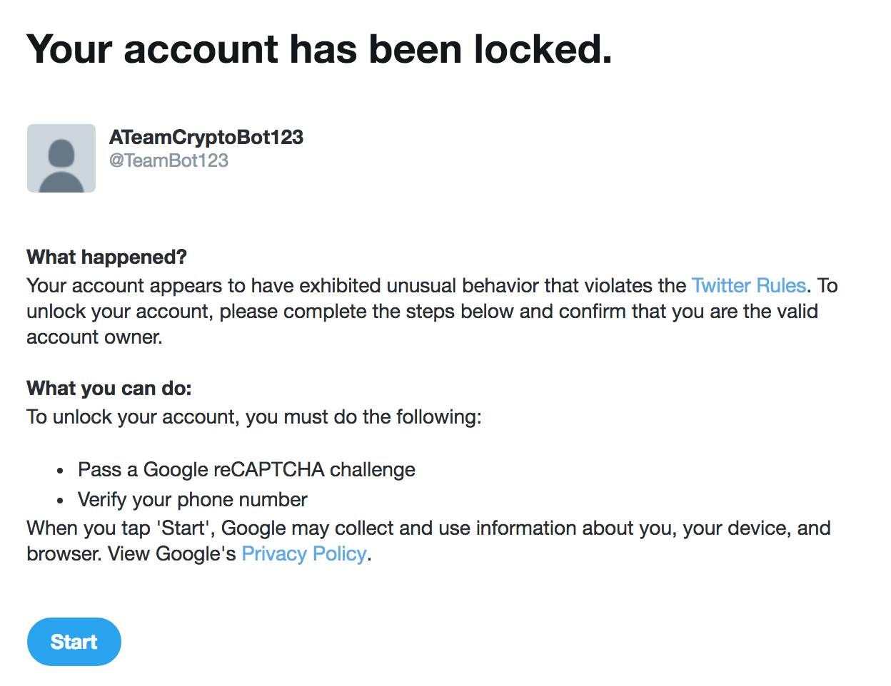
Challenges:

Slide 18
Challenges
Training Data Collection

Slide 19
Sources:
https://medium.com/@Melt_Dem/transparency-and-ethics-in-cryptocurrency-investing-4201cf776c64
https://www.geeksforgeeks.org/twitter-sentiment-analysis-using-python/
https://medium.com/@BlockchainEng/crypto-trading-bot-sentiment-analysis-bot-bfbd8dd1df5a
https://github.com/aaronkub/machine-learning-examples/blob/master/imdb-sentiment-analysis/Sentiment%20Analysis%20Walkthrough%20Part%201.ipynb
https://ieeexplore.ieee.org/document/6468032
https://towardsdatascience.com/sentiment-analysis-with-python-part-1-5ce197074184
https://towardsdatascience.com/sentiment-analysis-with-python-part-1-5ce197074184
https://ambcrypto.com/tron-trx-sentiment-analysis-april-25/
http://text-processing.com/docs/sentiment.html

