Slide 1
Email channel update
Notes:
Tom

Slide 2
Email Templates

Slide 3
Email Templates
Be You
New email template has been designed, implemented and in action
Mobile responsive
On Brand
Easier to use
Visually more appealing
Tested on multiple email clients and devices
Multiple different visuals and layouts available to suit different email goals
Beyond Blue
Currently being briefed to our agency
Utilizing our brand guidelines
Incorporating best practices

Slide 4
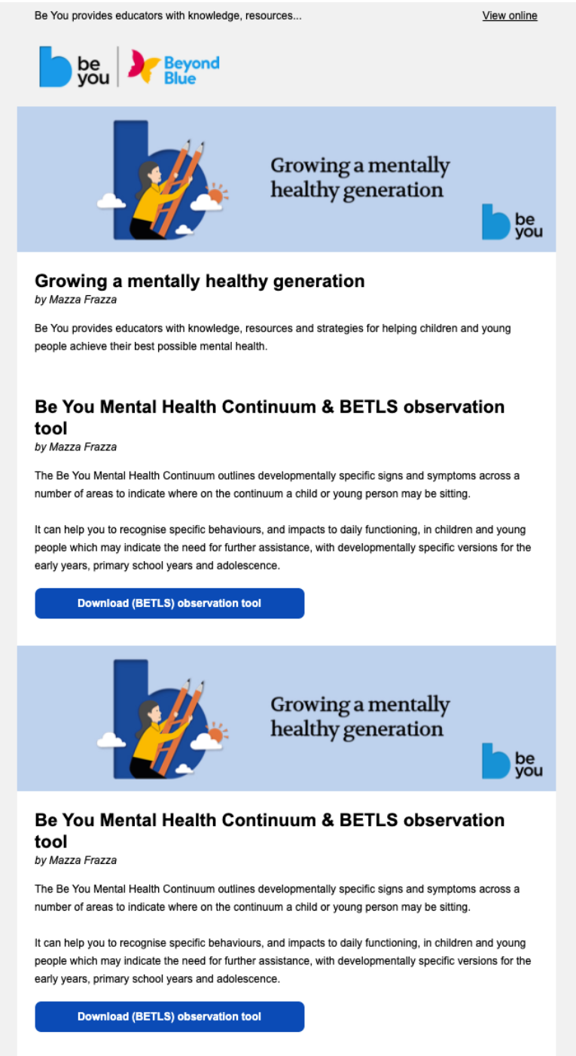
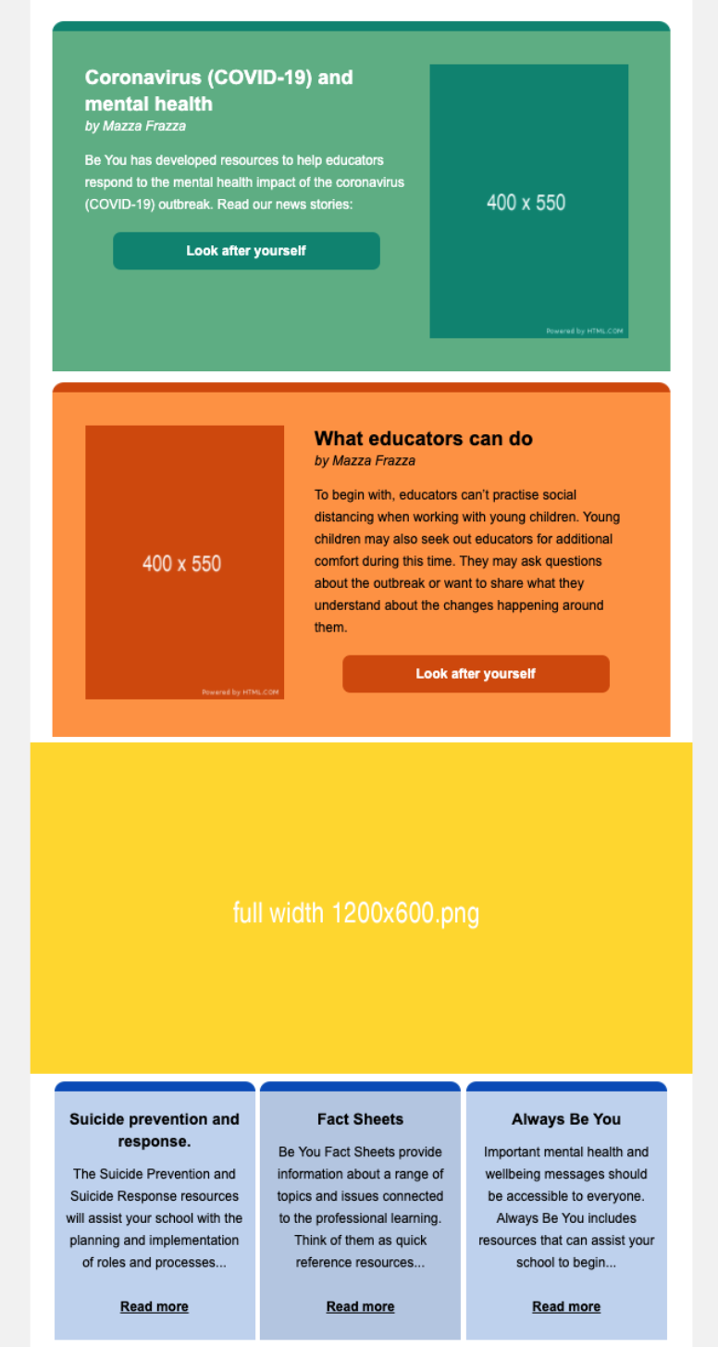
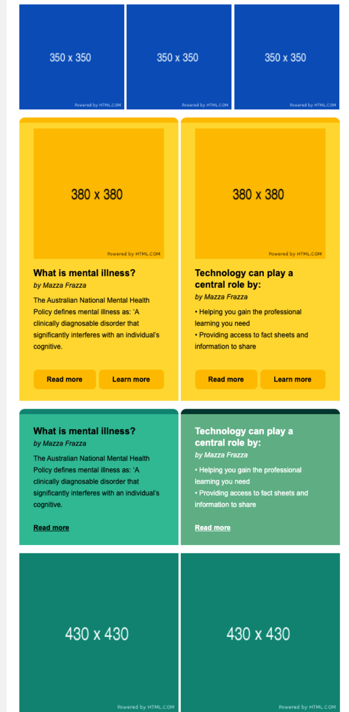
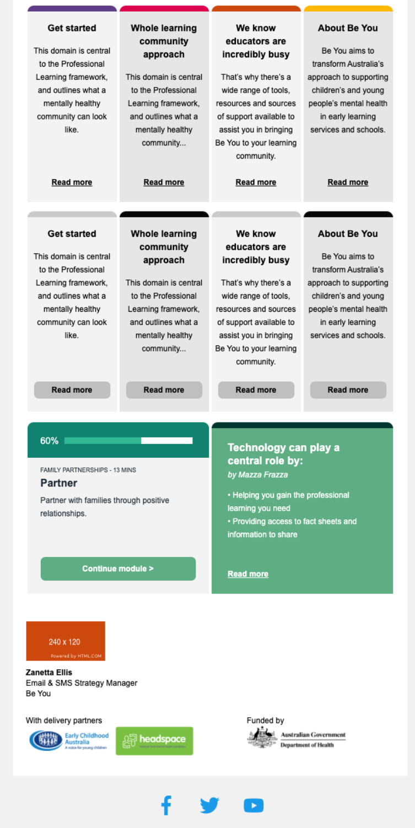
Be You Email Templates
Just a taster – many more options available

Slide 5
Preference Centres

Slide 6
Preference Centres
Be You
New preference centres have been implemented
Gives the control back to the audience – becoming more customer centric
Will be in use once communication journeys are kicked off
Specific to pre services & subscribers audience
Data being fed back into the CRM & SFMC to enrich contact data
Beyond Blue
Currently being briefed to our agency
Will be utilized to grasp a more enriched understanding of our audience
Gives the control back to the audience – becoming more customer centric
Will be used and linked from every email from Beyond Blue
A combination of implicit and explicit behaviour form our subscribers
    Form based feedback
    Click based behaviours
Data being fed back into the CRM & SFMC to enrich contact data

Slide 7
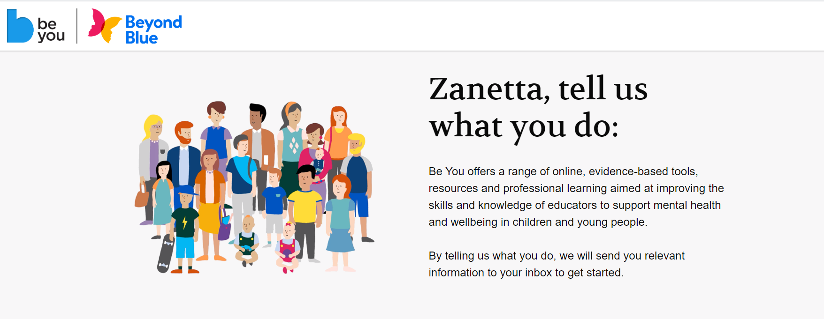
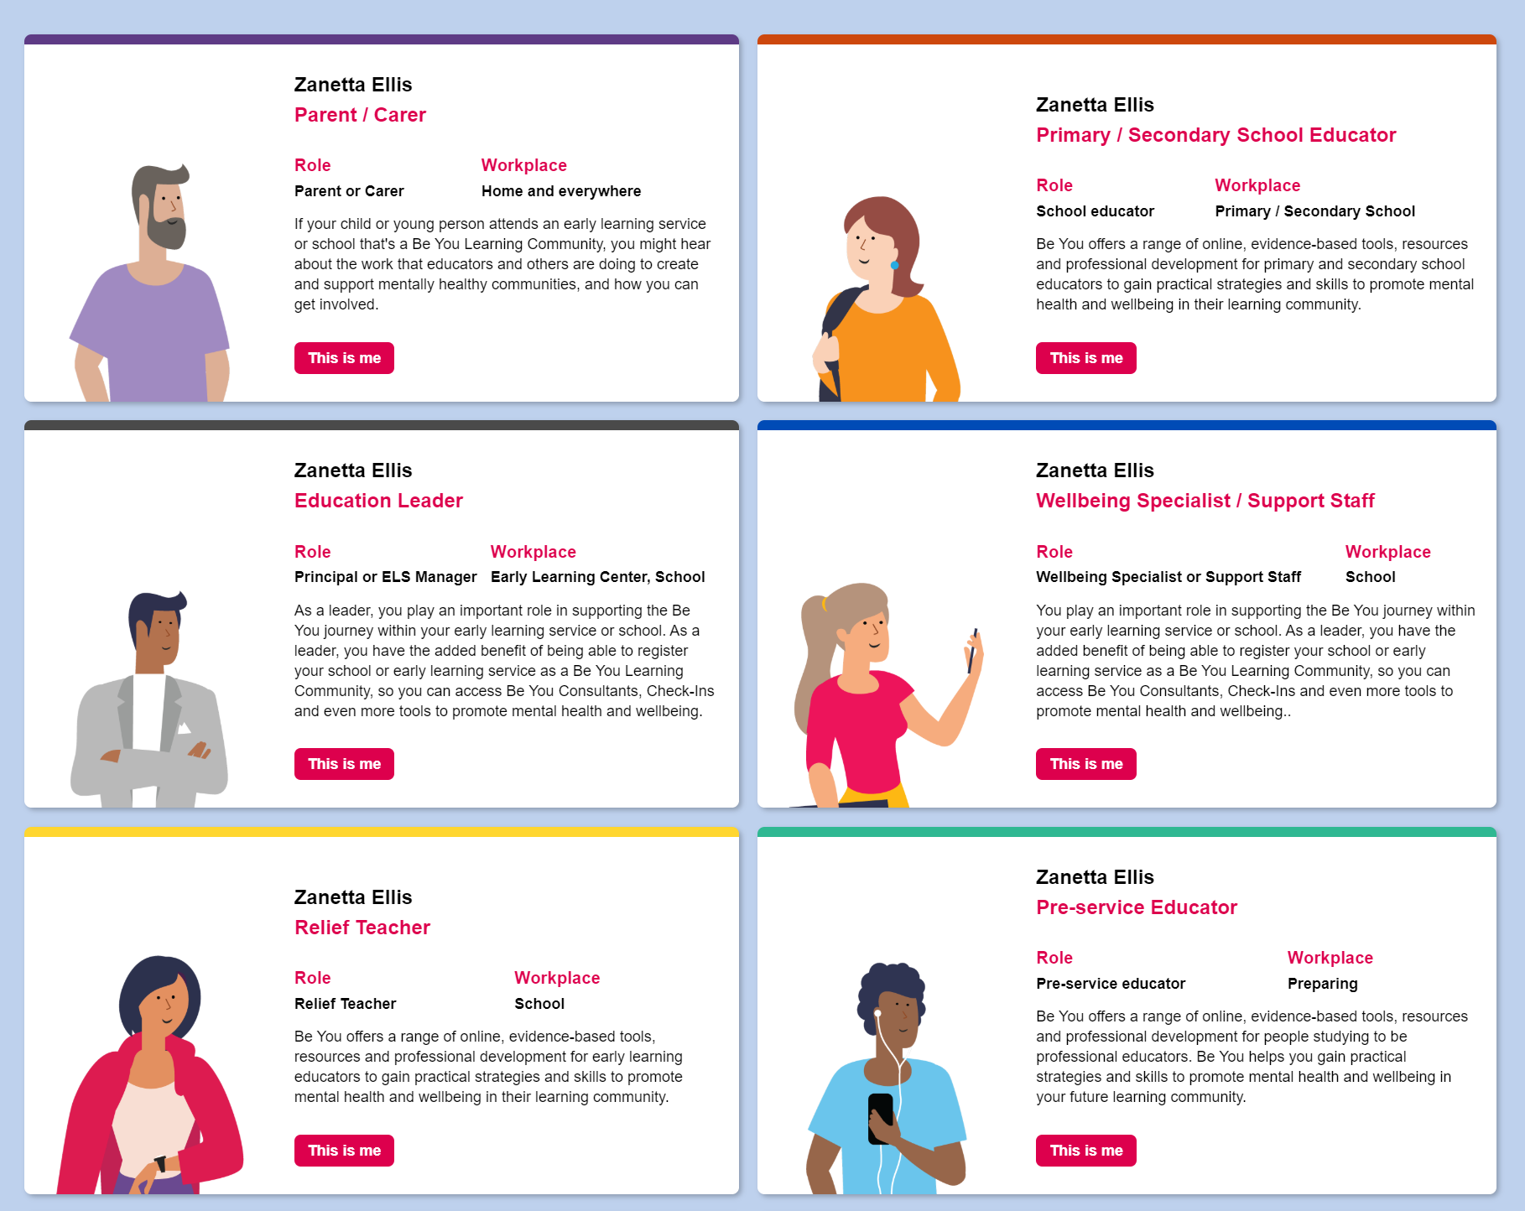
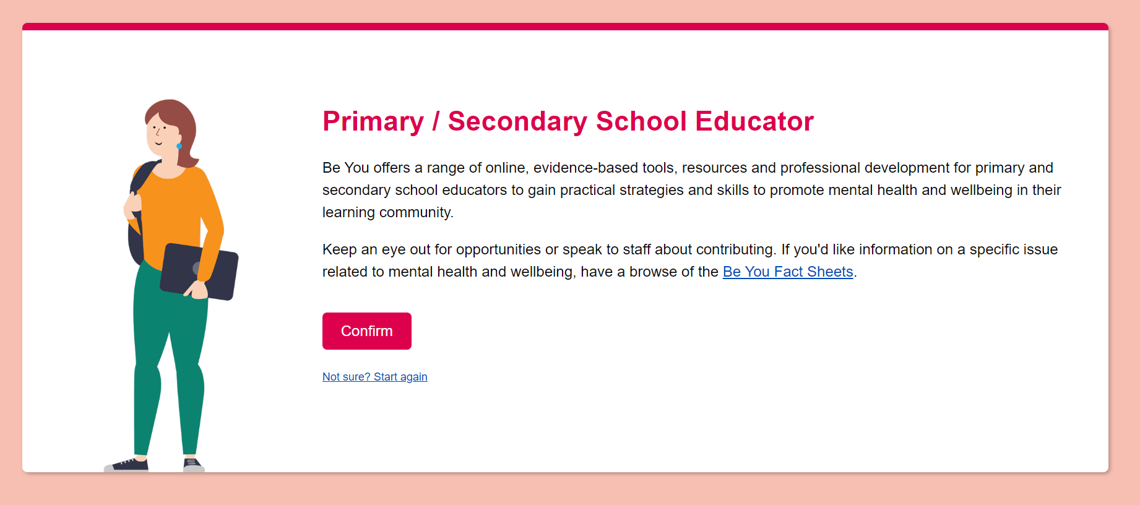
Be You - Subscriber Preference Centre
https://fe3215707564057a7 21079.pub.s10.sfmc-content.com/yadx3qil2pf?qs=2e5f3995b1834baaa86fcd966333e511

Slide 8
Education
Series

Slide 9
Email & SMS Education Series
What is it?
A series of sessions to showcase and educate the organisation on email and SMS.
These sessions will include the following:
Each topic explained
Best practices
How we use it within email campaigns and journeys
Discussion on benefits for Beyond Blue & Be You
Examples
Question time
The topics that are covered will be the following
Subject Lines
Pre Headers
Personalisation
Dynamic Content
AB Testing
Email Design
Journeys & Guided Sends
SMS
How does the data work
Email Benchmarks

Slide 10
Email & SMS Education Series
Why do this?
Beyond Blue & Be You have the amazing opportunity to utilise the email and SMS capabilities to improve the way we communicate with our contacts.
Internally there is a gap of knowledge and understanding of what email and SMS can do so by educating and providing examples and time to ask questions on each topic it will allow everyone to have a greater grasp on what can be achieved.
What’s in It For The Teams?
Teams will feel more empowered with additional knowledge and more comfortable when creating email and SMS briefs for the communication sends.
These sessions will also enable The Email Team to showcase the functionality and capabilities that we have and create many more ways of treating or email and SMS sends.
Outcomes for The Organisation
Broader understanding of the email and SMS channel.
An enhanced more personalised experience for our contacts.
Empowerment for each department of Beyond Blue & Be You
Upskilling of all individuals who attend.

Slide 11
Data Layer

Slide 12
Introduction of a Data Layer (Beyond Blue)
Current Data Situation
Multiple disparate CRM integrations
Inaccurate audiences counts & segmentation
No holistic single view of customer / supporter
Marketing Data Layer
Creates single customer view of active, contactable & actionable supporters / customers
Allows for simple and highly effective targeting without SQL coding
Removes data in compliance, data quality issues
Provides a customer / support layer of aggregated CRM data to be enhanced by Salesforce Marketing Cloud behavioural data & additional modelling

Slide 13
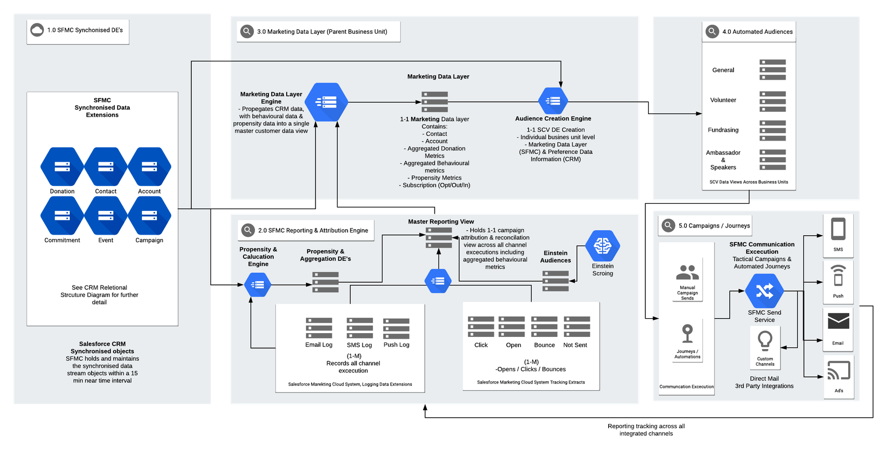

Slide 14
Outcomes for Beyond Blue
Master Reporting Engine
Enables holistic campaign reporting and reconciliation across all brands and campaigns.
Campaign engagements, conversion data on a large scale.
Feeds into propensity modelling & rolls up into the customer data layer for segmentation.
Propensity & Analytics Engine
Utilises implicit and explicit contact data (CRM/SFMC) to create modelling on future predictions.
Recency, Frequency and Monetary donation data will be the core source to feed for customer value segmentation.
Engagement data is utilised to feed into engagement segments for marketing segmentation.
Einstein (AI)
AI engagement scoring will be integrated into the Customer Data Layer, to enabled AI driven engagement segment (pending licenses).
Einstein send time optimisation will be utilised for journey sends (pending licenses).
Einstein engagement frequency & Einstein Content Selection will be looked at for use case implementation.

Slide 15
Data Modelling
RFM (Donation) based Modelling
Enables quantitative scoring and segmentation based on donation data
Contact to Supporter Conversion Propensity (In Progress)
Donation Upgrade Propensity Score (In Progress)
Lapsed Propensity Score (In Progress)
Attribution & Monetary Analytics / Modelling
Campaign Donation Attribution
Channel Attrition
Behaviour / Location / Device Based Modelling
Desktop/Mobile Affinity
Geolocation Affinity
Device Affinity
Email Client Affinity
Time Of Day / Day Of Week Affinity
Donation Upgrade Propensity Score (In Progress)

Slide 16
Modelling Statistics Highlights (still to be refined)
Average Engagements – 12 months
Mean – average of 7.7 opens per subscriber
Median – 4 is the middle number of opens on the bell curve
Mode – 1 is the most common amount of times opened by subscribers
Day Preference
    Friday (34.4%) and Wednesdays (21.2%) make up the highest email engagement days.
    Interestingly, Sunday (4.7%) sees a higher chance of email engagement than Monday (2.9%).
Time Preference
    Highest engagement at 4pm and then from 6pm – 8pm.
    The lowest performing business hour of the day is 1pm.
Desktop and Mobile Preferences
    Desktop and mobile split are very even compared to Australian trends
    51% prefer desktop (trend: 53%)
    49% prefer mobile (trend: 47%)
Devices Preferences
    49% of all mobile users use iPhone with the default Mail App, which provides the best email rendering experience.
    More than 86,000 users preferred device will support Interactive Email and other advanced features.
Donation Statistics
    Estimated $3.4 million from email campaigns YTD (including recurring)
    Highest Performing Single Email: BB_Tax_Appeal_EDM4_20200528_v2
    Newsletter emails perform exceptionally well with a total of $750k in donations attributed.
Donation Propensity
    There are 819 potentially high value donors – subscribers who donate regularly with good amounts and are responsive to promotions.
    Additionally, Beyond Blue has 289 new promising donors (July 2020), who have recently donated but not often.

Slide 17
Modelling Statistics Highlights (still to be refined)
Average Engagements – 12 months
Mean – average of 7.7 opens per subscriber
Median – 4 is the middle number of opens on the bell curve
Mode – 1 is the most common amount of times opened by subscribers
Day Preference
    Friday (34.4%) and Wednesdays (21.2%) make up the highest email engagement days.
    Interestingly, Sunday (4.7%) sees a higher chance of email engagement than Monday (2.9%).
Time Preference
    Highest engagement at 4pm and then from 6pm – 8pm.
    The lowest performing business hour of the day is 1pm.
Desktop and Mobile Preferences
    Desktop and mobile split are very even compared to Australian trends
    51% prefer desktop (trend: 53%)
    49% prefer mobile (trend: 47%)
Devices Preferences
    49% of all mobile users use iPhone with the default Mail App, which provides the best email rendering experience.
    More than 86,000 users preferred device will support Interactive Email and other advanced features.
Donation Statistics
    $3.4 million from email campaigns YTD (including recurring)
    Highest Performing Single Email: BB_Tax_Appeal_EDM4_20200528_v2 with $444k attributed to this campaign.
    Newsletter emails perform exceptionally well with a total of $750k in donations attributed.
Donation Propensity
    There are 819 potentially high value donors – subscribers who donate regularly with good amounts and are responsive to promotions.
    Additionally, Beyond Blue has 289 new promising donors (July 2020), who have recently donated but not often.

Slide 18
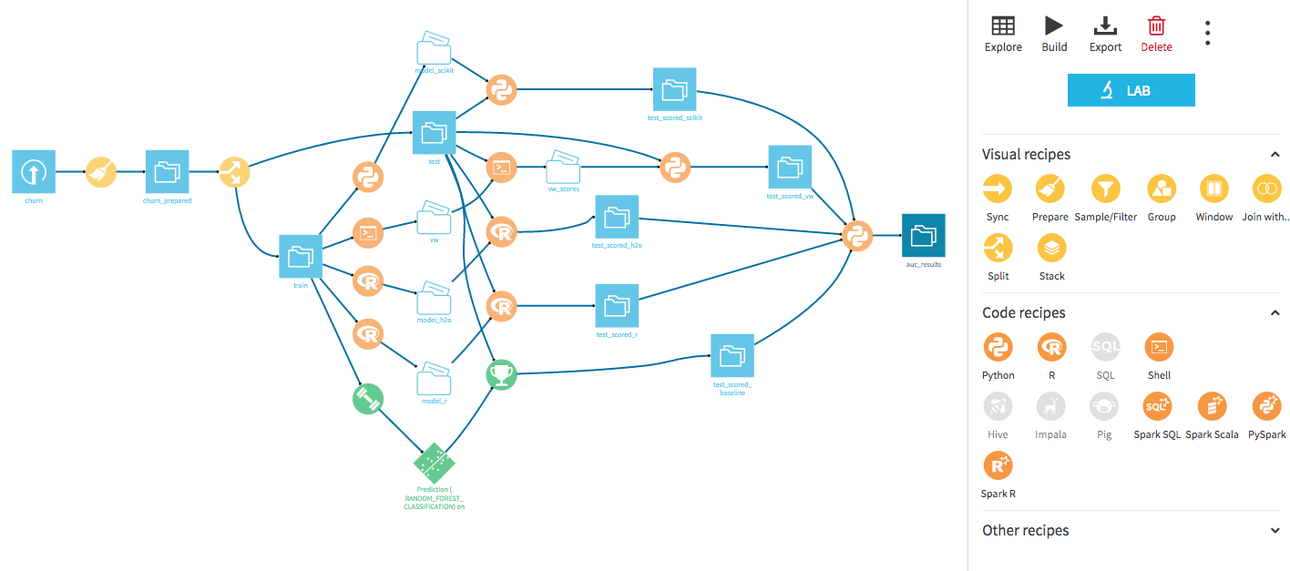
Looking to the future
Machine Learning for Beyond Blue
AI Predictive lifetime donor value (New Donors)
AI Propensity to convert to donor (First Time)
AI Propensity to convert to recurring
AI Propensity to upgrade
Propensity to churn / lapse

Slide 19
Next Steps
CRM Team
Data Cleanse
Email Team
Handover from the digital agency
Review handover
Provide insight to the broader Beyond Blue teams
Create a plan for the future with the new data plan and data structure within SFMC

Slide 20
Thanks!

