Slide 1


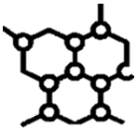







AI Core
Center for Translational AI
Material Design Manufacturing
Ethics
Food Energy Water
Health
Quality of Life
Autonomy

Slide 2
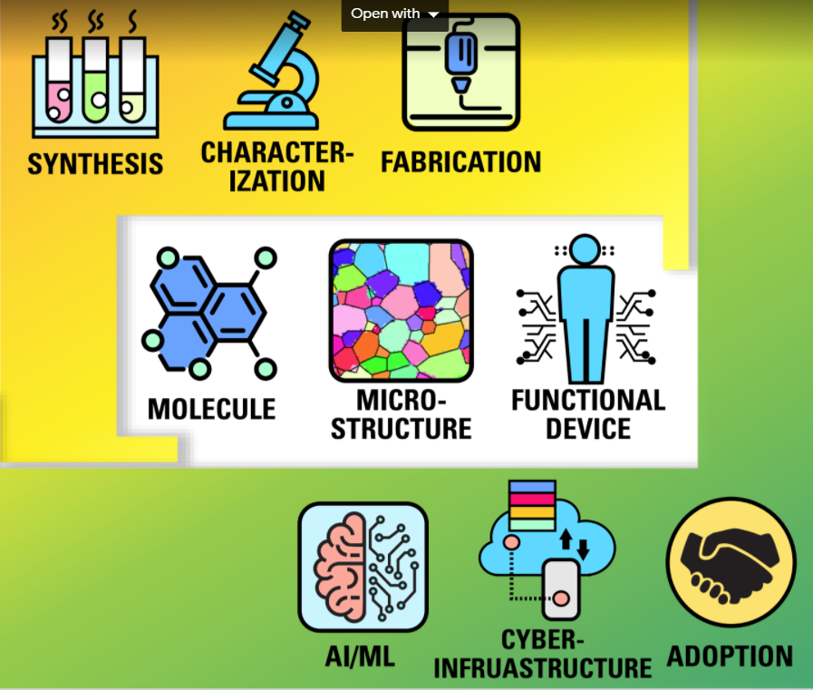

Slide 3
AI Core
Ethics
Materials Design Manufacturing
Center for Translational AI
Food
Energy
Water
Health
Quality of Life
Autonomy

Slide 4


