Slide 1


DOCKER
Alberto Maillo
08/02/2024

Slide 2


Slide 3



O.S.
scripts, files, data…
Dependencies
4.1.2

Slide 4

O.S.
scripts, files, data…
Dependencies
4.1.2

Slide 5

Another O.S.
O.S.
Missing files
scripts, files, data…
Dependencies
4.2
Conflict dependencies
4.1.2

Slide 6

Another O.S.
O.S.
Missing files
scripts, files, data…
Dependencies
4.2
Conflict dependencies
4.1.2

Slide 7
docker
Another O.S.
O.S.
No Missing files
scripts, files, data…
Dependencies
4.1.2
No conflict dependencies
4.1.2

Slide 8
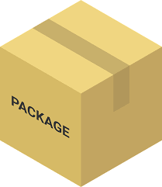
docker
O.S.
scripts, files, data…
Dependencies
4.1.2

Slide 9
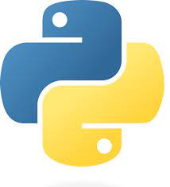

4.1.2
docker
3.8.2
Notes:
Can run at the same time indpendently

Slide 10
4.1.2
docker
3.8.2

Slide 11

4.1.2
docker

Slide 12
DOCKER. Definition
A platform for building, running, and shipping applications.
Package your application with everything you need -> isolate

Slide 13
DOCKER. Concepts
Image:
Contains everything to run the software
Code, libraries, runtime, libraries, dependencies, and configurattion files.
Built from a Dockerfile -> contains the instructions
Are immutable -> cannot be changed

Slide 14
DOCKER. Concepts
Container:
Run an instance of a Docker image
Run isolated from each other and from the host system
Can be started, stopped, deleted, and managed independently.
Created from docker images

Slide 15
DOCKER. Concepts
Docker engine:
The core component of the Docker platform
Manage Docker containers, storage volumes…
Build and manage Docker images

Slide 16
DOCKER. Concepts
Docker hub:
A cloud-based registry service
Central repository for Docker images
Store, share, and distribute publicly or privately
Official images
Command line interface -> push and pull
https://hub.docker.com/

Slide 17
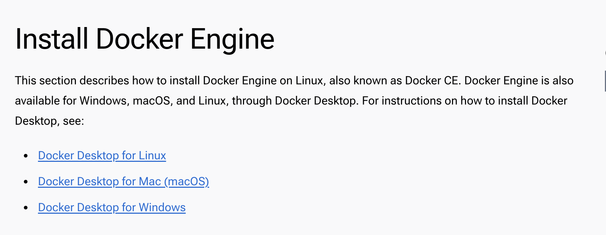
DOCKER. Installation
https://docs.docker.com/engine/install/

Slide 18
DOCKER. Example1. Creating an image
Commands:
docker ps –a -> show containers
docker rm <container_id> -> remove container
docker images | docker image ls -> show images
docker image rm <image_id>
docker build -t <image_name> . -> the “.” specify where the docker file is store: “.”=pwd
docker build -t <image_name> --progress=plain . &> build.log -> saving log output
docker run (-v) <image_name> -> run image (doesn’t matter directory). –v bind mount a volume

Slide 19
DOCKER. Example1. Connection DockerHub
Need to sign up in the docker hub https://hub.docker.com/
Commands:
docker tag <image_id> <username>/<repository_name>:<tag> -> tag your image to docker hub
docker login -> register to docker hub with your credentials
docker push <username>/<repository_name>:<tag> -> upload image to docker hub
docker pull <username>/<repository_name> -> download image from docker hub

Slide 20
DOCKER. Example1. Creating Dockerfile
# USE AN OFFICIAL PUBLIC R IMAGE
FROM r-base:4.2.2
# SET WORK DIR
WORKDIR /app
# COPY FILES -> DIRECTORY APP IN THE IMAGE
COPY dockerExercise1.R /app
# Install dependencies
RUN apt-get update && apt-get install -y \
libcurl4-gnutls-dev \
libssl-dev \
libxml2-dev
# INSTALL R PACKAGES
RUN R -e "install.packages('BiocManager', repos='http://cran.r-project.org')"
RUN R -e "BiocManager::install('limma')"
RUN R -e "BiocManager::install('GEOquery')"
RUN R -e "BiocManager::install('edgeR')"
# COMMAND TO RUN THE R SCRIPT
CMD Rscript dockerExercise1.R
Get official image
Set work directory
Copy relevant files
Install dependencies and packages
Running command

Slide 21

DOCKER. Existing example

Slide 22
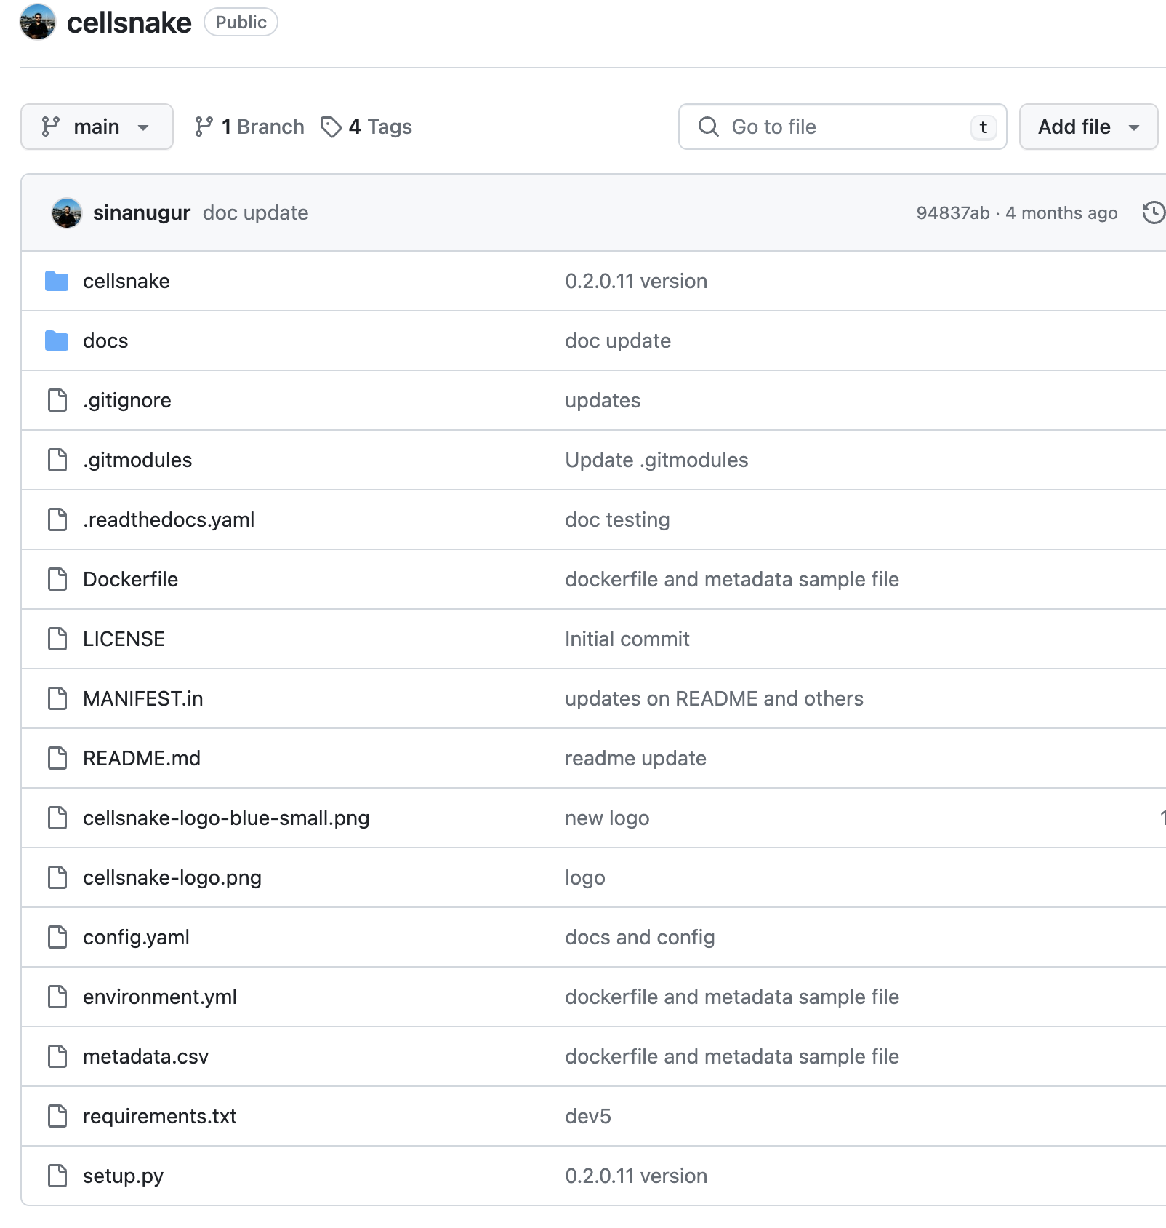
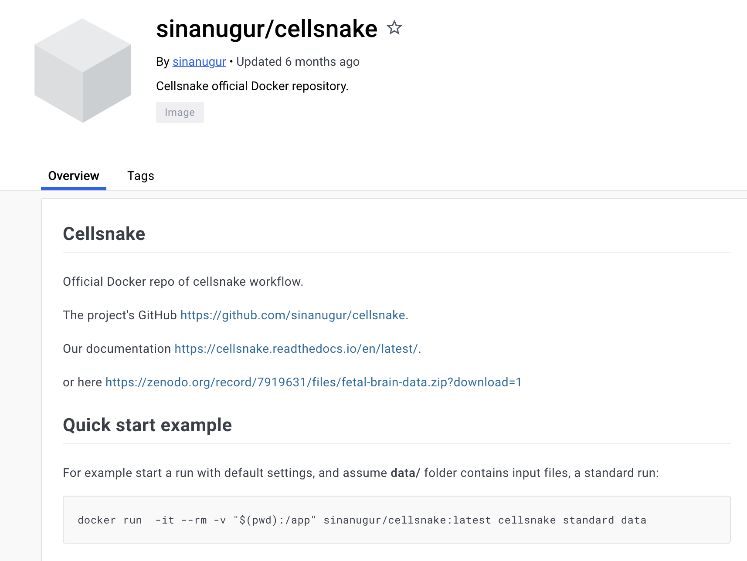
DOCKER. Existing example
Docker hub
docker pull sinanugur/cellsnake
https://hub.docker.com/r/sinanugur/cellsnake

Slide 23
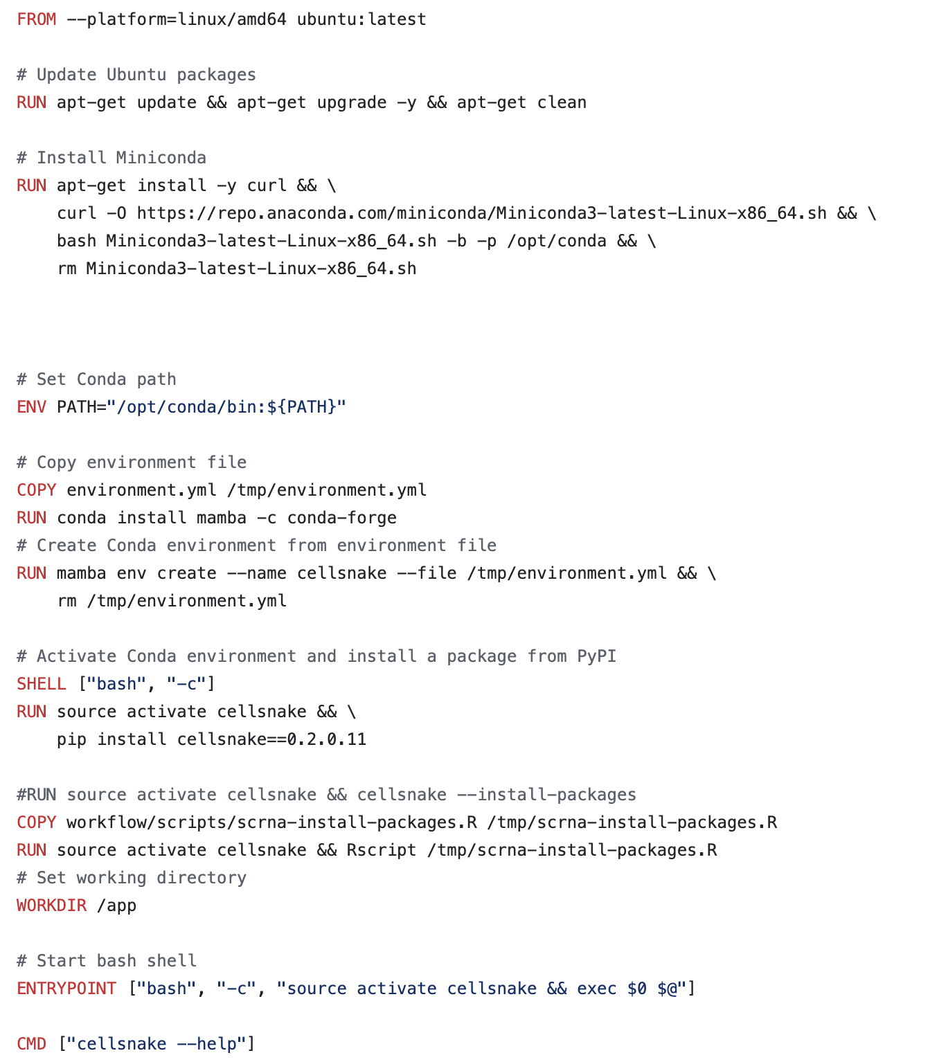
DOCKER. Existing example
1-ENV:
Set environment variables within the Docker image.
These variables can be accessed by any process running inside the container.
1-
2-SHELL:
Specify the default shell for running commands.
2-
3-ENTRYPOINT:
Set the process to run by default.
3-

Slide 24
SINGULARITY
Containerization platform
Specifically designed for high-performance computing (HPC)
Run through SLURM
Image format -> Singularity Image Format

Slide 25
SINGULARITY
Containerization platform
Specifically designed for high-performance computing (HPC)
Run through SLURM
Image format -> Singularity Image Format
Ibex manual: https://www.hpc.kaust.edu.sa/sites/default/files/files/public/Cluster_training/07_03_2019/Containers%20On%20HPC.pdf

Slide 26
SINGULARITY. Commands
Login in ilogin
module load singularity
Commands:
singularity build –fakeroot --force <image>.sif <file>.def -> build image
singularity run <image>.sif -> run image
singularity build --sandbox <apps name> docker://<repo>/<apps name> -> docker image convert into singularity

Slide 27
SINGULARITY. Commands
Login in glogin
module load singularity
Commands:
singularity build –fakeroot --force <image>.sif <file>.def -> login credentials and build image
singularity run <image>.sif -> run image
singularity build --sandbox <apps name> docker://<repo>/<apps name> -> docker image convert into singularity

Slide 28
SINGULARITY. Image
Bootstrap: docker
# OFICIAL IMAGE
From: ubuntu:20.04
# INSTALL DEPENDENCIES
%post
chmod 1777 /tmp
apt-get update && apt-get install -y libsm6 libxext6 vim git wget curl
apt-get install -y libxrender-dev python
# RUN SCRIPT
%runscript
echo "Hello, world!"
Get official image
file.def
Installdependencies
Run script

Slide 29
THANK YOU!!

