Slide 1
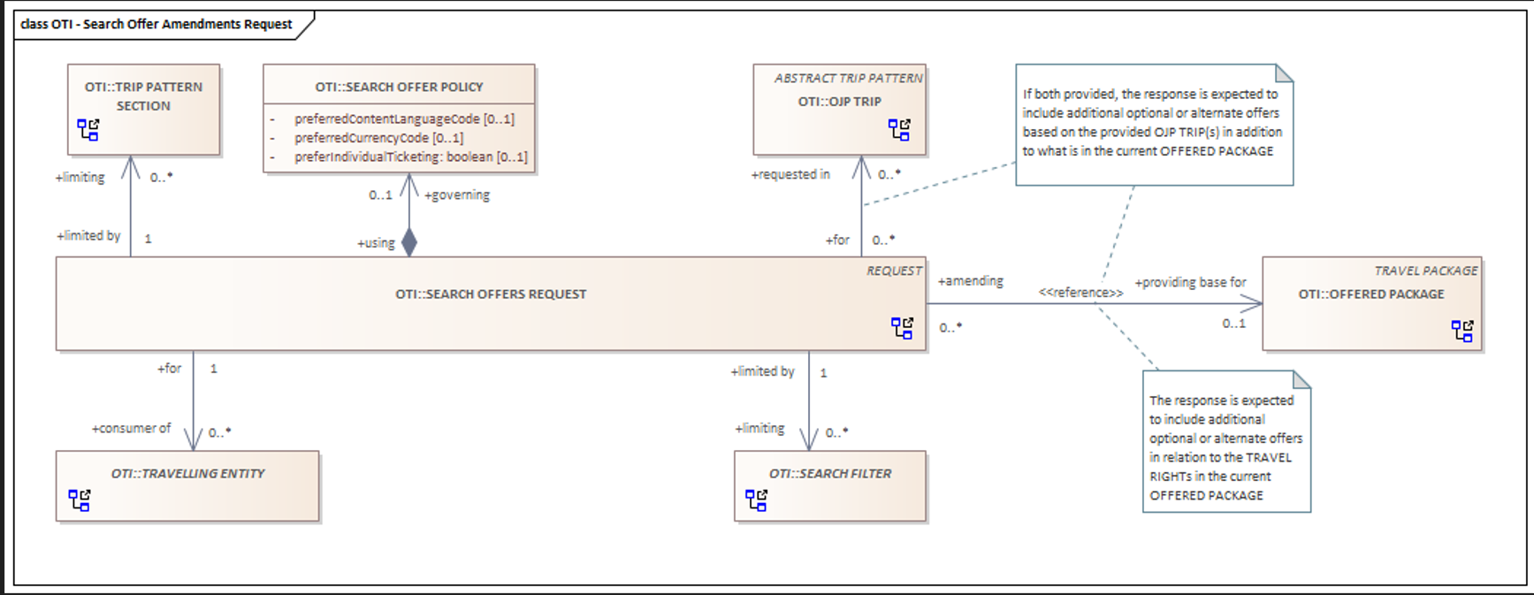

Slide 2
Read as: SEARCH OFFER REQUEST limited by zero to many TRIP PATTERN SECTIONs

Slide 3
Or read as: TRIP PATTERN SECTION limiting one SEARCH OFFER REQUEST

Slide 4
Read <<reference>> as that SEARCH OFFER REQUEST should include a reference to OFFERED PACKAGE instead of specifying the expanded OFFERED PACKAGE

Slide 5
Right-adjusted blue-circled diagram symbol means that there is a separate diagram describing the parent REQUEST Left-adjusted red-circled diagram symbol means that there is a separate diagram describing the TRAVELLING ENTITY

