Slide 1
EUDIT — End-to-End Sales & After-Sales Business Process
15 Process Steps · 160 Processes · BRM V1.2 · Based on CoRoM, OSDM, OMSA, TOMP, FerryGateway, NeTEx
CUSTOMER SALES JOURNEY → Steps 01 – 05
Pre-Sales
01
Search & Planning
02
Offer & Pricing
03
Reservation
04
Booking & Order
05
›
›
›
›
9 processes
10 processes
15 processes
9 processes
21 processes
↓
TRANSITION & DISRUPTION MANAGEMENT → Steps 06 – 10
Payment
06
Fulfillment
07
Pre-Trip Info
08
In-Trip Services
09
Disruption Mgmt
10
›
›
›
›
8 processes
11 processes
7 processes
4 processes
9 processes
NEW V1.2
↓
AFTER-SALES, SETTLEMENT & GOVERNANCE → Steps 11 – 15
A/S Exchange
11
A/S Refund
12
A/S Complaint
13
Settlement
14
Governance
15
›
›
›
›
9 processes
16 processes
9 processes
7 processes
16 processes
EUDIT Working Group · BRM V1.2 · March 2026 · CoRoM · OSDM · OMSA · TOMP · FerryGateway · NeTEx

Slide 2
EUDIT Sales Process Taxonomy — 15 Steps × 160 Processes
CoRoM §6 · OSDM UC1-15 · OMSA OGC Processes · TOMP Booking Lifecycle · FerryGateway · NeTEx / GTFS
01 · Pre-Sales — 9 processes
02 · Search & Planning — 10 processes
03 · Offer & Pricing — 15 processes
Catalogue Consultation · Fare Product Discovery · Station & Stop Lookup · Ext. Data Source Registry (OMSA)
Trip / Timetable Search · Multi-modal Journey Planning · On-Demand Trip Planning · Vessel / Sailing Search (Ferry)
Fare Offer Construction · Dynamic / Real-time Pricing · Offer On-Hold (chargeable) · Upsell / Cross-sell Offer
04 · Reservation — 9 processes
05 · Booking & Order — 21 processes
06 · Payment — 8 processes
Seat Reservation · Cabin Selection (Ferry) · PRM Space Reservation · Mandatory Reservation
Two-Stage Commit · Offer Selection into Package · Traveller Management (OMSA) · Physical Asset Assignment
Card Payment Auth · Travel Account Debit · Split Payment · B2B Invoice / Settlement
07 · Fulfillment — 11 processes
08 · Pre-Trip Info — 7 processes
09 · In-Trip Services — 4 processes
Barcode/QR Issuance (Aztec) · BoB BCT (CBOR/COSE) · NFC / Smart Card Fulfillment · Travel Document Retrieval
Booking Confirmation Delivery · Journey Reminder · Platform / Track Push · Connection Risk Warning
Real-time Journey Tracking · Delay Notification (push) · On-board Service Access · Emergency Assistance Trigger
10 · Disruption Mgmt — 9 processes ★ NEW
11 · A/S Exchange — 9 processes
12 · A/S Refund — 16 processes
Pre-Departure Disruption Alert · In-Trip Disruption Notification · Alternative Route Proposal · Situation Exchange (NeTEx)
Outward Journey Exchange · Travel Date / Time Change · Class Upgrade · Exchange Fee Waiver (Overrule Code)
Standard Cancellation · Refund Claim Submission (Phase 1) · Refund Claim Confirmation (Phase 2) · Voucher Issuance
13 · A/S Complaint — 9 processes
14 · Settlement — 7 processes
15 · Governance — 16 processes
Delay Comp. Claim (PRR Art.17) · PRM Assistance Complaint · Travel Guarantee Activation · Complaint Status Tracking
Revenue Settlement · VAT Reporting (dom./int.) · Clearing House Submission · Corporate Reconciliation
OAuth 2.0 / mTLS / JWT · API Versioning & Lifecycle · GDPR Data Retention & Deletion · Conformance Declaration
★ New step added in BRM V1.2 | Processes derived from OMSA, OSDM, CoRoM, TOMP, FerryGateway
EUDIT Working Group · BRM V1.2 · March 2026 · CoRoM · OSDM · OMSA · TOMP · FerryGateway · NeTEx

Slide 3
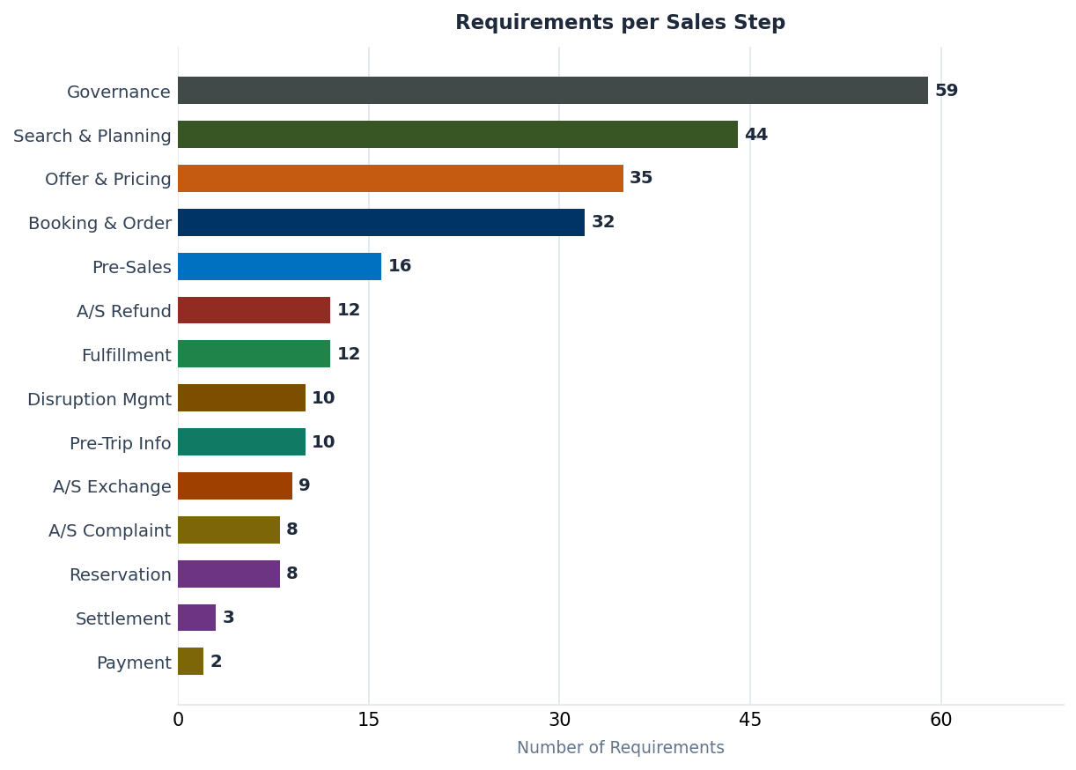
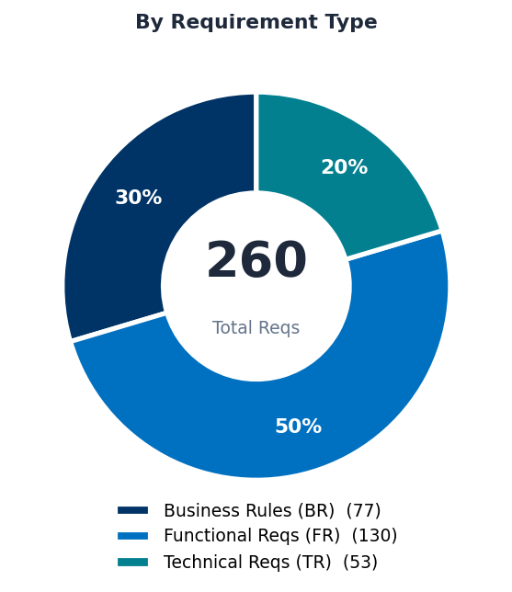
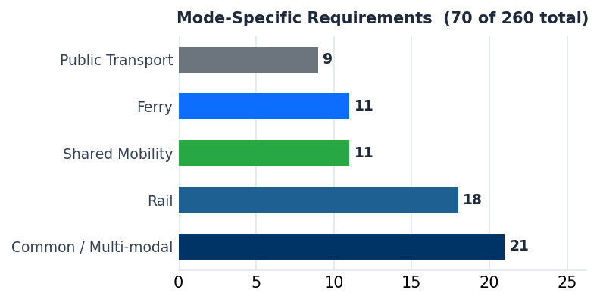
Requirements Coverage — 260 Requirements across 15 Process Steps
260
77
130
53
BRM V1.2 · EUDIT Working Group · March 2026
Total
Business Rules
Functional Reqs
Technical Reqs
EUDIT Working Group · BRM V1.2 · March 2026 · CoRoM · OSDM · OMSA · TOMP · FerryGateway · NeTEx

