Slide 1
NTS datasets: availability and applicability
Data Insight - Owen O’Neill – July 2024
Notes:
Hi Everybody,
I'm going to be talking to you today about the NTS datasets that we've got, and their availability and applicability to various tasks that you might have.

Slide 2
NTS – what is it ?
National (England) Travel Survey
Historically covered Wales + Scotland too
Longitudinal: main questions asked annually
Supplementary questions cycled / asked occasional
Travel Diary: self reported, validated by researchers, currently paper, experimenting with electronic diary
Men are bad at completing diary for whole week
Weighting applied to correct survey biases
Extremely important to apply correct weighting values when querying !
Notes:
Firstly what is the NTS ?
**
It is the national travel survey, and what we mean by national is England although in the past it used to cover Wales and Scotland, but not anymore.
**
it's a longitudinal study with the main questions asked annually and a number of supplementary questions which are either cycled or asked occasionally.
**
The main event is the travel diary which is self reported by respondents and then validated by the field researchers. This is currently on paper although they're experimenting with an electronic diary.
And it's notable that men are bad at completing the diary for the whole week
**
To correct for this and other survey bias a series of weightings are applied to the raw data.
It's extremely important to apply those weightings correctly otherwise you will generate numbers that are complete nonsense

Slide 3
Local Availability
End User Licence:
Geographic – metropolitan areas:
Demographic – ethnicity breakdown not useful for analysis
Less restrictive licence terms
Special Licence:
Geographic – LA areas:
Demographic – standard ethnicity breakdown
Licence terms require us to have approved & controlled list of personnel accessing data + review outputs to prevent personal disclosure.
Notes:
In terms of the local availability of the dataset we now have two versions available.
**
there is the end user licence version which allows us to achieve a geographic breakdown at the metropolitan area level.
The ethnicity demographic information within this is not useful for our usual analysis.
However because the data is less identifiable the licence terms are less restrictive in terms of who we can give access to the raw data. **
then we have the special licence version of the dataset, this allows us to get to a local area geography, and has the standard ethnicity demographic information that you would expect to see in most surveys.
The licence terms on this are more restrictive and we have to have an approved and controlled list of people that have access to the raw data, and we are required to review outputs to prevent potential personal disclosure of results both internally and externally.

Slide 4
Limitations
Sample size, sample size, sample size
Individual count < 300 / 1000 trips not statistically significant
Slicing by multiple variables / ‘small’ geographies rapidly hit limit.
Small = LA
Aggregate over multiple years
Notes:
Limitations on using the NTS can be summarised as
**
sample size, sample size and sample size
**
the recommendation is that individual counts of less than 300 - and trip counts of less than 1000 are not statistically significant and should not be relied upon.
**
once you start slicing by multiple variables - and you get into small geographies you rapidly hit this sample size limit.
In this context “small” means local authority, and the way we counteract that is by aggregating over multiple years in order to boost sample size.

Slide 5
Limitations
Covid hangover in participation rates:
Geographic coverage patchy below met region level
Year | “Fully productive” individuals (completed travel diary)
2018 | 14150
2019 | 14356
2020 | 6239
2021 | 9971
2022 | 8087
LA | Pro-rata respondent count | 2022 respondent count
Birmingham | 164 | 97
Coventry | 49 | 37
Dudley | 46 | 15
Sandwell | 49 | 16
Solihull | 31 | 4
Walsall | 41 | 5
Wolverhampton | 38 | 34
Notes:
There are further limitations in that there is still a hangover in participation rates from COVID
**
this table shows the number of participants that have completed a travel diary, which in NTS speak are termed “fully productive” individuals.
We can see that there was a significant drop off in particpation from the 14,000 level down to around 9000 post COVID. We've been told that the 2023 sample size will be doubled - but we don't know if this is double what we've seen in the past few years - or double compared to pre COVID.
**
The geographic coverage gets particularly patchy below the metropolitan region level of geography.
In this table we can see in the left hand column what would have been a population pro rata respondent count for 2022 based on the national participation rate of 8100 people.
In the right hand column we can see the actual number of respondents for our LA. We can see that for Wolverhampton it's happy days - whereas for Solihull and Walsall we have a large shortfall in the number of respondents needed to get a population pro rata sample.
This is again why we have to aggregate over potentially long periods of time at ‘small’ geographies.

Slide 6
Favourite Queries
Trip Rate (overall) – met level – annual + most popular modes
Trip Rate (Modal Split) - met level – 3 year aggregation
NTS0303: Average number of trips, stages, miles and time spent travelling by mode: England, 2002 onwards
Trip Purpose
NTS0409: Average number of trips and distance travelled by purpose and main mode: England, 2002 onwards
Notes:
There are a number of your most favourite queries that we have replicated at the local level - such as overall trip rate, trip rates split by mode, and trip purpose.
Depending on which geography and mode we're looking at we have to aggregate these over different time periods in order to achieve a sufficient sample.
At the Met region level we can give an overall trip rate annually and also do that for the most popular modes such as walking (all distances) and car.
Again at the Met level (depending on which modes we're looking at) if we aggregate over three years we can provide information on a larger number of modes.

Slide 7
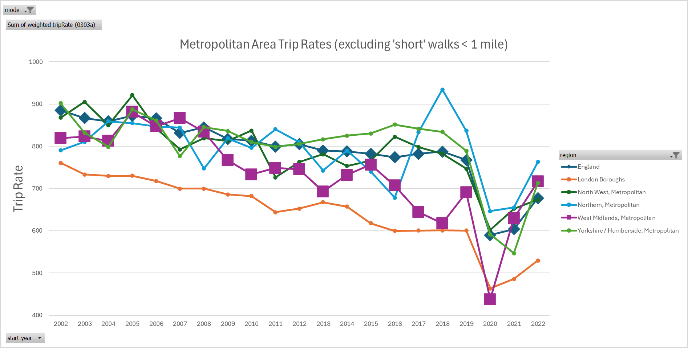
Notes:
For example, here we see what we’ve come to expect, a downward trend in overall trip rates – having this dataset allows us to compare ourselves with other metro areas, instead of other entire regions.

Slide 8
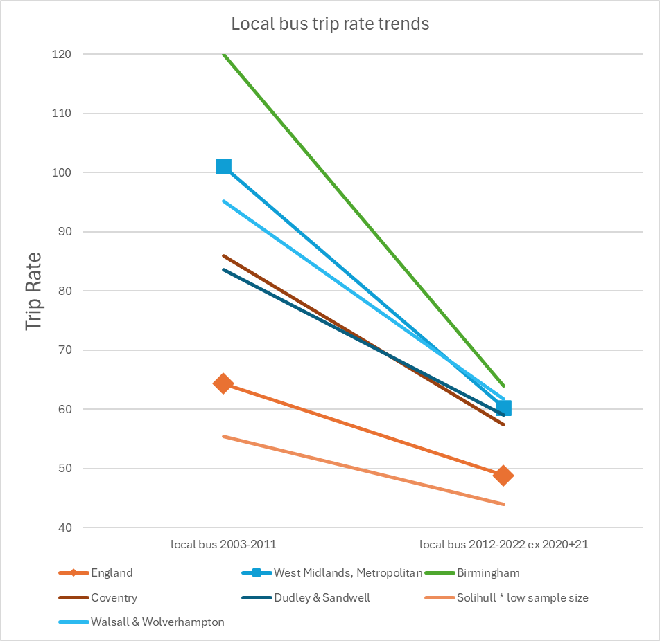
Notes:
To illustrate the impact of geography and mode on trip rate we can see a piece of work done for the local transport plan. In order to get a sufficient sample size for local authority level bus usage we've had to aggregate the nine years from 2003 to 2011 and aggregate nine years from 2012 to 2022 excluding the two worst covid years. Even then we've had to combine Dudley and Sandwell together and also combine Walsall and Wolverhampton together - With a big Asterix beside Solihull because it's got a low sample size but we know that that's got a significantly different pattern of behaviour, so hasn’t been combined with any other LAs.
In common with many other research results the larger population of Birmingham means that it dominates the results for the wider combined authority area.

Slide 9
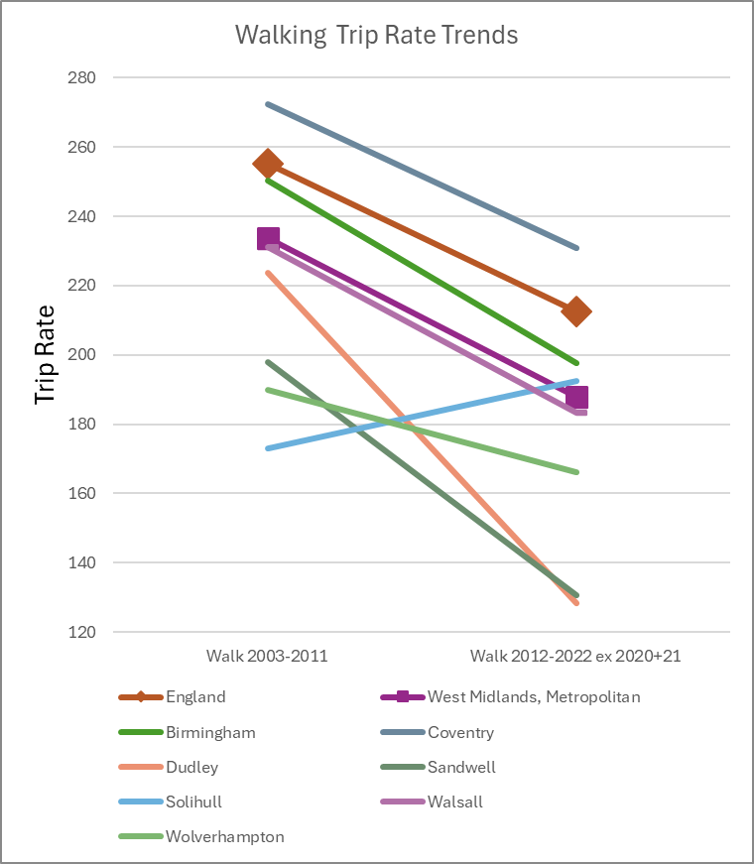
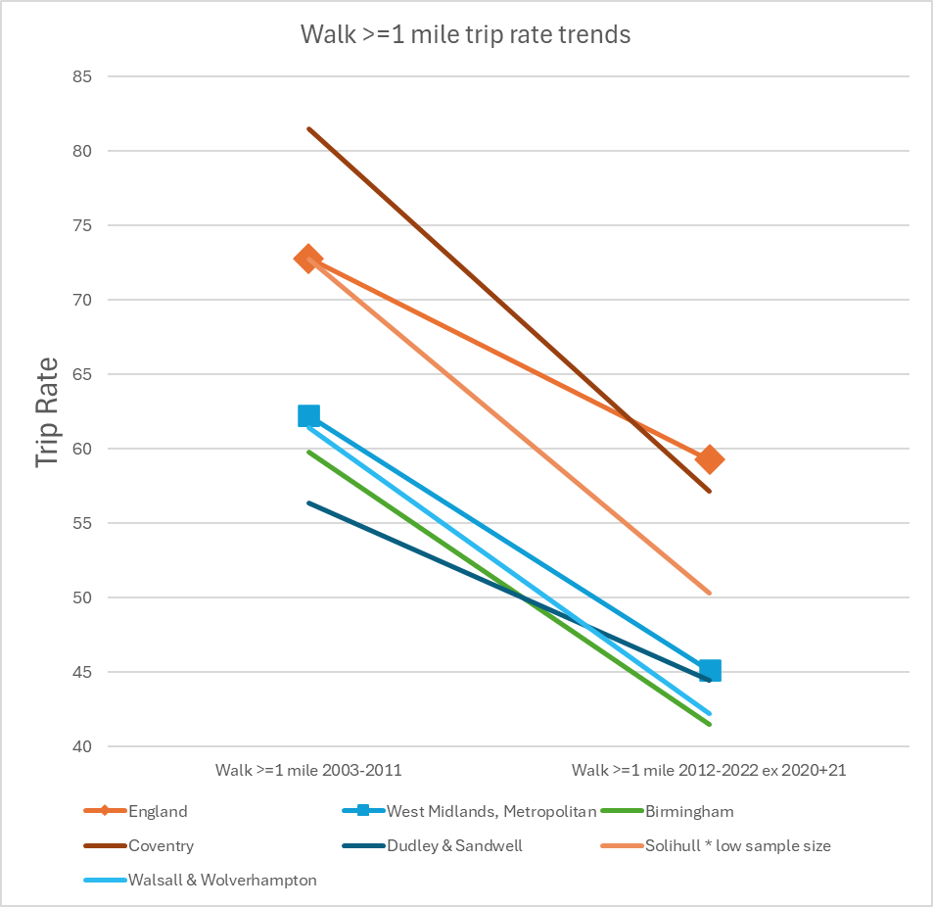
Notes:
Walking is a very popular mode so we can provide local authority results more easily, however long walks (meaning over a mile in each direction) are not a popular mode. These two charts deliberately show how easy is to get into a complete mess presenting this information, since they use different levels of aggregation and different colours for every area. It suggests that during Covid - Solihill residents started doing more ‘short walks’, and their increased number of ‘short walks’ has up until 2022 been sustained, even if their ‘long walk’ behaviour is more typical of national trends – but needs a recovered sample size to validate this.

Slide 10
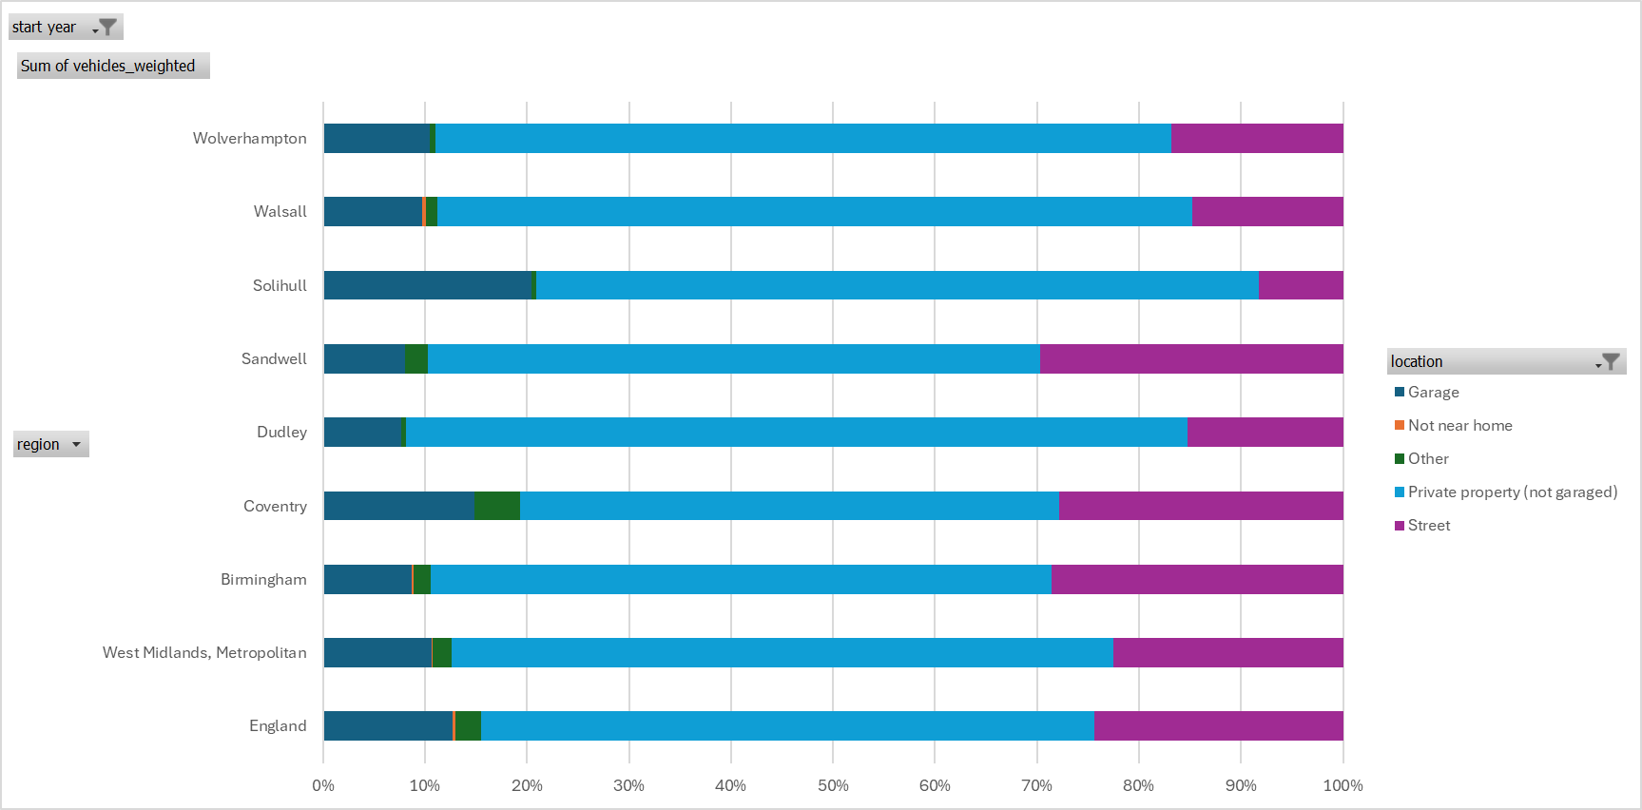
NTS0908: location vehicle parked overnight
Aggregated results 2008-2022
Only statistically significant for Birmingham, Coventry, Walsall
Notes:
Other types of information we can get are about where vehicles are stored overnight.
In order to get anywhere near a respectable sample size we've had to aggregate these results for the entire period that the question has been asked which is every other year from 2008 to 2022. The results are unsurprising, but it is valuable to have evidence to back up our intuition about variations between local authorities. It is not shocking to see that Solihull has the highest proportion garage usage and lowest amount of on street parking. Conversely Sandwell has a low garage usage and very high proportion of on street parking – equally not shocking that parking on a driveway dominates, since this survey is about actual usage – not if a garage exists.

Slide 11
Less well travelled
“Attitudes” questions e.g. barriers to using active travel to school ?
Rotation of questions / different sets of questions asked in different years. Two releases per year.
Recent topics have been - attitudes and experiences relating to :-
bus fare caps, concessionary travel
cycling, electric vehicles and charging, local bus travel
personal safety
ultra-low emission vehicles
air travel, ferry travel, international travel, concerns about travelling during covid
cycling (focus on e-bikes and cycle training), walking and travel behaviour during covid
https://www.gov.uk/government/collections/national-travel-attitudes-study-ntas
Notes:
Some less well known parts of the NTS are the attitudes questions,
**
which are about people's travel perceptions.
These are either asked in rotation or as parts of various different one-off waves of study.
Recent topics have included bus fare caps, electric vehicles, personal safety and cycling – amongst others.

Slide 12
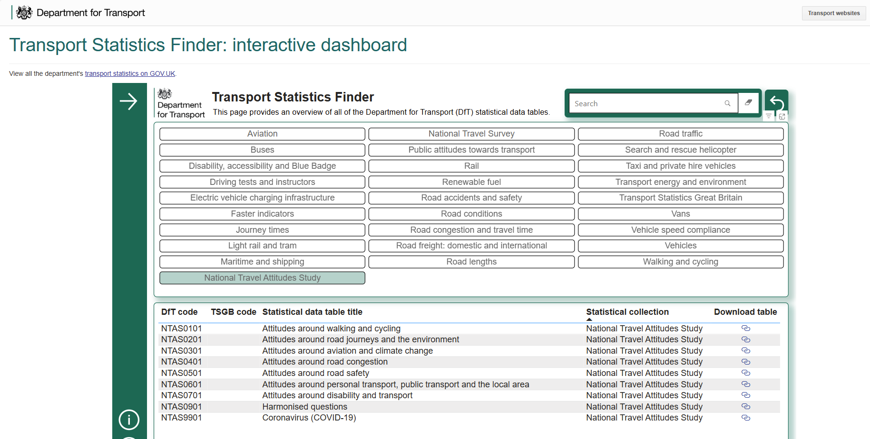
Useful Resources
Transport Statistics Finder: interactive dashboard (not just NTS)
https://maps.dft.gov.uk/transport-statistics-finder/index.html
Notes:
There are some other useful resources that are not particularly NTS related - such as the transport stats finder dashboard which can be a quick way to find your way to data on a variety of transport topics.

Slide 13
Questions ?
NTS datasets: availability and applicability
Further query writing information
https://wmcanet.sharepoint.com/sites/DataInsightService/SitePages/NTS-(National-Travel-Survey)---bri.aspx
Data Insight - Owen O’Neill – July 2024
datainsight@tfwm.org.uk
owen.oneill@tfwm.org.uk
Notes:
Any questions ?

