Slide 1
Demanda de Transporte Learning- Multinomial Logit model Gabriel Nova Sander van Cranenburgh CityAI lab Section of Transport and Logistics Faculty of Technology, Policy and Management Delft University of Technology

Slide 2



Limitation of theory-based DCM
The researcher needs to a priori specify the functional form of the utility function: V_{i} = f(x_{i})
But the true DGP is unlikely to be found, considering the large number of potential specifications with interactions, nonlinearities, asymmetries, etc.
Machine Learning (ML) is the field of study that gives computers the ability to learn without being explicitly programmed.” – Arthur Samuel, 1959
MLPs can indeed overcome the ad-hoc-ness of specifying the model
“We need to strike a balance between model performance and behavioural insights”
But, the ‘costs’ are TOO high …
MLPs give no behavioural or economic insight
MLPs may violate behavioural intuition
MLPs also involve parameter (→ ad-hoc-ness)
Utility-based ML
(aka hybrid choice models)
2

Slide 3
L-MNL model
Idea “Learning-MNL”
Not all variables (features) are equally of interest to understand and explain choice behaviour
Let’s create a model with 2 parts:
a ‘restrictive’ but transparent part: RUM-MNL
a fully flexible but opaque part: MLP
Variables of …
behaviour interest go into the RUM-MNL
not of behavioural interest go into the MLP
Variables of behavioural interest
RUM-MNL model in MLP form
Variables NOT of behavioural interest
Fully connected MLP

Slide 4
L-MNL model
Nodes cast as utility
Creating the L-MNL architecture
V_{i}
There are J alternatives → J utility nodes
MNL-part
(in MLP form)
Use one hidden node per alternative
In MNL part, ensure the same weights are used
Use softmax function at output layer

Slide 5
L-MNL model
No arrows between attributes of alt j and the utility of alt i
Creating the L-MNL architecture
Nodes cast as utility
V_{i} = B_{TT}TT_{i}+B_{TC}TC_{i}
In an RUM-MNL model
β_{m} applies to every alternative i
MNL-part
(in MLP form)
Use one hidden node per alternative
In MNL part, ensure the same weights are used
Use softmax function at output layer

Slide 6
L-MNL model
Creating the L-MNL architecture
MNL-part
(in MLP form)
Use one hidden node per alternative
In MNL part, ensure the same weights are used
Use softmax function at output layer

Slide 7

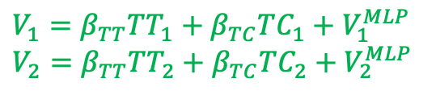
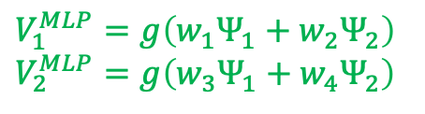

L-MNL model
Creating the L-MNL architecture
$$V_{1}=β_{TT}TT_{1}+β_{TC}TC_{1}+V_{1}^{MLP}$$
$$V_{2}=β_{TT}TT_{2}+β_{TC}TC_{2}+V_{2}^{MLP}$$
MLP-part
+
Variables NOT of behaviour interest
Ψ₁
$$V_{1}^{MLP}$$
+
Ψ₂
$$V_{2}^{MLP}$$
$$V_{1}^{MLP}=g\left(w_{1}Ψ_{1}+w_{2}Ψ_{2}\right)$$
$$V_{2}^{MLP}=g\left(w_{3}Ψ_{1}+w_{4}Ψ_{2}\right)$$
MLP with any number of nodes and layers
In this example, β_{TT} and β_{TC} can be interpreted as marginal utilities of cost and time
Use one hidden node per alternative
In MNL part, ensure the same weights are used
Use softmax function at output layer
Use MLP for variables not of beh. interest and add its outputs to the utility nodes

Slide 8

Hybrid choice models
Final observations
Hybrid choice models inevitably involve striking a balance between model fit and behavioural insights
In general
A high(er) mode fit means the model is close(r) to the true DGP
→ More reliable estimates (at least in theory)
Better predictions/forecasts (at least in theory)
Imposing restrictions onto the model (typically) results in:
Better interpretable models
‘Better behaved’ models
No violation of fungibility
No violation of behavioural regularity
Less erratic predictions

Slide 9

Hybrid choice models
Final observations
MLP-based hybrid models are not uniquely identifiable
Sensitive to local solutions
Sensitive to hyperparameter settings
When covariates (strongly) correlate with attributes used in the MNL-part of behavioural layers, they may get be biased (‘polluted’)
Hybrid models are more challenging to implement
A lot of research into hybrid choice models is going on. The jury about their added value and use is still out

Slide 10
Empirical example L-MNL model

Slide 11


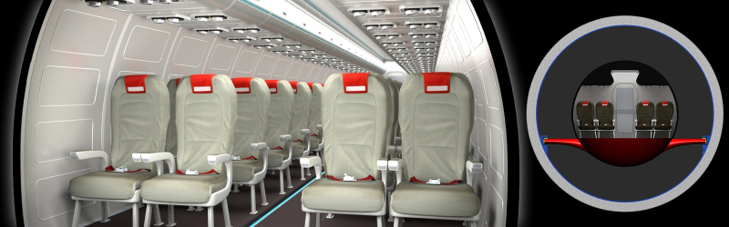


Empirical example L-MNL model
MNL-part
Swiss Metro
Implementation
We use PyTorch, which is a more specialised Deep Learning (DL) package developed by Meta AI
PyTorch requires a more Pythonic way of coding
PyTorch works uses its own DL datatypes: “tensors”
MNL part identical to RUM-MNL choice model
Transparent weights: B_{TT}, B_{TC}, ASC_{TR}, ASC_{SM}
Covariates MLP-part: AV Purpose, First class, Gender, Age
+
+
MLP-part
Ψ₁
$$V_{1}^{MLP}$$
Covariates
Ψ₂
$$V_{2}^{MLP}$$

Slide 12
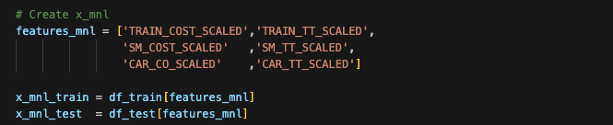
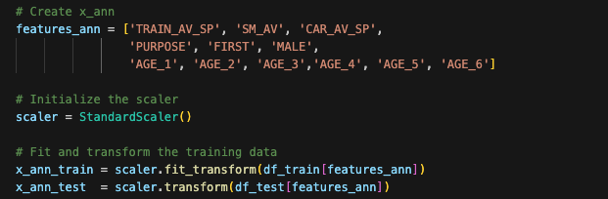
Empirical example L-MNL model
Steps
Split data in a training and test set
A) Estimate linear-RUM MNL on the train data
B) Compute the Log-likelihood of the test data given the model
Scale the data
We scale the variables going into the MLP-part
We do not scale the variables going into the MNL-part
Dummy code the choices
--- Same as before

Slide 13
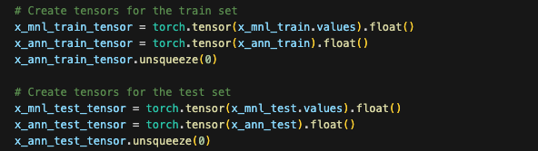
Empirical example L-MNL model
Steps
Split data in a training and test set
A) Estimate linear-RUM MNL on the train data
B) Compute the Log-likelihood of the test data given the model
Scale the data
We scale the variables going into the MLP-part
We do not scale the variables going into the MNL-part
Dummy code the choices
Create convert data into tensors

Slide 14
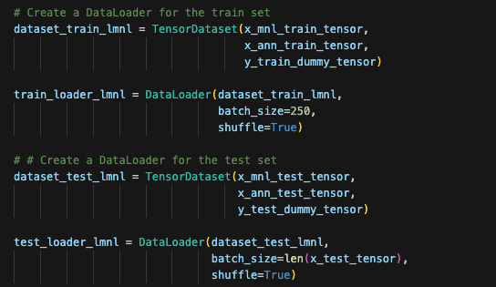
Empirical example L-MNL model
Steps
Split data in a training and test set
A) Estimate linear-RUM MNL on the train data
B) Compute the Log-likelihood of the test data given the model
Scale the data
We scale the variables going into the MLP-part
We do not scale the variables going into the MNL-part
Dummy code the choices
Create convert data into tensors
Put data train and test data in a “DataLoader”

Slide 15
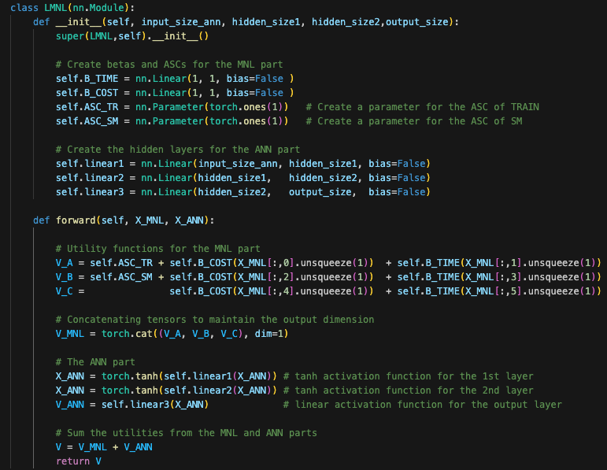
Empirical example L-MNL model
Steps
Create the model!
A new model class is created
For MNL-part:
Linear function for βs
Separate params for ASCs
For MLP-part:
3 fully Connected layers
Output size last layer = 3
In the Forward function, the “utilities” are computed using the initialised building blocks
Utilities are summed and returned

Slide 16
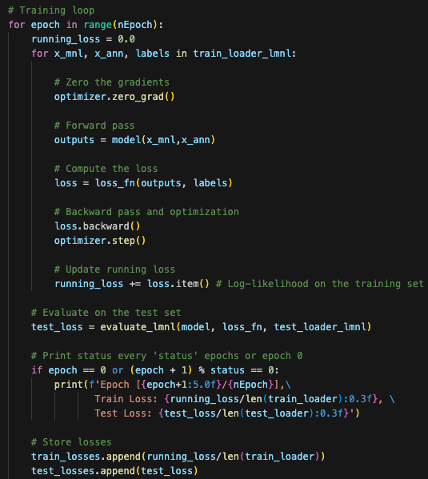
Empirical example L-MNL model
Steps
Training!
The optimisation is more manually coded, compared to e.g. training an MLP in sk-learn or estimating a theory-driven choice model using biogeme
Performance on the test set is evaluated after each epoch
Mini batches are taken from the dataloader

Slide 17
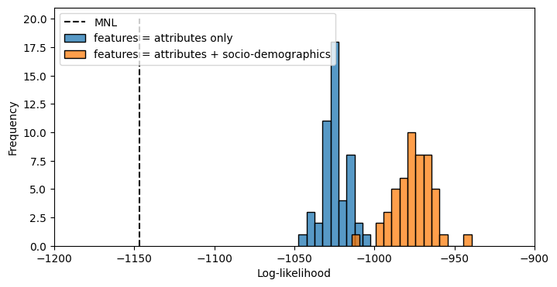
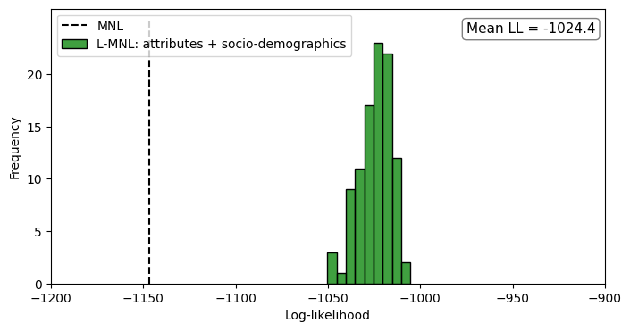

Empirical example L-MNL model
Results
The model performance of the L-MNL model is in line with expectations:
$${LL}_{test}^{MLP}>{LL}_{test}^{L−MNL}>{LL}_{test}^{MNL}$$

Slide 18
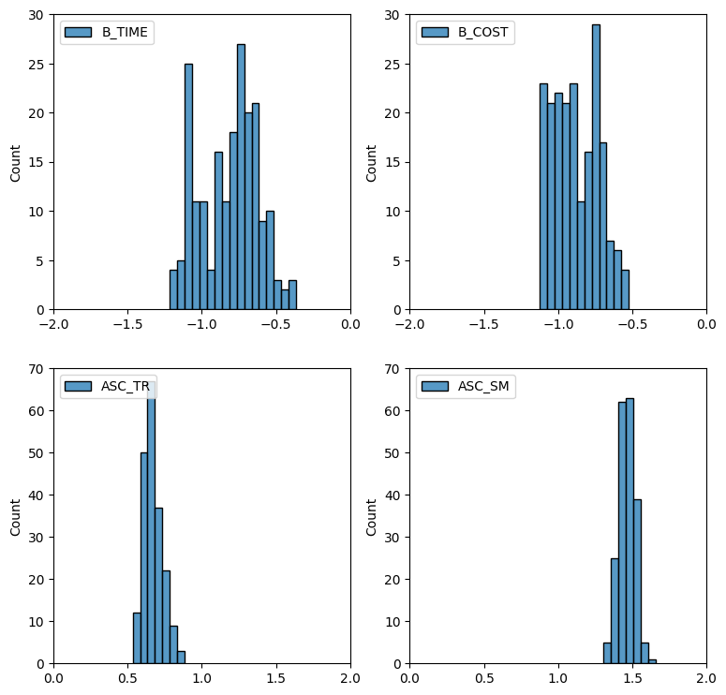
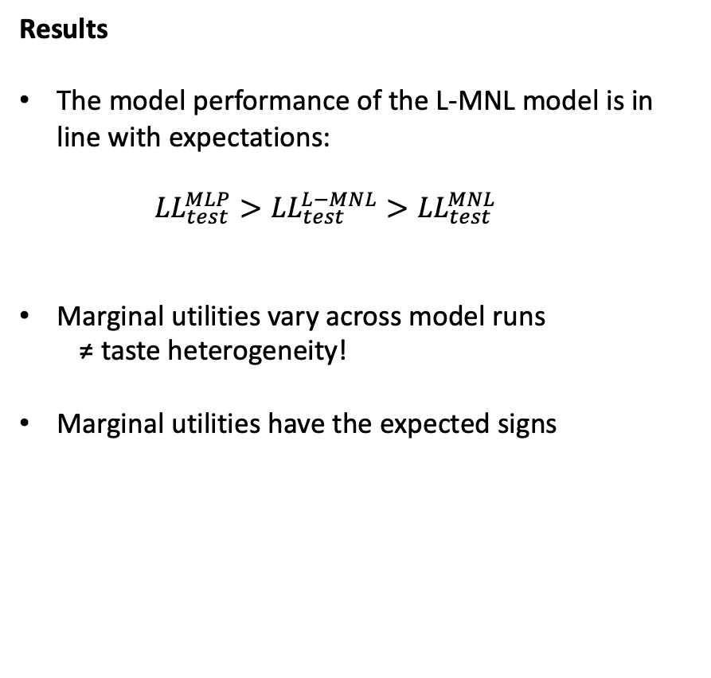
Empirical example L-MNL model
Results
The model performance of the L-MNL model is in line with expectations:
$${LL}_{test}^{MLP}>{LL}_{test}^{L−MNL}>{LL}_{test}^{MNL}$$
Marginal utilities vary across model runs
≠ taste heterogeneity!
Marginal utilities have the expected signs

Slide 19
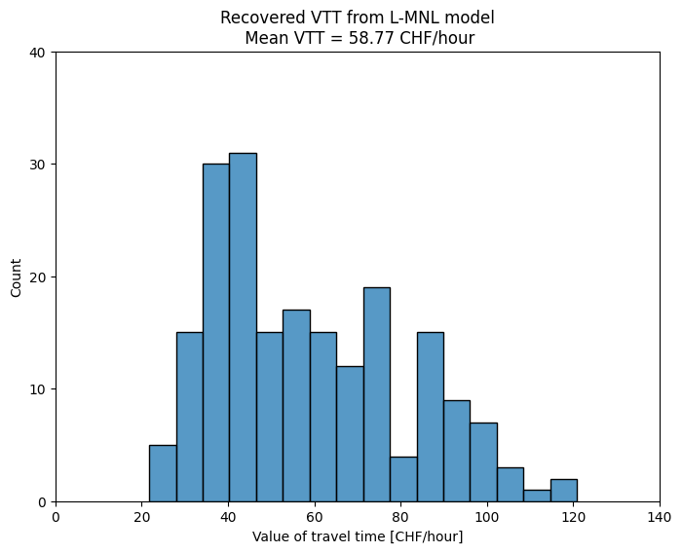
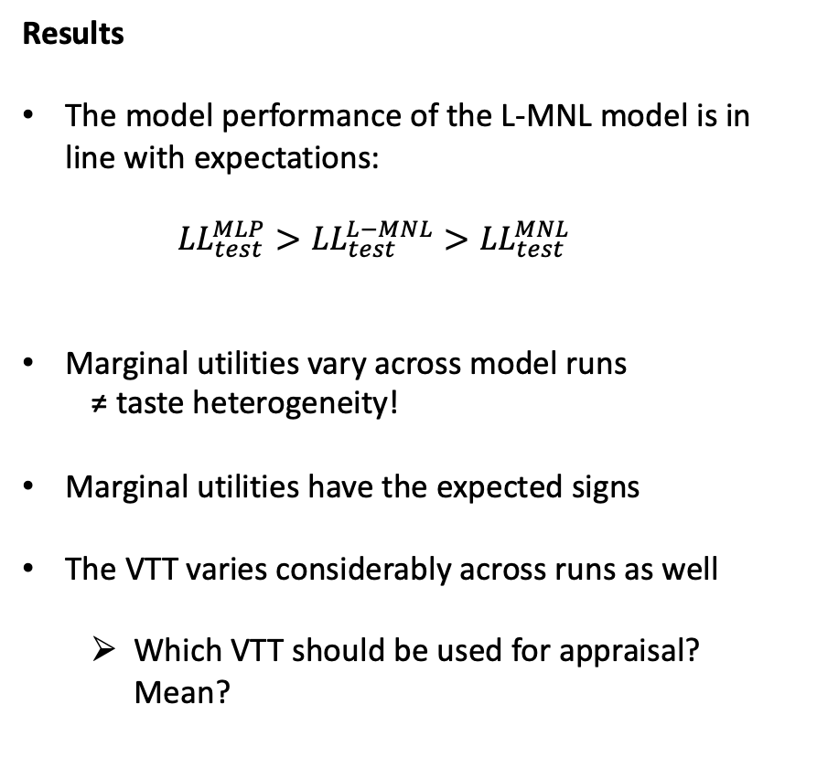
Empirical example L-MNL model
Results
The model performance of the L-MNL model is in line with expectations:
$${LL}_{test}^{MLP}>{LL}_{test}^{L−MNL}>{LL}_{test}^{MNL}$$
Marginal utilities vary across model runs
≠ taste heterogeneity!
Marginal utilities have the expected signs
The VTT varies considerably across runs as well
Which VTT should be used for appraisal? Mean?

Slide 20
Lab session 2 Machine learning approaches for discrete choice analysis L-MNL model

Slide 21
Lab session 2
Lab sessions aim to:
Show and reinforce how the ML models and ideas presented in class are put to practice.
Help you gather hands-on machine learning skills.
Learning objective for this lab session:
Estimate a RUM-MNL model using PandasBiogeme
Train L-MNL model and extract behavioural insights from them, such as WTPs
Discuss the strengths and weaknesses of using fully transparent RUM models, hybrid models and fully opaque ANNs

Slide 22
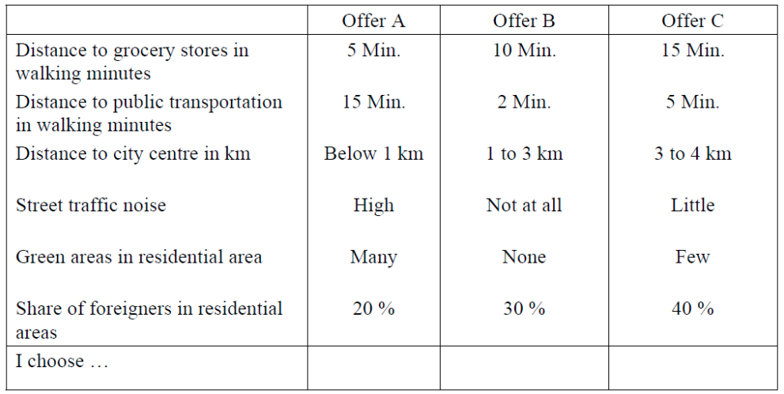
Lab session 2
Data
Neighbourhood location choices, collected in Hanover, Mainz, Bern, and Zurich
Stated Choice data
Straightforward experimental design
3 unlabelled alternatives
6 generic attributes

Slide 23

Lab session 2 Let’s GO!

Slide 24

Take-aways
Choice behaviour can be studied from theory-driven AND data driven perspectives
Theory-driven and data-driven models both have strength and weaknesses
Field can learn a lot from ML
Data-driven discrete choice analysis is a new emerging field. Key challenges:
Transparency
Economic outputs
Rigorous long-term prediction (out-of-distribution generalisation)
Machine learning models are not only capable of predicting choices, but can -when cleverly used- also provide behavioural insights (e.g. through XAI)
Machine learning is not confined to very large RP data sets, but can also be applied to small SP data sets

Slide 25

Thank you for your attention! g.nova@tudelft.nl

