Slide 1

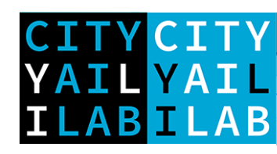

Machine learning approaches for discrete choice analysis
Gabriel Nova*¹, Sander van Cranenburgh¹
City AI Lab, Transport and Logistics Faculty of Technology, Policy and Management, Delft University of Technology

Slide 2
Course set-up
Course material
Van Cranenburgh, S., Wang, S., Vij, A., Pereira, F., & Walker, J. (2022). Choice modelling in the age of machine learning-discussion paper. Journal of Choice Modelling, 42, 100340.
Géron, A. (2019). Hands-on machine learning with Scikit-Learn, Keras, and TensorFlow: Concepts, tools, and techniques to build intelligent systems. " O'Reilly Media, Inc.".
Sifringer, B., Lurkin, V., & Alahi, A. (2020). Enhancing discrete choice models with representation learning. Transportation Research Part B: Methodological, 140, 236-261.
Molnar, C. (2020). Interpretable machine learning. Lulu. com
2

Slide 3
Theory-driven Models (RUM-MNL)

Slide 4

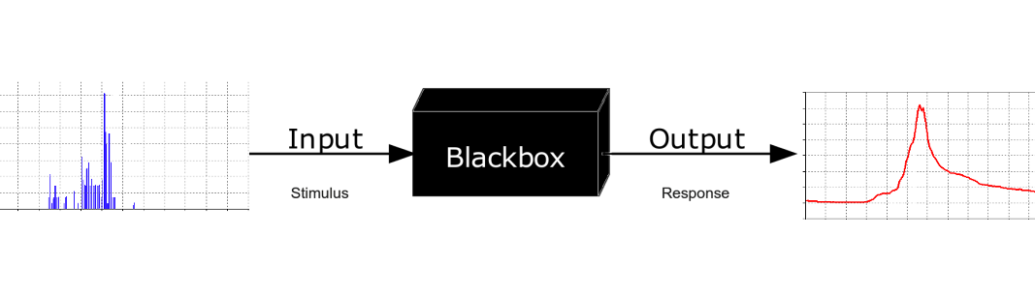
Theory-driven vs data-driven
Theory-driven
How does this work out in choice modelling?
Random Utility Theory: →Samuelson 1948→Luce 1959 → Lancaster 1966 → McFadden, 1974
Alternative i is chosen if and only if U_{i} > U_{j} ∀ j ≠ i
U_{i} = V_{i} + ε_{i}
V_{i} = f(x_{im},β), ε_{i} ~ G(◦)
Guiding principle
Data generating process is a stochastic model
Analyst imposes structure based on theory
Set of parameters, sign. levels
Choice task
Choice
f := X→Y

Slide 5
Theory-driven vs data-driven
Theory-driven
How does this work out in choice modelling?
Behavioural THEORY provides:
Meaning to model parameters: e.g. β = marginal utility
Guidance in model specification
Economic outputs: WtP, Value-of-time → Appraisal, e.g. Cost-Benefit Analysis (CBA)
Solid ground for extrapolation → long-term forecasting
Elegant communication to policy-makers
Guiding principle
Data generating process is a stochastic model
Analyst imposes structure based on theory
Set of parameters, sign. levels
Choice task
Choice
f := X→Y

Slide 6
Limitations of RUM-MNL models

Slide 7

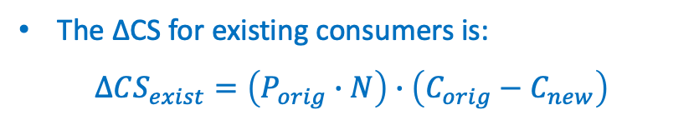
Limitations of RUM-MNL models
The RUM-MNL model is not a perfect model of choice behaviour: it has four key limitations
𝜀 is assumed to be i.i.d. across observations and alternatives. This is often unrealistic.
RUM-MNL assumes people maximise utility, whose utility of alternative i only depends on the attribute levels of alternative i: V_{i} = f(x_{i})
Nesed Logit (NL) model (1980 – 1990)
Mixed Logit (ML) model (1990-2005)
Descriptive models of choice behaviour, e.g.
Random Regret Minimisation
Elimination-by-aspects
Satisfycing
Lexicographic
7

Slide 8

Limitations of RUM-MNL models
The RUM-MNL model is not a perfect model of choice behaviour: it has four key limitations
RUM-MNL cannot handle image/text/signals data
(it is blind to images)
In real-life many choice situations involve images to convey information about the product or service
Images can much more effectively convey information about Scales, Textures, and Shapes than text or numbers
Incomplete understanding of choice behaviour
Data-driven models (aka Machine learning)
Computer-vision enriched choice model
8

Slide 9
Limitations of RUM-MNL models
The RUM-MNL model is not a perfect model of choice behaviour: it has four key limitations
The researcher needs to a priori specify the functional form of the utility function: V_{i} = f(x_{i})
The true DGP is unlikely to be found, considering the large number of potential specifications with interactions, nonlinearities, asymmetries, etc.
But estimates, std errors are only reliable when the utility function equals the true Data Generating Process (DGP).
→ Biased estimates and predictions
Data-driven models (aka Machine Learning)
Hybrid choice models
Machine Learning + eXplainable AI techniques
9

Slide 10
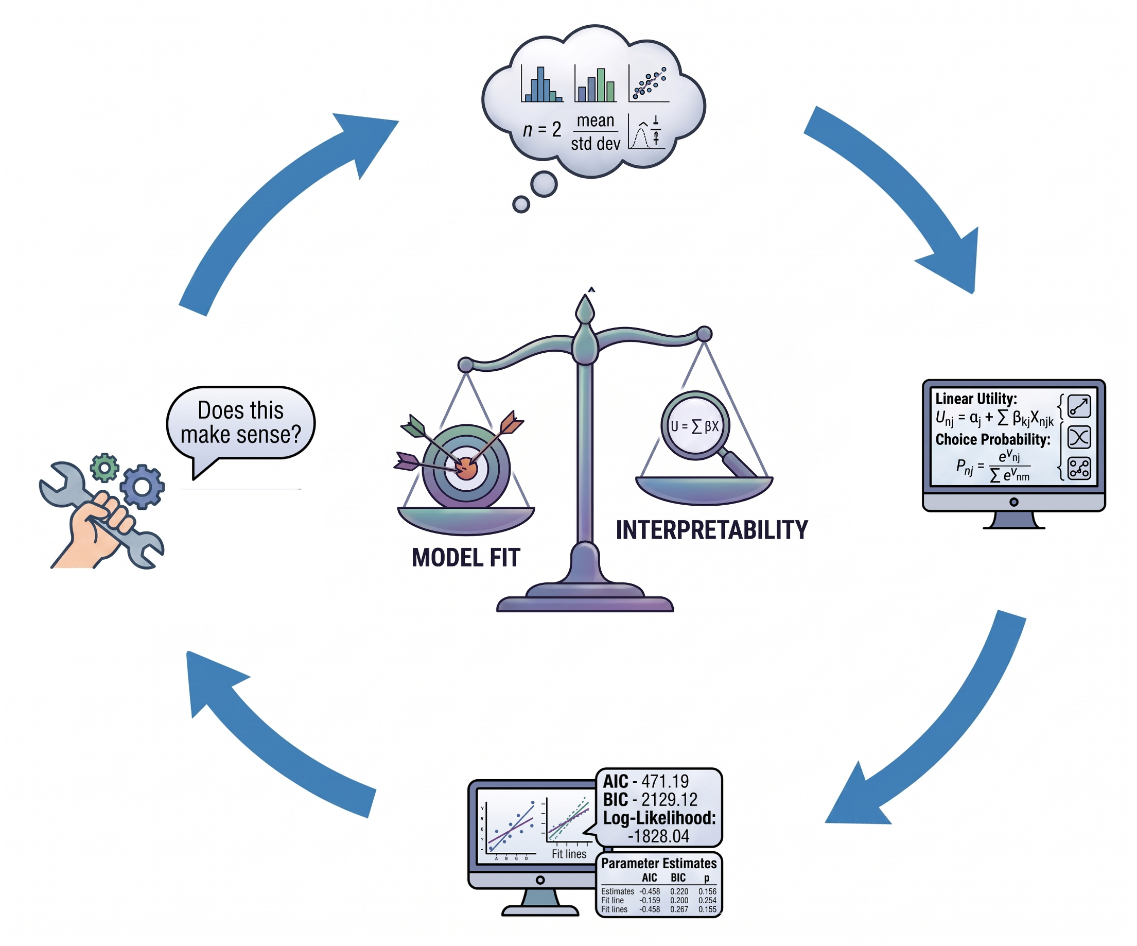
Model Specification Problem (PhD dissertation)
Specification is an iterative, trial-and-error process
Multi-objective criteria
Model performance
Parsimony
Behavioural plausibility
Modelling decisions
Which attributes enter the utility functions
Whether to allow non-linear effects
Whether tastes are generic or alternative-specific
How to capture observed heterogeneity
Hypothesis
Outcome interpretation
Specification
Estimation
10
Notes:
10

Slide 11
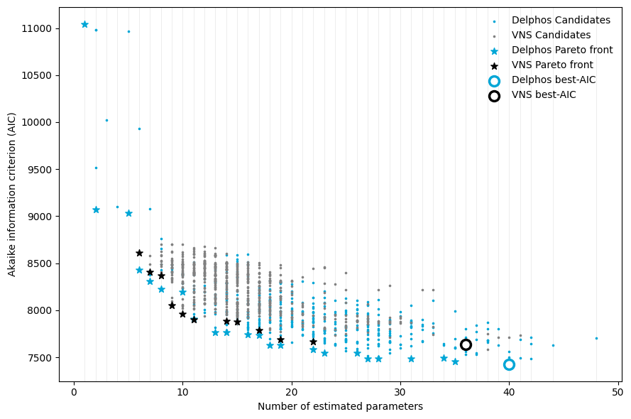

Delphos (PhD dissertation)
Swissmetro (Bierlaire et al., 2001)
Modelling space
Variables: ASC, TT,TC,HE,SE
$Transformations:L, Log, box−cox$
$Taste:G, S$
$Covariate:$ $A\text{ge}\text{, }\text{Inc}\text{, }\text{C}\text{las}\text{s}\text{, }\text{G}\text{a}\text{, }\text{G}\text{ender}$
11
Ortelli et al., (2021). VNS - Assisted specification of discrete choice models
Notes:
11

Slide 12
Data-driven Models

Slide 13
Theory-driven vs data-driven
Theory-driven
(discrete choice models)
Data-driven
(supervised machine learning)
Guiding principle
Data generating process is a stochastic model
Analyst imposes structure based on theory
Set of parameters, sign. levels
Guiding principle
Data generating process is complex and cannot be known
Analyst does not impose structure: g needs to be learned from the data
→Good (in-distribution) prediction
f := X→Y
Inherently Unknown
g

Slide 14
Machine Learning paradigms

Slide 15
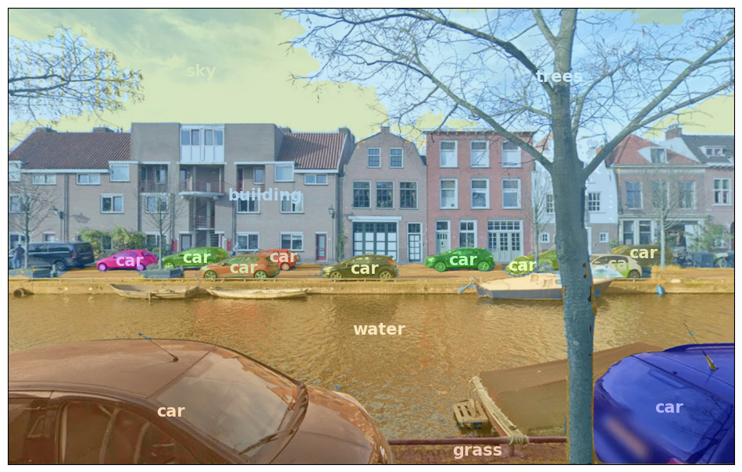
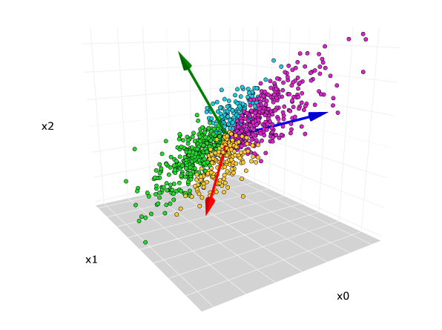

Machine Learning paradigms
Supervised Learning
Data: $\left(X,Y\right)$
Goal: Learn a function $\left(f\right)$to map $X→Y$
Examples: Regression, Classification, Object detection, …
Unsupervised Learning
Data: $\left(X\right)$, no labels!
Goal: Learn some hidden structure/pattern of the data
Examples: Clustering, Dimensionality, Feature learning, …
15
Notes:
15

Slide 16

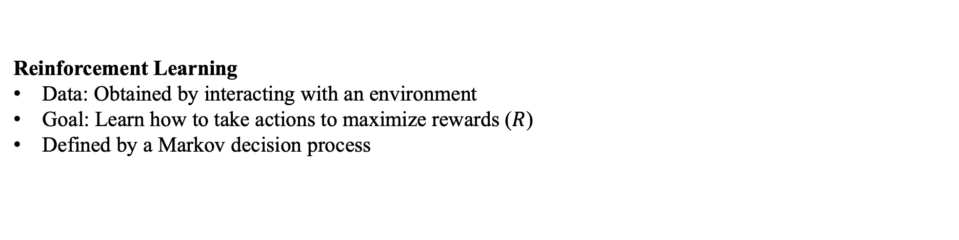
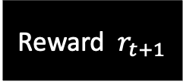
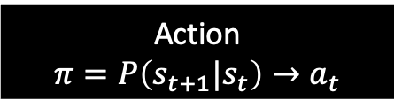

Machine Learning paradigms
Reinforcement Learning
Data: Obtained by interacting with an environment
Goal: Learn how to take actions to maximize rewards ($R$)
Defined by a Markov decision process
Action
$$π=P\left(s_{t+1}|s_{t}\right)→a_{t}$$
State $s_{t+1}$
Agent
Environment
State $s_{t}$
Reward $r_{t+1}$
Feedback that measures the agent’s action
16
Notes:
16

Slide 17
Artificial Neural Networks

Slide 18
Artificial neural networks
Layers
Nodes
Feed forward MultiLayer Perceptron (MLP)
Input layer consists of the features (explanatory variables)
The output layer consists of the target variable (dependent variable, e.g. the class)
Hidden layer(s) consists of a finite number hidden nodes (set by the analyst)
1 hidden layer → Shallow neural network
2 or more hidden layers → Deep neural network

Slide 19
Artificial neural networks
Connections
Feed forward MultiLayer Perceptron (MLP)
The links (black arrows) contain the weights w that need to be trained
Fully connected network (common, but not strictly necessary)
Even for this very simple network already 3 x 3 + 3 x 2 = 15 weights*
* Excluding bias weights

Slide 20
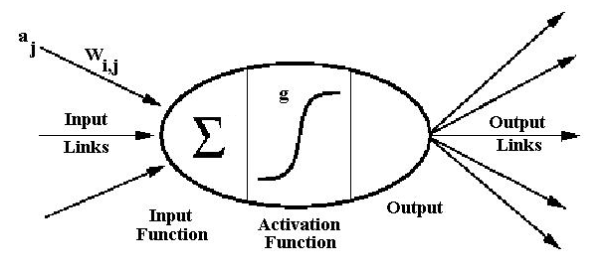
Artificial neural networks
Nodes
Hidden node (a.k.a. neuron)
Feed forward MultiLayer Perceptron (MLP)
At each hidden node:
The sum of the inputs is computed
A transfer (a.k.a. activation) function g is applied (set by the analyst)
Output is forwarded to the nodes in the next layer
w_{ji} are the trainable weights

Slide 21
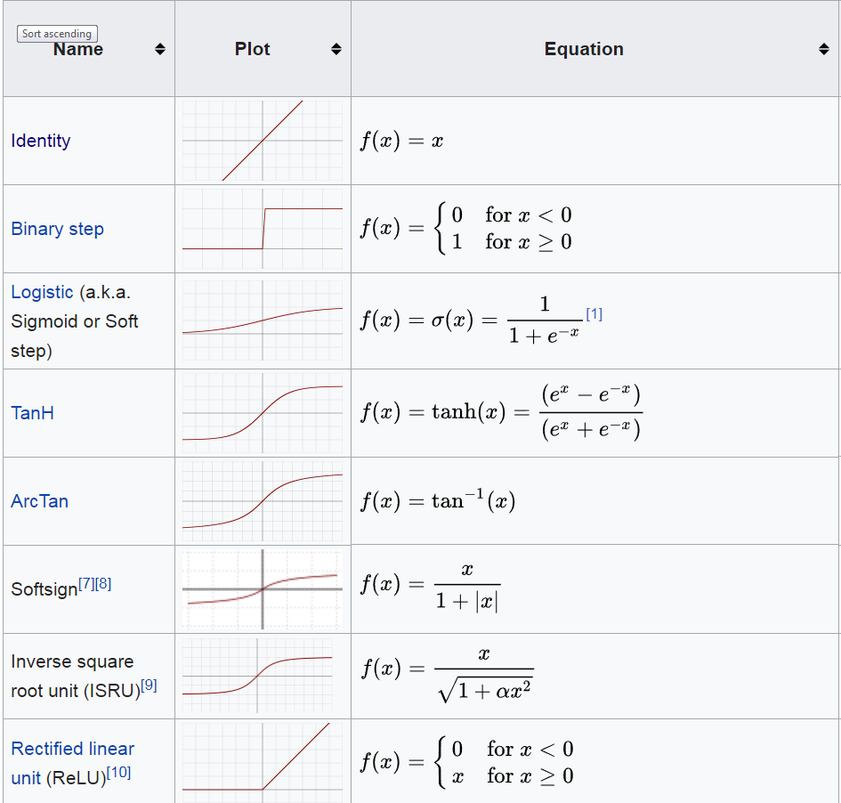
Artificial neural networks
Transfer functions
The most suitable transfer function depends problem, e.g. depth of network, and amount of data one works with
…and many more…
Source: Wikipedia

Slide 22
Artificial neural networks
Bias nodes
Bias nodes are often not depicted in graphical representations of neural networks
The bias nodes ensure input, even if input space is 0
The weights associated with the bias nodes on the output layer can be conceived as intercept
Bias nodes have nothing to do with “bias”; in fact, they can be conceived as ASCs

Slide 23
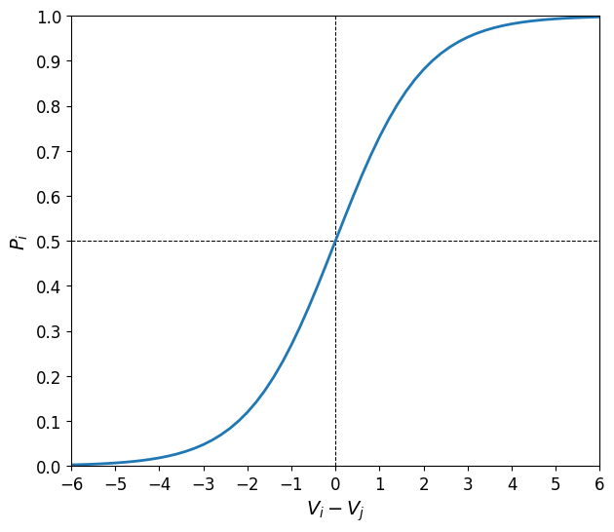
Artificial neural networks
Output layer function
Binary class classification: Logistic
Multiclass classification: Softmax
a.k.a. Binary Logit function in choice modelling
a.k.a. Multinomial Logit function choice modelling
Softmax function

Slide 24
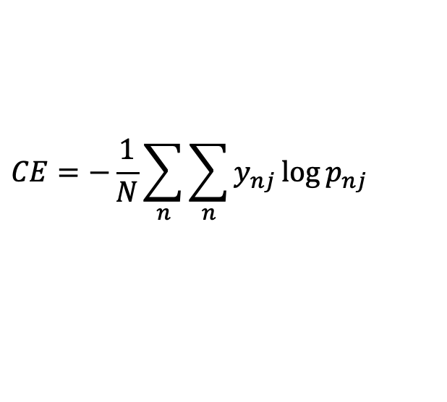
Artificial neural networks
Loss function
The loss function measures the (global) performance of the model given the data. It quantifies the error between predicted values and expected values in a single real number.
When working with choice data, we (almost always) use the cross-entropy (CE) loss
a.k.a. log loss
$$CE=−\frac{1}{N}\sum_{n}{\sum_{n}{y_{nj}\log{p_{nj }}}}$$
Minimisation of the cross-entropy is equivalent to maximisation of the (log-)likelihood
Minimising the cross-entropy implies maximising the (log-)likelihood of the data, given the model

Slide 25
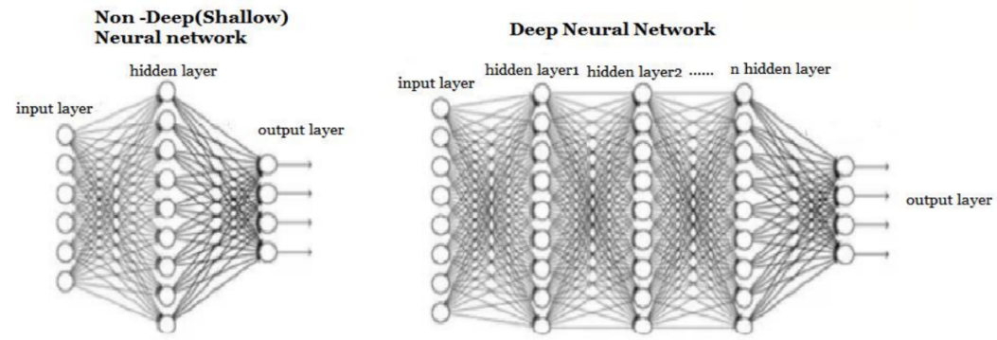
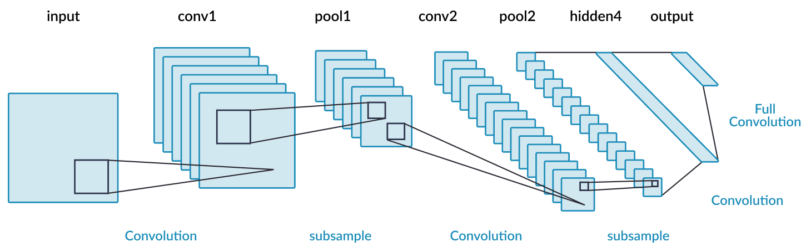
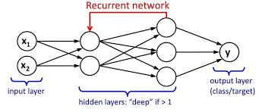
Artificial neural networks
Types
ANNs come in many different types:
Shallow and deep MultiLayer Perceptrons
Convolution neural nets (e.g. computer vision)
Recurrent Neural networks (e.g. text, speech)

Slide 26
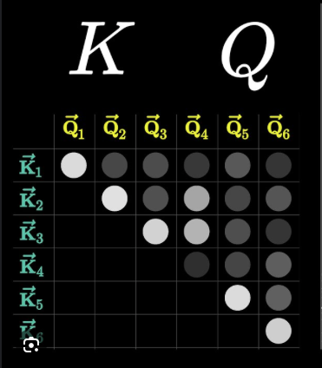
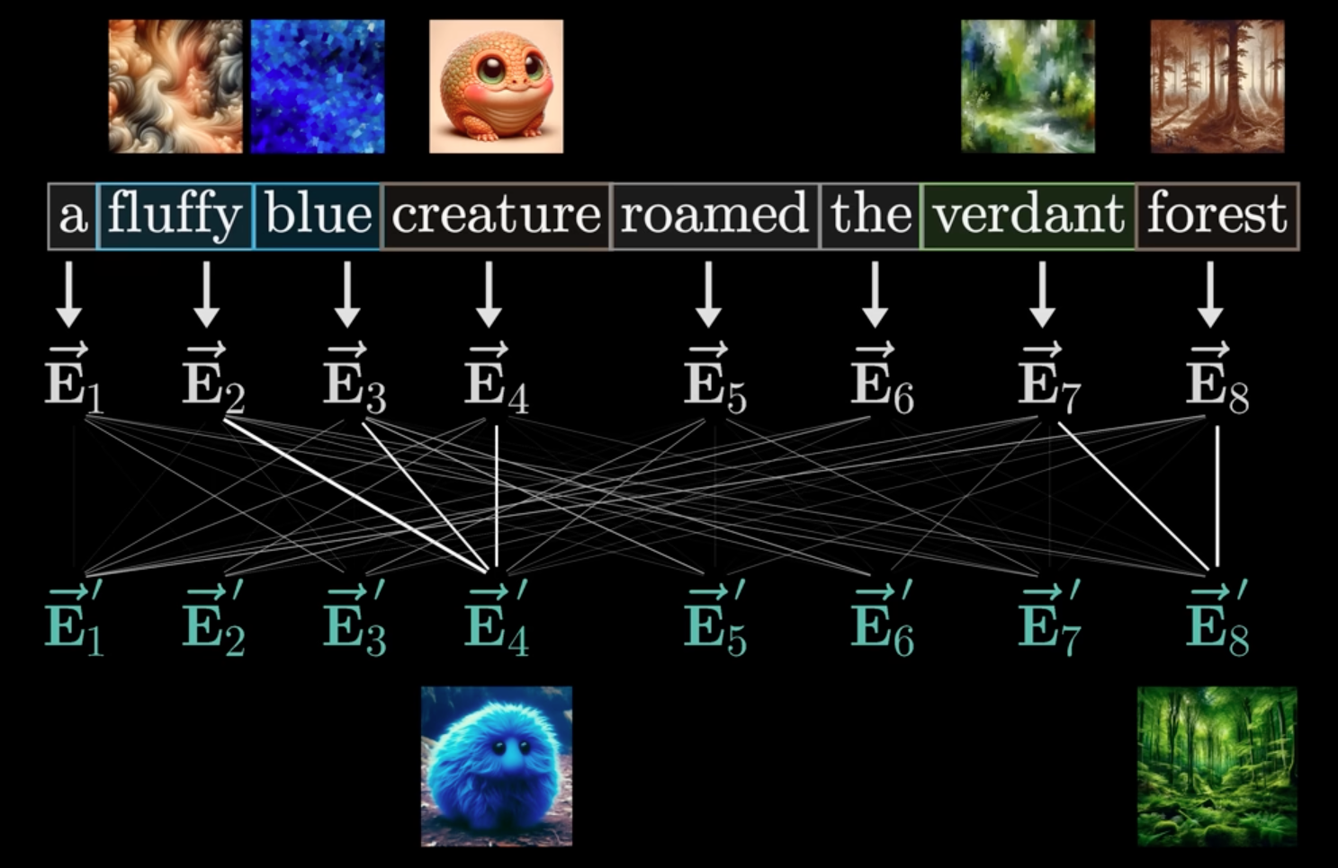
Artificial neural networks
Types
ANNs come in many different types:
Transformers and attention layers

Slide 27
Training ANNs

Slide 28
Training ANNs
Training ANNs is nontrivial
Before we can train an ANN, we must pre-process our data
Pre-processing makes training ANNs more efficiently
Efficiently here refers to finding a better solution with the same amount of data
Features must be scaled
Categorical features must be dummy encoded
Missing values must be handled
Just like in case of traditional choice models

Slide 29
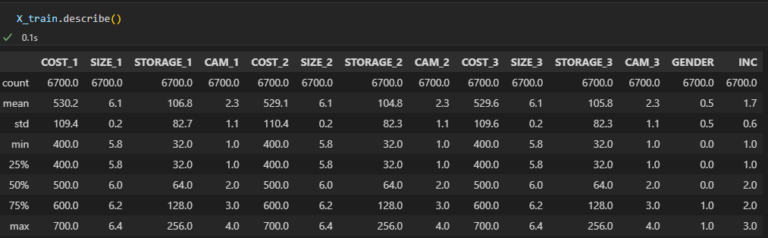
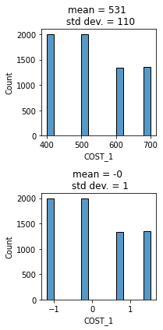
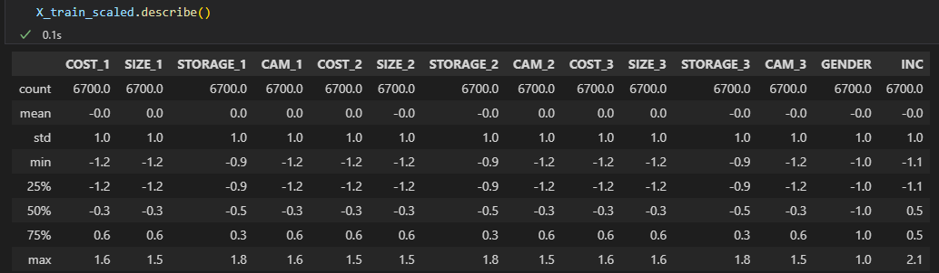
Training ANNs
Scaling greatly reduces the likelihood of getting stuck in poor local solutions
SciKit-learn’s StandardScaler is a commonly used scaler, which shifts the mean of each feature to zero and its standard deviation to 1
Important: always use the same scaler for the train and test data!
Original data
StandardScaler

Slide 30
Training ANNs
Training ANNs involves finding the weights w that minimise the loss function
Mathematically training an ANN is an ill-posed problem (“singular”)
Unlike choice models, ANNs are not uniquely identifiable: i.e., numerous sets of weights give the same output probability distribution on any data.
A=0,B=4
A=1,B=3
A=2,B=2
A=3,B=1
A=4,B=0
A + B = 4
not uniquely identifiable:
A + B = 4
A – B = 2
uniquely identifiable
A=3,B=1
But lack of identifiability is not a problem: the model weights cannot be interpreted anyway ☺

Slide 31
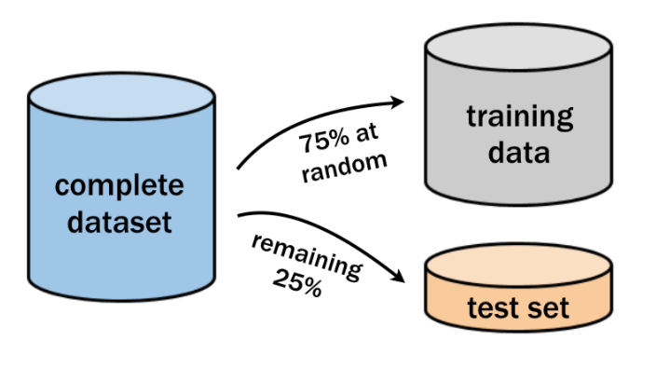
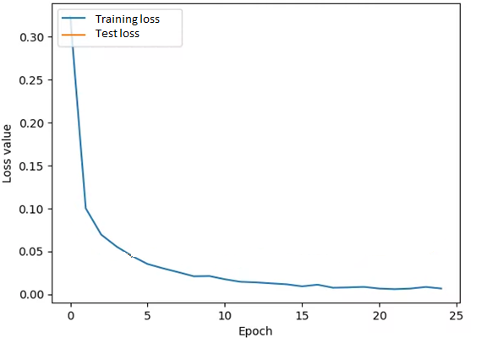
Training ANNs
Data must always be split in two parts:
Train set
Test set
The ANN is trained on the training set
The training stops when:
The performance on the training set no longer improves
Maximum epochs is reached
Learning curve plot

Slide 32
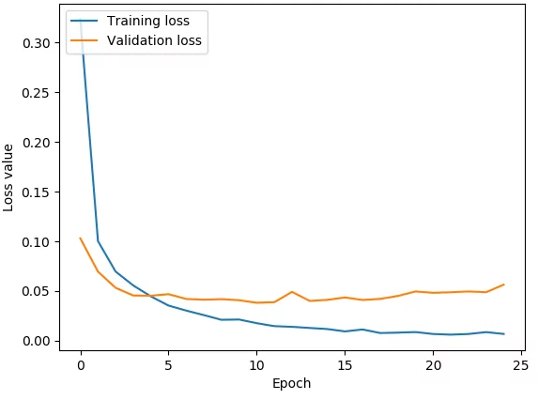
Training ANNs
Data must always be split in two parts:
Train set
Test set
The ANN is trained on the training set
The training stops when:
The performance on the training set no longer improves
Maximum epochs is reached
Early stopping (main idea)
After each epoch, the performance of the model is evaluated on test set
To avoid the model from overfitting, training stops when the performance of the test data no longer improves
Learning curve plot
Training loss
Test loss
5 epochs
STOP

Slide 33
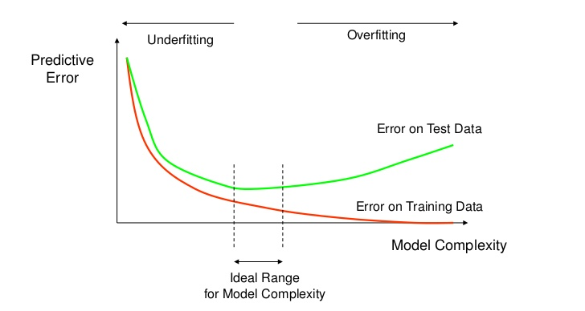
Training ANNs

Slide 34
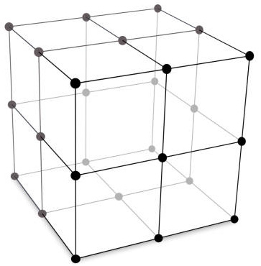
Training ANNs
When training an ANN a researcher needs to set the hyperparameters
Batch size
Optimisation algorithms
Learning rate
Regularisation
Hyperparameter tuning often involves the finding the optimal combination of hyperparameters, and often can considerably improve the model performance
To tune the hyperparameters often a simple grid search is used.
But, hyperparameter tuning can quickly become computationally excessive…

Slide 35
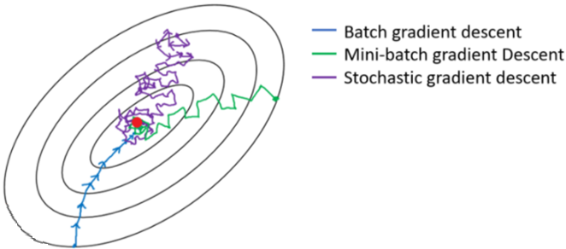
Training ANNs
Hyperparameters
Batch size: number of observations (aka instances) utilized in 1 iteration
Stability Robustness towards saddles and local minima
All instances (i.e. all data) Very stable Not so robust
Batch gradient descent
One instance randomly sampled Very instable Robust
Stochastic gradient descent
N instances randomly sampled Fairly stable Fairly robust
Mini batch gradient

Slide 36
Training ANNs
Hyperparameters
Batch size: number of observations (aka instances) utilized in 1 iteration
Stability Robustness towards saddles and local minima
All data Very stable Not so robust
Batch gradient descent
One instance randomly sampled Very instable Robust
Stochastic gradient descent
N instances randomly sampled Fairly stable Fairly robust
Mini batch gradient
Robustness of different optimisation algorithms

Slide 37
Training ANNs
Hyperparameters
Batch size: number of observations (aka instances) utilized in 1 iteration
Stability Robustness towards saddles and local minima
All instances (i.e. all data) Very stable Not so robust
Batch gradient descent
One instance randomly sampled Very instable Robust
Stochastic gradient descent
N instances randomly sampled Fairly stable Fairly robust
Mini batch gradient
In 1 epoch all the observations (instances) in the data has been utilised ones
Relationship batch size, iteration, epoch
N = 10,000 observations
BS = 1,000 (mini)batch size
10 iterations per Epoch

Slide 38
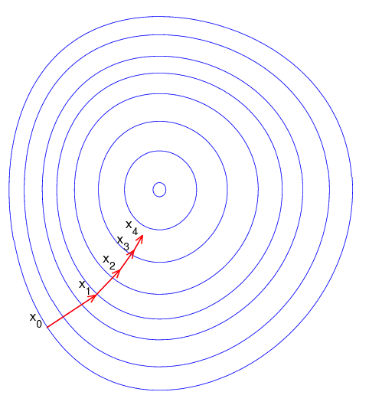
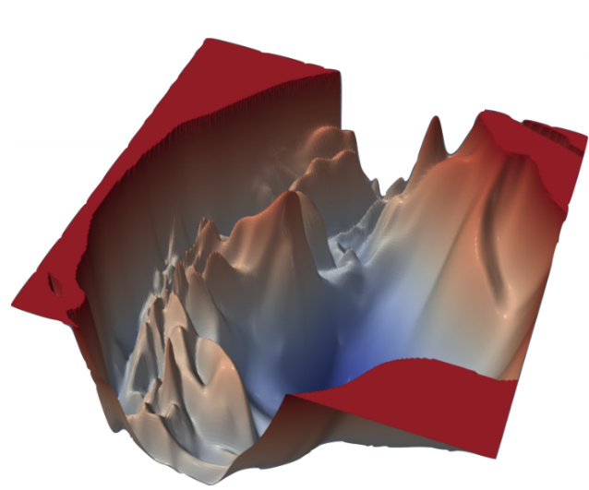
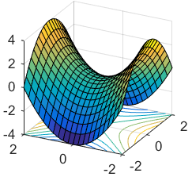
Training ANNs
Hyperparameters
Optimisation algorithms: procedure for finding the weights that result in the minimum or maximum output of the function
Gradient Descent (GD) [most commonly used: e.g. Adam, Adagrad, RMSprop]
L-BFGS
Levenberg–Marquardt (combination ↑)
Optimisation algorithms differ from one another in terms of:
Speed to converge to a solution
Robustness towards local minima and saddle points
Local minima
Saddle point
While the global minimum is seldom found, this is not necessarily a problem.
A ‘good’ local minimum can still be good

Slide 39
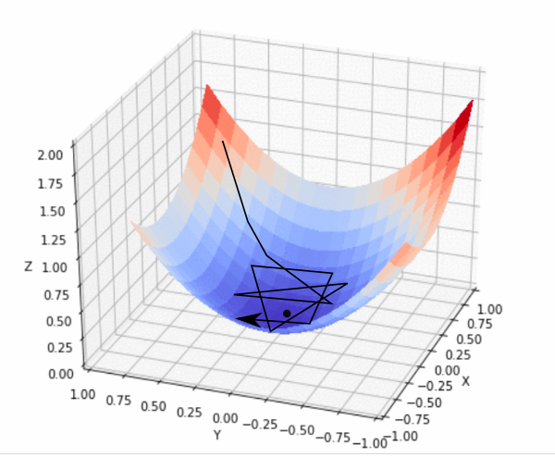
Training ANNs
Hyperparameters
Learning rate: determines the step size at an iteration
Large learning rate
Small learning rate
Too big →
Overshooting (instability)
Too small →
Slow to converge
Get stuck in local solutions

Slide 40
Training ANNs
Hyperparameters
Regularisation: penalises the magnitudes of the weights, to avoid overfitting
L1 regularisation (aka Lasso) penalises the sum of the absolute values of the weights
L2 regularisation (aka ridge) penalises the sum of the squared values of the weights
The penalty is added to the cost (loss) function:
The hyperparameter α governs the strength of the penalty relative to the cost function
Too high α → risks underfitting
Too low α → risks overfitting
Cross-entropy (minimising the cross-entropy implies maximising LL)
Penalty

Slide 41
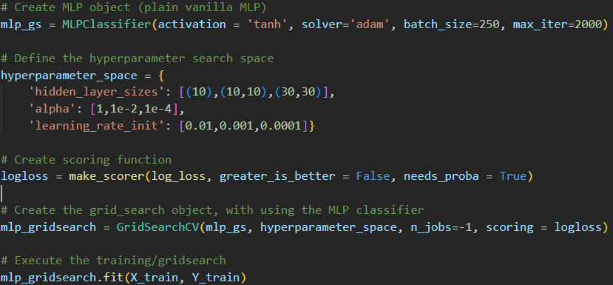
Training ANNs
Hyperparameter tuning in practice
For hyperparameter tuning we can use SciKit-learn’s GridSearchCV

Slide 42
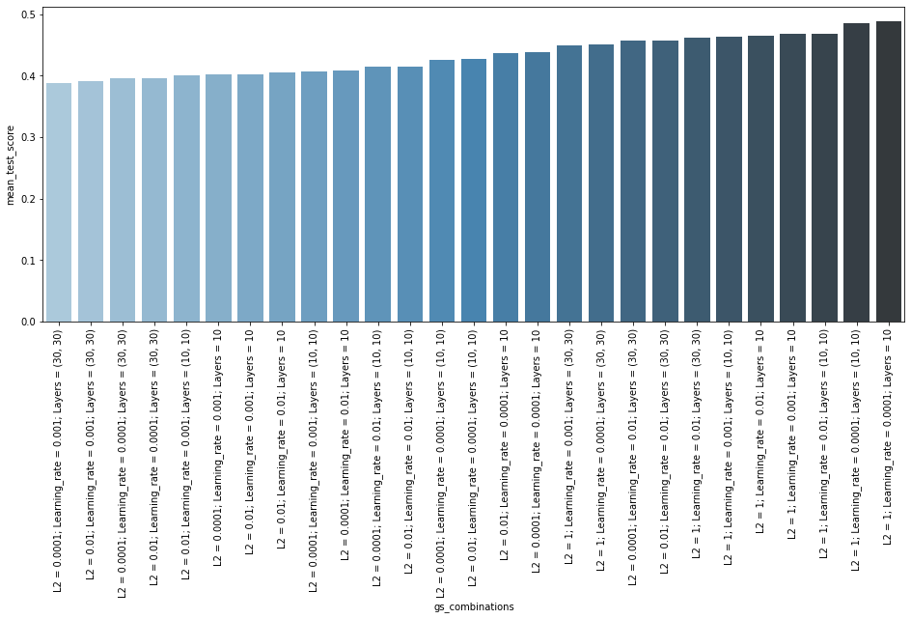
Training ANNs
Hyperparameter tuning in practice
For hyperparameter tuning we can use SciKit-learn’s GridSearchCV
In this case, these hyperparameters:
L2 = 0.0001
Lr = 0.001
Layers = (30,30)
result in the best generalisation performance
Note: we do not consider the weights of the model to assess its performance

Slide 43

K-fold cross validation
K-fold cross validation is a method to more rigorously evaluate the generalisation performance (vs train/test)
K-fold cross validations is a ‘must use’ when tuning the hyperparameters
When tuning hyperparameters on a simple train/test split, one risks overfitting on the particular manifestation of the test-split
All data
K-fold cross validation procedure for hypertuning:
Split data in K-folds
For m = 1…M (models with hyperparameter settings)
For k = 1…K
Train the model, while leaving fold k out
Evaluate the model performance on fold k
Compute avg. performance of model m across all K folds
Identify hyperparameters based on the best avg. performance across folds
For deployment: train model with optimised hyperparameters on all data

Slide 44
Model performance metrics

Slide 45
Model performance metrics
While in choice modelling almost exclusively, the LL is used as the yardstick for model performance, in machine learning, various other metrics are used
The following metrics are commonly used in ML in classification tasks:
Accuracy
Precision
Recall
Matthew’s coefficient
These metrics are computed based on the confusion matrix
vc

Slide 46
Model performance metrics
Confusion matrix
Shows counts from predicted and actual outcomes.
Predictions are based on highest probability alternative
P_{in} = [0.21 0.42 0.37] → [0 1 0]
Counts on the diagonal are correctly classified outcomes
Counts on the off diagonal elements are the misclassified outcomes
Confusion matrix (2 classes)
 |  | True outcome
 |  | Positive | Negative
Predicted outcome | Positive | 30 | 70 | 100
 | Negative | 20 | 100 | 120
 |  | 50 | 170 | 220

Slide 47
Model performance metrics
Confusion matrix (2 classes)
True Positive (TP)
The model correctly predicts the positive class
False Positive (FP)
The model incorrectly predicts positive class
True Negative (TN)
The model correctly predicts the negative class
False Negative (FN)
The model incorrectly predicts negative class
Confusion matrix (2 classes)
 |  | True outcome
 |  | Positive | Negative
Predicted outcome | Positive | True Positives (TP) | False Positives (FP)
 | Negative | False Negatives (FN) | True Negatives (TN)

Slide 48
Model performance metrics
Confusion matrix (2 classes)
Accuracy [0,1]
Ratio of correctly predicted observations to the total observations
numerator
 |  | True outcome
 |  | Positive | Negative
Predicted outcome | Positive | TP | FP
 | Negative | FN | TN
denominator

Slide 49
Model performance metrics
Confusion matrix (2 classes)
Accuracy [0,1]
Example (N = 220)
Health state prediction: DIABETES or HEALTHY
 |  | True outcome
 |  | DIABETES | HEALTHY
Predicted outcome | DIABETES | 30 (TP) | 70 (FP) | 100
 | HEALTHY | 20 (FN) | 100 (TN) | 120
 |  | 50 | 170 | 220

Slide 50
Model performance metrics
Confusion matrix (2 classes)
Precision [0,1]
Ratio of correctly predicted positive (negative) observations to the total predicted positive (negative) observations
numerator
 |  | True outcome
 |  | Positive | Negative
Predicted outcome | Positive | TP | FP
 | Negative | FN | TN
denominator
aka Positive Predictive Value
aka Negative Predictive Value

Slide 51
Model performance metrics
Confusion matrix (2 classes)
Precision [0,1]
Example
Health state prediction: DIABETES or HEALTHY
 |  | True outcome
 |  | DIABETES | HEALTHY
Predicted outcome | DIABETES | 30 (TP) | 70 (FP) | 100
 | HEALTHY | 20 (FN) | 100 (TN) | 120
 |  | 50 | 170 | 220
The question that this metric answer:
Of all patients predicted to have DIABETES, how many actually have DIABETES?

Slide 52
Model performance metrics
Confusion matrix (2 classes)
Recall [0,1]
Ratio of correctly predicted positive (negative) observations to the all observations actually in that class
numerator
denominator
 |  | True outcome
 |  | Positive | Negative
Predicted outcome | Positive | TP | FP
 | Negative | FN | TN
← a.k.a. Sensitivity
← a.k.a. Specificity

Slide 53
Model performance metrics
Confusion matrix (2 classes)
Recall [0,1]
Example
Health state prediction: DIABETES or HEALTHY
 |  | True outcome
 |  | DIABETES | HEALTHY
Predicted outcome | DIABETES | 30 (TP) | 70 (FP) | 100
 | HEALTHY | 20 (FN) | 100 (TN) | 120
 |  | 50 | 170 | 220
← a.k.a. sensitivity
← a.k.a. specificity
The question that this metric answer:
Of all the patients that truly have DIABETES, how many did the model predict?

Slide 54
Model performance metrics
Confusion matrix (2 classes)
Matthew’s correlation coefficient
MCC combines precision, specificity, sensitivity into a single number
MCC only returns a high score if the prediction is good in all of the four confusion matrix categories
 |  | True outcome
 |  | Positive | Negative
Predicted outcome | Positive | 30 (TP) | 70 (FP) | 100
 | Negative | 20 (FN) | 100 (TN) | 120
 |  | 50 | 170 | 220

Slide 55
Model performance metrics
Confusion matrix (2 classes)
Matthew’s correlation coefficient
Example
Health state prediction: DIABETES or HEALTHY
 |  | True outcome
 |  | DIABETES | HEALTHY
Predicted outcome | DIABETES | 30 (TP) | 70 (FP) | 100
 | HEALTHY | 20 (FN) | 100 (TN) | 120
 |  | 50 | 170 | 220

Slide 56

Model performance metrics
Confusion matrix (2 classes)
Matthew’s correlation coefficient
 |  | True outcome
 |  | Positive | Negative
Predicted outcome | Positive | TP | FP
 | Negative | FN | TN
Derive the minimum and maximum
value that MCC can attain: [a,b]?

Slide 57
Model performance metrics
Confusion matrix (classes > 2)
Same logic (called micro-averaging)
 |  | True outcome
 |  | Class 1 | Class 2 | Class 3
Predicted outcome | Class 1 | 30 | 40 | 30 | 100
 | Class 2 | 10 | 100 | 10 | 120
 | Class 3 | 10 | 10 | 80 | 100
 |  | 50 | 150 | 120 | 320

Slide 58
An empirical example MLP
58

Slide 59
Empirical example MNL
All attributes and socio-demographic variables enter in the utility
The output layer contains the utilities predicted choice probabilities for the alternatives
RUM-MNL

Slide 60
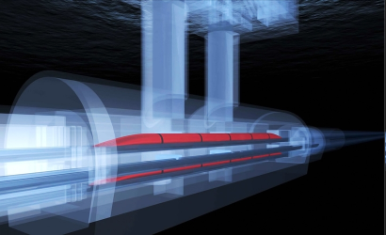

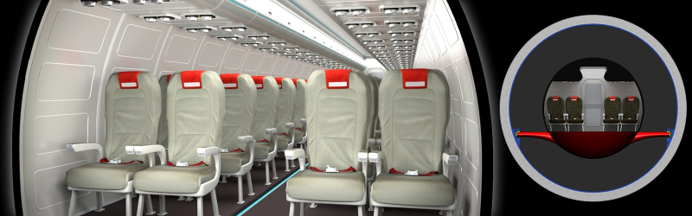
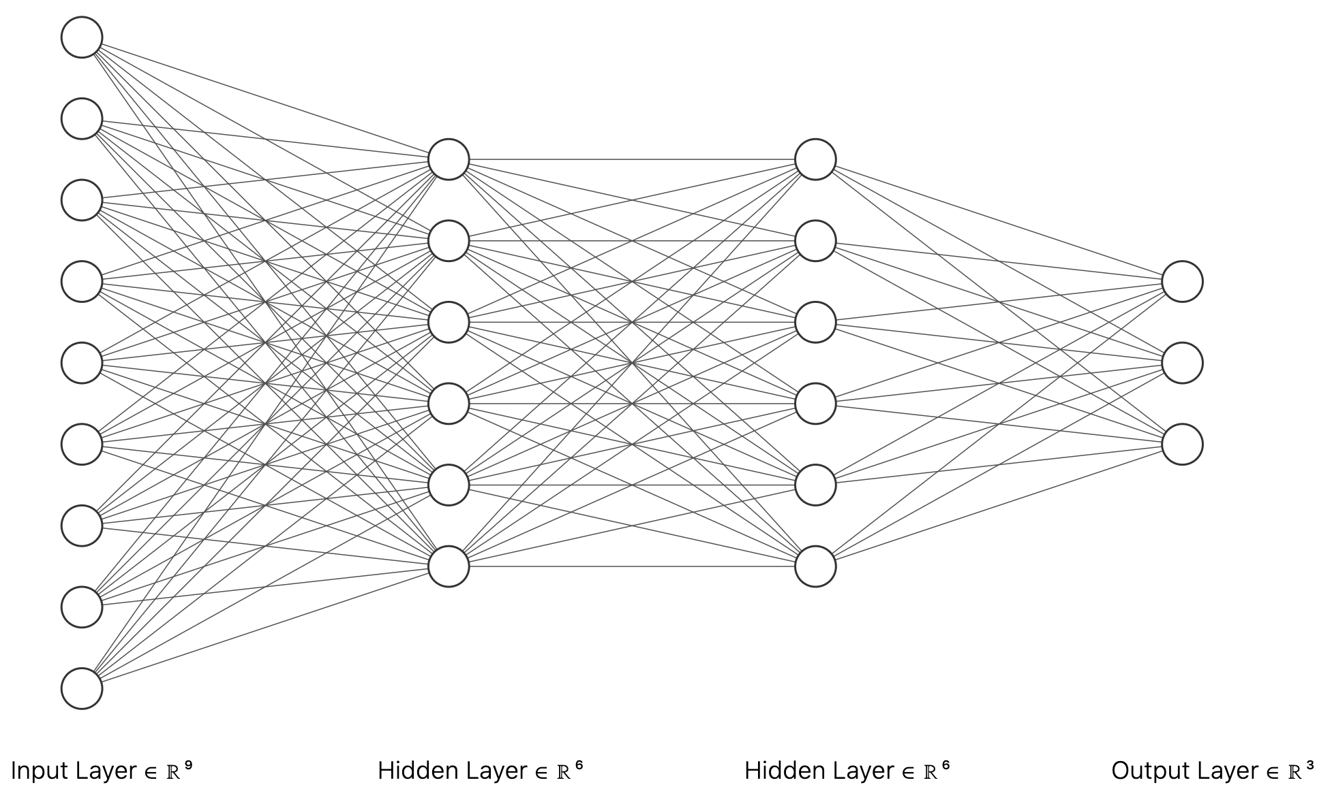
Empirical example MLP
Swiss metro
Two cases
Only attributes
Attributes + socio demographic variables
TRAIN
SM
CAR
Attributes of alternatives: Travel cost and time for each alternative

Slide 61
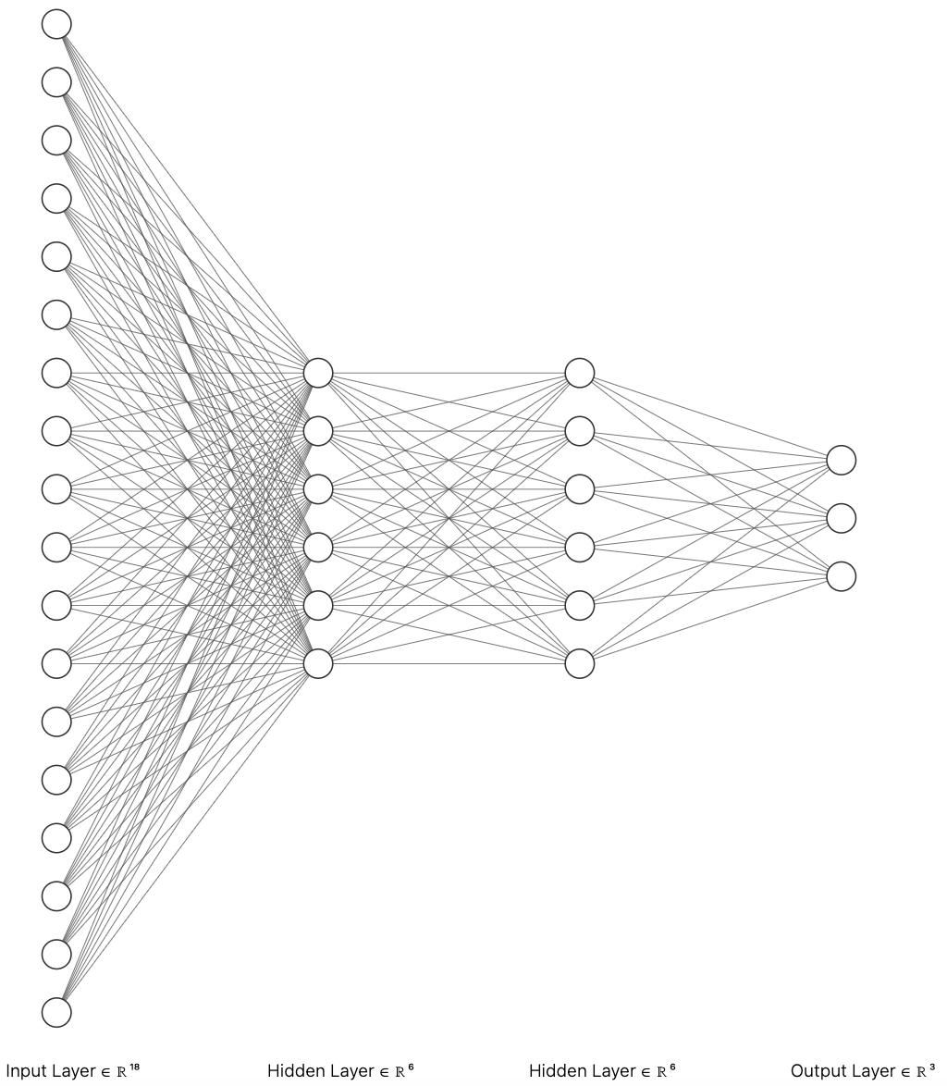
Empirical example MLP
Swiss metro
Two cases
Only attributes
Attributes + socio demographic variables
Attributes of alternatives: Travel cost and time for each alternative
TRAIN
SM
CAR
Socio-demographic variables, e.g. age, income

Slide 62
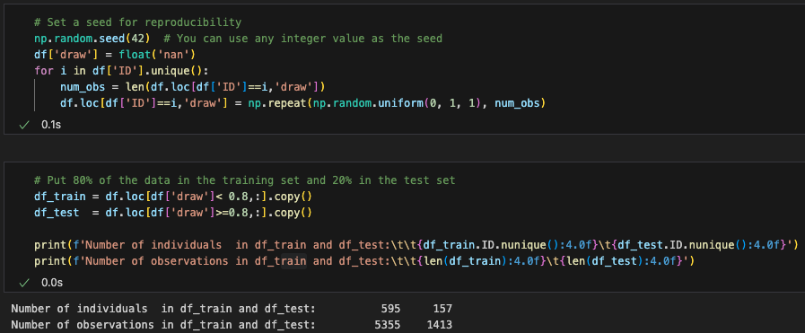
Empirical example MLP: Case A
MLP using attributes of alternatives only
Split data in a training and test set
The data set is ‘manually’ split by ‘ID’ to avoid data leakage
Data leakage refers to the unintentional spoiling of information from the training data into the test set

Slide 63
Empirical example MLP: Case A
MLP using attributes of alternatives only
Split data in a training and test set
A) Estimate linear RUM-MNL on the train data
B) Compute the Log-likelihood of the test data given the model (as the benchmark)
Always good practice to start with a simple linear-additive RUM-MNL

Slide 64
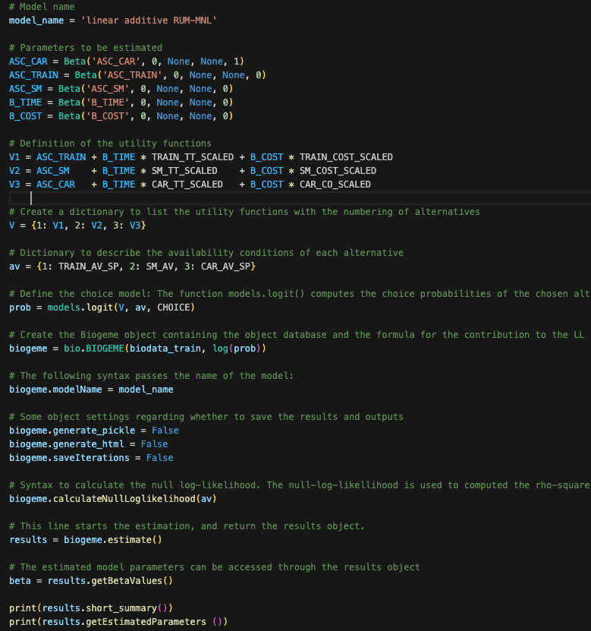
Empirical example MLP: Case A
MLP using attributes of alternatives only
Split data in a training and test set
A) Estimate linear RUM-MNL on the train data
B) Compute the Log-likelihood of the test data given the model

Slide 65
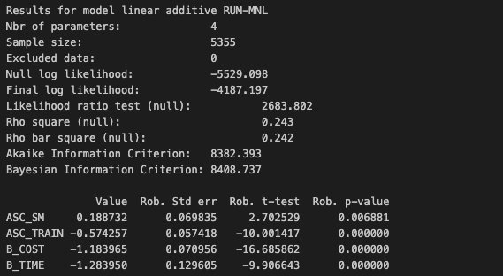
Empirical example MLP: Case A
MLP using attributes of alternatives only
Split data in a training and test set
A) Estimate linear RUM-MNL on the train data
B) Compute the Log-likelihood of the test data given the model
← Sample size of train set
← LL_{training set}

Slide 66
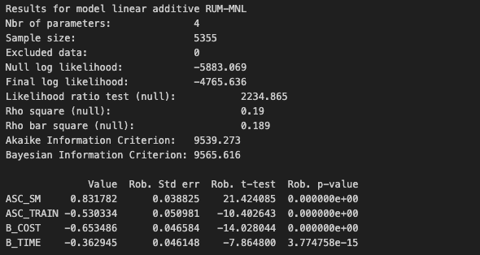
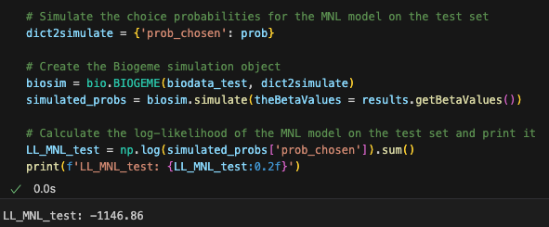
Empirical example MLP: Case A
MLP using attributes of alternatives only
Split data in a training and test set
A) Estimate linear RUM-MNL on the train data
B) Compute the Log-likelihood of the test data given the model
← Sample size of train set
← LL_{training set}
Create simulation object for test data set →
Simulate the choice probabilities using β of estimated model →
LL of the benchmark model →

Slide 67
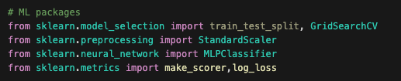
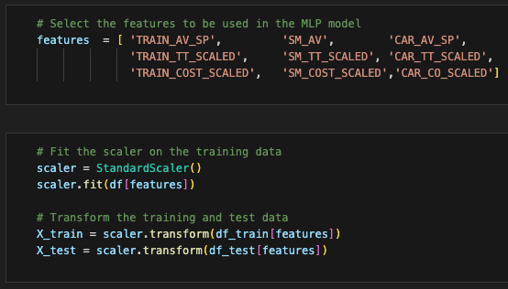
Empirical example MLP: Case A
MLP using attributes of alternatives only
Split data in a training and test set
A) Estimate linear-RUM MNL on the train data
B) Compute the Log-likelihood of the test data given the model
Scale the data
Availabilities enter the model just as any other feature
Rescale the data using the StandardScaler

Slide 68
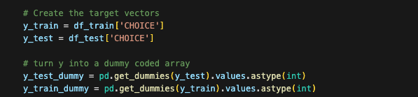
Empirical example MLP: Case A
MLP using attributes of alternatives only
Split data in a training and test set
A) Estimate linear-RUM MNL on the train data
B) Compute the Log-likelihood of the test data given the model
Scale the data
Dummy code the choices

Slide 69
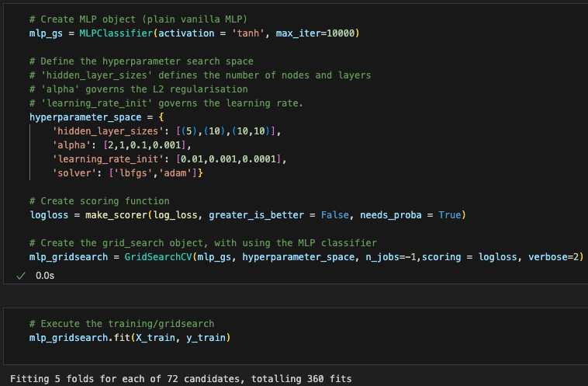

Empirical example MLP: Case A
MLP using attributes of alternatives only
Split data in a training and test set
A) Estimate linear-RUM MNL on the train data
B) Compute the Log-likelihood of the test data given the model
Scale the data
Dummy code the choices
Tune hyperparameters, using a gridsearch object
← Create MLP object
← Search space
↓Define the loss function
Gridsearch object
Start training the models!
Best hyperparameters

Slide 70
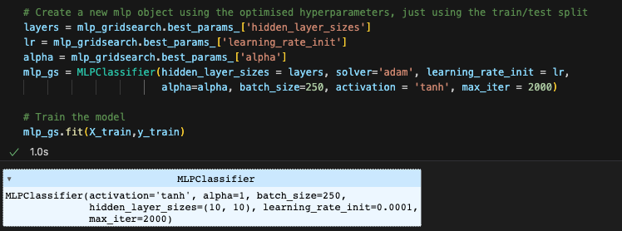
Empirical example MLP: Case A
MLP using attributes of alternatives only
Split data in a training and test set
A) Estimate linear-RUM MNL on the train data
B) Compute the Log-likelihood of the test data given the model
Scale the data
Dummy code the choices
Tune hyperparameters, using a gridsearch
Train model with tuned hyperparameters

Slide 71

Empirical example MLP: Case A
MLP using attributes of alternatives only
Split data in a training and test set
A) Estimate linear-RUM MNL on the train data
B) Compute the Log-likelihood of the test data given the model
Scale the data
Dummy code the choices
Tune hyperparameters using a gridsearch
Train model with tuned hyperparameters
Compute the log-likelihood of the test data, given the trained MLP model
Now we can compare LL_{MLP} with LL_{MNL} (-1146)
MLP model obtains a much better model fit (-116 LL points)
Suggests data generating process substantially deviate from linear-additive RUM!

Slide 72


Empirical example MLP: Case A
MLP using attributes of alternatives only
MLPs are not uniquely identifiable
To see how robust the improvement in performance is, we must train numerous instances of the MLP
MNL is uniquely identifiable. Convex LL → guaranteed unique solution
MLP model robustly improves model fit, on avg by almost 120 LL points
Var(LL) = ~70 LL

Slide 73

Empirical example MLP: Case B
MLP using attributes of alternatives + socio-demographic variables
There is no good theory about how socio-demographic variables interact with tastes and preferences
It is often unclear how to incorporate socio-demographic variables in the utility function
We might as well feed socio-demographic variables to the MLP

Slide 74


Empirical example MLP: Case B
MLP using attributes of alternatives + socio-demographic variables
Categorical socio-dem data with more than two levels (e.g. ‘AGE’, INCOME’) must be dummy-coded
Converts categorical data into new dummy columns
Dummy coding each ORIGIN/DEST station leads to many sparse columns
Just 5 stations account for the majority of the trips
Therefore, we treat (recode) all non-frequent stations as one category

Slide 75

Empirical example MLP: Case B
MLP using attributes of alternatives + socio-demographic variables
Categorical socio-dem data (e.g. ‘purpose’, destination’) must be dummy-coded
Extend the list of features
Categorical data with just two levels
We add many new features (43)
Increasing risk of overfitting

Slide 76
Empirical example MLP: Case B
MLP using attributes of alternatives + socio-demographic variables
Categorical socio-dem data (e.g. ‘purpose’, destination’) must be dummy-coded
Extend the list of features
Scale the data
Dummy code the choices
Tune hyperparameters, using a gridsearch
Train model with tuned hyperparameters
Compute the Log-likelihood of the test data
Exactly the same as before

Slide 77
Empirical example MLP: Case B
MLP using attributes of alternatives + socio-demographic variables
Adding socio-demographic features further substantially improves the generalisation performance
But it is unclear how this comes about

Slide 78

Empirical example MLP: Case B
MLP using attributes of alternatives + socio-demographic variables
Adding socio-demographic features further substantially improves the generalisation performance
But it is unclear how this comes about
Var(LL) = ~150 LL → Variance increases

Slide 79

MLP
MNL
Final observations
MLPs usually outperform traditional MNL-based choice models in terms of model fit
MLPs indeed can overcome the ad-hoc-ness of the model specification in traditional choice models
MLP
(best model)
However …
MLPs give ZERO behavioural or economic insight
MLPs may violate behavioural regularity e.g.
An increase in cost will (in some cases) lead to an increase in demand
MLP
(top 10 models)

Slide 80

MLP
Final observations
MLPs usually outperform traditional MNL-based choice models in terms of model fit
MLPs indeed can overcome the ad-hoc-ness of the model specification in traditional choice models
However …
MLPs give ZERO behavioural or economic insight
MLPs may violate behavioural regularity e.g.
An increase in cost will (in some cases) lead to an increase in demand
Utility-based ML
a.k.a. Hybrid choice models
Proportional substitution. Despite their complexity ANNs cannot account for unobserved preference heterogeneity
One cannot “trust” this model to make sensible predictions + multiple outcomes

