Slide 1
Use Case - 2
E2E Service in ML Topology

Slide 2
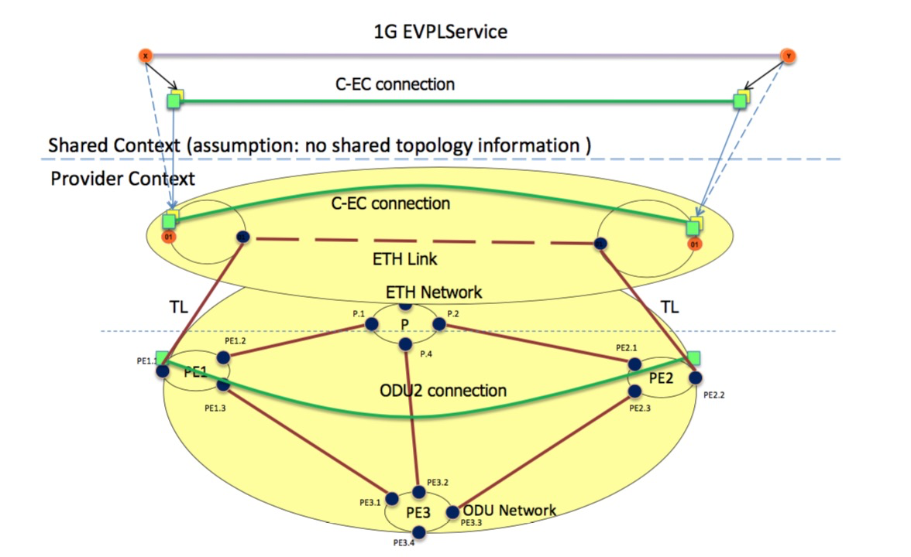
E2E Service in ML Topology
PE1-1.1
PE1-1
PE1-1.2
PE2-1.2
PE2-1.1
ETH→Network B
ETH-UNI
PE2-1
TTP 2
TTP 4
OTN→Network A
Tun-id-1-fw
Source: T-API FRS

Slide 3
TL implications
ETH link in red dashed line does not exist until OTN server trail (ODU2 connection) is created.
From topology prospective TL exist to indicate “potential” layer transition and connectivity
When server trail is created , ETH network will add the ETH link in the ETH topology
ETH link is supported by the OTN tunnel (ODU2 connection)
Until TL is not used, does not exists any I2RS Link related .
As soon as ODU2 tunnel is created (with teas-yang-te draft), ETH link is appearing in the ETH topology.
TL permits multi-layer topology representation for path computation, so should belongs to 1 topology.

Slide 4
Domain-1 TAPI Context Topology
This slide depicts the complete Topology exposed by domain-controller 1 to the multi-domain-controller*
It is assumed that the exposed TAPI-Context Topology is a 2 Node abstraction (1 per layer) of domain-controller ‘s internal Context
It is assumed that no Connectivity has been setup in the entire domain and this is the initial Topology view
TAPI Context-1
Node Edge Point (Edge)
D1
Node Edge Point (Internal)
1.D1
D1-e
Service End Point
Connection EndPoint
2.D1
Topology
3.D1
4.D1
Node
Mapping
D1-o
Link
Transitional Link
5.D1
6.D1
Connection
*The multi-domain controller may have to invoke more than one retrieval API operation to get this view

Slide 5
Transitional Link
draft-ietf-teas-yang-te-topo-05
Tunnel Termination Point (TTP)
Logical Sub-node
Server Link Termination Point (S-LTP)
C-LTP-1,2,3
C-LTP-4,5,6
Client Link Termination Point (C-LTP)
C-LTP-1,2,3
C-LTP-4,5,6
TTP client
Layer 2
Layer 3
TTP-1
TTP-3
TTP-2
Transitional Link
TTP-1
TTP-3
TTP-2
Layer 1
LTP-1
Transformation
LTP-1
LTP-6
LTP-6
LTP-5
LTP-2
LTP-5
LTP-2
LTP-4
LTP-3
LTP-4
LTP-3

Slide 6
Logical nodes separation
LTP
Link 1-2
PE1
TTP
PE1-E
PE1-1.1
Link
PE1-1.2
Transitional Link
Connection
TTP-1
PE1-O
TTP-2
PE1.2
PE1.1
ODU2
PE1.3

Slide 7
Added Support for Multi-layer Topology
draft-ietf-teas-yang-te-topo-05
Transitional link
Connects link termination points at different layers.
Modeling abstraction
Added switch-layer attributes to TE Link Termination Point.
Added a flag to TE Link to indicate transitional.
What about adding “sub-node” concept at this point, related to specific TTP?
augment /nw:networks/nw:network/nw:node:
+--rw te!
+--rw tunnel-termination-point* [tunnel-tp-id]
+--rw tunnel-tp-id binary
+--rw config
| +--rw switching-capability? identityref
| +--rw encoding? identityref
+--ro state
+--ro switching-capability? identityref
+--ro encoding? identityref
augment /nw:networks/nw:network/nt:link:
+--rw te!
+--rw config
| +--rw te-link-attributes
| +--rw interface-switching-capability* [switching-capability]
| | +--rw switching-capability identityref
| | +--rw encoding? identityref
| | +--rw max-lsp-bandwidth* [priority]
+--ro state
+--ro is-transitional? empty
“Layer 1” at one end, “Layer 2” at other end.
Which is the client and which the server with this coding ?

Slide 8
TL Questions
Hom many nodes have to be existing in the topology?
1 logical ETH node + 1 logical OTN node
ETH topology + OTN topology
ETH link in red dashed line does not exist until OTN server trail (ODU2 connection) is created.
1 node (two sub-logical node) but the node is part of 1 topology (ETH) and OTN node is “supporting” node ?
At I2RS level the TL link should be the link between two TTP. But TTP is visible at topology level or just in te-topology for path computation purpose?
TTP is described in the te-node augmentation, not as augmentation from i2rs TP.

Slide 9
ETH Topology (i2rs) Model Instantiation
<networks>
<network>
network-id=Network-B
<link>
link-id: LID-NWB-FWD-1
<node>
node-id: PE1-1
<node>
node-id: PE2-1
<network-types>
[ETH]
<source>
src-node: <PE1-1 ref>
source-tp: <PE1-1.2 ref>
<destination>
dest-node: <PE2-1 ref>
dest-tp: <PE2-1.2 ref>
<termination-point>
tp-id: PE1-1.1
<termination-point>
tp-id: PE2-1.1
ETH Link
[PE1-1.2 <-> P2-1.2]
<termination-point>
tp-id: PE1-1.2
<termination-point>
tp-id: PE2-1.2
<link>
link-id: LID-NWB-REV-1
<source>
src-node: <PE2-1 ref>
source-tp: <PE2-1.2 ref>
<destination>
dest-node: <PE1-1 ref>
dest-tp: <PE1-1.2 ref>
This “link” does not exist in the i2rs until TL is not used.

Slide 10
OTN Topology (i2rs) Model Instantiation
<networks>
<network>
network-id=Network-A
<link>
link-id: LID-NWA-FWD-1
<node>
node-id: PE1
<node>
node-id: PE2
<node>
node-id: PE3
<node>
node-id: P
<network-types>
[OTN]
<source>
src-node: <PE1 ref>
source-tp: <PE1.2 ref>
<destination>
dest-node: <P ref>
dest-tp: <P.1 ref>
<termination-point>
tp-id: PE1.1
<termination-point>
tp-id: PE2.1
<termination-point>
tp-id: PE3.1
<termination-point>
tp-id: P.1
OTN Link-1
[PE1.2 <-> P.1]
<termination-point>
tp-id: PE1.2
<termination-point>
tp-id: PE2.2
<termination-point>
tp-id: PE3.2
<termination-point>
tp-id: P.2
<link>
link-id: LID-NWA-REV-1
<termination-point>
tp-id: PE1.3
<termination-point>
tp-id: PE2.3
<termination-point>
tp-id: PE3.3
<termination-point>
tp-id: P.3
<source>
src-node: <P ref>
source-tp: <P.1 ref>
<destination>
dest-node: <PE1 ref>
dest-tp: <PE1.2 ref>
<termination-point>
tp-id: PE3.4
<termination-point>
tp-id: P.4
OTN Link-2
[P.2 <-> PE2.1]
OTN Link-3
[P.4 <-> PE3.2]
OTN Link-4
[PE1.3 <-> PE3.1]
OTN Link-5
[PE2.3 <-> PE3.3]

Slide 11
ODU2 Connection: TEAS Tunnel Model Instantiation
<te>
<te>
<tunnels>
<tunnels>
<tunnel>
name: <ODU2-Service-1 ref>
type: <p2p ref>
tunnel-id: <ODU2-tunnel-1-id ref>
<tunnel>
name: <ODU2-Service-1 ref>
type: <p2p ref>
tunnel-id: <tODU2-unnel-1-id ref>
<lsps-state>
<config>
name: ODU2-Service-1
tunnel-id: ODU2-tunnel-1-id
type: p2p
bandwidth: 10Gbps
lsp-prot-type: unprotected
admin-status: up
Source:PE1 ip adr
Destination:PE2 ip adr
Src-tp-id: PE1.1 id/TTP2 in PE1
Dst-tp-id: PE2.2/TTP4 in PE2
<Hierarchical-link-id>
Local-te-node-id=PE1-1
Local-te-link-tp-id=PE1-1.2
Remote-te-node-id=PE2-1
Te-topology-id=Network-B
<primary-paths>
<state>
name: ODU2-Service-1
tunnel-id: ODU2-tunnel-1-id
type: p2p
bandwidth: 10Gbps
lsp-prot-type: unprotected
tunnel-oper-status: up
<primary-paths>
<lsp>
src: 0.0.0.0
dest: 0.0.0.0
tunnel-id:ODU2-tunnel-1-id
lsp-id: ODU2-lsp-1-id
type: P2P
lsp-oper-status: up
lsp-protection-role: working
<config>
type: explicit
<state>
type: explicit
<explicit-route-objects>
index: 0
e-r-usage: route-include-ero
type: link
link-ref: < tun-id-1-fw>
<lsp>
<lsp-ref>
<lsp-record-route>
LO ODU Src & Dest not shown
Do we need to put here TTP or related LTP?
ODU2 Connection
<rro>
subobject-index: 0
type: link-ref
link-ref: <LID-NWA-FWD-4
ref>
<explicit-route-objects>
index: 1
e-r-usage: route-include-ero
type: link
link-ref: <tun-id-1-rev
ref>
It would be ETH link supported by OTN tunnel
<rro>
subobject-index: 0
type: link-ref
link-ref: <LID-NWA-FWD-4
ref>
Config Datastore
Operational/State Datastore

Slide 12
TEAS Topology Model: Dynamic ETH link Instantiation
<networks>
<network>
network-id=Network-A, provider-id= x client-id= ..
<networks-state>
<node>
node-id: PE2-1
<network-types>
=/te-topology/eth-topology
<node>
node-id: PE1-1
<link>
Link-id: ETH-1
<link>
Link-id: Linkx
<network>
network-ref: <NW-A ref>
server-provided: true
<config>
<source>
src-node: <PE1-1>
source-tp: <PE1-1.2>
< underlay-topology >
Provider-id: <Y>
Network-id: <….>
Client-id: <0>
<destination>
dest-node: <PE2-1>
dest-tp: <PE2-1.2>
I2rs-yang-network-topo
<termination-point>
tp-id: PE1-1.1
<link attributes>
<termination-point>
tp-id: …
<termination-point>
tp-id:PE1-1.2
Underlay: true
Provider-id=Y
<Underlay-tunnel-src>
tp-ref=PE1.1
Node-ref=PE1
Underlay-tunnel-dst>
Tp-ref=PE2.2
Node-ref=PE2
Do we need to put here TTP or related LTP?
<termination-point>
tp-id: ….
< connectivity matrix>
The capability between each TP pairs

Slide 13
Transitional Link: TEAS Topology Model :multi-layer representation
<network>
network-id=Network-B
Are TTP visible into I2rs topology?
<link>
link-id: <Link1-2>
<source>
src-node: <PE1 –E ref>
source-tp: <TTP-1 ref>
<dest>
dst-node: <PE1 –O ref>
dst-tp: <TTP-2 ref>
To be completed
<te>
<state>
is-transitional
oper-status: up
information-source: system-processed
<config>
Config tree not shown

Slide 14
Backup

Slide 15
Transitional Link: TEAS Topology Model Instantiation: ETH node
<network>
network-id=Network-B
Oops!!
Which i2rs Link to augment?
<link>
link-id: <ETH-UNI-Link>
What is the ODU endpoints of link? OTN PTP or HO or LO ODU?
<te>
<state>
is-transitional
oper-status: up
information-source: system-processed
<config>
Config tree not shown
Where is the association between link & ODU2 connection?
<information-src-entry>
link-index: 1234 (Is this lsp-id / tunnel-id)?
link-protection-type: unprotected
max-link-bandwidth: 10G
Max-resv-link-bandwidth: NA
<te-link-attributes>
access-type: point-to-point
is-abstract
name: 1234 (Is this lsp-id / tunnel-id)?
admin-status: up
link-index: 1234 (Is this lsp-id / tunnel-id)?
link-protection-type: unprotected
max-link-bandwidth: 10G
Max-resv-link-bandwidth: NA
<interface-switching-capability>
switching-capability: ????
encoding: lsp-encoding-digital-wrapper
<interface-switching-capability>
switching-capability: ????
encoding: lsp-encoding-digital-wrapper
Duplicate containment of te-link-info-attributes

Slide 16
Multi-layer node decomposition Example: L1+L0 OTN switch
Logical sub-node N2_L1
Transformation: physical view to topological view
TP₂₁
N2
TP₁
● ● ●
TP_{2n}
● ● ●
Layer 1
ODUk TPs
TP_{n}
transitional link with client/server
adapt./term.
Layer 0
OCh TP
WDM Line
Note: only one optical transponder (OT) is shown above. Nodes typically have many OTs and each is represented as transitional link in the topology.
Aggregation of transitional links is for further study.
Logical sub-node N2_L0
Dual-layer node N2 is decomposed into 2 logical sub-nodes: N2_L1 and N2_L0
Transitional link between N2_L1 and N2_L0 with following TPs on the link ends: N2_L1 side: set of ODUk TPs, N2_L0 side: single OCh TP
Example: 100G OCh TP → ODUk TPs {80 x ODU0, 40 x ODU1, 10 x ODU2, 2 x ODU3, 1 x ODU4}

Slide 17
Pending & Missing Items
Pending Model Instantiations:
TE Topology instantiation
Create Tunnel RPC
Missing Modeling:
Access Link (Done)
OTN Mux Service

Slide 18
Hierarchical Control Example
1.G
TAPI Context-G
10.G
2.R
9.R
TAPI Context-R
Node Edge Point (Network Edge)
4.R
12.R
3.G
11.G
Node Edge Point (Network Internal)
Multi-Domain Controller
1
Service EndPoint
1.D1
5.D1
5.D2
7.D2
7.D3
11.D3
TAPI Context-1
TAPI Context-2
TAPI Context-3
2.D1
6.D1
6.D2
8.D2
8.D3
12.D3
3.D1
4.D1
9.D3
10.D3
Domain-1 Controller
Domain-2 Controller
Domain-3 Controller
Domain-1
Domain-2
Domain-3
UNI
NNI
NNI
UNI
D1-4
D3-4
G-1
1
D2-1
D2-3
11
G-2
D1-1
D1-3
D3-3
D3-1
5
7
D3-3
R-1
2
D1-2
6
D2-2
8
D3-2
12
R-2
UNI
3
4
9
10
UNI
G-3
R-3
R-4
G-4

