Slide 1
IETF Transport Model Instance Diagrams
June 11th, 2016

Slide 2
Use Case - 2
E2E Service in ML Topology

Slide 3
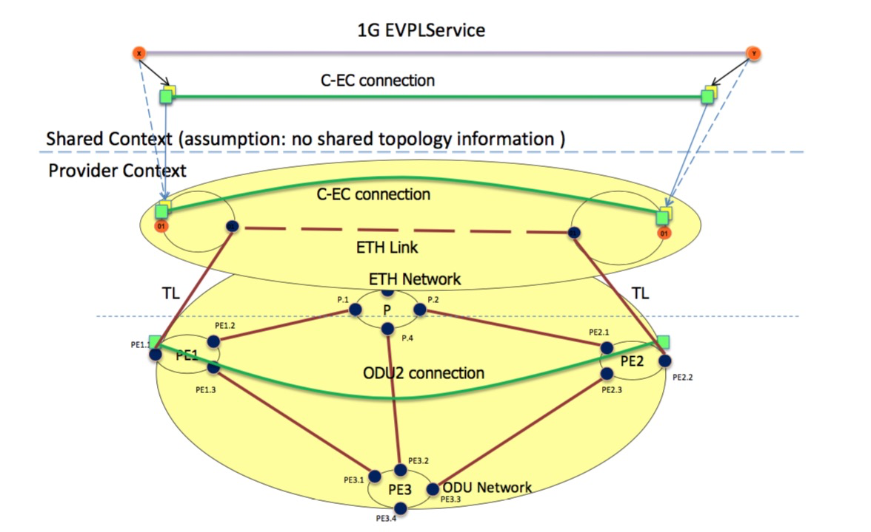
E2E Service in ML Topology
PE1-1.1
PE1-1
PE1-1.2
PE2-1.2
PE2-1.1
PE2-1
Source: T-API FRS

Slide 4
OTN Topology (i2rs) Model Instantiation
<networks>
<network>
network-id=Network-A
<link>
link-id: LID-NWA-FWD-1
<node>
node-id: PE1
<node>
node-id: PE2
<node>
node-id: PE3
<node>
node-id: P
<network-types>
[OTN]
<source>
src-node: <PE1 ref>
source-tp: <PE1.2 ref>
<destination>
dest-node: <P ref>
dest-tp: <P.1 ref>
<termination-point>
tp-id: PE1.1
<termination-point>
tp-id: PE2.1
<termination-point>
tp-id: PE3.1
<termination-point>
tp-id: P.1
OTN Link-1
[PE1.2 <-> P.1]
<termination-point>
tp-id: PE1.2
<termination-point>
tp-id: PE2.2
<termination-point>
tp-id: PE3.2
<termination-point>
tp-id: P.2
<link>
link-id: LID-NWA-REV-1
<termination-point>
tp-id: PE1.3
<termination-point>
tp-id: PE2.3
<termination-point>
tp-id: PE3.3
<termination-point>
tp-id: P.3
<source>
src-node: <P ref>
source-tp: <P.1 ref>
<destination>
dest-node: <PE1 ref>
dest-tp: <PE1.2 ref>
<termination-point>
tp-id: PE3.4
<termination-point>
tp-id: P.4
OTN Link-2
[P.2 <-> PE2.1]
OTN Link-3
[P.4 <-> PE3.2]
OTN Link-4
[PE1.3 <-> PE3.1]
OTN Link-5
[PE2.3 <-> PE3.3]

Slide 5
ETH Topology (i2rs) Model Instantiation
<networks>
<network>
network-id=Network-B
<link>
link-id: LID-NWB-FWD-1
<node>
node-id: PE1-1
<node>
node-id: PE2-1
<network-types>
[ETH]
<source>
src-node: <PE1-1 ref>
source-tp: <PE1-1.2 ref>
<destination>
dest-node: <PE2-1 ref>
dest-tp: <PE2-1.2 ref>
<termination-point>
tp-id: PE1-1.1
<termination-point>
tp-id: PE2-1.1
ETH Link
[PE1-1.2 <-> P2-1.2]
<termination-point>
tp-id: PE1-1.2
<termination-point>
tp-id: PE2-1.2
<link>
link-id: LID-NWB-REV-1
<source>
src-node: <PE2-1 ref>
source-tp: <PE2-1.2 ref>
<destination>
dest-node: <PE1-1 ref>
dest-tp: <PE1-1.2 ref>

Slide 6
ODU2 Connection: TEAS Tunnel Model Instantiation
<te>
<te>
<tunnels>
<tunnels>
<tunnel>
name: <ODU2-Service-1 ref>
type: <p2p ref>
tunnel-id: <ODU2-tunnel-1-id ref>
<tunnel>
name: <ODU2-Service-1 ref>
type: <p2p ref>
tunnel-id: <tODU2-unnel-1-id ref>
<lsps-state>
<config>
name: ODU2-Service-1
tunnel-id: ODU2-tunnel-1-id
type: p2p
bandwidth: 10Gbps
lsp-prot-type: unprotected
admin-status: up
<primary-paths>
<state>
name: ODU2-Service-1
tunnel-id: ODU2-tunnel-1-id
type: p2p
bandwidth: 10Gbps
lsp-prot-type: unprotected
tunnel-oper-status: up
<primary-paths>
<lsp>
src: 0.0.0.0
dest: 0.0.0.0
tunnel-id:ODU2-tunnel-1-id
lsp-id: ODU2-lsp-1-id
type: P2P
lsp-oper-status: up
lsp-protection-role: working
<config>
type: explicit
<state>
type: explicit
<endpoint>
type: root
endpoint-address:0.0.0.0
network-id: <Network-A ref>
node-id: <PE1 ref>
tp-id: <PE1.1 ref>
<userlabel>
userlabel=MyODU2Svc
<explicit-route-objects>
index: 0
e-r-usage: route-include-ero
type: link
link-ref: <LID-NWA-FWD-4
ref>
<endpoint>
type: root
endpoint-address:0.0.0.0
network-id: <Network-A ref>
node-id: <PE1 ref>
tp-id: <PE1.1 ref>
<lsp>
<lsp-ref>
<lsp-record-route>
LO ODU Src & Dest not shown
ODU2 Connection
<rro>
subobject-index: 0
type: link-ref
link-ref: <LID-NWA-FWD-4
ref>
<endpoint>
type: root
endpoint-address:0.0.0.0
network-id: <Network-A ref>
node-id: <PE2 ref>
tp-id: <PE2.2 ref>
<explicit-route-objects>
index: 1
e-r-usage: route-include-ero
type: link
link-ref: <LID-NWA-FWD-5
ref>
<endpoint>
type: root
endpoint-address:0.0.0.0
network-id: <Network-A ref>
node-id: <PE2 ref>
tp-id: <PE2.2 ref>
<rro>
subobject-index: 0
type: link-ref
link-ref: <LID-NWA-FWD-4
ref>
Config Datastore
Operational/State Datastore

Slide 7
Transitional Link: TEAS Topology Model Instantiation
<network>
network-id=<ODU-OCH-id>
Oops!!
Which i2rs Link to augment?
<link>
link-id: <Which Link?>
What is the ODU endpoints of link? OTN PTP or HO or LO ODU?
<te>
<state>
is-transitional
oper-status: up
information-source: system-processed
<config>
Config tree not shown
Where is the association between link & ODU2 connection?
<information-src-entry>
link-index: 1234 (Is this lsp-id / tunnel-id)?
link-protection-type: unprotected
max-link-bandwidth: 10G
Max-resv-link-bandwidth: NA
<te-link-attributes>
access-type: point-to-point
is-abstract
name: 1234 (Is this lsp-id / tunnel-id)?
admin-status: up
link-index: 1234 (Is this lsp-id / tunnel-id)?
link-protection-type: unprotected
max-link-bandwidth: 10G
Max-resv-link-bandwidth: NA
<interface-switching-capability>
switching-capability: ????
encoding: lsp-encoding-digital-wrapper
<interface-switching-capability>
switching-capability: ????
encoding: lsp-encoding-digital-wrapper
Duplicate containment of te-link-info-attributes

Slide 8
Multi-layer node decomposition Example: L1+L0 OTN switch
Logical sub-node N2_L1
Transformation: physical view to topological view
TP₂₁
N2
TP₁
● ● ●
TP_{2n}
● ● ●
Layer 1
ODUk TPs
TP_{n}
transitional link with client/server
adapt./term.
Layer 0
OCh TP
WDM Line
Note: only one optical transponder (OT) is shown above. Nodes typically have many OTs and each is represented as transitional link in the topology.
Aggregation of transitional links is for further study.
Logical sub-node N2_L0
Dual-layer node N2 is decomposed into 2 logical sub-nodes: N2_L1 and N2_L0
Transitional link between N2_L1 and N2_L0 with following TPs on the link ends: N2_L1 side: set of ODUk TPs, N2_L0 side: single OCh TP
Example: 100G OCh TP → ODUk TPs {80 x ODU0, 40 x ODU1, 10 x ODU2, 2 x ODU3, 1 x ODU4}

