Slide 1
Transport Requirement
May 05th, 2016

Slide 2
Network Topology & Service Constructs
Requirements

Slide 3
Generic Requirements
[R1] User Intent: Maintain separation between high level user intent and the state in the network [Ref: OpenConfig].
E.g. separation between user service request, including all constraints, and the actual service & connection state in the network.
[R2] State Management: Network and service objects supporting the following states [Ref: TAPI-FRS]:
Administrative state (locked, unlocked),
Operational state (enabled,disabled)
Lifecycle state (Planned, Potential, Installed, In_Conflict, Pending_Removal)
[R3] Identification: Network and service object identifiers [Ref: TAPI-FRS]:
IDs [1]
Names[NV]
Labels[NV]
Extensions [NV]

Slide 4
Network & TE Topology
[R4]: Network Topologies [Ref: TAPI-FRS]:
Topology Retrieval:
Allow retrieval of top-level Topology instances.
Topology elements:
Allow retrieval of Nodes and Links present in the topology.
Multi-level topologies [Ref: CIM]:
Allow retrieval of lower level topologies.
Virtual Topologies (VTN):
Documented in a later section

Slide 5
Topology Link
[R5]
Support for the following Topological Links [Ref: TAPI-FRS]:
Physical Links
Logical / Abstract Links
Compound Link: Internally aggregated lower-level serial/parallel links.
Access Links: Links connecting router ports to client port of the transport system.
Transitional Links: Links between layers.
Link attributes:
Cost, Latency, Integrity and Capacity
Risk characteristics including shared-risk
Link elements:
Allow retrieval of the associated topology / virtual topology.
Allow retrieval of associated nodes and termination points.
Layering
Association to the underlay circuit/service, if any.

Slide 6
Topology Node
[R6]
Support for the following Topology Nodes [Ref: TAPI-FRS, CIM]:
Physical Node
Logical / Abstract Node
Chassis / Forwarding Domain (do we need this?)
Node attributes:
Layer information
Node Type (?)
Node Version (?)
Node elements:
Allow retrieval of termination points present in the node.
Allow retrieval of the associated topology / virtual topology
Layering:
Associations to the underlay/server nodes, if any.

Slide 7
Termination Points
[R7]
Support for the following Termination Points [Ref: OpenConfig]:
Physical client side TP
Logical TP
Optical channel TP
Physical Line side TP
Termination Point attributes [Ref: OpenConfig]:
Supporting equipment vendor, part, and revision

Slide 8
Service
[R8]
Support for CRUD operations for the service
Support for Service creation and update requests with the following inputs and outputs [Ref: TAPI-FRS]:
Service Request Inputs:
Service ID (for service update)
Service Type (P2P, P2MP, MP2MP)
P2P – Uni-directional, Bi-directional
Capacity
Service End Points with following details:
End Point role (root, leaf)
Reference to the Termination Point
Service Endpoint Layer
Optional Constraints:
Service Layer
Service Level (CoS, Priority, Resiliency, Availability)
Latency
Cost
Risk Characteristics (shared risk): SRLG/Diversity
Include Path, Exclude Path (Nodes and Node Edge Points)

Slide 9
Service
Risk Characteristics / Protection support:
Protection Type: UnProtected, 1+1, 1:N, etc.
Schedule: Start & End Time
Service Request Output:
Service ID (for service creation)
Service States
Service characteristics - inputs
Support for service notifications:
Service lifecycle notifications: Service creation, deletion, Attribute Value Change
State change notifications: Operational state notification
Any requirements around the following:
Service Policies: TBD
Service Templates: TBD

Slide 10
Connection
[R9]
Connection creation can be triggered as part of the service creation request.
Connection creation request should use inputs provided for service creation. These inputs include the following [Ref: TAPI-FRS]:
Service End Points with following details:
End Point role (root, leaf)
Reference to the Termination Point
Service Endpoint Layer
Capacity
Optional Constraints:
Service Layer
Service Level (CoS, Priority, Resiliency, Availability)
Latency
Cost
Risk Characteristics (shared risk): SRLG/Diversity
Include Path, Exclude Path (Nodes and Node Edge Points)
Objective function (e.g. Minimize cost, Minimize latency, etc.)

Slide 11
Connection
Connection Request Output:
Connection ID
Connection States
Connection path
Routing constraints that are met
Support for connection notifications:
Connection lifecycle notifications: Connection creation, deletion, Attribute Value Change
State change notifications: Operational state notification
Do we need Connection to represent device cross connected / flow entry?

Slide 12
Virtual Network (VTN)
[R10]
TBD

Slide 13
Summary & Log
Requirements | Briefing | Log
[R1]: User Intent | Modeling requirements?
[R2]: State Management | Parameter requirements?
[R3]: Identification | Parameter requirements?
[R4]: Network Topologies | A mixture of both protocol and parameter requirements?
[R5]: Topology Node | Parameter requirements?
[R6]: topology links | Parameter requirements?
[R7]: topology tp | Parameter requirements?
[R8]: service | A mixture of both protocol and parameter requirements?
[R9]: connection | parameter requirements?
[R10]: VTN | No content yet

Slide 14
Transport Use Cases
Requirements

Slide 15
Mapping from Service/EVC to ForwardingConstruct Single Provider, single Forwarding Domain
managed object classes at Service level (potentially appearing at Legato, Interlude)
managed object classes at Resource level (potentially appearing at Presto)
EVC (the end-to-end CarrierEthernetService)
ForwardingConstruct
NE
NE
UNI
ForwardingDomain
UNI
The MEF 7.3 UNI class represents the UNI-N architectural construct, plus some aspects of related Ethernet Link.
LTP
LTP
Source: MEF

Slide 16
Mapping from Service/EVC to ForwardingConstruct Single Provider, two FDs separately managed
managed object classes at Service level (potentially appearing at Legato, Interlude)
managed object classes at Resource level (potentially appearing at Presto)
EVC (the end-to-end CarrierEthernetService)
ForwardingConstruct
ForwardingConstruct
NE
NE
NE
NE
ForwardingDomain
ForwardingDomain
UNI
I-NNI
UNI
LTP
I-NNI
LTP
LTP
LTP
Source: MEF

Slide 17
Mapping from Service/EVC to ForwardingConstruct Single Provider, single managed FD, partitioning
managed object classes at Service level (potentially appearing at Legato, Interlude)
managed object classes at Resource level (potentially appearing at Presto)
EVC (the end-to-end CarrierEthernetService)
ForwardingConstruct
ForwardingConstruct
ForwardingConstruct
ForwardingDomain
NE
NE
NE
NE
ForwardingDomain
ForwardingDomain
UNI
UNI
LTP
I-NNI
LTP
I-NNI
LTP
LTP
Link
Source: MEF

Slide 18
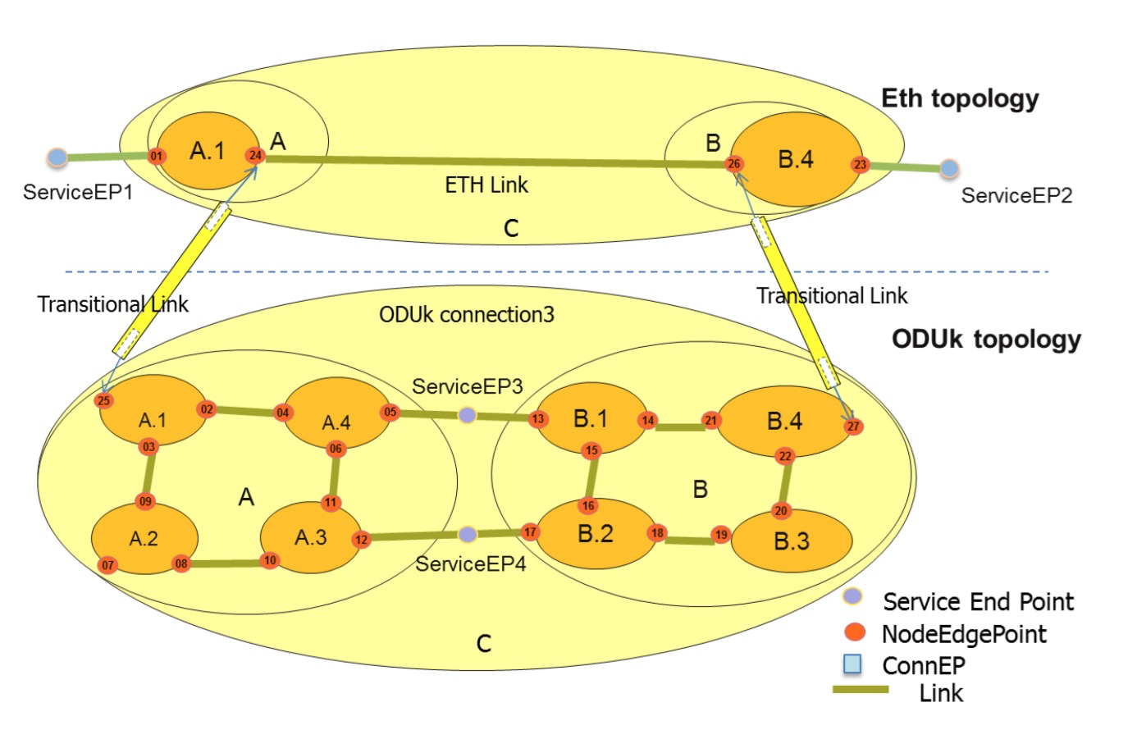
Multi-Layer Topology Instantiation
Source: T-API FRS

Slide 19
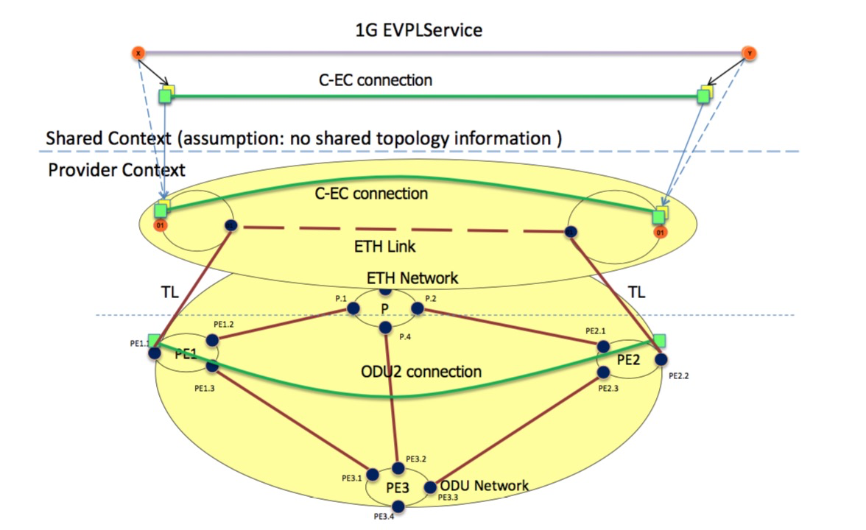
E2E Service in ML Topology
Source: T-API FRS

Slide 20
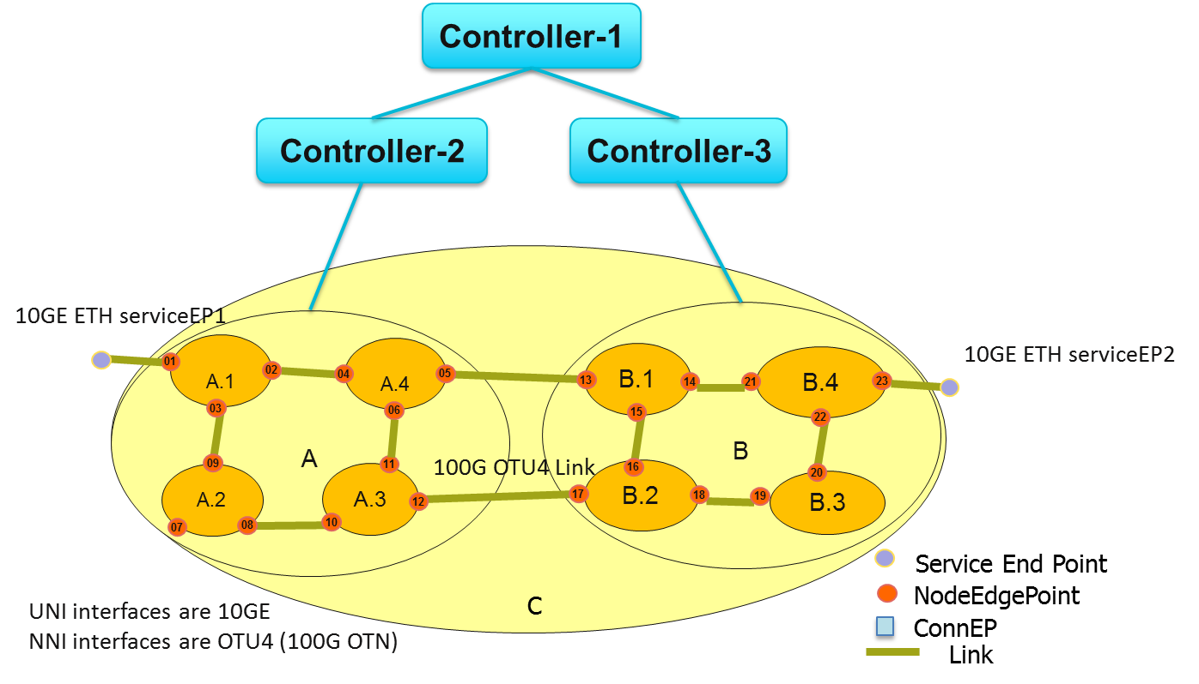
Multi-layer and multi-domain

Slide 21
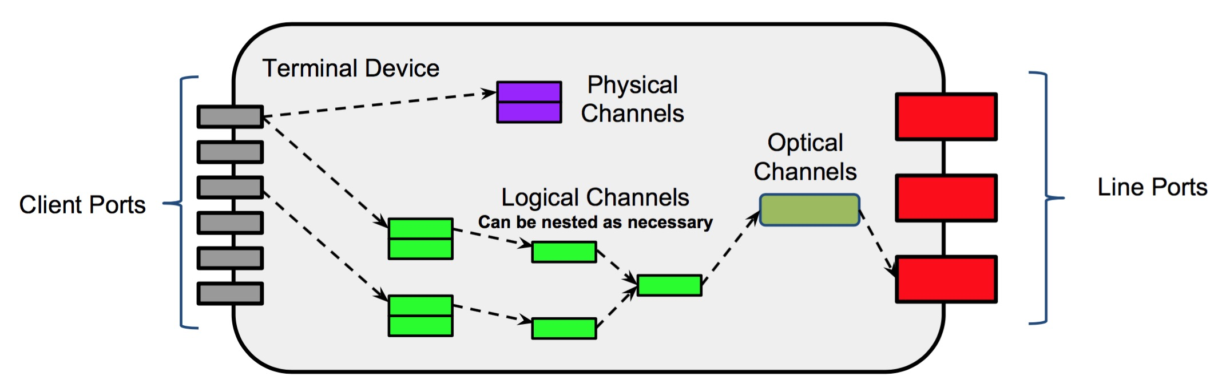
Terminal Device Model
Source: OpenConfig

