Slide 1

1
Detecting hand gestures from EMG data
1.05.2024
─
Team Members -
Ajitesh Kumar Singh (IMT2022559) Keshav Goyal (IMT2022560) Himanshu Khatri (IMT2022584)

Slide 2
2
Problem Statement:
Detect Hand Gestures from EMG data.
Data Available at: https://archive.ics.uci.edu/ml/datasets/EMG+data+for+gestures
Explain how the signal is acquired.
Observe signals corresponding to various gestures and identify uniquie characteristics in the signal corresponding to each gesture.
Can you classify the signals based on the gesture without using Machine/Deep learning?

Slide 3
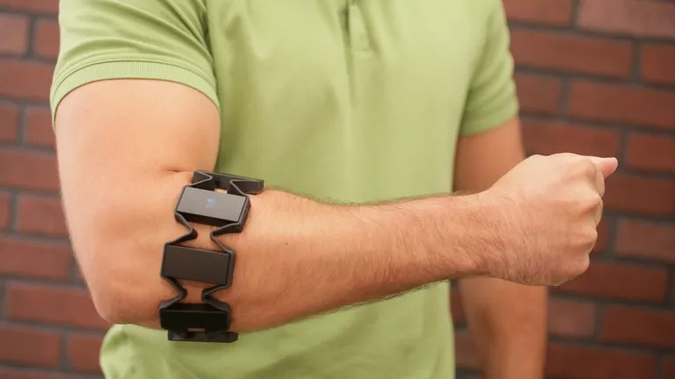
2
EMG SIGNALS
Electromyography (EMG) is a technique for measuring and recording the electrical activity of muscles. When a muscle contracts, it generates electrical signals due to the movement of ions across the cell membrane of muscle ﬁbers. These electrical signals can be detected by placing electrodes on the skin over the muscle of interest. EMG signals can provide information about muscle function, such as the timing and strength of muscle contractions, as well as the presence of muscle disorders or neuromuscular diseases.
HOW ARE EMG SIGNALS ACQUIRED
EMG signals are acquired by placing electrodes on the skin over the muscle of interest. There are two types of EMG electrodes: surface electrodes and indwelling (needle) electrodes.
Surface electrodes are non-invasive and can be placed on the skin over the muscle of interest. They detect the electrical activity of the muscle ﬁbers beneath the skin. Surface electrodes are typically used for surface EMG (s-EMG), which measures the activity of superﬁcial muscles that are close to the skin surface.
Indwelling (needle) electrodes are invasive and are inserted directly into the muscle tissue. They can provide more precise measurements of the electrical activity of individual muscle ﬁbers. Indwelling electrodes are typically used for needle EMG (n-EMG), which measures the activity of deep muscles that are not accessible with surface electrodes.
Once the electrodes are in place, the electrical signals generated by the muscle contractions are ampliﬁed and recorded using an EMG machine. The recorded EMG signals can then be analyzed to provide information about the function and health of muscles.
For our datasets MYO thalmic bracelet has been used.
The acquisition of electromyography (EMG) signals using the MYO armband involves several steps:
Sensor Placement:

Slide 4
3
The MYO armband is equipped with eight sensors that are evenly spaced around the forearm. These sensors are placed directly on the skin surface of the forearm, allowing them to detect the electrical activity generated by the muscles in that area.
Detection of Electrical Activity:
When muscles in the forearm contract or produce movement, they generate electrical signals due to the movement of ions across their cell membranes. The sensors in the MYO armband are designed to detect these electrical signals as they propagate through the muscle tissue.
Electrode Sensitivity:
The electrodes within the MYO armband are sensitive to the minute electrical changes that occur during muscle contraction. They are designed to accurately capture and measure these electrical signals, even amidst other electrical noise present in the environment.
Signal Amplification:
The electrical signals detected by the sensors are typically very weak and need to be amplified for reliable measurement. The MYO armband likely includes built-in amplification circuitry to boost the strength of the EMG signals while minimizing noise interference.
Analog-to-Digital Conversion (ADC):
Once the EMG signals are amplified, they are converted from analog to digital format using an analog-to-digital converter (ADC). This conversion process involves sampling the analog signal at regular intervals and assigning digital values to each sample.
Data Transmission:
The digitized EMG signals are then transmitted wirelessly from the armband to a connected device, such as a computer or smartphone. This allows for real-time monitoring and analysis of the muscle activity detected by the sensors.
Signal Processing and Interpretation:
Upon receiving the EMG signals, software algorithms within the connected device process and interpret the data. These algorithms may include techniques for filtering out noise, identifying specific muscle activity patterns, and translating the signals into meaningful commands or actions.
User Interaction:
Finally, the interpreted EMG signals can be used to control various applications or devices based on the user's muscle movements. For example, the signals may be used to control a computer cursor, navigate through menus, or interact with virtual reality environments.
Gestures -
- Hand at rest - The hand is in a relaxed, stationary position.
- Hand clenched in a fist - The hand is tightly closed with fingers curled into the palm.
- Wrist flexion - The hand is bent downward at the wrist, as if pointing the fingers towards the body.

Slide 5
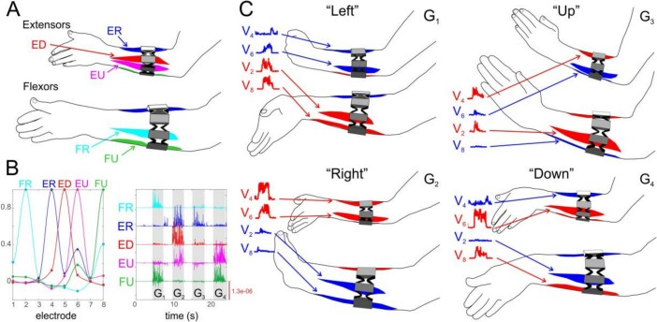
4
– Wrist extension - The hand is bent upward at the wrist, as if pointing the fingers away from the body.
– Radial deviations - The hand is tilted towards the thumb side of the forearm.
- Ulnar deviations - The hand is tilted towards the pinky side of the forearm.
- Extended palm - The hand is open and flattened, fingers spread apart.
For experimental purposes, we recruited 37 healthy volunteers of either sex (24 women and 13 men) from 18 to 41 years old, and of different fitness and training (12 trained and 25 not trained subjects). In the context of this work by “trained”, we mean persons who regularly practice sport or other activities related to manual small motility (playing guitar, embroidery, etc.).
Raw Data Format
Classifying Raw Data
This code snippet organizes raw data ﬁles into distinct classes based on their content. It reads through each ﬁle, identiﬁes the class of the data, and sorts it into separate output ﬁles corresponding to each class. Additionally, it handles ﬁles with speciﬁc preﬁxes by placing them into distinct subdirectories within the destination folder. Finally, it conﬁrms the successful sorting of data upon completion.
Code :
import os
# Create directory if it does not exist

Slide 6
5
def create_directory(directory):
if not os.path.exists(directory): os.makedirs(directory)
# Process files and sort them into different classes
def process_files(folder_path, folder_path_destination , n): outputMap = {
"0": "0.txt",
"1": "1.txt",
"2": "2.txt",
"3": "3.txt",
"4": "4.txt",
"5": "5.txt",
"6": "6.txt",
"7": "7.txt",
}
# Check if the folder path exists if not os.path.exists(folder_path):
print("Folder path does not exist.") return
# Create the destination folder if it does not exist create_directory(folder_path_destination)
# Walk through the folder and process the files for root, dirs, files in os.walk(folder_path):
for folder in dirs:
# Check if the number of folders to sample is 0 if(n==0):
break
n = n-1
# Get the folder name and the folder path folder_name = os.path.join(root, folder)
# Check if the folder name is .DS_Store for filename in os.listdir(folder_name):
if filename == ".DS_Store": continue
print("Processing file:", filename + " in folder:", folder) # Open the file and read the lines in it
with open(os.path.join(folder_name, filename), 'r') as file:
# Iterate through the lines in the file and process them for line in file:
line = line.strip() class_name = line[-1] output_file = ""
# Check if the class name is in the output map and get the output file if class_name in outputMap:
output_file = outputMap[class_name]
# Check if the output file is not empty and write the line to the output file create_directory(os.path.join(folder_path_destination,folder, "DataFor1")) create_directory(os.path.join(folder_path_destination,folder, "DataFor2"))
output_location = ""
# Check if the filename starts with 1 or 2 if filename.startswith("1"):
output_location = os.path.join(folder_path_destination, folder , "DataFor1", output_file)

Slide 7

6
elif filename.startswith("2"):
output_location = os.path.join(folder_path_destination, folder , "DataFor2", output_file)
# Write the line to the output file if output_location:
with open(output_location, 'a') as f: f.write(line + "\n")
print("Data sorted successfully.")
# TODO: Change the folder path
folder_path = "/Users/ajiteshkumarsingh/Documents/Semester 4/Signal Processing/Project/EMG_data_for_gestures-master" folder_path_destination = "/Users/ajiteshkumarsingh/Documents/Semester 4/Signal Processing/Project/Output"
# Get the number of folders to sample
n = int(input("Enter the number of folders you want sample of : "))
# Process the files
process_files(folder_path, folder_path_destination,n)
CODE FOR CONVERTING .TXT TO .XLSX
import os
import pandas as pd import re
# Function to convert text files to Excel files def txt_to_excel(input_folder, output_folder):
# Iterate through each folder in the input directory for folder in os.listdir(input_folder):
folder_path = os.path.join(input_folder, folder)
if os.path.isdir(folder_path):
# Create corresponding output folder
output_subfolder = os.path.join(output_folder, folder) os.makedirs(output_subfolder, exist_ok=True)
# Navigate to DataFor1 and DataFor2 folders for data_folder in ['DataFor1', 'DataFor2']:
data_path = os.path.join(folder_path, data_folder)
if os.path.isdir(data_path):
# Create output folder for DataFor1 and DataFor2 output_data_folder = os.path.join(output_subfolder, data_folder) os.makedirs(output_data_folder, exist_ok=True)
# Iterate through each text file in DataFor1 and DataFor2 folders

Slide 8
7
for i in range(7):
txt_file = os.path.join(data_path, f"{i}.txt")
if os.path.isfile(txt_file):
# Read text file with variable whitespace as delimiter using regex with open(txt_file, 'r') as file:
lines = file.readlines() data = []
for line in lines:
# Split line using regex to handle variable whitespace
row = [float(value) if re.match(r'^-?\d+(?:\.\d+)?(?:e[-+]?\d+)?$', value) else value for value in re.split(r'\s+', line.strip()) if value]
# Convert to float if possible data.append(row)
# Convert list of lists to DataFrame data = pd.DataFrame(data)
# Write data to Excel file in the respective output folder output_file = os.path.join(output_data_folder, f"{i}.xlsx") data.to_excel(output_file, index=False, header=False) print(f"Converted {txt_file} to {output_file}")
#TODO: Change the folder path
input_folder = '/Users/ajiteshkumarsingh/Documents/Semester 4/Signal Processing/Project/Output' #
Folder containing the 36 folders
output_folder = '/Users/ajiteshkumarsingh/Documents/Semester 4/Signal Processing/Project/OutputExcel' # Folder to store the Excel files
# Convert text files to Excel files txt_to_excel(input_folder, output_folder)
Filtering and Statistical Calculations
For each Excel ﬁle, it reads the SEMG signals into a table, ﬁlters the signals using a Butterworth band-stop ﬁlter to remove noise, and calculates various statistical measures such as maximum amplitude, peak frequency, mean amplitude, mean, skewness, and kurtosis
Code -
% Define output folder path outputFolder = 'OutputResults_6-9';
% Create output folder if it doesn't exist if ~exist(outputFolder, 'dir')
mkdir(outputFolder); end
% Iterate over folders from OutputExcel/25/ to OutputExcel/36/ for folderNum = 13:24
% Define data folder path for the current iteration dataFolder = fullfile('OutputExcel', num2str(folderNum));
% Iterate over DataFor1 and DataFor2 subfolders for dataSubfolder = {'DataFor1', 'DataFor2'}
subfolderName = dataSubfolder{1};
subfolder = fullfile(outputFolder, sprintf('DataFor%d_%s_Results', folderNum,

Slide 9
8
subfolderName));
% Create subfolder for each data subfolder if it doesn't exist if ~exist(subfolder, 'dir')
mkdir(subfolder);
end
% Iterate over Excel files in the current data subfolder for fileIdx = 0:6
filename = fullfile(dataFolder, subfolderName, sprintf('%d.xlsx', fileIdx)); try
% Read SEMG signals from Excel file into a table T = readtable(filename);
t = T.(1); % time vector in seconds signals = table2array(T(:, 6:9));
% assuming the SEMG signals are in columns 2 to 5
% Design a 4th order Butterworth band-stop filter fs = 1000; % sampling frequency in Hz
f1 = 48; % lower frequency cutoff in Hz f2 = 52; % upper frequency cutoff in Hz Wn = [f1/(fs/2), f2/(fs/2)];
[b,a] = butter(4, Wn, 'stop');
% Initialize arrays to store results
max_amp = zeros(4,1); % maximum amplitude of amplitude spectrum peak_freq = zeros(4,1); % frequency with maximum PSD
mean_amp = zeros(4,1); % mean of the amplitude spectrum mean_time = zeros(4,1); % mean in time domain skewness_time = zeros(4,1); % skewness in time domain kurtosis_time = zeros(4,1); % kurtosis in time domain
% Apply the filter to each signal and plot in subplots figure;
for i = 1:4
signal = signals(:,i);
filtered_signal = filter(b, a, signal);
% Plot the filtered signal and its frequency spectrum subplot(4,2,(i-1)*2+1);
plot(t, filtered_signal); xlabel('Time (ms)'); ylabel('Amplitude (mV)');
title(sprintf('Filtered Signal %d', i));
nfft = 2^nextpow2(length(filtered_signal)); f = linspace(0, fs/2, nfft/2+1);
filtered_signal_fft = fft(filtered_signal, nfft); filtered_signal_fft_mag = abs(filtered_signal_fft(1:nfft/2+1));
% Find maximum amplitude of amplitude spectrum and peak frequency [max_amp(i), idx] = max(filtered_signal_fft_mag(2:end)); peak_freq(i) = f(idx+1);
mean_amp(i) = mean(filtered_signal_fft_mag);
% Plot frequency spectrum of filtered signal subplot(4,2,i*2);
plot(f, filtered_signal_fft_mag); xlim([0, 100]);
xlabel('Frequency (Hz)'); ylabel('Magnitude');
title(sprintf('Frequency Spectrum of Filtered Signal %d', i));

Slide 10
9
% Calculate mean, skewness, and kurtosis in time domain mean_time(i) = mean(filtered_signal);
skewness_time(i) = skewness(filtered_signal); kurtosis_time(i) = kurtosis(filtered_signal);
end
% Save statistical measures in a text file
resultsFilename = fullfile(subfolder, sprintf('Results_%d.txt', fileIdx)); fid = fopen(resultsFilename, 'w');
fprintf(fid, "Maximum amplitude of amplitude spectrum: \n"); fprintf(fid, "%f\n", max_amp);
fprintf(fid, "Peak frequency (excluding 0 frequency component): \n"); fprintf(fid, "%f\n", peak_freq);
fprintf(fid, "Mean of amplitude spectrum: \n"); fprintf(fid, "%f\n", mean_amp);
fprintf(fid, "Mean in time domain: \n"); fprintf(fid, "%f\n", mean_time); fprintf(fid, "Skewness in time domain: \n"); fprintf(fid, "%f\n", skewness_time); fprintf(fid, "Kurtosis in time domain: \n"); fprintf(fid, "%f\n", kurtosis_time); fclose(fid);
% Save the plot
saveas(gcf, fullfile(subfolder, sprintf('Plot_%d.png', fileIdx))); close(gcf);
catch
disp(['Error processing file: ' filename]);
end
end
end end
A fourth-order Butterworth band-stop ﬁlter is used to effectively attenuate noise in a speciﬁc frequency range from SEMG signals. This type of ﬁlter ensures a maximally ﬂat response within the passband and a sharp cutoff at the corner frequency, enhancing noise removal while preserving signal integrity. The choice of a fourth-order ﬁlter over lower orders enhances noise attenuation due to its sharper cutoff and ﬂatter passband response, which aids in maintaining the shape of the SEMG signals. Speciﬁcally, the 48-52 Hz cutoff range targets power line interference frequency (PLI), commonly originating from electrical noise in the European power grid operating at 50 Hz. This selection is adaptable to different regions with alternative grid frequencies, requiring adjustments to suit local power grid characteristics. The Butterworth ﬁlter's advantages include its minimal phase and amplitude distortion, ease of design, implementation, and stable performance across a wide frequency spectrum.

Slide 11
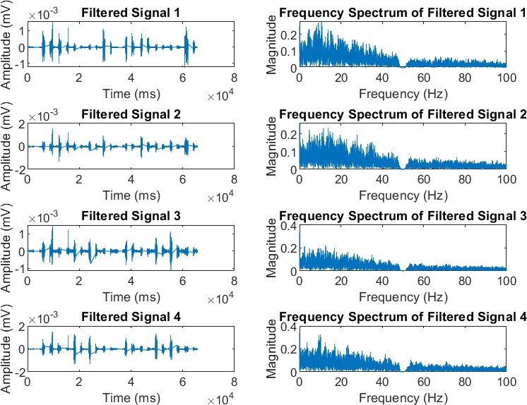
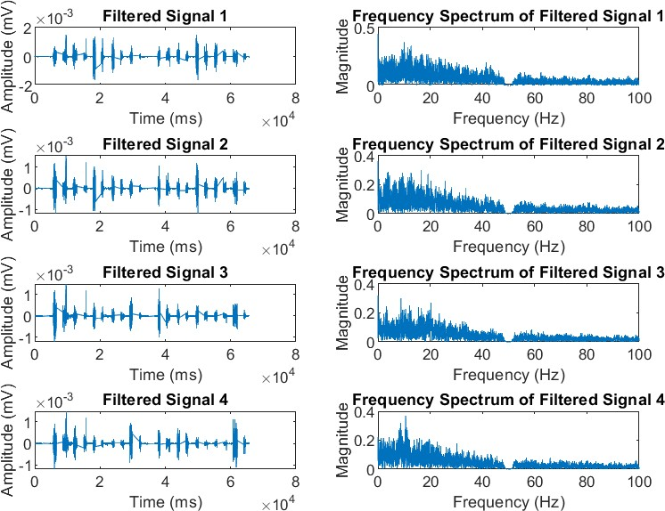
10
Plots and Statistical Values
Hand Gesture 0 Channel 2 to 5
Channel 6-9

Slide 12
11
Statistics –
Channels | Maximum Amplitude of Amp Spectrum | Peak Frequency | Amp Spectrum Mean
Channel 2 | 0.274896 | 10.620117 | 0.015772
Channel 3 | 0.235272 | 13.931274 | 0.015102
Channel 4 | 0.227316 | 12.573242 | 0.014217
Channel 5 | 0.321777 | 9.979248 | 0.017887
Channel 6 | 0.377521 | 9.979248 | 0.021739
Channel 7 | 0.298466 | 16.662598 | 0.017962
Channel 8 | 0.301559 | 8.81958 | 0.015719
Channel 9 | 0.367352 | 10.620117 | 0.01647
Channels | Mean in time domain | Skewness in time domain | Kurtosis in time domain
Channel 2 | -0.000006 | 0.708474 | 24.386521
Channel 3 | -0.000006 | 1.197896 | 25.774211
Channel 4 | -0.000008 | 1.328929 | 29.391907
Channel 5 | -0.000008 | 0.97984 | 23.330564
Channel 6 | -0.000011 | 0.21173 | 18.357415
Channel 7 | -0.000009 | 0.675363 | 19.486716
Channel 8 | -0.000008 | 0.753219 | 25.936536
Channel 9 | -0.000005 | 0.709427 | 21.36489

Slide 13
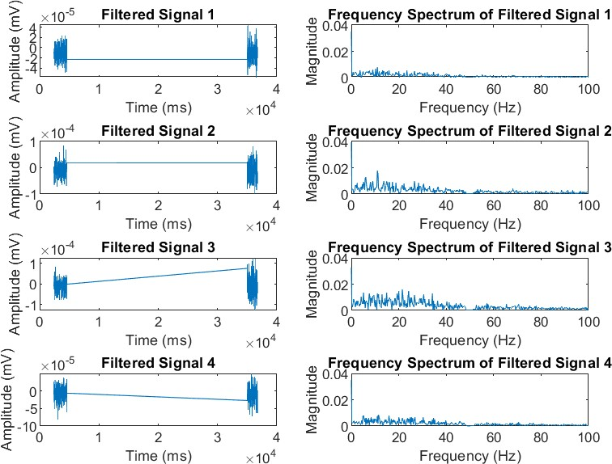
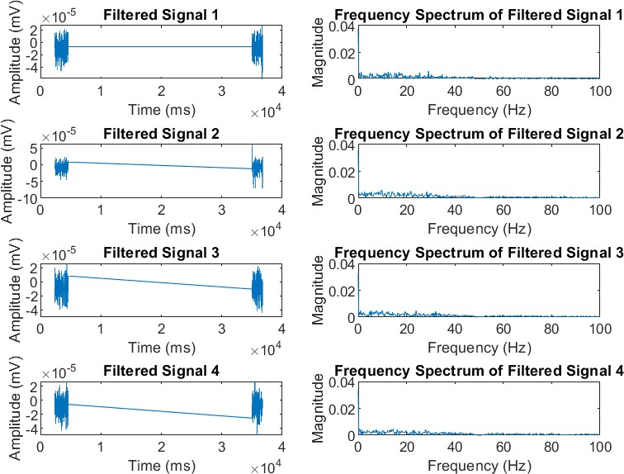
12
Hand Gesture 1
Channel 2- 5
Channel 6-9

Slide 14
13
Statistics –
Channels | Maximum Amplitude of Amp Spectrum | Peak Frequency | Amp Spectrum Mean
Channel 2 | 0.007872 | 10.986328 | 0.000497
Channel 3 | 0.017966 | 10.986328 | 0.000899
Channel 4 | 0.01603 | 21.484375 | 0.00127
Channel 5 | 0.008434 | 11.474609 | 0.000671
Channel 6 | 0.00617 | 29.052734 | 0.000449
Channel 7 | 0.006146 | 9.765625 | 0.000463
Channel 8 | 0.004989 | 7.568359 | 0.000416
Channel 9 | 0.004711 | 14.404297 | 0.00042
Channels | Mean in time domain | Skewness in time domain | Kurtosis in time domain
Channel 2 | -0.000009 | -0.120581 | 3.463561
Channel 3 | -0.00001 | 0.156157 | 3.448899
Channel 4 | -0.000009 | 0.203526 | 3.851384
Channel 5 | -0.000009 | -0.09712 | 3.287711
Channel 6 | -0.00001 | -0.21557 | 3.408265
Channel 7 | -0.000009 | -0.41278 | 7.185126
Channel 8 | -0.000009 | -0.176128 | 2.940346
Channel 9 | -0.000009 | -0.023951 | 3.292194

Slide 15
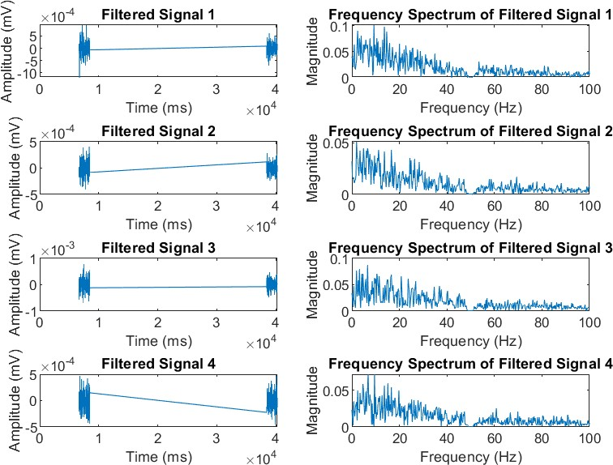
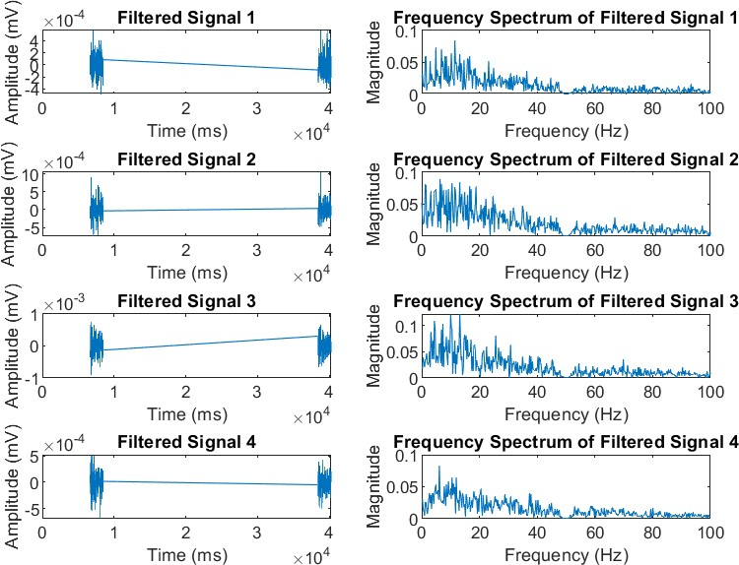
14
Hand Gesture 2
Channel 2 – 5
Channel 6-9

Slide 16
15
Statistics –
Channels | Maximum Amplitude of Amp Spectrum | Peak Frequency | Amp Spectrum Mean
Channel 2 | 0.101066 | 9.277344 | 0.007614
Channel 3 | 0.051148 | 1.953125 | 0.003803
Channel 4 | 0.087115 | 6.591797 | 0.006585
Channel 5 | 0.071986 | 9.521484 | 0.00502
Channel 6 | 0.084284 | 11.474609 | 0.005217
Channel 7 | 0.089035 | 6.347656 | 0.006806
Channel 8 | 0.122303 | 13.183594 | 0.007301
Channel 9 | 0.083333 | 6.103516 | 0.005322
Channels | Mean in time domain | Skewness in time domain | Kurtosis in time domain
Channel 2 | -0.000011 | -0.343632 | 4.658737
Channel 3 | -0.000009 | -0.090659 | 3.690446
Channel 4 | -0.00001 | 0.154232 | 3.537216
Channel 5 | -0.000006 | 0.067457 | 3.03262
Channel 6 | -0.000008 | 0.472658 | 3.594577
Channel 7 | -0.000015 | 0.317565 | 5.072643
Channel 8 | -0.000005 | 0.03232 | 3.261633
Channel 9 | -0.000008 | -0.131487 | 3.749513

Slide 17
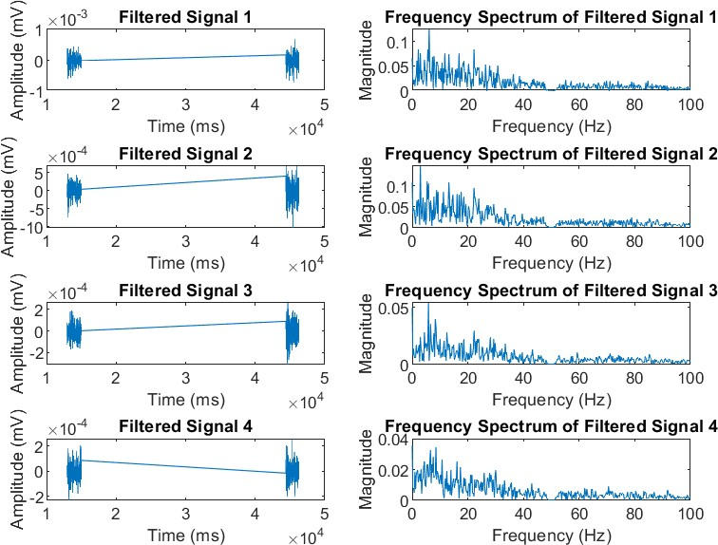
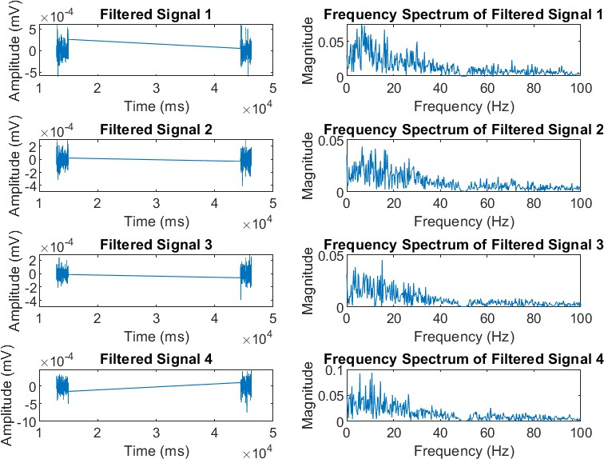
16
Hand Gesture 3
Channel 2-5
Channel 6-9

Slide 18
17
Statistics –
Channels | Maximum Amplitude of Amp Spectrum | Peak Frequency | Amp Spectrum Mean
Channel 2 | 0.124978 | 6.103516 | 0.006023
Channel 3 | 0.146961 | 2.929688 | 0.007378
Channel 4 | 0.054003 | 5.859375 | 0.00252
Channel 5 | 0.034678 | 8.544922 | 0.002256
Channel 6 | 0.073071 | 6.347656 | 0.005184
Channel 7 | 0.043228 | 6.591797 | 0.003266
Channel 8 | 0.045008 | 15.136719 | 0.002574
Channel 9 | 0.093058 | 10.742188 | 0.005245
Channels | Mean in time domain | Skewness in time domain | Kurtosis in time domain
Channel 2 | -0.000018 | -0.129615 | 4.02818
Channel 3 | -0.000028 | -0.402745 | 3.868791
Channel 4 | -0.000013 | 0.085222 | 3.255256
Channel 5 | -0.000009 | 0.172259 | 3.596624
Channel 6 | -0.000008 | 0.360642 | 5.024361
Channel 7 | -0.000009 | -0.211669 | 3.589971
Channel 8 | -0.000008 | -0.136229 | 5.097286
Channel 9 | -0.000013 | -0.429283 | 3.833445

Slide 19
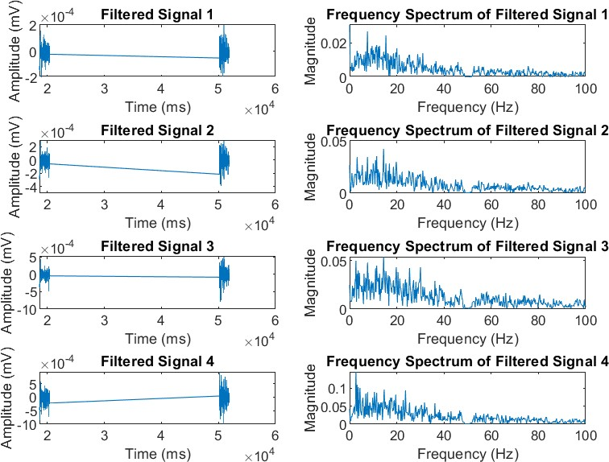
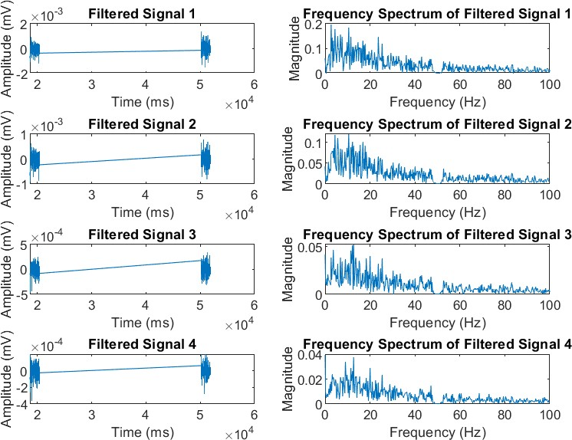
18
Hand Gesture 4
Channel 2-5
Channel 6-9

Slide 20
19
Statistics –
Channels | Maximum Amplitude of Amp Spectrum | Peak Frequency | Amp Spectrum Mean
Channel 2 | 0.026582 | 7.568359 | 0.00165
Channel 3 | 0.042373 | 14.404297 | 0.00277
Channel 4 | 0.053825 | 14.404297 | 0.004363
Channel 5 | 0.145026 | 2.685547 | 0.007858
Channel 6 | 0.197157 | 2.685547 | 0.012248
Channel 7 | 0.119842 | 10.498047 | 0.008055
Channel 8 | 0.052166 | 12.695312 | 0.003438
Channel 9 | 0.03756 | 12.695312 | 0.002325
Channels | Mean in time domain | Skewness in time domain | Kurtosis in time domain
Channel 2 | -0.000009 | -0.068088 | 3.96984
Channel 3 | -0.000008 | -0.203246 | 4.608476
Channel 4 | -0.000007 | -0.461339 | 6.299454
Channel 5 | -0.000012 | -0.145486 | 4.018881
Channel 6 | -0.000018 | -0.171152 | 3.540774
Channel 7 | -0.000012 | -0.408301 | 3.5266
Channel 8 | -0.000012 | -0.293759 | 3.549287
Channel 9 | -0.000011 | -0.398744 | 4.080933

Slide 21
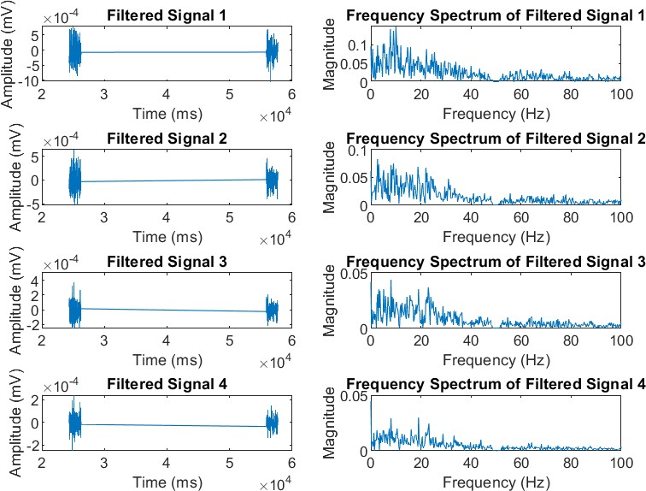
20
Hand Gesture 5
Channel 2-5
Channel 6-9

Slide 22
21
Statistics –
Channels | Maximum Amplitude of Amp Spectrum | Peak Frequency | Amp Spectrum Mean
Channel 2 | 0.025805 | 23.193359 | 0.001737
Channel 3 | 0.062926 | 7.080078 | 0.003964
Channel 4 | 0.109764 | 5.859375 | 0.006606
Channel 5 | 0.149018 | 10.009766 | 0.008695
Channel 6 | 0.149246 | 10.009766 | 0.00891
Channel 7 | 0.083609 | 2.685547 | 0.005647
Channel 8 | 0.04373 | 8.056641 | 0.002771
Channel 9 | 0.030113 | 19.042969 | 0.001758
Channels | Mean in time domain | Skewness in time domain | Kurtosis in time domain
Channel 2 | -0.000012 | -0.053933 | 3.419018
Channel 3 | -0.000015 | -0.019883 | 2.938764
Channel 4 | -0.000014 | -0.000494 | 3.877864
Channel 5 | -0.000023 | 0.274037 | 3.753195
Channel 6 | -0.000027 | 0.000903 | 3.093579
Channel 7 | -0.000017 | 0.384834 | 3.521631
Channel 8 | -0.000011 | 0.245717 | 4.233101
Channel 9 | -0.000012 | 0.030881 | 5.151498

Slide 23
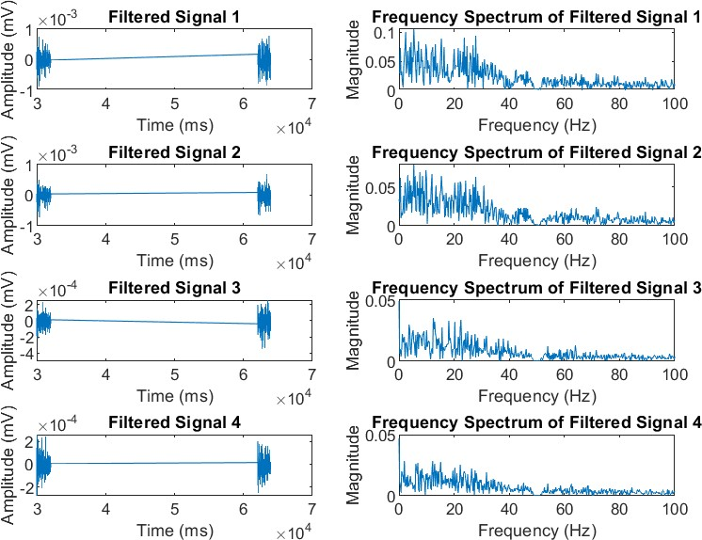
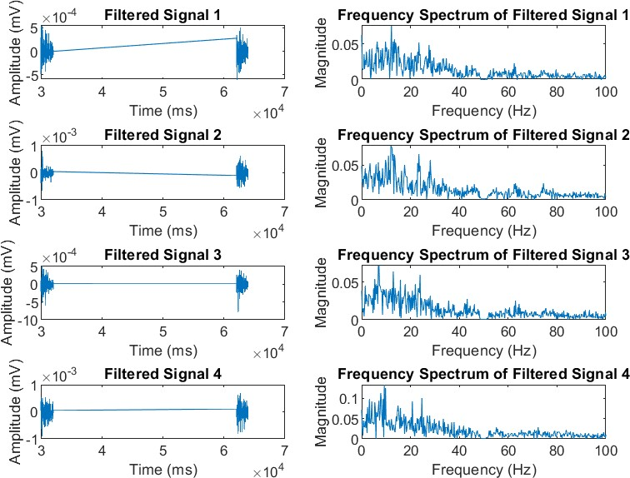
22
Hand Gesture 6
Channel 2-5
Channel 6 -9

Slide 24
23
Statistics –
Channels | Maximum Amplitude of Amp Spectrum | Peak Frequency | Amp Spectrum Mean
Channel 2 | 0.105191 | 5.371094 | 0.008258
Channel 3 | 0.078621 | 5.371094 | 0.006179
Channel 4 | 0.034961 | 12.451172 | 0.002803
Channel 5 | 0.028627 | 1.953125 | 0.002473
Channel 6 | 0.074826 | 12.207031 | 0.004912
Channel 7 | 0.077602 | 11.962891 | 0.005677
Channel 8 | 0.071861 | 7.080078 | 0.004831
Channel 9 | 0.132845 | 9.277344 | 0.007431
Channels | Mean in time domain | Skewness in time domain | Kurtosis in time domain
Channel 2 | -0.000008 | -0.083002 | 3.867035
Channel 3 | -0.000009 | -0.297717 | 4.250015
Channel 4 | -0.000013 | -0.445698 | 4.75749
Channel 5 | -0.000013 | 0.340282 | 3.696553
Channel 6 | -0.000016 | 0.316635 | 4.5378
Channel 7 | -0.000013 | -0.037809 | 5.302603
Channel 8 | -0.00001 | -0.712318 | 6.746033
Channel 9 | -0.000019 | -0.275888 | 3.704422
Gesture Detection Code
from tabulate import tabulate
#TODO - Change the folder path to the location of the OutputResults folder movement = 6
folders = 36
# Define flag names flag_names = {
"class_0": "Class 0",
"class_1": "Class 1",
"class_2": "Class 2",
"class_3": "Class 3",
"class_4": "Class 4",
"class_5": "Class 5",
"class_6": "Class 6"
}
# Final priorities dictionary priorities = {

Slide 25
24
"Class 0": [0,0],
"Class 1": [0,0],
"Class 2": [0,0],
"Class 3": [0,0],
"Class 4": [0,0],
"Class 5": [0,0],
"Class 6": [0,0]
}
for TestCase in range(1, folders + 1): # Reset flags for each test case
flags = {
"class_0": 0,
"class_1": 0,
"class_2": 0,
"class_3": 0,
"class_4": 0,
"class_5": 0,
"class_6": 0
}
if TestCase <= 12:
subfolder = "1_12"
elif 13 <= TestCase <= 24: subfolder = "13_24"
elif 25 <= TestCase <= 36: subfolder = "25_36"
#TODO - Change the folder path to the location of the OutputResults folder folderPath = f"/Users/ajiteshkumarsingh/Documents/Semester 4/Signal
Processing/Project/PlotAndStats/{subfolder}/OutputResults_2-5/DataFor{TestCase}_DataFor1
_Results"
folderPath2 = f"/Users/ajiteshkumarsingh/Documents/Semester 4/Signal
Processing/Project/PlotAndStats/{subfolder}/OutputResults_6-9/DataFor{TestCase}_DataFor1
_Results"
# Load the data
with open(f"{folderPath}/Results_{movement}.txt", "r") as f: data1 = f.read().split("\n")
with open(f"{folderPath2}/Results_{movement}.txt", "r") as f: data2 = f.read().split("\n")
# Extract the required data
amplitude_spectrum1 = int(data1.index("Mean of amplitude spectrum: ")) amplitude_spectrum2 = int(data2.index("Mean of amplitude spectrum: "))
# Extract the required data for Amplitude Spectrum
amplitude_spectrum2_5 = [float(data1[amplitude_spectrum1 + i]) for i in range(1, 5)] amplitude_spectrum6_9 = [float(data2[amplitude_spectrum2 + i]) for i in range(1, 5)] amplitude_spectrum = amplitude_spectrum2_5 + amplitude_spectrum6_9

Slide 26
25
# Extract the required data for Kurtosis
kurtIndex1 = int(data1.index("Kurtosis in time domain: ")) kurtIndex2 = int(data2.index("Kurtosis in time domain: "))
Kurtosis2_5 = [float(data1[kurtIndex1 + i]) for i in range(1, 5)] Kurtosis6_9 = [float(data2[kurtIndex2 + i]) for i in range(1, 5)]
Kurtosis = Kurtosis2_5 + Kurtosis6_9
# Extract the required data for Peak Frequency
peak_freq1 = int(data1.index("Peak frequency (excluding 0 frequency component): ")) peak_freq2 = int(data2.index("Peak frequency (excluding 0 frequency component): "))
peak_freq2_5 = [float(data1[peak_freq1 + i]) for i in range(1, 5)] peak_freq6_9 = [float(data2[peak_freq2 + i]) for i in range(1, 5)] peak_freq = peak_freq2_5 + peak_freq6_9
# Flag 0: Highest probability
if all(i > 6 for i in Kurtosis): flags["class_0"] += 1
# Flag 1: Condition based on amplitude spectrum if abs(amplitude_spectrum[-2] * 1e6) < 1000:
flags["class_1"] += 1
# Flag 5: Multiple conditions
if all(abs(amplitude_spectrum[i] - 0.002) < 0.002 for i in range(4)): flags["class_5"] += 1
# Flag 5: Another condition
if sum(Kurtosis[i] - [4, 3, 4, 5][i] for i in range(-1, -5, -1)) < 2.4:
flags["class_5"] += 1
# Flag 4: Condition based on peak frequency
if sum(i >= 10 or abs(i - 10) < 0.5 for i in peak_freq) > 5: flags["class_4"] += 1
# Flag 4: Another condition based on peak frequency
if amplitude_spectrum.index(max(amplitude_spectrum[:4])) == 3 and amplitude_spectrum.index(
min(amplitude_spectrum[4:8])) == 4:
flags["class_4"] += 1
# Flag 2: Condition based on amplitude spectrum
if amplitude_spectrum.index(max(amplitude_spectrum[:4])) in [0, 3]:
flags["class_2"] += 1
# Flag 6: Condition based on amplitude spectrum
if amplitude_spectrum.index(min(amplitude_spectrum[:4])) in [1, 2]:
flags["class_6"] += 1
if amplitude_spectrum.index(max(amplitude_spectrum[:4])) != 3 and

Slide 27
26
amplitude_spectrum.index(
min(amplitude_spectrum[4:8])) != 6:
flags["class_3"] += 1
# Define flag priority according to the specified order flag_priority = [
("class_0", 0),
("class_1", 1),
("class_5", 3),
("class_4", 5),
["class_3", 2],
("class_6", 4),
("class_2", 6)
]
# Sort the flag_priority list based on the specified order flag_priority.sort(key=lambda x: x[1])
# Define flag names flag_names = {
"class_0": "Class 0",
"class_1": "Class 1",
"class_2": "Class 2",
"class_3": "Class 3",
"class_4": "Class 4",
"class_5": "Class 5",
"class_6": "Class 6"
}
print("\n")
print(f"The predicted order of priorities for TestCase {TestCase} is: ") numbers = 2
# Assign points to each class based on their position in the list l l = []
for flag_name, _ in flag_priority: if flags[flag_name] == 1:
l.append(flag_names[flag_name])
names = list(flag_names.values())
if len(l) == 2 and l[0] == names[6] and l[1] == names[2]: l.clear()
l.append(names[5]) l.append(names[6])
# Assign points to each class based on their position in the list l IterationPriority = {
"Class 0": [0, 0],
"Class 1": [0, 0],
"Class 2": [0, 0],
"Class 3": [0, 0],

Slide 28
27
"Class 4": [0, 0],
"Class 5": [0, 0],
"Class 6": [0, 0]
}
for i in l:
num = 0
# Assign points to each class based on their position in the list l if(num == 0):
x = 9
priorities[i][0] += 1
priorities[i][1] += x * priorities[i][0] IterationPriority[i][0] += 1
IterationPriority[i][1] += x * IterationPriority[i][0] num += 1
else:
priorities[i][0] += 1
priorities[i][1] += (7 - l.index(i)) * priorities[i][0] IterationPriority[i][0] += 1
IterationPriority[i][1] += (7 - l.index(i)) * IterationPriority[i][0] num += 1
if(movement == numbers):
IterationPriority[names[2]][1] += 8 * IterationPriority[names[2]][0] priorities[names[2]][1] += 8 * priorities[names[2]][0]
# Convert the dictionary items to a list of tuples
data = [(key, value[0], value[1]) for key, value in IterationPriority.items()]
# Print using tabulate with headers
print(tabulate(data, headers=["Class", "Frequency", "Priority"], tablefmt="pretty"))
print("\n")
print("--------------------------------------------")
print("The final order of priorities is: ")
print("--------------------------------------------")
data = [(key, value[0], value[1]) for key, value in priorities.items()]
print(tabulate(data, headers=["Class", "Frequency", "Priority"], tablefmt="pretty")) print("\n")
max_key = max(priorities, key=lambda k: priorities[k][1]) print("The class with the highest priority is: ", max_key) print("\n")
print("\n")

Slide 29
28
Setup: The script begins by setting up some initial variables. It speciﬁes the number of movements and folders to process.
Data Structure Initialization: It sets up dictionaries to store ﬂag names [ﬂag for the particular class] and priorities for each class.
Processing Loop: The script goes through each folder (representing a test case). For each test case:
It determines the subfolder based on the test case number.
Constructs ﬁle paths to load data from text ﬁles.
Loads data such as amplitude spectrum, kurtosis, and peak frequency.
Evaluates conditions (ﬂags) based on the loaded data and increments corresponding ﬂags accordingly.
Priority Assignment:
It deﬁnes a priority order for the ﬂags.
Sorts the ﬂags based on their priority order.
Prints the predicted order of priorities for the current test case.
Assigns points to each class based on their positions in the priority list and certain conditions.
Calculates priorities for each class based on the assigned points.
Printing Results:
After processing all test cases, it prints the ﬁnal order of priorities for each class.
It identiﬁes the class with the highest priority across all test cases and prints it.
Summary:
Essentially, the script analyzes data from diﬀerent tests, looks for speciﬁc patterns or conditions, and assigns priorities to diﬀerent classes based on these patterns. It then provides insights into which classes are most important across all the tests.

Slide 30
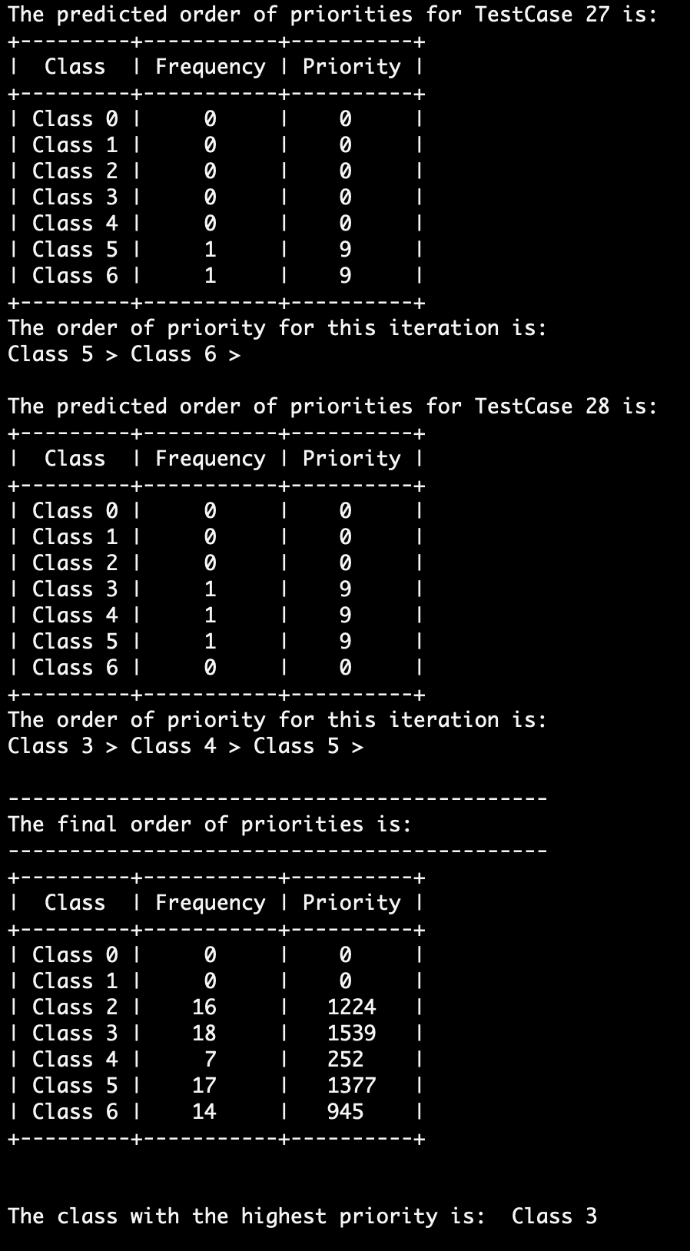
29
(OUTPUT OF THE CODE)

Slide 31
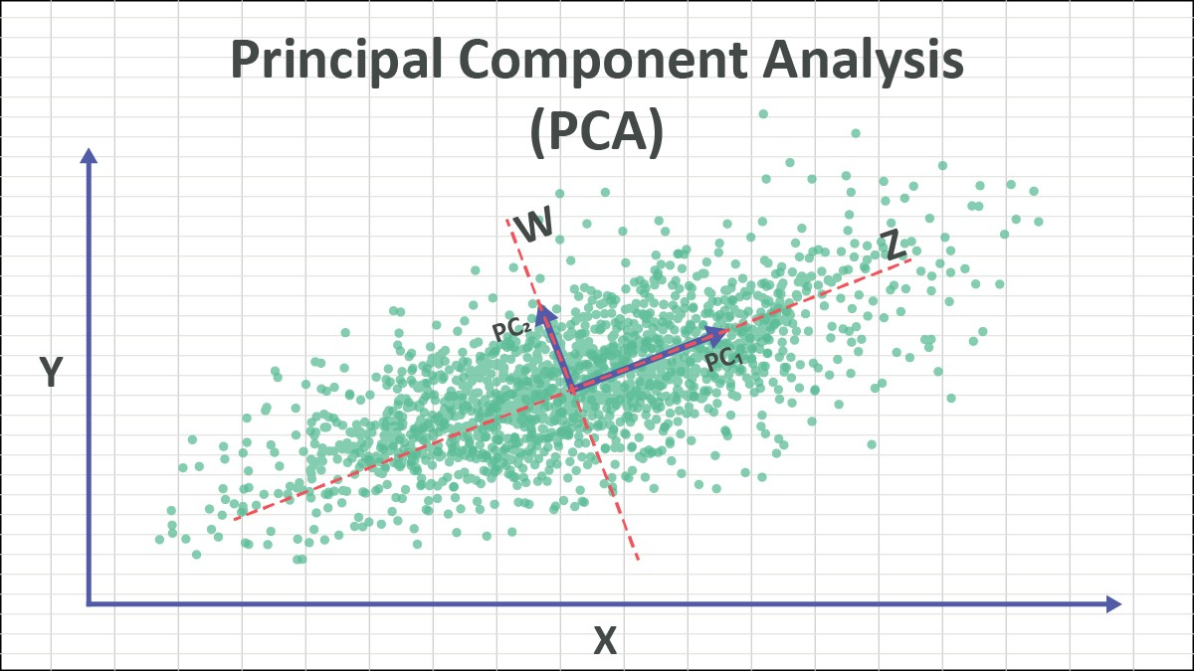
30
Principal Component Analysis (PCA)
Now, to classify the signals, without the use of Machine Learning/Deep Learning, we make use of Principal Component Analysis, or PCA. Since we have 8 channels, it becomes difficult to visualise and analyse the data. Thus, we use PCA to reduce the dimensions so that most of the information comes in the first few channels so we can analyse the data more easily. Principal components are linear combinations of initial variables. PCA would reorganise the data such that the first few channels contain most of the information (or we can say that those channels have the most variance).
The relationship between variance and information here is that the larger the variance carried by a line (along a dimension), the larger the dispersion of the data points along it, and the larger dispersion along a line, the more information it has.
After performing PCA, we found out that most of the information lies in the first 4 channels. Therefore, we consider only the first 4 channels for our analysis. Most of the variance after performing PCA was in the 4 new channels created. It is nearly 80-95% on the first 4 channels. Thus, reduction of dimensions can lead to easier analysis of the data.

Slide 32
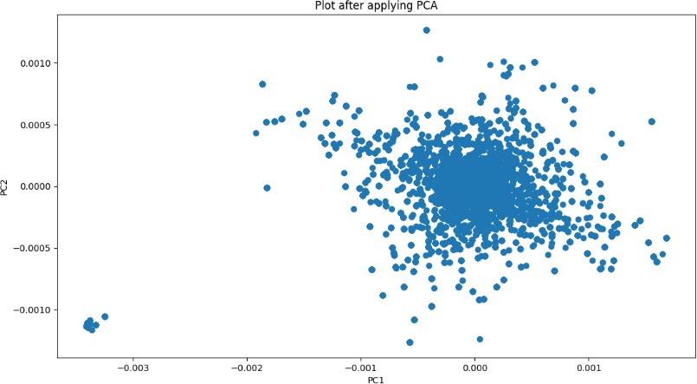
31
Gesture 0:
85% of the data in first 4 channels
Channels | Variance
New Channel 1 | 49.65230749
New Channel 2 | 19.52878509
New Channel 3 | 11.6451382
New Channel 4 | 6.72540867
New Channel 5 | 6.12963001
New Channel 6 | 2.68861993
New Channel 7 | 2.16626442
New Channel 8 | 1.46384619

Slide 33
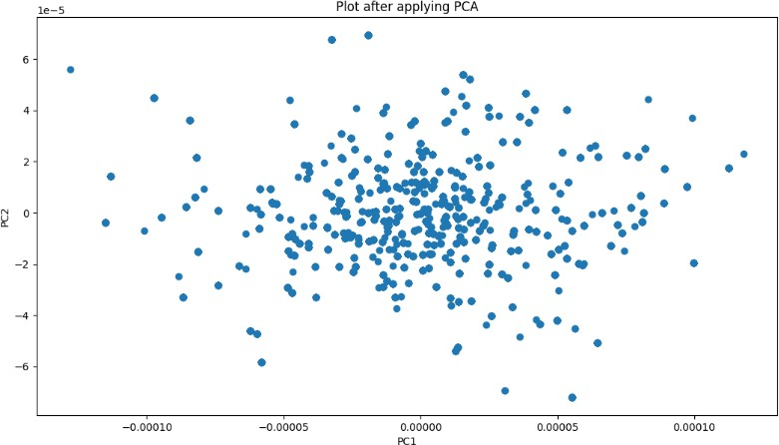
32
Gesture 1:
82% of the data in first 4 channels
Channels | Variance
New Channel 1 | 54.73247233
New Channel 2 | 16.49652786
New Channel 3 | 7.85355353
New Channel 4 | 5.73604404
New Channel 5 | 4.75363977
New Channel 6 | 4.05314531
New Channel 7 | 3.33020264
New Channel 8 | 3.04441452

Slide 34
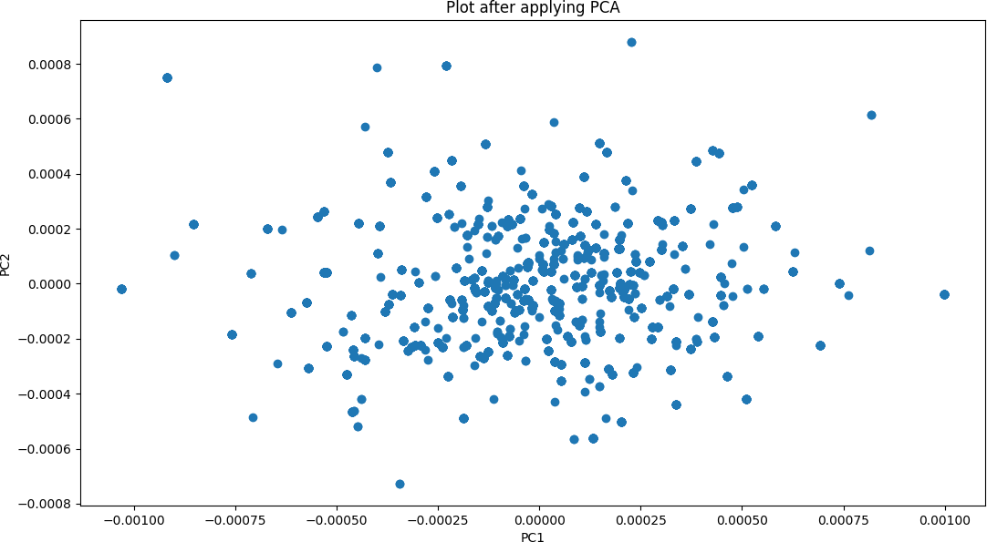
33
Gesture 2:
85% of the data in first 4 channels
Channels | Variance
New Channel 1 | 35.79645797
New Channel 2 | 20.29541733
New Channel 3 | 16.74650055
New Channel 4 | 14.55827207
New Channel 5 | 6.13036481
New Channel 6 | 3.61872157
New Channel 7 | 1.85970759
New Channel 8 | 0.9945581

Slide 35
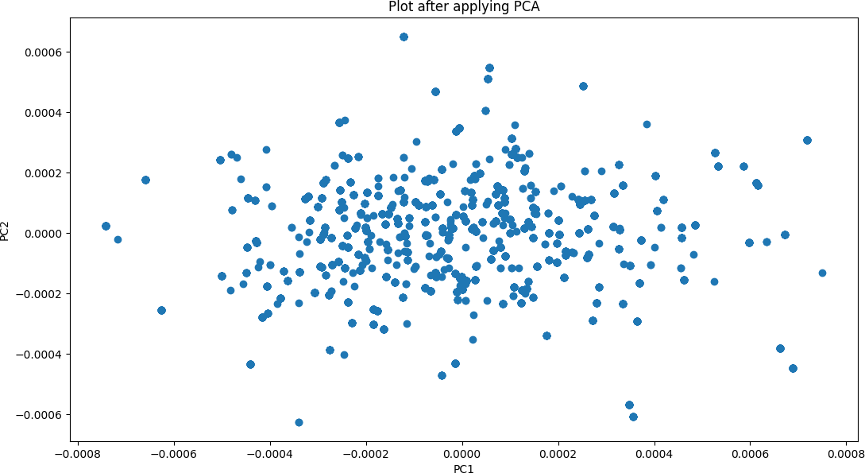
34
Gesture 3:
91% of the data in first 4 channels
Channels | Variance
New Channel 1 | 48.12966371
New Channel 2 | 22.55855958
New Channel 3 | 15.75550142
New Channel 4 | 6.89813765
New Channel 5 | 2.90265947
New Channel 6 | 2.06777538
New Channel 7 | 1.41936478
New Channel 8 | 0.268338

Slide 36
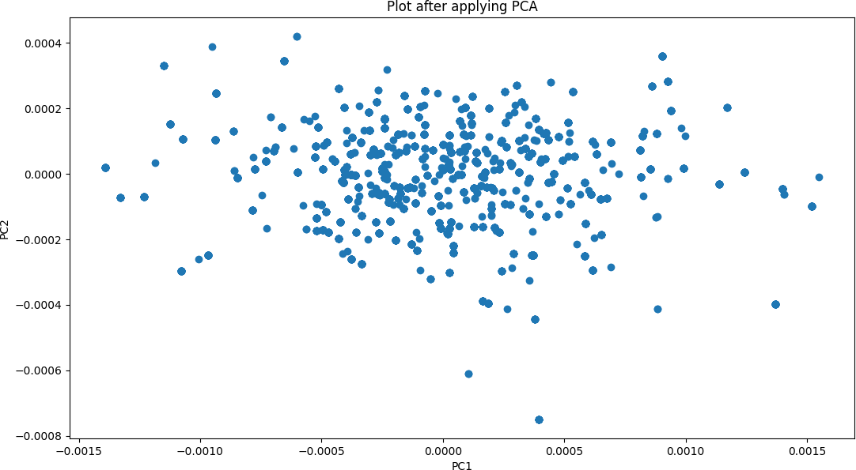
35
Gesture 4:
95% of the data in first 4 channels
Channels | Variance
New Channel 1 | 83.4175411
New Channel 2 | 6.8535264
New Channel 3 | 5.1674458
New Channel 4 | 1.9608720
New Channel 5 | 1.6734037
New Channel 6 | 0.5298696
New Channel 7 | 0.3206698
New Channel 8 | 0.0766717

Slide 37
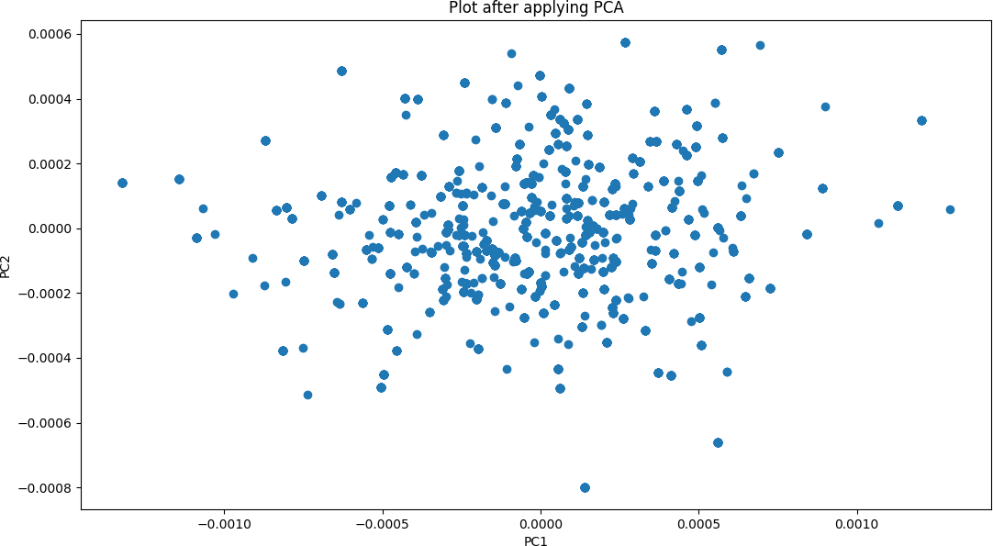
36
Gesture 5:
96% of the data in first 4 channels
Channels | Variance
New Channel 1 | 63.1259174
New Channel 2 | 21.2104104
New Channel 3 | 8.4111868
New Channel 4 | 4.4137873
New Channel 5 | 1.4214121
New Channel 6 | 0.8580062
New Channel 7 | 0.4240615
New Channel 8 | 0.1352182

Slide 38
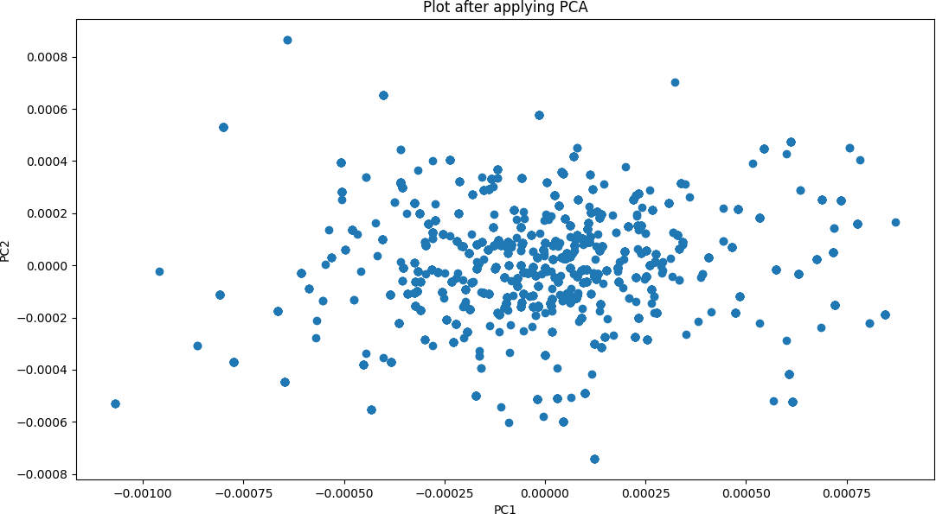
37
Gesture 6:
89% of the data in first 4 channels
Channels | Variance
New Channel 1 | 45.3106641
New Channel 2 | 21.4491720
New Channel 3 | 18.6901783
New Channel 4 | 5.4762636
New Channel 5 | 4.4453960
New Channel 6 | 2.3999182
New Channel 7 | 1.9437568
New Channel 8 | 0.2846511

Slide 39
38
import numpy as np
import matplotlib.pyplot as plt import pandas as pd
def pca(X):
# mean center the data
X_meaned = X - np.mean(X , axis = 0)
# calculate the covariance matrix
cov_mat = np.cov(X_meaned , rowvar = False)
# calculate eigenvectors & eigenvalues of the covariance matrix eigen_values , eigen_vectors = np.linalg.eigh(cov_mat)
# sort the eigenvalues in decreasing order sorted_index = np.argsort(eigen_values)[::-1] sorted_eigenvalue = eigen_values[sorted_index] sorted_eigenvectors = eigen_vectors[:,sorted_index]
# select the first n eigenvectors, n is desired dimension
# of our reduced subspace (i.e., number of principal components) eigenvector_subset = sorted_eigenvectors[:,0:4]
# transform the data onto the new subspace
X_reduced = np.dot(eigenvector_subset.transpose(),X_meaned.transpose()
).transpose()
return X_reduced, sorted_eigenvalue, np.mean(X,axis=0)
excel_file = "C:\\Users\\rog\\OneDrive\\Desktop\\iiitb\\Sem4\\OutputExcel\\1\\DataFor1\\6.xlsx" df = pd.read_excel(excel_file)
selected_columns = df.iloc[:, 1:9]
text_file = "output.txt" # Name of the output text file selected_columns.to_csv(text_file, sep=' ', index=False) data = np.loadtxt(text_file, skiprows=1)
data2=[]
for i in range(len(data)):
j=len(data[i]) data1=[]
for k in range(j): data1.append(data[i][k]) data2.append(data1) #get all the data # Perform PCA
X_reduced, eigenvalues, mean = pca(data2)
# Print the variance explained by each principal component

Slide 40
39
variance_ratio = eigenvalues *100/ np.sum(eigenvalues) print('Variance ratio: ', variance_ratio) np.savetxt('afterPCA.txt', X_reduced)
# Plot the data in the reduced subspace plt.scatter(X_reduced[:, 0], X_reduced[:, 1]) plt.xlabel('PC1')
plt.ylabel('PC2')
plt.title('Plot after applying PCA') plt.show()
Data Preprocessing:
The script first reads an Excel file containing the dataset using Pandas.
It selects specific columns from the dataset (columns 1 to 8) and saves them into a text file named "output.txt" with space-separated values.
Then, it loads the data from the text file into a NumPy array for further processing.
Principal Component Analysis (PCA):
PCA is performed on the dataset using a custom function named pca(X).
Inside the pca function:
The data is mean-centered by subtracting the mean of each feature column.
The covariance matrix of the mean-centered data is calculated.
Eigenvalues and eigenvectors of the covariance matrix are computed.
Eigenvalues are sorted in descending order, and the corresponding eigenvectors are reordered accordingly.
The top 4 eigenvectors (principal components) are selected to transform the data into a reduced subspace.
The data is transformed onto the new subspace using matrix multiplication.
The function returns the transformed data (X_reduced), sorted eigenvalues, and the mean of the original dataset.
Variance Ratio Calculation:
The script calculates the variance explained by each principal component as a percentage of the total variance.
Visualization:
The reduced data (X_reduced) is plotted in a 2D scatter plot using Matplotlib.
The x-axis represents the first principal component (PC1), and the y-axis represents the second principal component (PC2).
The plot provides a visualization of the data distribution in the reduced subspace after applying PCA.

