Slide 1
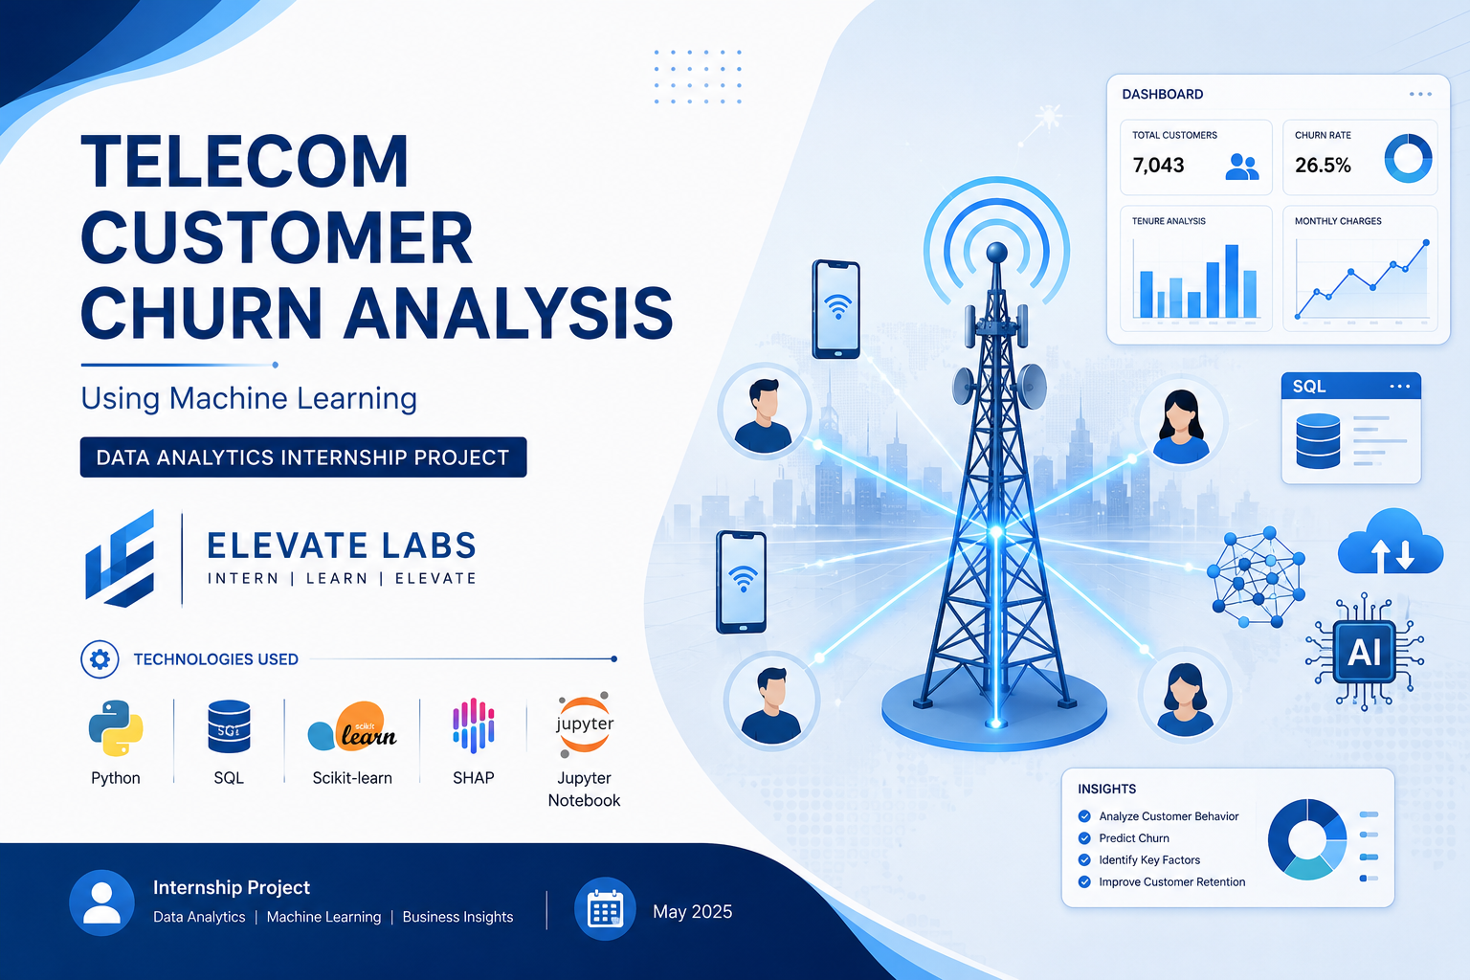

Slide 2

Project Objective
Key PointsPredict whether a telecom customer will churn.
Analyze customer behaviour using SQL and Python.
Compare multiple machine learning models.
Identify important factors affecting churn using SHAP.
Provide business recommendations to reduce customer churn.

Slide 3
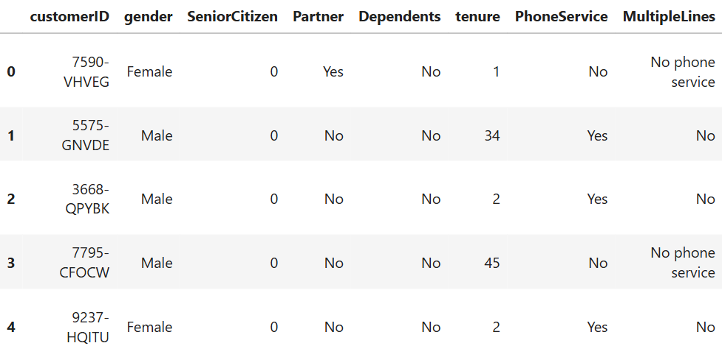
Dataset Overview
Attribute | Value
Dataset | Telco Customer Churn
Rows | (7.043)
Columns | (21)
Target Variable | Churn
Type | Classification
Target Variable: Churn (Yes/No)

Slide 4
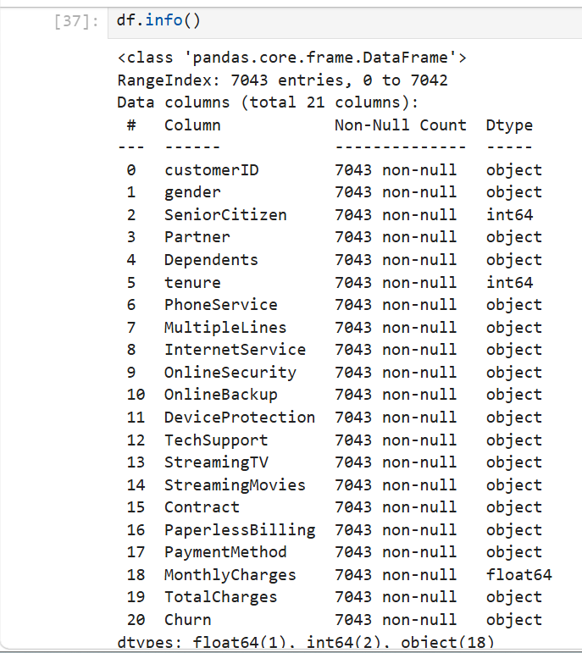
Data Cleaning
Data Cleaning Performed
Dataset contains 7,043 rows and 21 columns
Converted TotalCharges to numeric.
Handled missing values.
No duplicate records found .
Encoded categorical variables.
Prepared dataset for machine learning.

Slide 5
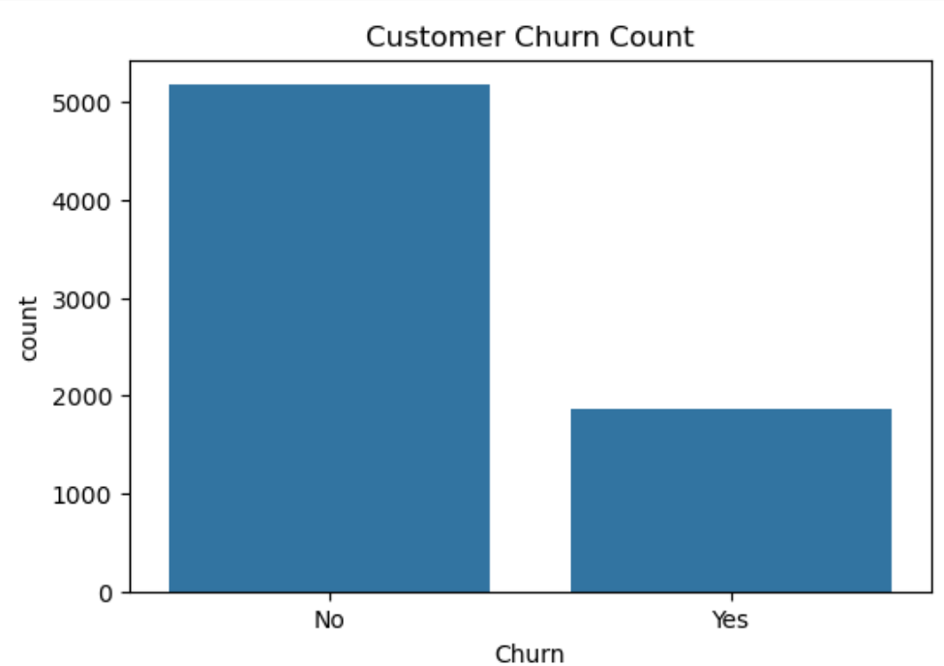
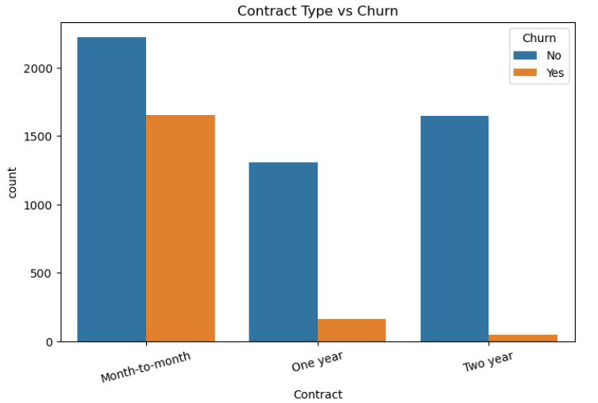
Exploratory Data Analysis (EDA)
Key Observations
Month-to-month contracts show higher churn.
Customers with short tenure churn more.
Monthly charges influence churn.
Customer behaviour differs across contract and service types.

Slide 6
SQL Analysis
Total Customers | 1869
Contract Analysis | Month-to-month | 1655
 | One year | 166
 | Two year | 48
Payment Method Analysis | Bank transfer | 1542
 | Credit card | 1521
 | Electronic check | 2365
 | Mailed check | 1604
Internet Service Analysis | DSL | 2416
 | Fiber optic | 3096
 | No | 1520
Monthly Charges by Churn | No | 61.30740848343966
 | Yes | 74.4413322632423
Key Points
Total Customers
Contract-wise Churn
Payment Method Analysis
Internet Service Analysis
Monthly Charges by Churn
SQL INSIGHTS:
Aggregated customer statistics.
Compared churn across services.
Identified customer behaviour patterns.

Slide 7
ML Models
Project Workflow
Dataset
↓
Data Cleaning
↓
Feature Encoding
↓
Train-Test Split (80:20)
↓
Model Training
↓
Prediction
↓
Evaluation
Model | Purpose
Logistic Regression | Baseline classification
Decision Tree | Rule-based prediction
Random Forest | Ensemble classification

Slide 8
Model Performance
Model | Accuracy
Logistic Regression | (80%)
Decision Tree | (78%)
Random Forest | (84%)
Best Model: Random Forest achieved the highest accuracy.

Slide 9
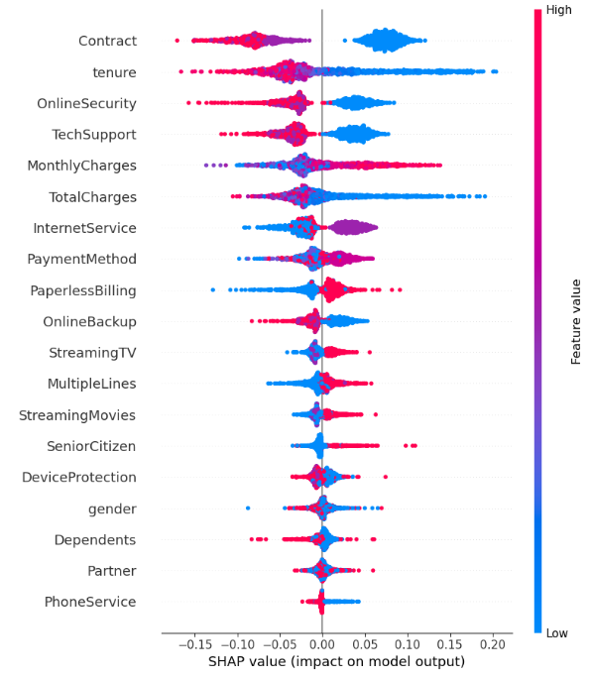
SHAP Feature Importance
Important Features
Contract
Tenure
MonthlyCharges
TotalCharges
InternetService
SHAP explains which features contributed most to churn prediction.

Slide 10
Key Insights
Key Insights
Month-to-month customers are more likely to churn.
Short-tenure customers show higher churn.
Higher monthly charges are associated with churn.
Contract type is an important predictor.
Random Forest performed best.
SHAP identified the most influential features.

Slide 11
Business Recommendations
Key Points
Offer discounts to month-to-month customers.
Encourage long-term contracts.
Reward loyal customers.
Monitor high-risk customers.
Improve customer support.
Use predictive analytics for retention.
Telecom Customer Churn Analysis

Slide 12
Conclusion
This project successfully analyzed telecom customer churn using SQL, Python, and machine learning techniques.
Multiple classification models were trained and evaluated, and SHAP was used to explain model predictions.
The findings can help telecom companies identify customers at risk of leaving and implement effective retention strategies.

Slide 13


