Slide 1
Ecommerce Logistics API and Applications
Desenvolvimento de Software de Larga Escala – 1M.EIC 01
06/01/2023

Slide 2



The problem
Logistics poses a challenge for new up and coming e-commerce businesses.
Finding and managing storage of products after manufacturing.
Coordinating the transport of products, both to physical shops and to the end user.
Notes:
Nowadays, and due to the COVID-19 pandemic, there is an explosion of businesses trying to get into E-commerce
These brands don’t necessarily have the logistics figured out or the budget to get their products from the manufacturer to the final consumer
Furthermore, managing warehouse storage and transport logistics between manufacturer and physical stores is an unnecessary burden for the brand
With the advancements in technology and by also influence of the COVID-19 pandemic, that has been a rapid increase in businesses getting into e-commerce. (why is e-commerce being chosen) Some being even e-commerce exclusive
For many of these businesses a major challenge is Logistics.
They might have solid ideas for their products, however they sometimes need to get the materials to produce them, to source the manufacturing, finding and managing storage and products, coordinating the transports of products with warehouses, physical shops and end users. Lots of different and complicated logistics
This can be very time and resource consuming, specially for businesses that are just getting into this field.

Slide 3
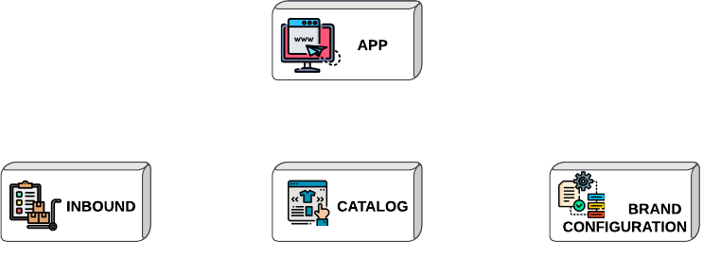
The solution
Everything in one place
Warehouse and Transport
Product Management
Configure your Services
Notes:
We’ve built a service that takes care of the whole logistic process from the manufacturer to their final recipient, including storage and transport
It allows brands to fully track the process and be aware of where the products are and where and when they will arrive
One can organize the items that are being managed by MAERSK as well as their particular characteristics
They can also configure return policies and what should be done in case of missing stock
However, we have come to the rescue, and we’ve built a system capable of dealing with the whole logistic process, all the way from the manufacturer to the final customer.
REDO: With this system, supervising warehouse and the status of product transport has been made easy and simple
Items and products that are being managed by MAERSK can be organized as well as their particular characteristics and variations
Configuration system is also provided to allow the personalization of return policies and the actions to take in case of missing stock

Slide 4



How is this better?
Scalability
Reliability
Intuitive
Replacement for a legacy system
Notes:
It works well and reliably
It’s capable of functioning even when some of its services are unavailable
It’s scalable, using a reliable way of communicating between these services
It’s intuitive, with an easy to understand, cohesive design
It’s a good replacement to the legacy system
Flutter brings native, class-leading performance in a single codebase
ASP.NET is simple to use and deals well with high request loads

Slide 5

























Meet the team

Slide 6
“Focus on your vision and leave the logistics to us”
Notes:
“Let’s launch/ship this idea to the world”
“Join us in revolutionizing the world of e-commerce”
“Join us in completing our missions idea to the world”

Slide 7
Appendix

Slide 8
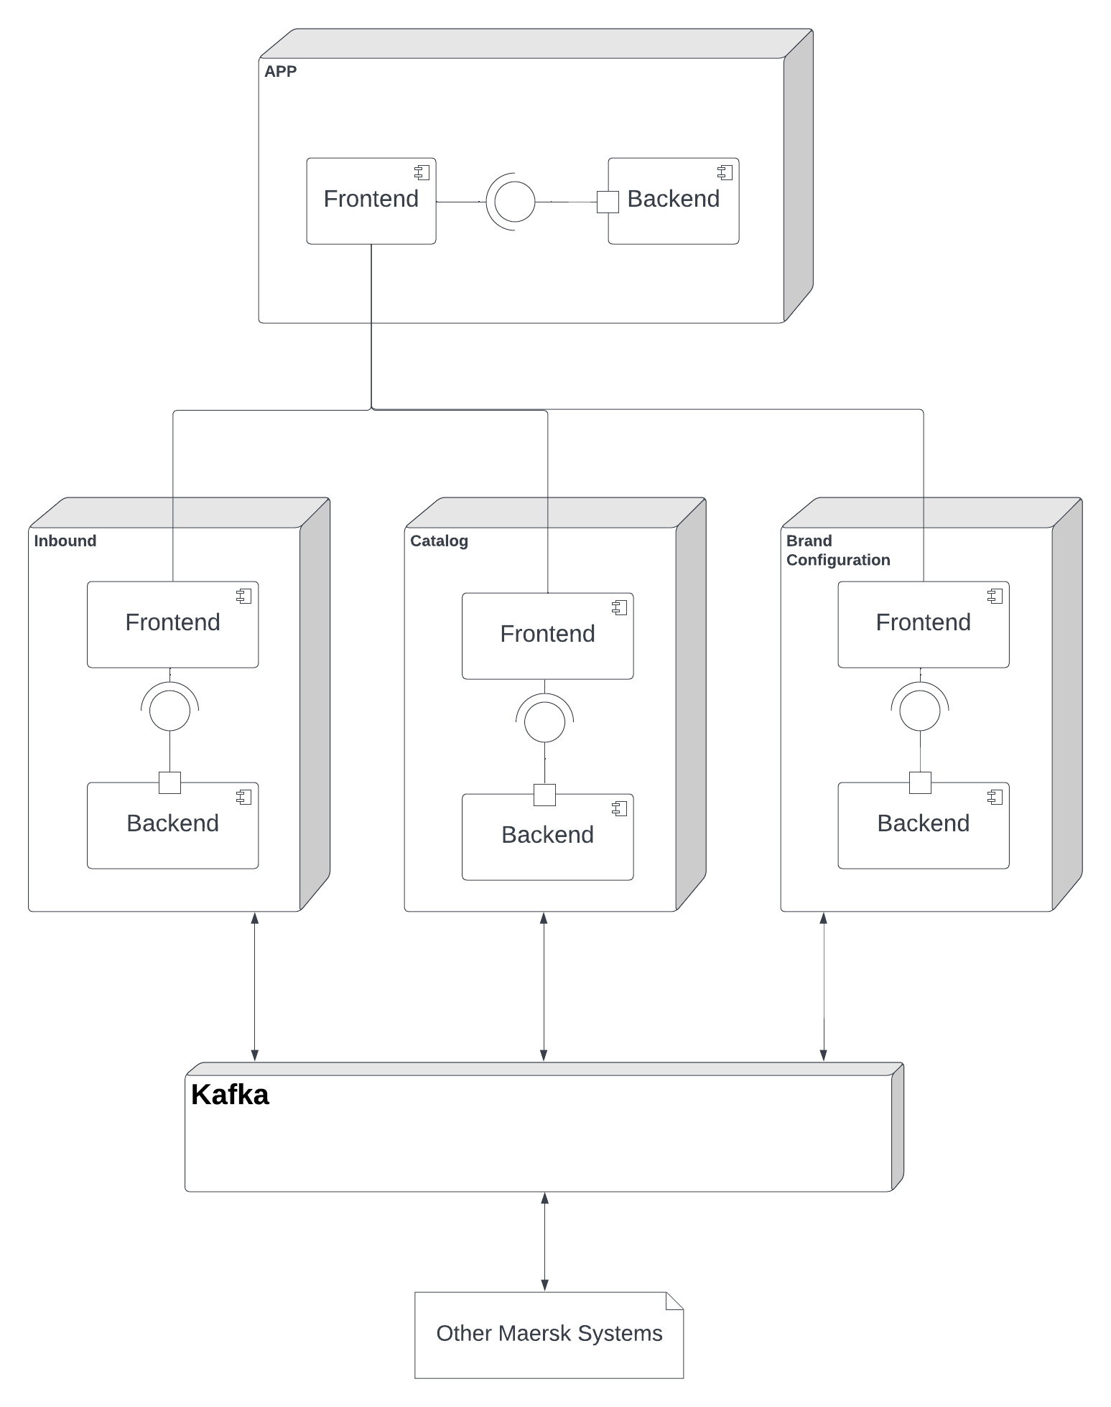
Product architecture
The base app bootstraps the inbound, the catalog and the brand configuration.
These microservices communicate only via Kafka messages and scale well since there is no coupling.
Flutter for the frontend and ASP.NET for the backend. They are modern and work reliably.

Slide 9
Image Attribution
https://www.flaticon.com/free-icons/storage - Storage icons created by Nhor Phai
https://www.flaticon.com/free-icons/ecommerce - Ecommerce icons created by Eucalyp
https://www.flaticon.com/free-icons/logistics - Logistics icons created by Eucalyp
https://www.flaticon.com/free-icons/website - Website icons created by Freepik
https://www.flaticon.com/free-icons/items - Items icons created by Uniconlabs
https://www.flaticon.com/free-icons/catalog - Catalog icons created haiby Nhor P
https://www.flaticon.com/free-icons/process - Process icons created by Freepik
https://www.flaticon.com/free-icons/scalable - Scalable icons created by Freepik
https://www.flaticon.com/free-icons/best - Best icons created by Freepik
https://www.flaticon.com/free-icons/intuitive - Intuitive icons created by Freepik

